Slide 1
Lesson 1: Motors and Sound
Programming Solutions

Slide 2
Learning to program
An effective way to learn to program is to learn to “read” a program.
Follow the steps and understand what each does. See how they fit together.
Then you can do your first program by modifying an existing program.
First we’ll look at some programs here and understand what they do.

Slide 3

Exercise 1: What does this do? See how much you can guess.

Slide 4
Exercise 1: Solution
Turn on motors connected to ports A and C in the reverse direction for 4 seconds, then stop both motors.
Red light
always ends
your program
Green light always
starts your program
Turn on motors
A and C
Stop all
motors
The white arrow to
the left means “reverse”
Wait for 4
seconds

Slide 5
Things to notice
Every program has a beginning and end. (Traffic lights.)
All icons are connected with “wires.”
This program is linear—one step follows another from beginning to end.

Slide 6

Exercise 2: Solution
Turn on motor A in the forward direction for a random amount of time, then stop the motor.
Use the watch icon
with the dice, which
means “random”

Slide 7

Exercise 3: Solution
Turn on motor A in the forward direction for 2 seconds, stop the motor, and beep once. Then turn on motor C in the reverse direction for 2 seconds, stop the motor, and beep twice.
Remember, the
white arrow to the
right means “forward”
And the white
arrow to the left
means “reverse”
Use 2 Play Sound
icons to play
2 beeps.

Slide 8
Key Point!
Writing down programs step by step in English makes them very easy to write in RoboLab.
Think about how to solve the given problem, then work out the logical steps. Write down the steps before writing your program.

Slide 9
Lesson 1: Motors and Sound
Troubleshooting Tips

Slide 10
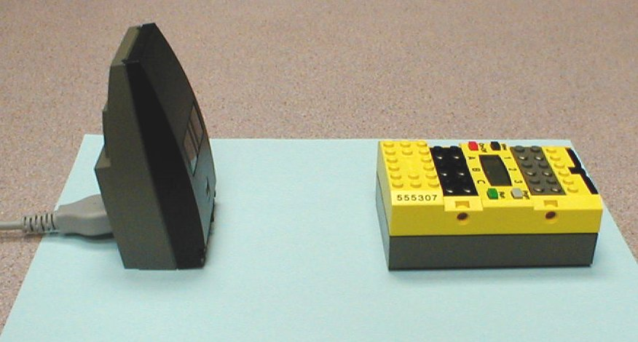
Problem 1a
Why can’t I download my program to the RCX?

Slide 11
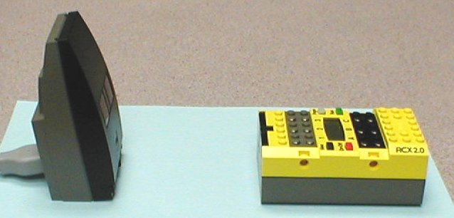
Solution 1a
The RCX was facing the wrong direction. (Don’t forget to turn it on too!)
InfraRed receiver must face IR Tower

Slide 12
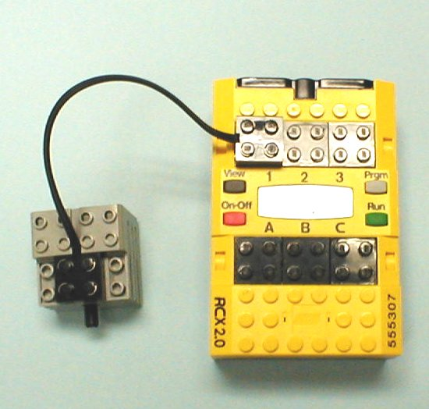
Problem 1b
Why won’t the motor work?
This is a sensor port, NOT a motor port.

Slide 13
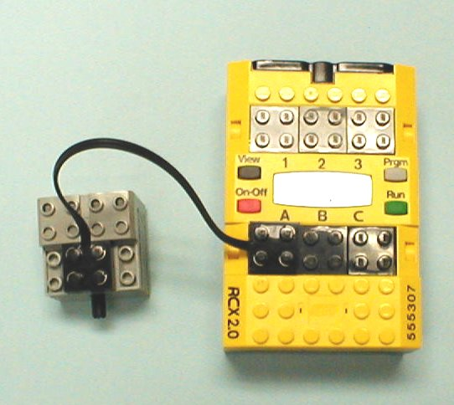
Solution 1b
It was connected to a sensor port. Motor ports are A, B, and C.
Sensor ports
Motor ports

Slide 14

Problem 1c
What is wrong with this program?

Slide 15
Solution 1c
Bad wiring. Always check for bad wires.
Missing wire
Bad wire

Slide 16

Problem 1d
This program is supposed to turn on Motor A for 4 seconds, then turn off the motor. What’s wrong?

Slide 17

Solution 1d
There was no “Stop Motor” icon.

Slide 18
Mentor session assignment
You will start by writing (copying) a somewhat complicated program for a line follower robot and test it on your Tug of War vehicle. (You’ll have to add a light sensor that points at the ground.)
Then you’ll delete most of the program to do our simple Tug of War program.
For Tug of War your robot will turn on the motors when a touch sensor is pressed. This is a requirement of the assignment.
You can’t compete if your robot can’t perform this simple task.

Slide 19
http://www.education.rec.ri.cmu.edu/previews/rcx_products/robolab_video_trainer/rob_vid_train_preview.htm#

