Slide 1
Lesson 6: Containers
Programming Solutions

Slide 2
Containers
Containers are global variables.
  Can be used anywhere in the program.
  Can be used to store (remember) numbers.
  Container values are the numbers stored in the containers.
Three basic containers: red, blue, yellow.
  Containers found in the modifiers sub-menu.
  Container functions found in the containers sub-menu.
    Arithmatic functions (fill container, add to container)
    Logic functions (and/or)
    Can fill with values from sensors, timers, etc.

Slide 3
Container Wait For, Loop, and Fork
Same as other wait for, loop, and fork commands.
Container wait for causes the program to wait until the specified container is equal to the integer value specified.

Slide 4
Integer math
Containers ONLY work with integers: 1,2,3,4,….
  3/2 does not equal 1.5, because 1.5 is not an integer.
  In integer math 3/2=1.

Slide 5
Tasks
The RCX can run more than one task at a time.
  Similar to having multiple windows open on your computer.
Tasks are independent. Every task must end with its own stop light.
  Tasks can cause hardware conflicts.
Start a task with a task split command.
You cannot merge tasks, you can only merge forks.

Slide 6
Tips
Displaying data to the LCD panel is a common way of debugging a program.
See presentation l6_containers.ppt and l5_multi_task_timers.ppt for programming examples.

Slide 7
Exercise 1
This program requires 2 touch sensors. The program “remembers” how many times the first touch sensor is pressed. When the second touch sensor is pressed, it plays twice as many beeps as the number of times the first touch sensor was pressed.

Slide 8
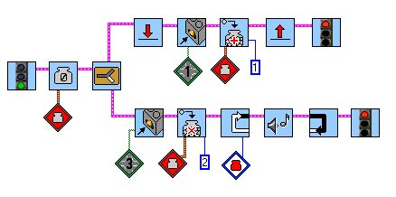
Exercise 1: Solution
The first task adds 1 to the
container every time the first
touch sensor is pressed.
I used 2 tasks, one
for each touch sensor.
When the 2nd touch
sensor is pressed...
The number in
the container is
doubled.
Then its value is
used in the loop.

Slide 9
Exercise 2
When the program is started, the value of the light sensor is stored. Then, after an 8 second delay, if the light sensor reads a greater value than the value that is stored, a rising sweep sound is played. Otherwise, if the light sensor reads a value that is less than or equal to the stored value, a descending sweep sound is played.

Slide 10
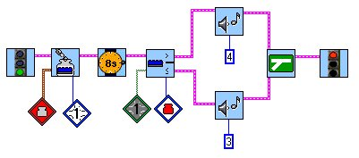
Exercise 2: Solution
Store the light sensor’s
reading in the container.
Don’t forget to
use the value
of the sensor port.
Then use its value
in the light sensor fork.

Slide 11
Lesson 6: Containers
Troubleshooting Tips

Slide 12
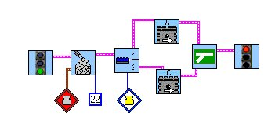
Problem 6a
This program wants to use the value of the red container, which is 22, in the light sensor fork. What’s wrong?

Slide 13
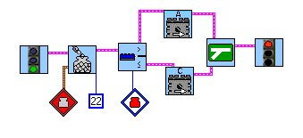
Solution 6a
The number 22 was stored in the red container, but the light sensor fork was using the value of the yellow container.

Slide 14
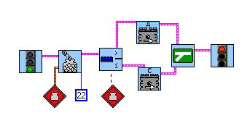
Problem 6b
Why is there a bad wire in this program?
bad wire

Slide 15
Solution 6b
Remember, forks and loops need to use the value of the container (modifier with white background).
container value

Slide 16
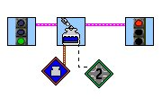
Problem 6c
Why is there a bad wire in this program?
bad wire

Slide 17
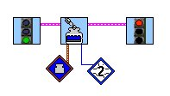
Solution 6c
To store a sensor value in a container, you must use the sensor port’s value.
sensor port
value

