Slide 1
Lecture #5, Oct 11, 2004
Reading Assignments
  Finish Chapter 3, Simple Graphics
  Read Chapter 4, Shapes II, Drawing Shapes
Today’s Topics
  Using the graphics primitives
  Drawing Primitive Shapes
  Sierpinski’s Triangle
  Snow-flake
  Coordinate Systems
  Position independent shapes
  Drawing the Shape Data-type

Slide 2
Turning in Homework
In order to facilitate my grading homework I would ask the following
Email me a copy of the homework. Include the code right in the body of the email. Put all directions in comments. I will try and run this email, so don’t clutter it with stuff that will make this hard.
Put your name and the homework # in the Subject heading. i.e. Subject: Tim Sheard #2
The e-mail is expected to be received before or on the due-date and will be acknowledged if you ask for acknowledgement.
The email address to use is: sheard@cse.ogi.edu
You are also expected to turn in a paper copy in class on the due date. This way I don’t have to print it, and I have something to write comments on.

Slide 3
Drawing Primitive Shapes
The Graphics libraries contain primitives for drawing a few primitive shapes.
We will build complicated drawing programs from these primitives
ellipse :: Point -> Point -> Draw ()
shearEllipse ::
Point -> Point -> Point -> Draw ()
line :: Point -> Point -> Draw ()
polygon :: [Point] -> Draw ()
polyline :: [Point] -> Draw ()

Slide 4
Coordinate Systems
Increasing x-axis
(0,0)
Increasing y-axis

Slide 5
Example Program
main2 =
runGraphics(
do { w <- openWindow "Draw some shapes" (300,300)
; drawInWindow w (ellipse (0,0) (50,50))
; drawInWindow w
(shearEllipse (0,60) (100,120) (150,200))
; drawInWindow w
(withColor Red (line (200,200) (299,275)))
; drawInWindow w
(polygon [(100,100),(150,100),(160,200)])
; drawInWindow w
(withColor Green
(polyline [(100,200),(150,200),
(160,299),(100,200)]))
; spaceClose w
} )

Slide 6
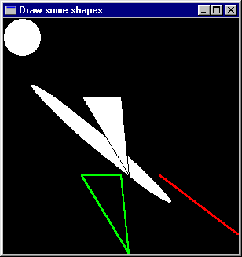
The Result
; drawInWindow w
(ellipse (0,0) (50,50))
; drawInWindow w
(shearEllipse (0,60)
(100,120)
(150,200))
; drawInWindow w
(withColor Red
(line (200,200)
(299,275)))
; drawInWindow w
(polygon [(100,100),
(150,100),
(160,200)])
; drawInWindow w
(withColor Green
(polyline
[(100,200),(150,200),
(160,299),(100,200)]))

Slide 7
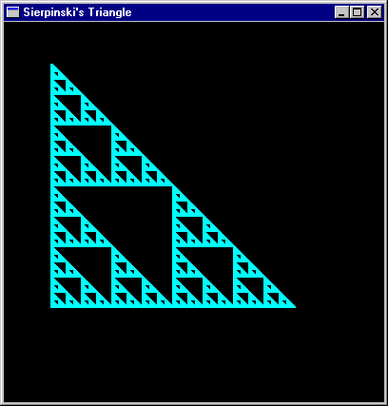
Building Programs
We’d like to build bigger things from these small pieces
Perhaps things such as fractals
  Example:
  Sierpinski’s Triangle
  a repeated drawing of
  a triangle at repeatedly
  smaller sizes.
Key Idea
  Separate pure computation
  from action

Slide 8
Geometry Isosceles Right Triangles
Remember y increases
as we go down the page
(x,y-size)
size * size + size * size = hyp * hyp
size
hyp
size / 2
(x+ (size / 2), y - (size / 2))
(x, y - (size / 2))
(x , y)
(x+ size, y)
size

Slide 9
Draw 1 Triangle
fillTri x y size w =
drawInWindow w
(withColor Blue
(polygon [(x,y),
(x+size,y),
(x,y-size)]))
minSize = 8
(x,y)
size

Slide 10
Sierpinski’s Triangle
(x,y-size)
sierpinskiTri w x y size =
if size <= minSize
then fillTri x y size w
else let size2 = size `div` 2
in do { sierpinskiTri w x y size2
; sierpinskiTri w x (y-size2) size2
; sierpinskiTri w (x + size2) y size2
}
main3 =
runGraphics(
do { w <- openWindow "Sierpinski's Tri" (400,400)
; sierpinskiTri w 50 300 256
; spaceClose w
} )
(x+ (size / 2),
y - (size / 2))
(x, y - (size / 2))
(x , y)
(x+ size, y)

Slide 11
Question?
What’s the largest triangle sierpinskiTri ever draws?
How come the big triangle is drawn?

Slide 12
Abstraction
Drawing a polygon in a particular window, with a particular color is a pretty common thing. Lets give it a name.
drawPoly w color points =
drawInWindow w
(withColor color (polygon points))

Slide 13
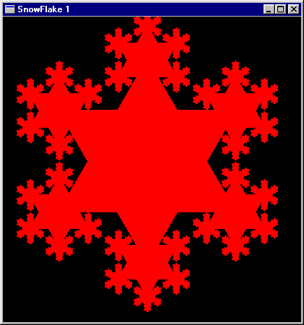
Draw a snowflake

Slide 14
Geometry of Snow flakes
Snow flakes are six sided
They have repeated patterns
An easy six sided figure is the Star of David
  Constructed from two equilateral triangles
side
radius
side
height
Radius = 2/3 * height
height = sqrt(side*side - (side*side)/4)

Slide 15
2 triangles with common center

Slide 16
Compute the corners
eqTri side (x,y) =
let xf = fromInt x
yf = fromInt y
sideDiv2 = side / 2.0
height = sqrt( side*side -
(sideDiv2 * sideDiv2) )
h1third = height / 3.0
h2third = h1third * 2.0
f (a,b) = (round a,round b)
in (map f [(xf, yf - h2third),
(xf - sideDiv2,yf + h1third),
(xf + sideDiv2,yf + h1third)],
map f [(xf - sideDiv2,yf - h1third),
(xf + sideDiv2,yf - h1third),
(xf,yf + h2third)])
(x,y)
side

Slide 17
Now repeat twice and draw
drawStar color1 color2 w side (x,y) =
do { let (a,b) = eqTri side (x,y)
; drawPoly w color1 a
; drawPoly w color2 b
}
main4 =
runGraphics(
do { w <- openWindow "Star of david”
(400,400)
; drawStar Red Green w 243 (200,200)
; spaceClose w
} )

Slide 18
For a snowflake repeat many times
snow1 w color size (x,y) =
if size <= minSize
then return ()
else do { drawStar color color
w (fromInt size) (x,y)
; sequence (map smaller allpoints)
}
where (triangle1,triangle2) =
eqTri (fromInt size) (x,y)
allpoints = (triangle1 ++ triangle2)
smaller x = snow1 w color (size `div` 3) x

Slide 19
To Draw pick appropriate sizes
main5 =
runGraphics(
do { w <- openWindow "SnowFlake 1”
(400,400)
; snow1 w Red 243 (200,200)
; spaceClose w
} )
Why 243?

Slide 20
Multiple Colors
snow2 w colors size (x,y) =
if size <= minSize
then return ()
else do { drawPoly w (colors !! 0) triangle2
; drawPoly w (colors !! 1) triangle1
; sequence (map smaller allpoints)
}
where (triangle1,triangle2) = eqTri (fromInt size) (x,y)
allpoints = (triangle1 ++ triangle2)
smaller x = snow2 w (tail colors) (size `div` 3) x
main6 =
runGraphics(
do { w <- openWindow "Snowflake" (400,400)
; snow2 w [Red,Blue,Green,Yellow] 243 (200,200)
; spaceClose w
} )

Slide 21
What Happened?
The list of colors was too short for the depth of the recursion
main7 =
runGraphics(
do { w <- openWindow "Snowflake 2" (400,400)
; snow2 w [Red,Blue,Green,Yellow,White] 243 (200,200)
; spaceClose w
} )
main8 = runGraphics(
do { w <- openWindow "Snowflake" (400,400)
; snow2 w (cycle [Red,Blue,Green,Yellow])
243 (200,200)
; spaceClose w
} )

Slide 22
Lets make it better
snow3 w colors size (x,y) =
if size <= minSize
then return ()
else do { drawPoly w (colors !! 0) triangle2
; drawPoly w (colors !! 1) triangle1
; snow3 w colors (size `div` 3) (x,y)
; sequence (map smaller allpoints) }
where (triangle1,triangle2) = eqTri (fromInt size) (x,y)
allpoints = (triangle1 ++ triangle2)
smaller x = snow3 w (tail colors) (size `div` 3) x
main9 =
runGraphics(
do { w <- openWindow "Snowflake" (400,400)
; snow3 w (cycle [Red,Blue,Green,Yellow,White]) 243 (200,200)
; spaceClose w } )

Slide 23
Recall the Shape Datatype
data Shape = Rectangle Side Side
| Ellipse Radius Radius
| RtTriangle Side Side
| Polygon [ Vertex ]
deriving Show
type Vertex = (Float,Float)
  -- We call this Vertex (instead of Point) so as
  -- not to confuse it with Graphics.Point
type Side = Float
type Radius = Float

Slide 24
Properties of Shape
Note that some shapes are position independent
  Rectangle Side Side
  RtTriangle Side Side
  Ellipse Radius Radius
But the Polygon [Vertex] Shape is defined in terms of where it appears in the plane.
Shape’s Size and Radius components are measured in inches.
The Window based drawing mechanism of the last lecture was based upon pixels.

Slide 25
Considerations
Where to draw position independent shapes?
  Randomly?
  In the upper left corner (the window origin)
  In the middle of the window
We choose to draw them in the middle of the window.
We consider this the shape module origin
So our model has both a different notion of “origin” and of coordinate system (pixels vs inches)
We need to handle this.
  Many systems draw about 100 pixels per inch.

Slide 26
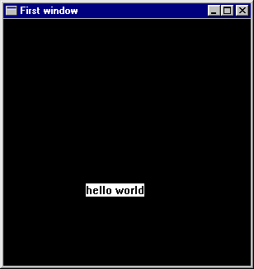
Visualize
Window Coordinate system
Shape Coordinate system
(200,200) pixels
or
(1,-1) inches

Slide 27
Coercion Functions
inchToPixel :: Float -> Int
inchToPixel x = round (100*x)
pixelToInch :: Int -> Float
pixelToInch n = (intToFloat n) / 100
intToFloat :: Int -> Float
intToFloat n = fromInteger (toInteger n)

Slide 28
Setting up the Shape window
xWin, yWin :: Int
xWin = 600
yWin = 500
trans :: Vertex -> Point
trans (x,y) = ( xWin2 + inchToPixel x,
yWin2 - inchToPixel y )
xWin2, yWin2 :: Int
xWin2 = xWin `div` 2
yWin2 = yWin `div` 2
( xWin2,
yWin2)
( xWin,
yWin )

Slide 29
Translating Points
trans :: Vertex -> Point
trans (x,y) = ( xWin2 + inchToPixel x,
yWin2 - inchToPixel y )
transList :: [Vertex] -> [Point]
transList [] = []
transList (p:ps) = trans p : transList ps

Slide 30
Translating Shapes
Convert a Shape (Rectangle, Ellipse, …) into a graphic Draw object (using the window functions line, polygon, …)
shapeToGraphic :: Shape -> Graphic
shapeToGraphic (Rectangle s1 s2)
= let s12 = s1/2
s22 = s2/2
in polygon
(transList [(-s12,-s22),(-s12,s22),
(s12,s22),(s12,-s22)])
shapeToGraphic (Ellipse r1 r2)
= ellipse (trans (-r1,-r2)) (trans (r1,r2))
shapeToGraphic (RtTriangle s1 s2)
= polygon (transList [(0,0),(s1,0),(0,s2)])
shapeToGraphic (Polygon pts)
= polygon (transList pts)
Note, first three are
position independent,
centered about the
origin

Slide 31
Define some test Shapes
sh1,sh2,sh3,sh4 :: Shape
sh1 = Rectangle 3 2
sh2 = Ellipse 1 1.5
sh3 = RtTriangle 3 2
sh4 = Polygon [(-2.5,2.5),
(-1.5,2.0),
(-1.1,0.2),
(-1.7,-1.0),
(-3.0,0)]

Slide 32
Draw a Shape
main10
= runGraphics (
do w <- openWindow "Drawing Shapes" (xWin,yWin)
drawInWindow w
(withColor Red (shapeToGraphic sh1))
drawInWindow w
(withColor Blue (shapeToGraphic sh2))
spaceClose w
)

Slide 33
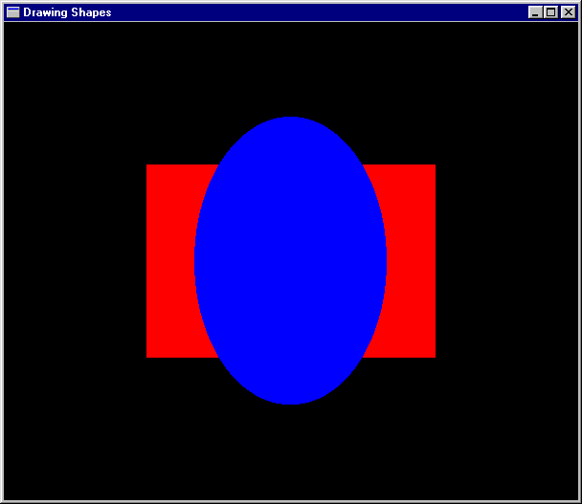

Slide 34
Draw multiple Shapes
type ColoredShapes = [(Color,Shape)]
shs :: ColoredShapes
shs = [(Red,sh1),(Blue,sh2),
(Yellow,sh3),(Magenta,sh4)]
drawShapes :: Window -> ColoredShapes -> IO ()
drawShapes w [] = return ()
drawShapes w ((c,s):cs)
= do drawInWindow w
(withColor c (shapeToGraphic s))
drawShapes w cs

Slide 35
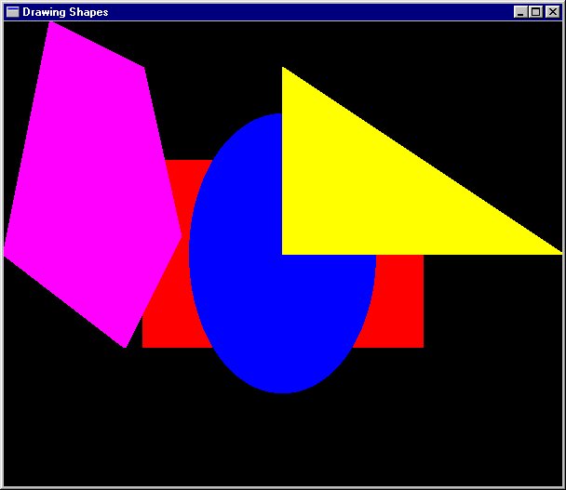
Make an Action
main11
= runGraphics (
do w <- openWindow
"Drawing Shapes" (xWin,yWin)
drawShapes w shs
spaceClose w )

Slide 36
Another Example
main12
= runGraphics (
do w <- openWindow "Drawing Shapes" (xWin,yWin)
drawShapes w (reverse coloredCircles)
spaceClose w
)
conCircles = map circle [0.2,0.4 .. 1.6]
coloredCircles =
zip [Black, Blue, Green, Cyan, Red, Magenta, Yellow, White]
conCircles

Slide 37
