Slide 1
Lecture #19, Dec 1 & 6, 2004
Todays Topics
  Haskore System
  The Music datatype
  MIDI Instruments
  Pitch & absolute Pitch
  Composing Music
    Delay
    Repeating
    Transposing
  Manipulating Music
    Duration
    Cutting
    Reversing
  Percussion
  Presentation and the MIDI file format
Read Chapter 20 - Functional Music Composition

Slide 2
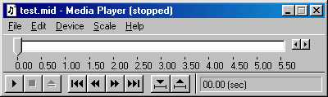
Haskore
Haskore is a Haskell library for constructing digital music
  It supports an abstract high-level description of musical concepts
  Maps into the Midi (Musical Instrument Digital Interface) standard
    a low-level binary bit based encoding of music
    can be “played” by “Media-Players”
Haskell
Haskore
Haskore
Abstract
High Level
Implementation
independent
MIDI
low level
bit based
implementation
standard
presentation

Slide 3

Musical Basics in Haskore
type Pitch = (PitchClass, Octave)
data PitchClass =
Cf | C | Cs | Df | D | Ds | Ef | E
| Es | Ff | F | Fs | Gf | G | Gs | Af
| A | As | Bf | B | Bs
deriving (Eq,Show)
type Octave = Int
Middle C
Octave 2
Octave 3
Octave 4
Cs Ds Fs Gs As
Df Ef Gf Af Bf
Cf
Ff Es
Cf Bs
C D E F G A B C

Slide 4






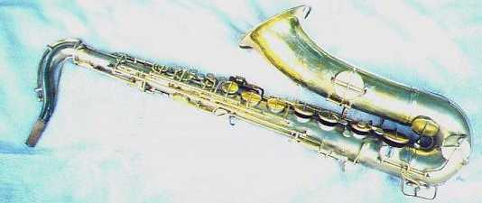
Music
data Music = Note Pitch Dur
| Rest Dur
| Music :+: Music
| Music :=: Music
| Tempo
(Ratio Int) Music
| Trans
Int Music
| Instr IName Music

Slide 5
Midi Standard supports lots of instruments
data IName
= AcousticGrandPiano | BrightAcousticPiano | ElectricGrandPiano | HonkyTonkPiano | RhodesPiano | ChorusedPiano | Harpsichord | Clavinet | Celesta | Glockenspiel | MusicBox | Vibraphone | Marimba | Xylophone | TubularBells | Dulcimer | HammondOrgan | PercussiveOrgan | RockOrgan | ChurchOrgan | ReedOrgan | Accordion | Harmonica | TangoAccordion | AcousticGuitarNylon | AcousticGuitarSteel | ElectricGuitarJazz | ElectricGuitarClean | ElectricGuitarMuted | OverdrivenGuitar | DistortionGuitar | GuitarHarmonics | AcousticBass | ElectricBassFingered | ElectricBassPicked | FretlessBass | SlapBass1 | SlapBass2 | SynthBass1 | SynthBass2 | Violin | Viola | Cello | Contrabass | TremoloStrings | PizzicatoStrings | OrchestralHarp | Timpani | StringEnsemble1 | StringEnsemble2 | SynthStrings1 | SynthStrings2 | ChoirAahs | VoiceOohs | SynthVoice | OrchestraHit | Trumpet | Trombone | Tuba | MutedTrumpet | FrenchHorn | BrassSection | SynthBrass1 | SynthBrass2 | SopranoSax | AltoSax | TenorSax | BaritoneSax | Oboe | Bassoon | EnglishHorn | Clarinet | Piccolo | Flute | Recorder | PanFlute | BlownBottle | Shakuhachi | Whistle | Ocarina | Lead1Square | Lead2Sawtooth | Lead3Calliope | Lead4Chiff | Lead5Charang | Lead6Voice | Lead7Fifths | Lead8BassLead | Pad1NewAge | Pad2Warm | Pad3Polysynth | Pad4Choir | Pad5Bowed | Pad6Metallic | Pad7Halo | Pad8Sweep | FX1Train | FX2Soundtrack | FX3Crystal | FX4Atmosphere | FX5Brightness | FX6Goblins | FX7Echoes | FX8SciFi | Sitar | Banjo | Shamisen | Koto | Kalimba | Bagpipe | Fiddle | Shanai | TinkleBell | Agogo | SteelDrums | Woodblock | TaikoDrum | MelodicDrum | SynthDrum | ReverseCymbal | GuitarFretNoise | BreathNoise | Seashore | BirdTweet | TelephoneRing | Helicopter | Applause | Gunshot | Percussion
deriving (Show,Eq,Ord,Enum)

Slide 6
Duration & Absolute Pitch
type Dur = Ratio Int
  fractions of Integers such as 3 /4. We write (3 % 4) in Haskell.
type AbsPitch = Int
absPitch :: Pitch -> AbsPitch
absPitch (pc,oct) = 12*oct + pcToInt pc
(C,0)
(C,1)
(C,2)
(C,3)
0 1 2 3 4 5 6 7 8 9 10 11 12 24 36 . . .

Slide 7

Pitch to integer
pcToInt :: PitchClass -> Int
pcToInt pc = case pc of
Cf -> -1 -- should Cf be 11?
C -> 0 ; Cs -> 1
Df -> 1 ; D -> 2 ; Ds -> 3
Ef -> 3 ; E -> 4 ; Es -> 5
Ff -> 4 ; F -> 5 ; Fs -> 6
Gf -> 6 ; G -> 7 ; Gs -> 8
Af -> 8 ; A -> 9 ; As -> 10
Bf -> 10 ; B -> 11 ; Bs -> 12 -- maybe 0?
Note how several different pitches have the same absolute pitch. This is because the “flat” of some notes is the “sharp” of another.
Cs Ds Fs Gs As
Df Ef Gf Af Bf
Cf
Ff Es
Cf Bs
C D E F G A B C

Slide 8
From AbsPitch to Pitch
pitch12 = [C,Cs,D,Ds,E,F,Fs,G,Gs,A,As,B]
pitch :: AbsPitch -> Pitch
pitch a = (pitch12 !! mod a 12, quot a 12)
trans :: Int -> Pitch -> Pitch
trans i p = pitch (absPitch p + i)
Dist above C
octave
(C,0)
(C,1)
(C,2)
(C,3)
0 1 2 3 4 5 6 7 8 9 10 11 12 24 36 . . .

Slide 9
Generic Music - Notes
cf,c,cs,df,d,ds,ef,e,es,ff,f,fs,gf,g,gs,af,a,as,bf,b,bs
:: Octave -> Dur -> Music
cf o = Note(Cf,o); c o = Note(C,o); cs o = Note(Cs,o)
df o = Note(Df,o); d o = Note(D,o); ds o = Note(Ds,o)
ef o = Note(Ef,o); e o = Note(E,o); es o = Note(Es,o)
ff o = Note(Ff,o); f o = Note(F,o); fs o = Note(Fs,o)
gf o = Note(Gf,o); g o = Note(G,o); gs o = Note(Gs,o)
af o = Note(Af,o); a o = Note(A,o); as o = Note(As,o)
bf o = Note(Bf,o); b o = Note(B,o); bs o = Note(Bs,o)
Given an Octave creates a function from Dur to Music in that octave. Note that Note :: Pitch -> Dur -> Music
These functions have the same names as the constructors of the PitchClass but they’re not capitalized.

Slide 10
Generic Music - Rests
wn, hn, qn, en, sn, tn :: Dur
dhn, dqn, den, dsn :: Dur
wnr, hnr, qnr, enr, snr, tnr :: Music
dhnr, dqnr, denr, dsnr :: Music
wn = 1 ; wnr = Rest wn -- whole
hn = 1%2 ; hnr = Rest hn -- half
qn = 1%4 ; qnr = Rest qn -- quarter
en = 1%8 ; enr = Rest en -- eight
sn = 1%16 ; snr = Rest sn -- sixteenth
tn = 1%32 ; tnr = Rest tn -- thirty-second
dhn = 3%4 ; dhnr = Rest dhn -- dotted half
dqn = 3%8 ; dqnr = Rest dqn -- dotted quarter
den = 3%16 ; denr = Rest den -- dotted eighth
dsn = 3%32 ; dsnr = Rest dsn -- dotted sixteenth

Slide 11

Lets Write Some Music!
line, chord :: [Music] -> Music
line = foldr (:+:) (Rest 0)
chord = foldr (:=:) (Rest 0)
Example 1
cScale =
line [c 4 qn, d 4 qn, e 4 qn,
f 4 qn, g 4 qn, a 4 qn,
b 4 qn, c 5 qn]
Note the change
in Octave

Slide 12
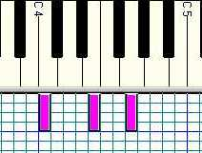




More Examples
  cMaj = [ n 4 hn | n <- [c,e,g] ]
  cMin = [ n 4 wn | n <- [c,ef, g] ]
Example 2
  cMajArp = line cMaj
Example 3
  cMajChd = chord cMaj
Example 4
  ex4 = line [ chord cMaj, chord cMin ]

Slide 13

Time Delaying Music
delay :: Dur -> Music -> Music
delay d m = Rest d :+: m
ex5 = cScale :=: (delay dhn cScale)

Slide 14

Transposing Music
ex6 = line [line cMaj,Trans 12 (line cMaj)]
12 tone
difference

Slide 15

Repeating Music
repeatM :: Music -> Music
repeatM m = m :+: repeatM m
nBeatsRest n note =
line ((take n (repeat note)) ++ [qnr])
ex7 =
line [e 4 qn, d 4 qn, c 4 qn, d 4 qn,
line [ nBeatsRest 3 (n 4 qn) | n <- [e,d] ],
e 4 qn, nBeatsRest 2 (g 4 qn) ]

Slide 16
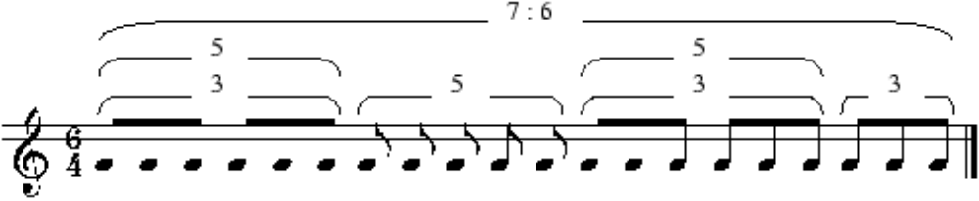
Fancy Stuff
pr1, pr2 :: Pitch -> Music
pr1 p = Tempo (5%6)
(Tempo (4%3) (mkLn 1 p qn :+:
Tempo (3%2) (mkLn 3 p en :+:
mkLn 2 p sn :+:
mkLn 1 p qn ) :+:
mkLn 1 p qn) :+:
Tempo (3%2) (mkLn 6 p en))
pr2 p = Tempo (7%6)
(m1 :+:
Tempo (5%4) (mkLn 5 p en) :+:
m1 :+:
Tempo (3%2) m2)
where m1 = Tempo (5%4) (Tempo (3%2) m2 :+: m2)
m2 = mkLn 3 p en
mkLn n p d = line (take n (repeat (Note p d)))
pr12 :: Music
pr12 = pr1 (C,5) :=: pr2 (G,5)

Slide 17
How long is a piece of music?
dur :: Music -> Dur
dur (Note _ d) = d
dur (Rest d) = d
dur (m1 :+: m2) = dur m1 + dur m2
dur (m1 :=: m2) = dur m1 `max` dur m2
dur (Tempo a m) = dur m / a
dur (Trans _ m) = dur m
dur (Instr _ m) = dur m

Slide 18
Reversing a piece of music
revM :: Music -> Music
revM n@(Note _ _) = n
revM r@(Rest _) = r
revM (Tempo a m) = Tempo a (revM m)
revM (Trans i m) = Trans i (revM m)
revM (Instr i m) = Instr i (revM m)
revM (m1 :+: m2) = revM m2 :+: revM m1
revM (m1 :=: m2)
= let d1 = dur m1
d2 = dur m2
in if d1>d2
then revM m1 :=: (Rest (d1-d2) :+: revM m2)
else (Rest (d2-d1) :+: revM m1) :=: revM m2

Slide 19
Cutting a piece of music short
cut :: Dur -> Music -> Music
cut d m | d <= 0 = Rest 0
cut d (Note x d0) = Note x (min d0 d)
cut d (Rest d0) = Rest (min d0 d)
cut d (m1 :=: m2) = cut d m1 :=: cut d m2
cut d (Tempo a m) = Tempo a (cut (d*a) m)
cut d (Trans a m) = Trans a (cut d m)
cut d (Instr a m) = Instr a (cut d m)
cut d (m1 :+: m2) =
let m1' = cut d m1
m2' = cut (d - dur m1') m2
in m1' :+: m2'

Slide 20
Comments
Music is a high level abstract representation of music.
Its analyzable so we can do many things with it
  First, we can play it
  But we can also
    compute its duration (without playing it)
    reverse it
    scale it’s Tempo
    truncate it to a specific duration
    transpose it into another key

Slide 21
Percussion
data PercussionSound
= AcousticBassDrum -- MIDI Key 35
| BassDrum1 -- MIDI Key 36
| SideStick -- ...
| AcousticSnare | HandClap | ElectricSnare | LowFloorTom
| ClosedHiHat | HighFloorTom | PedalHiHat | LowTom
| OpenHiHat | LowMidTom | HiMidTom | CrashCymbal1
| HighTom | RideCymbal1 | ChineseCymbal | RideBell
| Tambourine | SplashCymbal | Cowbell | CrashCymbal2
| Vibraslap | RideCymbal2 | HiBongo | LowBongo
| MuteHiConga | OpenHiConga | LowConga | HighTimbale
| LowTimbale | HighAgogo | LowAgogo | Cabasa
| Maracas | ShortWhistle | LongWhistle | ShortGuiro
| LongGuiro | Claves | HiWoodBlock | LowWoodBlock
| MuteCuica | OpenCuica | MuteTriangle
| OpenTriangle -- MIDI Key 82
deriving (Show,Eq,Ord,Ix,Enum)

Slide 22

Let’s beat the drums
perc :: PercussionSound -> Dur -> Music
perc ps = Note (pitch (fromEnum ps + 35))
funkGroove
= let p1 = perc LowTom qn
p2 = perc AcousticSnare en
in Tempo 3 (Instr Percussion (cut 8 (repeatM
( (p1 :+: qnr :+: p2 :+: qnr :+: p2 :+:
p1 :+: p1 :+: qnr :+: p2 :+: enr)
:=: roll en (perc ClosedHiHat 2) )
)))

Slide 23
Music Presentation
Music is a highlevel, abstract representation
We call the playing of Music its Presentation
Presentation requires “flattening” the Music representation into a list of low level events.
  Events contain information about
    pitch
    start-time
    end-time
    loudness
    duration
    instrument etc.
The MIDI standard is a file format to represent this low level information.
Presentation is the subject of the next lecture.

Slide 24
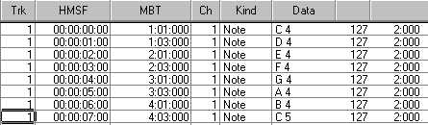
MIDI Event List
Hours,
Minutes,
Seconds,
Frames
Measure,
Beats,
Ticks
Pitch, Volume, Duration
track
channel
Time in 2 formats

