Slide 1
Fundamentals of
Staged Computation
Lecture 13: Automatic Binding Time Analysis
& Binding-time improvements
Tim Sheard
Oregon Graduate Institute
CSE 510 Section FSC
Winter 2004

Slide 2
Assignments
Correction: the ¾-term exam is not next week. Instead it will be on Tuesday March 8, 2005
Homework #7 is now assigned and is still
  Due Thursday March 3.

Slide 3
Automatic BTA
Take an unstaged function
  (* power : int -> int -> int *)
  fun power n x =
  if n=0 then 1
  else x * (power (n-1) x);
A specification of its Binding – spec
  n is static, x is dynamic
Add <_>, ~_, and lift _ to meet the spec
  fun pow1 n x =
  if n=0 then <1>
  else < ~x * ~(pow1 (n-1) x) >;

Slide 4
Questions
How do we specify the binding-times in a clear and non-ambiguous way, that is still precise?
  Use higher-order types with code types
How do we automate the placing of the staging annotations?
  Use abstract interpretation
  Use constraint solving
  Use search
    Use type-information to prune the search tree

Slide 5
Vision
Add a new kind of declaration to MetaML
bta pow1 = power at int -> <int> -> <int>;
Automatically generates
fun pow1 n x =
if n=0
then <1>
else < x * ~(pow1 (n-1) x) >;

Slide 6
Types are more precise
(* map : ('b -> 'a ) -> 'b list -> 'a list *)
fun map f [] = []
| map f (x::xs) = (f x) :: (map f xs);
bta map' = map at (a -> <b>) -> [a] -> <[b]>
Generates
fun map' f [] = <[]>
| map' f (x::xs) = < ~(f x) :: ~(map' f xs) >

Slide 7
Can be multi-stage (n>2)
(* iprod : int -> Vector -> Vector -> int *)
fun iprod n v w =
if n '>' 0
then ((nth v n) * (nth w n)) +
(iprod (n-1) v w)
else 0;
bta p3 = iprod at
int -> <Vector> -> <<Vector>> -> <<int>>
Generates
fun p3 n v w =
if n '>' 0
then << (~(lift (nth ~v n)) * (nth ~ ~w n)) +
~ ~(p3 (n-1) v w) >>
else <<0>>;

Slide 8
Desirable properties
Automatic BTA is part of the language, has semantic meaning
  Not a source-to-source transformation that works at the file level
The annotations are precise
  Capable of partially static data
  Capable of higher-order partially static
  More than 2 stages
Output understandable to programmers

Slide 9
Terms
Base terms
E = v | E E | fn v => E | i | if E E E
Annotated terms
E = …
| < E > | ~ E | lift E

Slide 10
Types
Base Types
T = I | T -> T
Annotated Types
T = . . .
| < T >

Slide 11
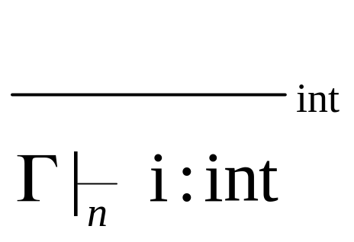
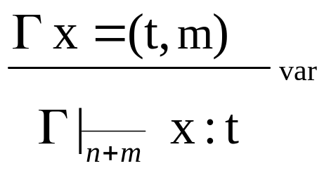
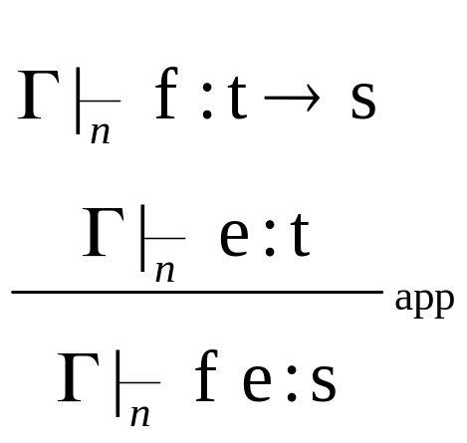
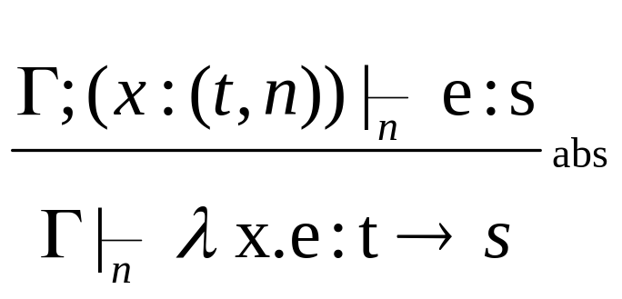
Well typed terms
Note without the level information, collapses to the usual rules for the typed lambda calculus

Slide 12
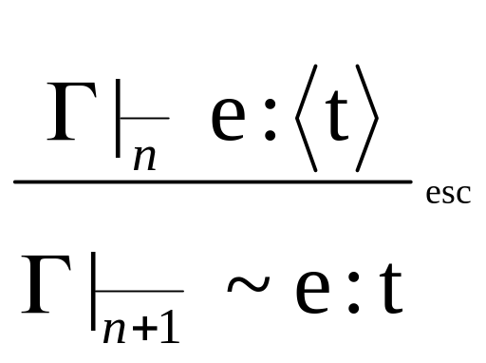
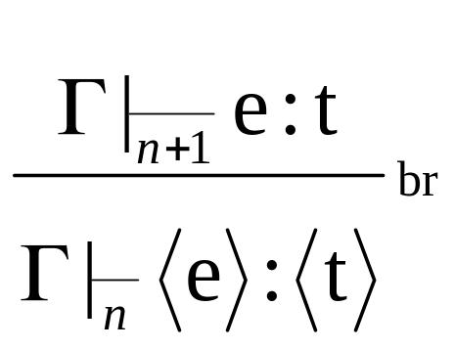
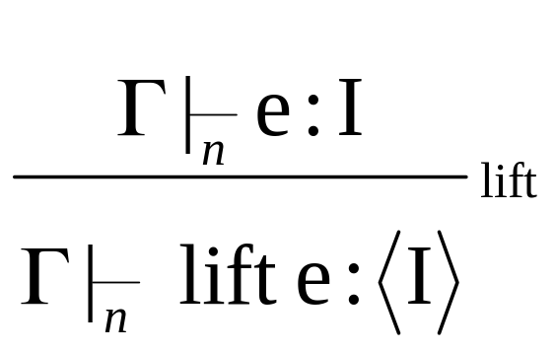
Well annotated terms
Rules for well typed terms plus . . .

Slide 13

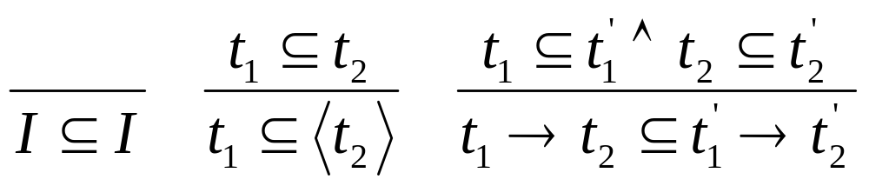
Relating actual types to needed types
f :: t
bta f’ = f at t’

Slide 14
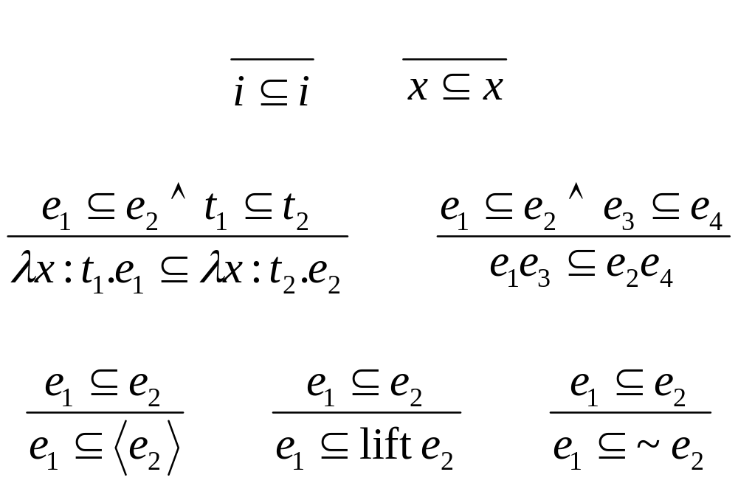
Relating terms to annotated terms

Slide 15
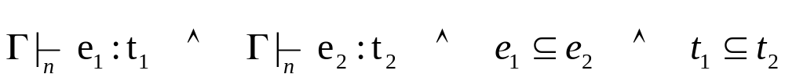
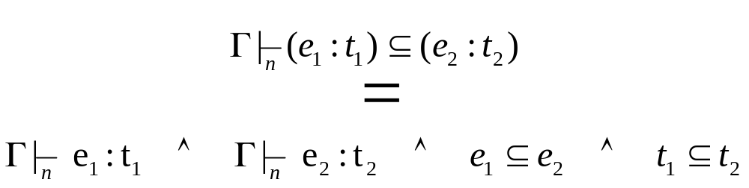
Define search
Find e₂ Given e₁, t₁, and t₂ such that
Define

Slide 16
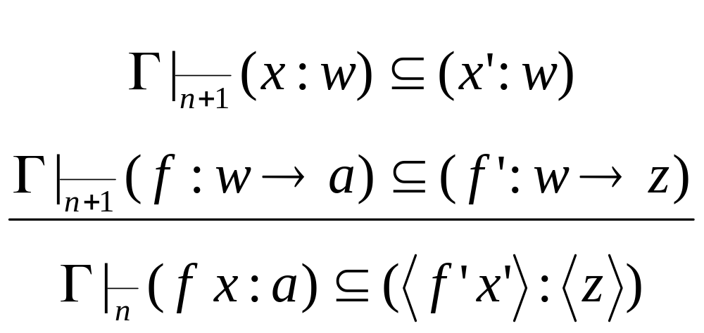
Search Judgments

Slide 17
Search = Failure + successes
Consider
Search for f’ and x’ may
  Fail
  1 or more successes

Slide 18
Haskell Program
data T = I -- int
| B -- bool
| Arr T T -- T -> T
| Code T -- < T >
| L T -- [ T ]
data E = EA E E -- f x
| EL String T E -- (λ x.E)
| EV String -- x
| EI Int -- 5
| Eif E E E -- if x then y else z
| EB E -- < E >
| ES E -- ~ E

Slide 19
Monad of multiple results
app1 n sig phi (a,Code z,EA f x) w =
do f' <- a1 (n+1) sig phi (Arr w a) (Arr w z) f
x' <- a1 (n+1) sig phi w w v
return (EB (EA f' x'))
app1 n sig phi _ _ = fail ""

Slide 20
Using to perform search
do f' <- comp1
x' <- comp2
return (EB (EA f' x'))
f’ | x’ | (EB (EA f' x'))
[] | [w,z] | []
[a,b] | [w,z] | [(EB (EA a w)) ,(EB (EA a z)) ,(EB (EA b w)) ,(EB (EA b z)) ]

Slide 21
The list monad
instance Monad [ ] where
(x:xs) >>= f = f x ++ (xs >>= f)
[] >>= f = []
return x = [x]
fail s = []
instance MonadPlus [ ] where
mzero = []
mplus = (++)

Slide 22
Search Combinators
type M a = [ a ]
ifFail [] ys = ys
ifFail xs ys = xs
first [] = fail "first done\n"
first [x] = x
first (x:xs) = ifFail x (first xs)
many [] = fail "many done\n"
many [c] = c
many (x:xs) = mplus x (many xs)
succeed s x = return x

Slide 23
Search Algorithm
a2 n sig phi x =
first
[ int1 n sig phi x -- i
, int2 n sig phi x -- <i>
, var1 n sig phi x -- x
, var2 n sig phi x -- <x>
, lam1 n sig phi x -- (fn x => e)
, lam2 n sig phi x -- <fn x => e>
, first [ if1 n sig phi x -- (if b <x> <y>)
, if2 n sig phi x -- <if b ~x ~y>
, if3 n sig phi x -- <if b x y> ]
, first [ if4 n sig phi x -- ~(if b <x> <y>)
, if5 n sig phi x -- (if b ~x ~y)
, if6 n sig phi x -- (if b x y) ]
, . . . ]

Slide 24
Search Algorithm cont.
a2 n sig phi x =
first
[. . .
,isEA sig x (\ w ->
many
[first[ app1 n sig phi x w -- <f v>
, many[ app2 n sig phi x w -- <~f v>
, app3 n sig phi x w -- <f ~x>
]
, app4 n sig phi x w -- <~f ~v>]
,first[app6 n sig phi x w -- (f <x>)
,app11 n sig phi x w -- (f:(<a>->b) x:<a>)]
,first[app5 n sig phi x w -- (f:(a-><b>) x:a)
,app7 n sig phi x w -- (f:(a->b) x:b)
,app8 n sig phi x w -- (~f v)
,app9 n sig phi x w -- (f ~v)
,app10 n sig phi x w -- (~f ~v)]
])
]

Slide 25
Algorithm Components
int1 n sig phi (I,I,EI i) =
do trace "int1 " n (EI i) I
succeed "int1" (EI i)
int1 n sig phi _ = fail ""--"Case 1"
int2 n sig phi (I,Code z,EI i) =
do trace "int2 " n (EI i) (Code z)
e' <- a1 (n+1) sig phi I z (EI i)
succeed "int2" (EB e')
int2 n sig phi _ = fail ""--"CASE 2"
var1 n sig phi (a,b,EV s) =
do trace "var1 " n (EV s) b
phi s b
var1 n sig phi _ = fail ""--"Case 3A"

Slide 26
More Components
lam1 n sig phi (Arr x y,Arr a b,EL s t e) =
do trace "lam1 " n (EL s t e) (Arr a b)
e' <- a1 n (ext sig s x)
(ext phi s (varTest s a)) y b e
succeed "lam1" (EL s a e')
lam1 n sig phi _ = fail ""--"CASE 4"
if1 n sig phi (a,Code z,Eif i j k) =
do trace "if1 " n (Eif i j k) (Code z)
b1 <- a1 n sig phi B B i
j1 <- a1 n sig phi a (Code z) j
k1 <- a1 n sig phi a (Code z) k
succeed "if1"(Eif b1 j1 k1)
if1 n sig phi _ = fail ""--"CASE 6A"

Slide 27
lam1 {0} \ f -> \ x -> f x : (I -> <I>) -> I -> <I>
lam1 {0} \ x -> f x : I -> <I>
app1 {0} f x : <I>
var1 {1} f : I -> I Fails. Actual type: I -> <I>
app2 {0} f x : <I>
var1 {1} f : <I -> I> Fails. Actual type: I -> <I>
var2 {1} f : <I -> I>
var1 {2} f : I -> I Fails. Actual type: I -> <I>
app3 {0} f x : <I>
var1 {1} f : I -> I Fails. Actual type: I -> <I>
app4 {0} f x : <I>
var1 {1} f : <I -> I> Fails. Actual type: I -> <I>
var2 {1} f : <I -> I>
var1 {2} f : I -> I Fails. Actual type: I -> <I>
app6 {0} f x : <I>

Slide 28
var1 {0} f : <I> -> <I> Fails. Actual type: I -> <I>
app11 {0} f x : <I>
var1 {0} f : <I> -> <I> Fails. Actual type: I -> <I>
app5 {0} f x : <I>
var1 {0} f : I -> <I>
var1 {0} x : I
app5 succeeded. returning value f x
lam1 succeeded. returning value \ x -> f x
lam1 succeeded. returning value \ f -> \ x -> f x
24
[\ f -> \ x -> f x]

Slide 29
dot : I -> [I] -> <[I]> -> <I>
\ n -> \ xs -> \ ys ->
if eq n 0
then <0>
else <add (mult (hd xs) (hd ~ys))
~(dot (sub n 1) (tl xs) <tl ~ys>)>
dot : I -> <[I]> -> <[I]> -> <I>
\ n -> \ xs -> \ ys ->
if eq n 0
then <0>
else <add (mult (hd ~xs) (hd ~ys))
~(dot (sub n 1) <tl ~xs> <tl ~ys>)>

Slide 30
dot : I -> <[I]> -> [I] -> <I>
\ n -> \ xs -> \ ys ->
if eq n 0
then <0>
else <add (mult (hd ~xs) (hd ys))
~(dot (sub n 1) <tl ~xs> (tl ys))>
dot : I -> [I] -> <[I] -> I>
\ n -> \ xs ->
<\ ys ->
~(if eq n 0
then <0>
else <add (mult (hd xs) (hd ys))
( ~(dot (sub n 1) (tl xs)) (tl ys))>)>

Slide 31
Binding-time improvements
Some programs don’t have a well formed annotation at some type.
Or if they do, the annotated program always goes into an infinite loop.
Or they generate large, or “ugly” code
But if we make small changes to the structure of the program, we can make it work.

Slide 32
#1 Splitting Arguments
type env = (string * int) list ;
Lookup: string -> env -> int
Set: string -> int -> env -> env
Ext: string -> int -> env -> env
Remove: env -> env
Interp0 : Com -> ((string * int) list) -> ((string * int) list)
fun interpret0 stmt env =
case stmt of
Assign(name,e) =>
let val v = eval0 e env in set name v env end
| Seq(s1,s2) =>
let val env1 = interpret0 s1 env
val env2 = interpret0 s2 env1
in env2 end

Slide 33
The env has two parts
The string is known at generation time
The int is only known at the time the code will be run.
Split: (string * int) list into
  String list
  Int list
Interp1:Com ->(string list)->(int list )->(int list)

Slide 34
fun interp1 stmt index stack =
case stmt of
Assign(name,e) =>
let val v = eval1 e index stack
val loc = pos name index
in put loc v stack end
| Seq(s1,s2) =>
let val stack1 = interp1 s1 index stack
val stack2 = interp1 s2 index stack1
in stack2 end

Slide 35
Naturally Stages
Interp2::Stmt-> string list-> <int list> -> <int list>
fun interp2 stmt index stack =
case stmt of
Assign(name,e) =>
<let val v = ~(eval2 e index stack)
in put ~(lift (pos name index)) v ~stack end>
| Seq(s1,s2) =>
<let val stack1 = ~(interp2 s1 index stack)
val stack2 = ~(interp2 s2 index <stack1>)
in stack2 end>

Slide 36
#2 Recursion v.s. Generated Loops
Consider
Interp0 : Com -> env -> env
fun interpret0 stmt env =
case stmt of
| While(e,body) =>
let val v = eval0 e env
in if v=0
then env
else interpret0 (While(e,body))(interpret0 body env) end

Slide 37
Diverges at generation time
fun interp2 stmt index stack =
case stmt of
. . .
| While(e,body) =>
<let val v = ~(eval2 e index stack)
in if v=0
then ~stack
else ~(interp2 (While(e,body)) index
(interp2 body index stack))
end>

Slide 38
Generate loop
| While(e,body) =>
<let fun loop stk0 =
let val v = ~(eval2 e index <stk0>)
in if v=0
then stk0
else let val stk1 =
~(interp2 body index <stk0>)
in loop stk1 end
end
in loop ~stack end>

Slide 39
#3 Partially static structures
Instead of splitting a structure into two structures, make it a structure that has some values and some code.
Datatype Exp
= Var of string
| App of (Exp*Exp)
| Lam of (string*Exp)
eval::Exp->(String*Value) list -> Value
eval::Exp >(String*<Value>) list -> <Value>

Slide 40
#4 Using continuations
fun match pat msigma (term as (Wrap t)) =
case (msigma) of
NONE => NONE
| SOME (sigma) =>
(case pat of
Var u =>
(case find u sigma of
NONE =>
SOME ((u,term) :: sigma)
| SOME w =>
if termeq w term
then SOME sigma
else NONE)

Slide 41
fun match pat k msigma term =
case (msigma) of
NONE => k NONE
| SOME (sigma) =>
(case pat of
Var u =>
(case find u sigma of
NONE =>
k (SOME ((u,term) :: sigma))
| SOME w =>
<if termeq ~w ~term
then ~(k (SOME sigma))
else ~(k NONE)>)

Slide 42
#5 Let–introduction
fun filter p [] = <[]>
| filter p (x::xs) =
<if ~p ~(lift x)
then ~(filter p xs)
else ~(lift x) ::
~(filter p xs)>;

Slide 43
fun filter p [] = <[]>
| filter p (x::xs) =
<let val ys = ~(filter p xs)
in if ~p ~(lift x)
then ys
else ~(lift x) :: ys end>;

Slide 44
#6 special cases
fun power 0 x = <1>
| power n = <~x * ~(power (n-1))>
<fn y => ~(power 3 <y>)>
→ <fn a => a * a * a * 1>
fun power 0 x = <1>
| power 1 x = x
| power n = <~x * ~(power (n-1))>
<fn y => ~(power 3 <y>)>
→ <fn a => a * a * a>

