Slide 1
Overview about automatic identification of landmarks in digital image

Slide 2
Contents
The aim of article
Methods
Summary the method

Slide 3
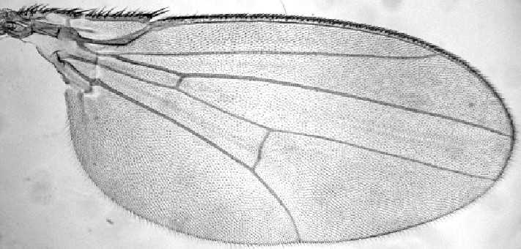
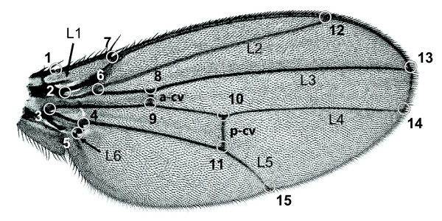
The aim of article
Developing an automated system for locating landmarks in digital image of Drosophila wings.
The data set consists 856 grey-scale image of Drosophila wings
The fly wing as an input image
The result after we indicate the landmarks
Note: Images cited from internet

Slide 4

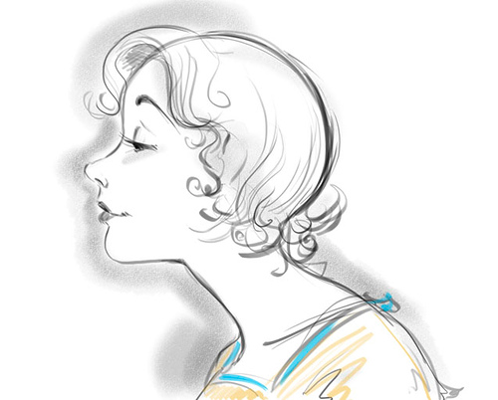
What is the landmark ?
A point in object
Correspondence between population of object
The examples about landmark
Note: Images cited from internet

Slide 5
Methods
Detection of the fly wing structure
Represent the compact invariant of the edge features using pairwise geometric histogram (PGH)
Global estimation of the pose using probabilistic Hough transform (PHT)
Correlation-based refinement, checking the propriety of landmark.

Slide 6
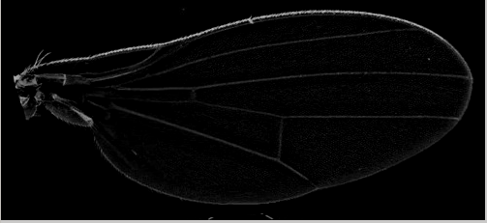
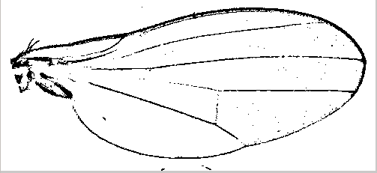
Preprocess image
Reducing the noise
Extracting and retaining essential information
Difference of Gaussian (DoG) and thresholding
The wing after applying the DoG
The wing after applying the DoG and threshodling

Slide 7
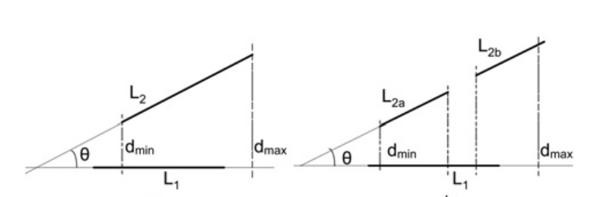
Detecting the structure of wings
Using the Canny algorithm to obtain the step edges
Apply the geometrical relationship between the vectors based on the geometric characteristics (e.g angle, ratio, perpendicular distances)
Geometric features (angle and perpendicular distance)
Note: Image cited from the article

Slide 8
Pairwise geometric histogram
Representing the edge features in a compact and invariant manner.
PGH is an approximation to the probabilistic density function
Hi(θ,d) = P(θi – θj,dij|ei)
where: - dij is perpendicular distance.
      θi – θj is relative angle between edge ei and ej

Slide 9
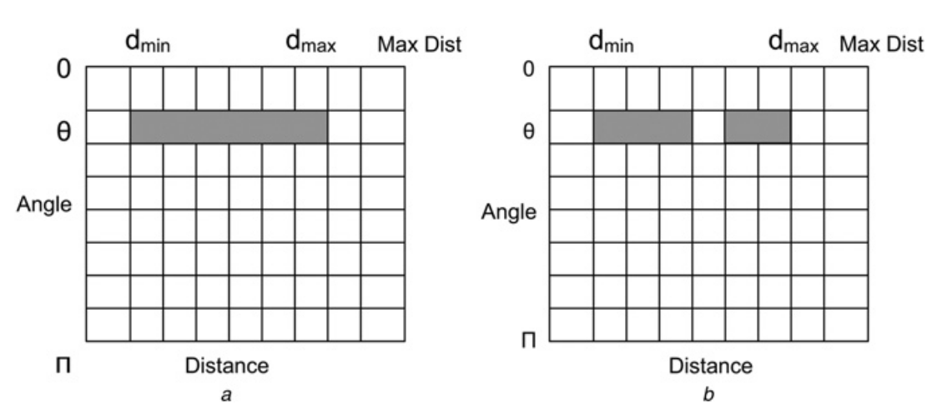
Histogram construction
Geometric features and histograms
Note: Image cited from the article

