Slide 1
Linh Le
Tute: 8-10 am,10-12 wed, thu

Slide 2

Convex
A function is convex if its second-order derivative is positive for all x.

Slide 3
Steps in Kmean
Step 1. Randomly pick k data points as our initial Centroids.
Step 2. Find the distance (Euclidean distance for our purpose) between each data points in our training set with the k centroids.
Step 3. Now assign each data point to the closest centroid according to the distance found.
Step 4. Update centroid location by taking the average of the points in each cluster group.
Step 5. Repeat the Steps 2 to 4 till our centroids don’t change.

Slide 4
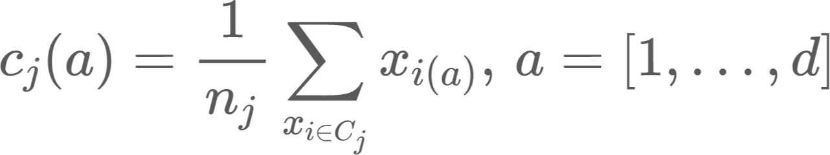
Steps in K-means
Input: K, set of points x1 …xn
Place centroids c1…ck at random locations
Repeat until convergence:
For each point xi:
Find nearest centroid cj through argminD(xi,cj) as j=[1,..,K]
Assign the point xi to cluster j
For each cluster j=1,...,K:
New centroid cj=mean of all points xi assigned to cluster j in previous step
Stop when none of the cluster assignments change
O(#iterations*#clusters*#instances*#dimensions)

Slide 5
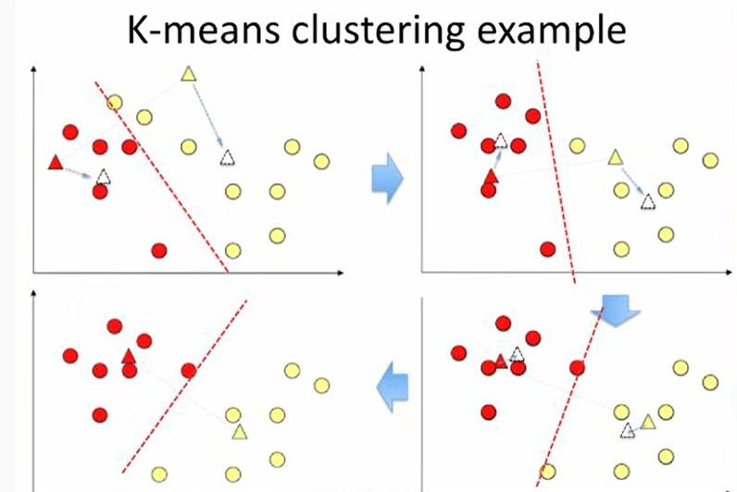

Slide 6


Preliminary
P(C): prior probability because it is the knowledge before looking at x
p(x|C): class likelihood = conditional probability that an event belonging to C has the associated observation value x.
p(x): the evidence = probability an observation x is seen.
p(x)=sum(p(x,C))=p(x|C=1)*P(C=1)+P(x|C=0)*P(C=0)

Slide 7

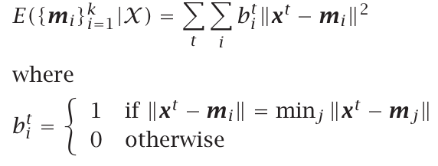
K-means
K reference vectors, mj, j=1,...,k.
If b_i^t =1 ->x^t \in group of m_i

Slide 8
Some methods to initialize alpaydin page 165
Take randomly selected k instances as the initial m_i
The mean of all data can be calculated and small random vectors are added to the mean to get the k initial m_i
Partitioning data into k groups, take the means of these groups as the initial centers
After convergence, all the centers should cover some subset of the data instances and be useful -> best to initialize centers where we believe there is data

Slide 9

Notes
Split ->2 by adding a small random vector to one of the two copies to make them different
centroid that covers too few instances can be removed and restart from some other part of the input space

Slide 10
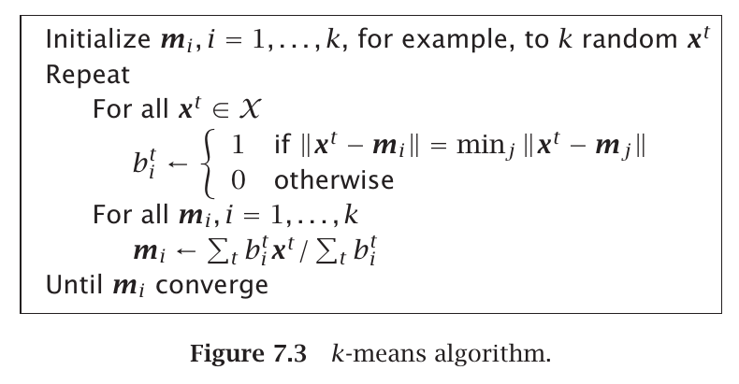
K-means - alpaydin page 167

Slide 11
EM - kmeans
=probabilistic approach
Density parameters?to maximize the likelihood of the sample

Slide 12
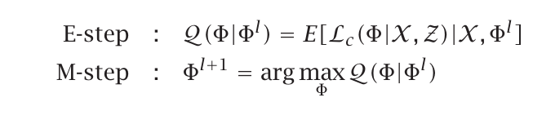
In the E-step we estimate the labels given our observed components
perform probabilistic assignments of each data point to some class based on the current hypothesis h for the distributional class parameters;
In the M-step, we update our component with the labels in E-step
update the hypothesis h for the distributional class parameters based on the new data assignments.

Slide 13
Question 1
From [Bishop 2006], N=43200 and the total number of bits required is:
24K+Nlog2(K)
log2(6)=2.58 but we must round up because we need a integer number of bits per pixel: [log2(6)]=3
24K+Nlog2(K)=24*6+43200*3=129744
Compression ratio (given the original image required by 1036800 bits):
129744/10336800 = 12.5%

Slide 14
1 | 2 | 3
4 | 5 | 6
7 | 8 | 9

Slide 15
Question 2
A different initialisation will likely have a different error value, so the curve could start higher or lower. The algorithm (and therefore the curve) follows a monotonic/non-increasing path to a local minimum of error, so the curve could end up at a higher or lower value than the curve in the book

Slide 16
Question 3
Row 2: There are two crescent-shaped cluster, but their location means that some points from 1 cluster are closer to points in the other cluster. 7/10 algorithms are affected by this
Row 4: The highly eccentric elliptical clusters are aligned parallel and very close together. The data would have high correlation
Row 6: The data looks uniform random in a square, revealing what the algorithms do without any clustering in the data

Slide 17
Question 4
Sum of error?
Value range of error?

Slide 18
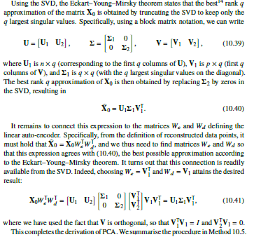

Slide 19
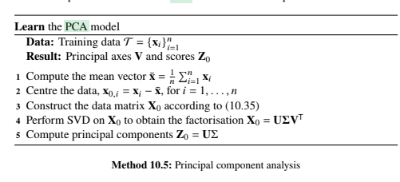

Slide 20
Step 1:
Calculate the covariance matrix for the whole dataset

Slide 21
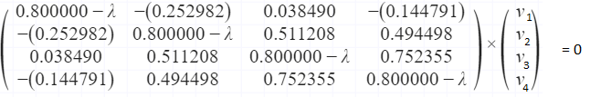
Step 2:
Calculate eigenvalues and eigen vectors.
An eigenvector is a nonzero vector that changes at most by a scalar factor when that linear transformation is applied to it. The corresponding eigenvalue is the factor by which the eigenvector is scaled. Let A be a square matrix (in our case the covariance matrix), ν a vector and λ a scalar that satisfies Aν = λν, then λ is called eigenvalue associated with eigenvector ν of A.
Aν-λν =0 ; (A-λI)ν = 0 -> det(A-λI) = 0 (because v is a non-zero vector)

Slide 22
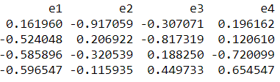
Final steps
Sort eigenvalues and their corresponding eigenvectors
Pick k eigen values and form a matrix of eigen vectors
Transform the feature matrix: Feature matrix*topk_eigenvectors = Transformed data

