Slide 1
Practice Week 3
Linh: Wed 8-10 am, Thu 8am-12am

Slide 2
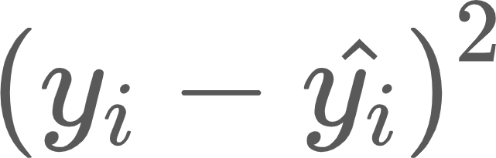
Linear Regression
Output variable y (a scalar)
Input variable x
The theta coefficients are the parameters of the models
Model needs to learn these coefficients for a good prediction
SE:
Notes:
The dimension of x is large so we can not use our eyes to find theta coefficients. From that point, we need a formulation to find the difference between the groundtruth y in the test dataset and the predicted value y^ from our model

Slide 3
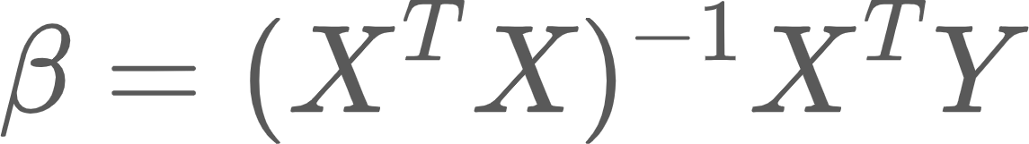
Practice Q1

Slide 4


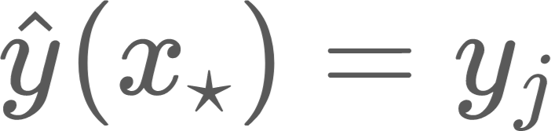
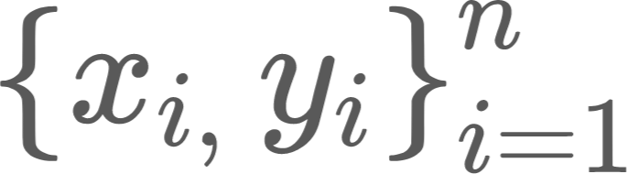
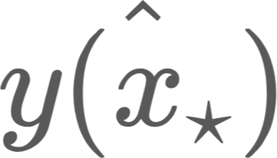

1-nearest neighbors (k-NN)
This method could be used for both regression and classification
1.Compute the Euclidean distance between the test input and all training input
2.Find with the shortest distance to
3.
Notations:
-Training data:
- Prediction
Notes:
Training data consists of n data points with input xi and corresponding output yi.

Slide 5
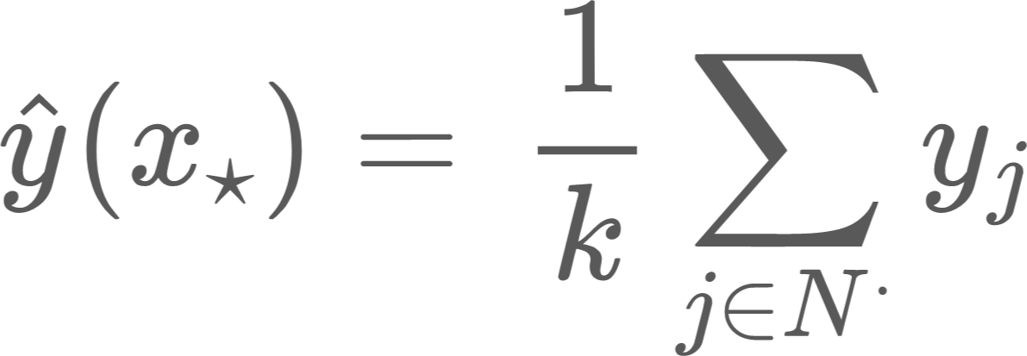
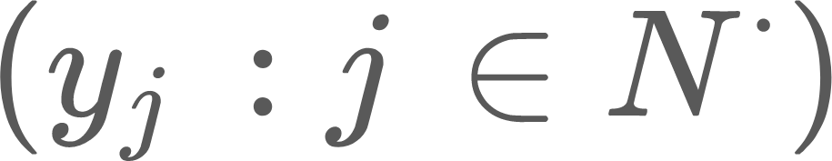
k-nearest neighbors (k-NN)
This method could be used for both regression and classification
1.Compute the Euclidean distance between the test input and all training input
2.Find with the shortest distance to
3. with regression problem; MV classification
Notations:
-Training data:
- Prediction
Notes:
In this class i will have some notations for the elements in the training and the test dataset
Training data consists of n data points with input xi and corresponding output yi.

Slide 6
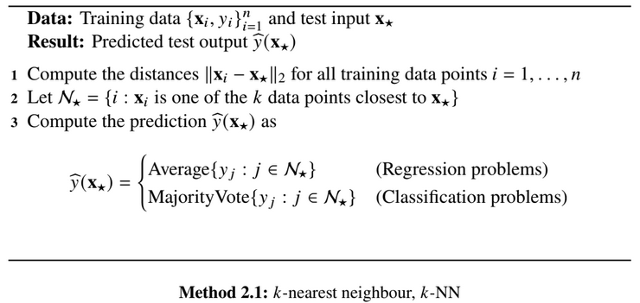

Slide 7
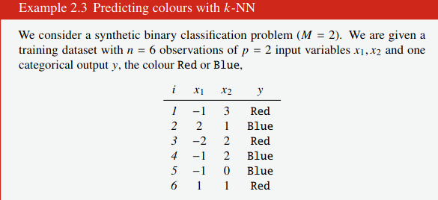
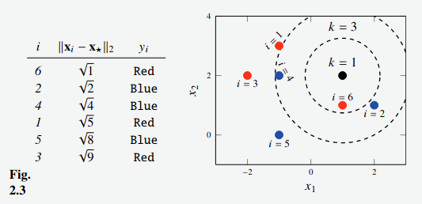
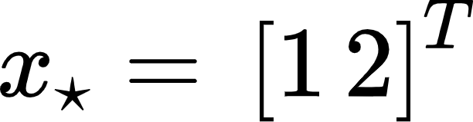
-2 settings k=1 and k = 3,
-k=1, output test = Red, j = 6
-k=3, j ∈[6, 2, 4] , output test = Blue (Blue wins with neighbors’ predicted output ∈ [Red, Blue, Blue]
Notes:
In this example, we compute the euclidean distance between each training data point and test data point, sort them in ascending order because we want to find the closest data points to the the test one. In figure 2.3, k=1 represented by the inner circle and k=3 by the outer circle

Slide 8
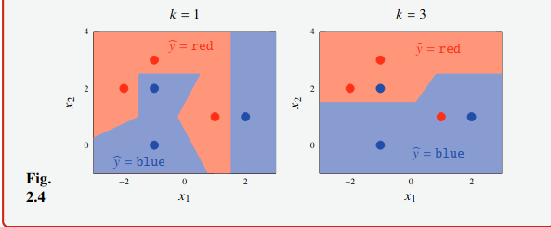
Some other definitions
The decision boundaries are the points
in the input space where the class prediction
CHANGES
Notes:
the ̄umber of ̄eighbours 𝑘 that are co ̄sidered whe ̄ maki ̄g a predictio ̄ with
𝑘Mnn is a ̄ importa ̄t choice the user has to makeN si ̄ce 𝑘 is ̄ot lear ̄ed by
𝑘Mnn itselfL but is desig ̄ choice left to the userL we refer to it as a hyperparameterN
throughout the bookL we will use the term ‘hyperparameterG for similar tu ̄i ̄g
parameters for other methodsN

Slide 9
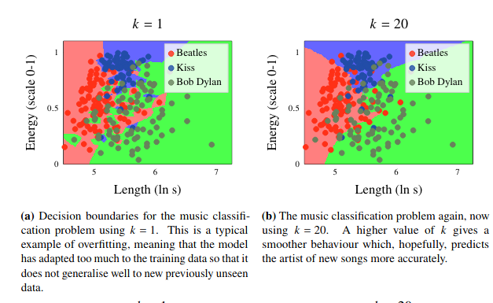
Some other definitions
Overfitting happens
when the model adapts very closely to the training data -> fails to fit the additional data
Underfitting happens when the model is too simple -> it leads to the poor predictions on the test data.

Slide 10

Decision Tree
depth of a tree
root nodes
decision nodes
Root node: starting point of a tree
Each node has 2 or more nodes extending from it
leaf nodes/terminal nodes: contain the answer, outcome for each action
A binary tree of height h has <= 2**h leaves
contain questions which extend more subnodes

Slide 11
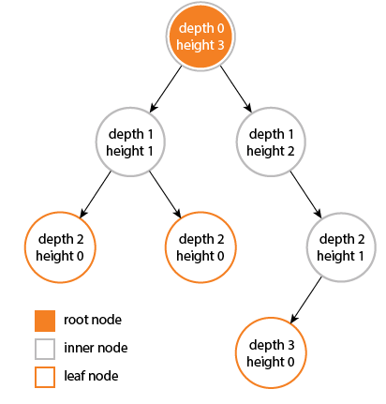
Decision tree
The depth of a node is the number of edges from the node to the tree's root node. A root node will have a depth of 0.
The height of a node is the number of edges on the longest path from the node to a leaf. A leaf node will have a height of 0.
Properties of a tree:
The height of a tree would be the height of its root node, or equivalently, the depth of its deepest node.
The diameter (or width) of a tree is the number of nodes on the longest path between
any two leaf nodes.
The tree below has a diameter of 6 nodes.

Slide 12
Is your date good or evil?(example collected from internet)
 | mask | cape | tie | ears | smokes | height | class
Batman | y | y | n | y | n | 180 | good
Robin | y | y | n | n | n | 176 | good
Alfred | n | n | y | n | n | 185 | good
Penguin | n | n | y | n | y | 140 | evil
Catwoman | y | n | n | y | n | 170 | evil
Joker | n | n | n | n | n | 179 | evil
Batgirl | y | y | n | y | n | 165 | ?
Riddler | y | n | n | n | n | 182 | ?
Your date | n | y | y | y | y | 181 | ?

Slide 13
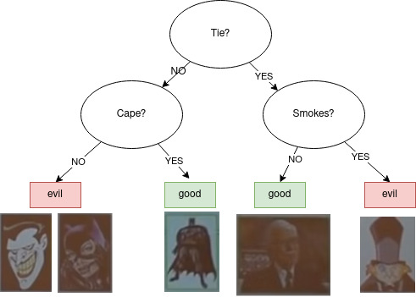
Decision Tree

Slide 14
Decision boundaries of decision trees are always perpendicular to X and Y axis

Slide 15
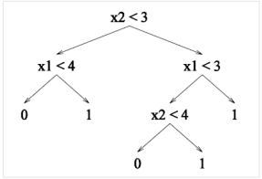
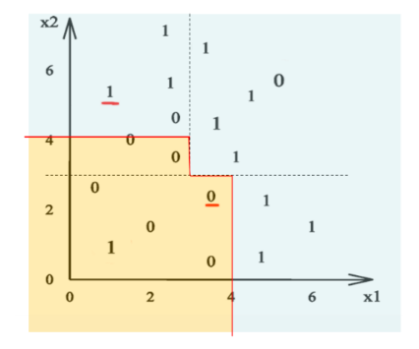
Question 1
Dimension of the feature space?
Depth of decision tree?
How are the two data points classified?
Draw
Classification accuracy of this decision tree?

Slide 16
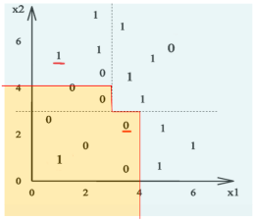
Question 1
Dimension of the feature space? 2
Depth of decision tree? 3
Is classified correctly
16/19 = 84%

Slide 17
Question 1
Sklearn.metrics accuracy, mean_squared_error
Sklearn.tree DecisionTreeRegressor, DecisionTreeClassifier
Sklearn.neighbors KNeighborsClassifier, KNeighborsRegressor
Decison boundaries->plt.contourf
Open csv->pd.open_csv(,names=[“X”,”Y”])

