Slide 1
FINAL CAPSTONE PROJECT

Slide 2
INTRODUCTION
My colleage wants to open up a hotel in populated city in Vietnam. But he lacks of information about the current situation of existing hotels to detect where the best place to build a hotel is. This project aims at finding an appropriate city to open it.This project can be used by anyone who wishes to open a hotel or any other retail business in Vietnam.

Slide 3
Data preparation
The data needed for this project would be the name of the cities in Vietnam and their respective latitudes and longitudes, also the name, id , latitude and longitude of the respective venues in and around the cities of Vietnam. Such data are provided freely from this website https://simplemaps.com/data/vn-cities, where the data is available in the form of a csv file and also the name, id , latitude and longitude of the respective venues
We save the data provided and import to dataframe using pandas library

Slide 4
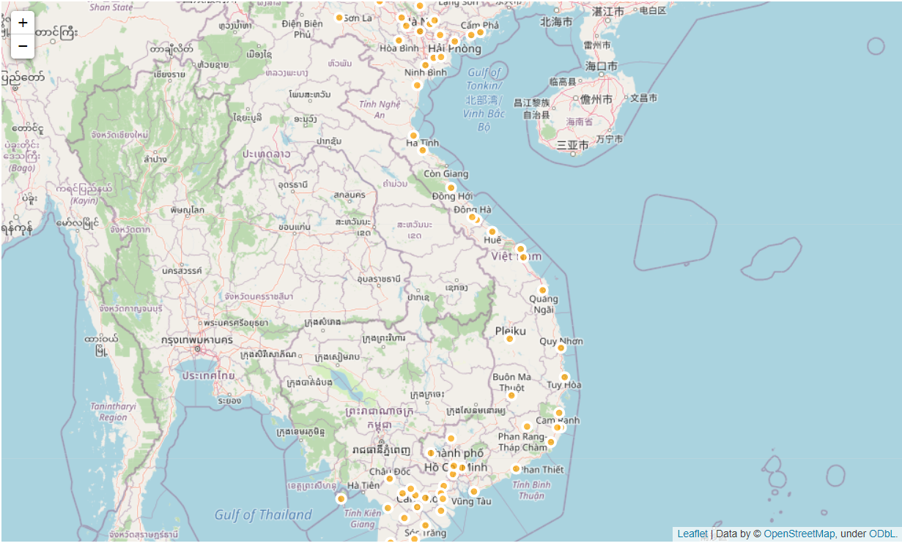
Data preparation (2)
After some data preprocessing steps, we place the data to country map using folium

Slide 5
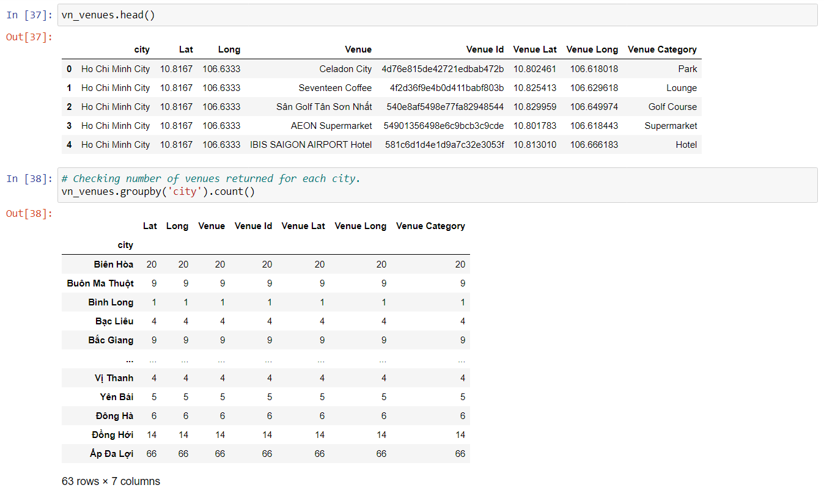
Data preparation (3)
The Foursquare API is used to retrieve the data containing the venue names and their latitude and longitude locations. A function is created called getNearbyVenues to clean the data in JSON. This function extracts only the relevant information and then converts it into a dataframe when called. This gives us our second dataframe , containing the venue names and their latitude and longitude locations.

Slide 6
Data clustering
Step 5: Analyzing each city's venues. One hot encoding is used to group all the different venues according to their category for each city.
Step 6: A function called return_most_common_venues is created to sort the venues in descending order .
Step 7: Another dataframe called v_ venues is created that contains the top 10 most common venues for each city.
Step 8: Use of customer segmentation specifically, KMeans algorithm, to divide the data into 4 clusters and then finally create one last dataframe that contains all the data, the name of the city, the latitude and longitude of the city, the top 10 most common venues of that city and the cluster number that the city belongs to

Slide 7
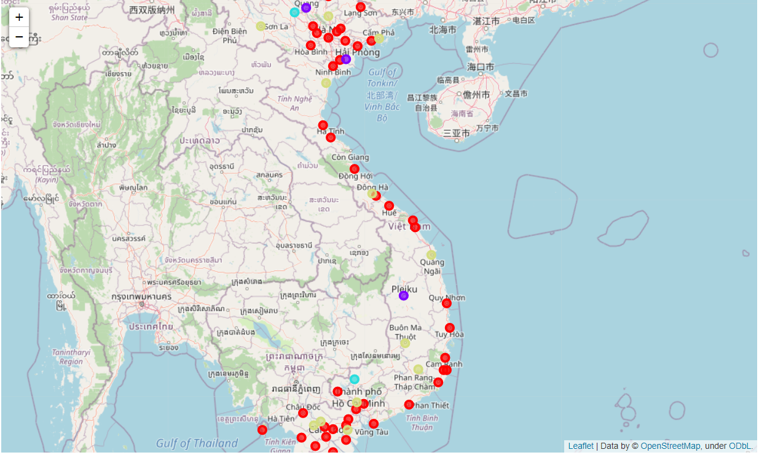
Data Clustering (2)
Step 9: For visualization, we plot the cluster onto the map of Vietnam. The different colours represent the different clusters.
Step 10: Print the different clusters groups separately.

Slide 8
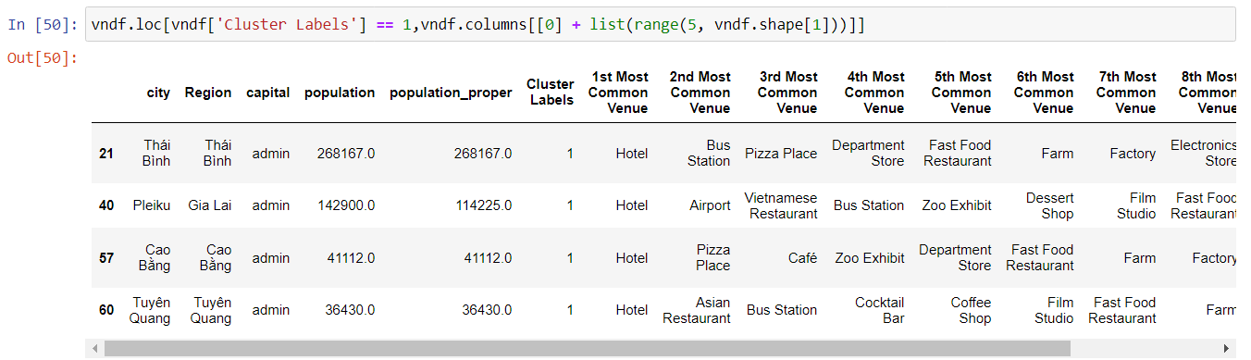
results
From the data we find that Cluster 2 is best fit the demand

Slide 9
Conclusion
From the cluster results, I can tell my colleage that he can think of opening his first hotel in one of 4 cities listed above: Thai Binh, Pleiku, Cao Bang, Tuyen Quang.

Slide 10
Thank you

