Slide 1


Hospital Portal
SUPERVISOR: MR. PHẠM CÔNG THÀNH
Hồ Hoàng Long – SE61761
Trần Phương Linh – SE62039
Bạch Minh Đức – SE61791 (Drop out)
Phạm Xuân Tùng – SE61590

Slide 2
Out line
Current Situation
Our Proposal
Features & Demo
Future plan

Slide 3
Current Situation

Slide 4





Current Situation

Slide 5




Current Situation
?!?

Slide 6

Current Situation

Slide 7


Current Situation

Slide 8
Advantages
Disadvantages
Incorporation of hospital management procedures and portals. The application can be accessed via the internet
Accuracy and instantaneous.
Synchronization and automation, reducing administrative procedures and human resources.
In fact, due to the influence of personality-related reasons, the automatic scheduling algorithm may not meet the requirements.
The hospital costs a certain amount of money to maintain the system (server, host).

Slide 9
Our Proposal

Slide 10


Our Proposal

Slide 11



Our Proposal
Admin
Manager
Scheduler
User

Slide 12
Our Proposal
Shift scheduler
Meeting scheduler
Mission scheduler
Notification

Slide 13



Our Proposal

Slide 14
Features & Demo

Slide 15
Main Features
Portal system management:
+ Manage department
+ Manage user
+ Manage room
Portal Features management:
+ Shift scheduler
+ Meeting scheduler
+ Mission scheduler
+ Notification

Slide 16
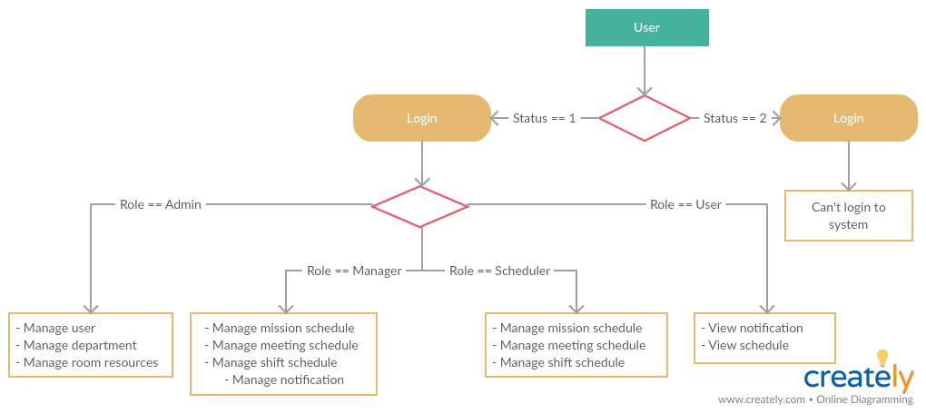
Manage user

Slide 17
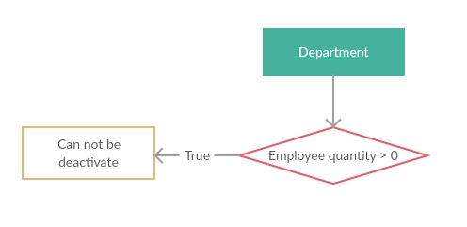
Manage department

Slide 18
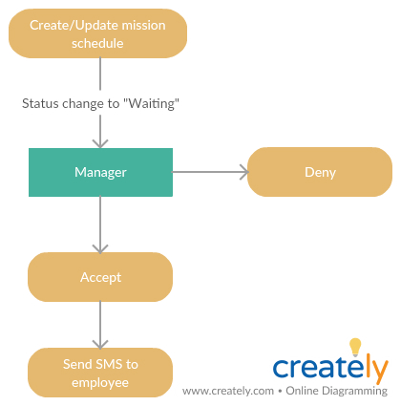
Manage mission schedule

Slide 19
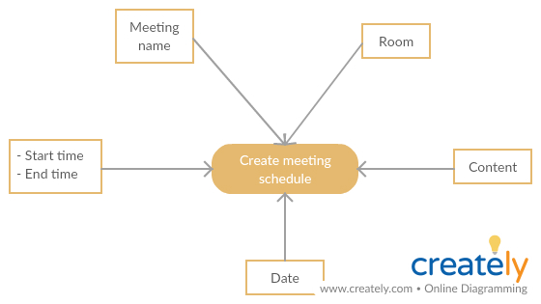
Manage meeting schedule

Slide 20
Manage shift schedule

Slide 21

Future plan
HOSPITAL- PORTAL

Slide 22
Improve
- Employee management system more effective.
- Automatic Scheduling.

Slide 23

Extend customer services
- Booking medical appointment

Slide 24



Extend customer services
Search medical services.
Search hospital’s work schedule
Feed back
HOSPITAL- PORTAL

