Slide 1


Hospital Portal
SUPERVISOR: MR. PHẠM CÔNG THÀNH
Hồ Hoàng Long – SE61761
Trần Phương Linh – SE62039
Bạch Minh Đức – SE61791 (Drop out)
Phạm Xuân Tùng – SE61590

Slide 2
Out line
Current Situation
Our Proposal
Features & Demo
Future plan

Slide 3
Current Situation

Slide 4





Current Situation

Slide 5




Current Situation
?!?

Slide 6

Current Situation

Slide 7


Current Situation

Slide 8
Advantages
Disadvantages

Slide 9
Our Proposal

Slide 10


Our Proposal

Slide 11



Our Proposal
Admin
Manager
Scheduler
User

Slide 12
Our Proposal
Shift scheduler
Meeting scheduler
Mission scheduler
Notification

Slide 13



Our Proposal

Slide 14
Features & Demo

Slide 15
Main Features
Portal system management:
+ Manage department
+ Manage user
+ Manage room
Portal Features management:
+ Shift scheduler
+ Meeting scheduler
+ Mission scheduler
+ Notification

Slide 16
Manage department
The department can contain 0, 1 or more users
The department has two status is Active and Disabled
The department can be disabled when not containing active user

Slide 17
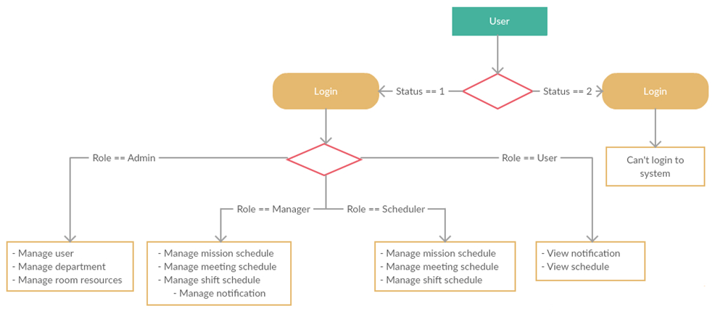
Manage user

Slide 18
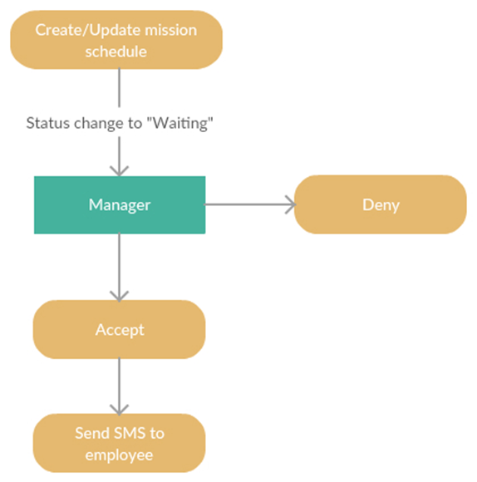
Manage mission schedule

Slide 19
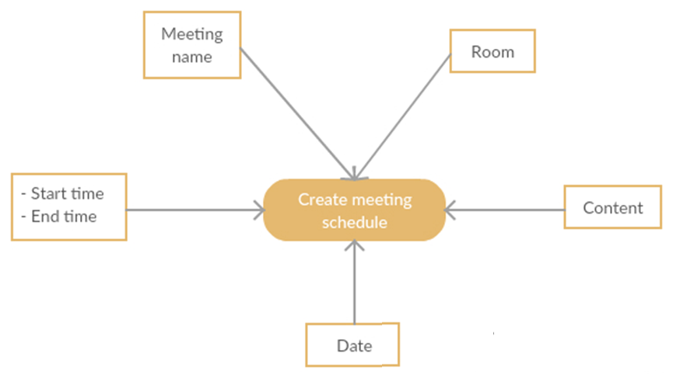
Manage meeting schedule

Slide 20
Manage shift schedule

Slide 21
Manage shift schedule
Department | Week
Waiting | Checked

Slide 22
Manage shift schedule
Posted=0
False
True
Posted : Empty
Posted : Posted

Slide 23
Manage shift schedule
Waiting=0
Waiting : Empty
True
False
True
Waiting=Posted
False
Waiting : Checked
Waiting : Uncheck

Slide 24
Manage shift schedule
Waiting : Uncheck
Accept
Check
Deny
Posted = Waiting
Waiting = Posted

Slide 25
Manage mission schedule

Slide 26

Future plan
HOSPITAL- PORTAL

Slide 27
Improve
- Employee management system more effective.
- Schedule setting system more convenience.

Slide 28

Extend customer services
- Booking medical appointment

Slide 29



Extend customer services
Search medical services.
Search hospital’s work schedule
Feed back
HOSPITAL- PORTAL

