Slide 1


Hospital Portal
SUPERVISOR: MR. PHẠM CÔNG THÀNH
Hồ Hoàng Long – SE61761
Trần Phương Linh – SE62039
Bạch Minh Đức – SE61791 (Drop out)
Phạm Xuân Tùng – SE61590

Slide 2
Outline
Current Situation
Our Proposal
Features & Demo
Future plan

Slide 3
1. Current situation

Slide 4





Current Situation

Slide 5




Current Situation
?!?

Slide 6

Current Situation

Slide 7


Current Situation

Slide 8
2.Our proposal

Slide 9


Our Proposal

Slide 10
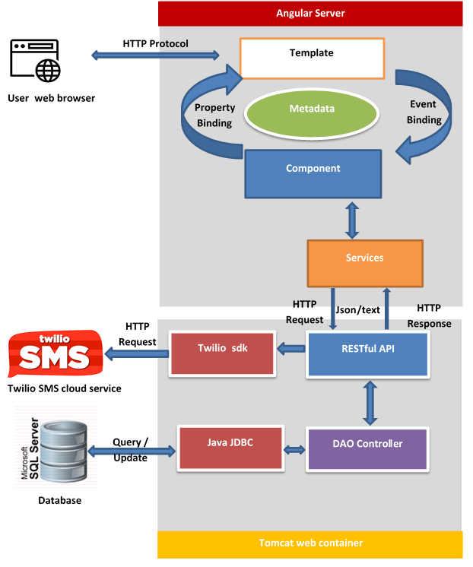
Our Proposal

Slide 11
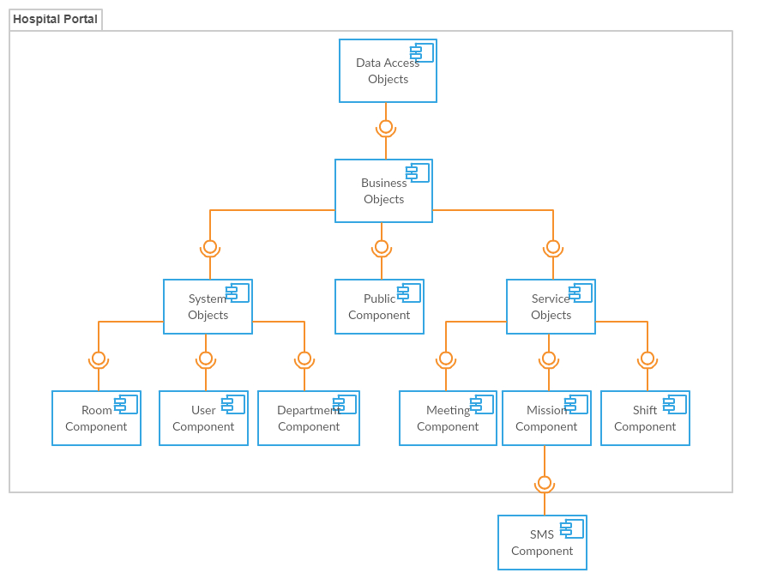
Our Proposal

Slide 12
3. Features & demo

Slide 13



Role overview
Admin
Manager
Scheduler
User

Slide 14
Main Features
Portal system management:
+ Manage department
+ Manage user
+ Manage room
Portal Features management:
+ Shift scheduler
+ Meeting scheduler
+ Mission scheduler
+ Notification

Slide 15
Portal Features management
Shift scheduler
Meeting scheduler
Mission scheduler
Notification

Slide 16



Manage Shift scheduler

Slide 17


Manage mission schedule

Slide 18

Manage meeting schedule

Slide 19

Manage notification

Slide 20
Portal system management
Manage department
Manage user
Manage room

Slide 21

Manage department

Slide 22

Manage user

Slide 23

Manage room

Slide 24
Advantages
Disadvantages
Incorporation of hospital management procedures and portals. The application can be accessed via the internet
Accuracy and instantaneous.
Synchronization and automation, reducing administrative procedures and human resources.
The hospital costs a certain amount of money to maintain the system (server, host).
Notes:
Kết hợp thủ tục quản lý bệnh viện và cổng thông tin. Ứng dụng có thể được truy cập qua internet
Độ chính xác và tức thời.
Đồng bộ hóa và tự động hóa, giảm thủ tục hành chính và nguồn nhân lực.

Slide 25
4. Future plans

Slide 26

4. Future plan
HOSPITAL- PORTAL

Slide 27

4. Future plan

Slide 28
Improve
- Employee management system more effective.
- Suggest the most suitable work schedule for scheduler.

Slide 29

Extend customer services
- Booking medical appointment

Slide 30



Extend customer services
Search medical services.
Search hospital’s work schedule
Feed back
HOSPITAL- PORTAL

