Slide 1


Hospital Portal
SUPERVISOR: MR. PHẠM CÔNG THÀNH
Hồ Hoàng Long – SE61761
Trần Phương Linh – SE62039
Bạch Minh Đức – SE61791 (Drop out)
Phạm Xuân Tùng – SE61590

Slide 2
Outline
Current Situation
Our Proposal
Features & Demo
Future plan

Slide 3
1. Current situation

Slide 4





Current Situation

Slide 5




Current Situation
?!?

Slide 6

Current Situation

Slide 7


Current Situation

Slide 8
Advantages
Disadvantages
Incorporation of hospital management procedures and portals. The application can be accessed via the internet
Accuracy and instantaneous.
Synchronization and automation, reducing administrative procedures and human resources.
The hospital costs a certain amount of money to maintain the system (server, host).

Slide 9
2.Our proposal

Slide 10


Our Proposal

Slide 11



Our Proposal
Admin
Manager
Scheduler
User

Slide 12
Our Proposal
Shift scheduler
Meeting scheduler
Mission scheduler
Notification

Slide 13



Our Proposal

Slide 14
3. Features & demo

Slide 15
Main Features
Portal system management:
+ Manage department
+ Manage user
+ Manage room
Portal Features management:
+ Shift scheduler
+ Meeting scheduler
+ Mission scheduler
+ Notification

Slide 16
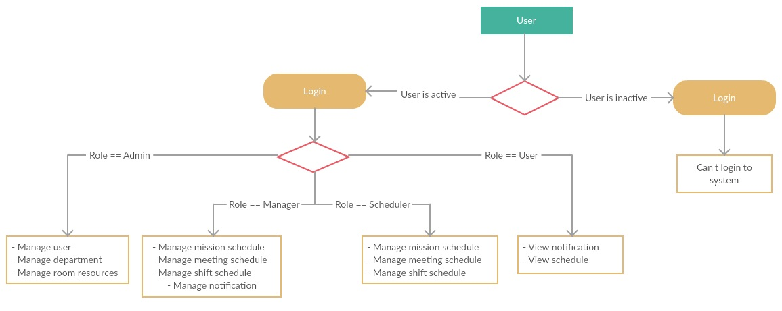
Role overview

Slide 17

Manage mission schedule

Slide 18

Manage meeting schedule

Slide 19

Create shift schedule

Slide 20
Update shift schedule

Slide 21
4. Future plans

Slide 22

4. Future plan
HOSPITAL- PORTAL

Slide 23
Improve
- Employee management system more effective.
- Suggest the most suitable work schedule for scheduler.

Slide 24

Extend customer services
- Booking medical appointment

Slide 25



Extend customer services
Search medical services.
Search hospital’s work schedule
Feed back
HOSPITAL- PORTAL

