Slide 1
C Programming Lecture Series
16th August
IIT Kanpur
C Course, Programming club, Fall 2008

Slide 2
About ‘the’ Course
An assignment based course
More emphasis on problem solving
Instructors:
Deepak Majeti. mdeepak@
Nitin Munjal. nitinm@
Rishi Kumar. rishik@
Satendra Kumar Yadav. satendra@
C Course, Programming club, Fall 2008

Slide 3
Topics to be covered
Introduction to Programming in C & Restricted Exposure to Linux - Today
Data, Operators, I/O - Tomorrow
Conditional Expressions, Control Flow – 23rd Aug.
Loops
Functions for structure and Recursion
Pointer and Arrays
Dynamic allocation
Structures and Applications, Storage Classes
Pre-processor, File Handling, Math library
Algorithms: searching, sorting
C Course, Programming club, Fall 2008

Slide 4
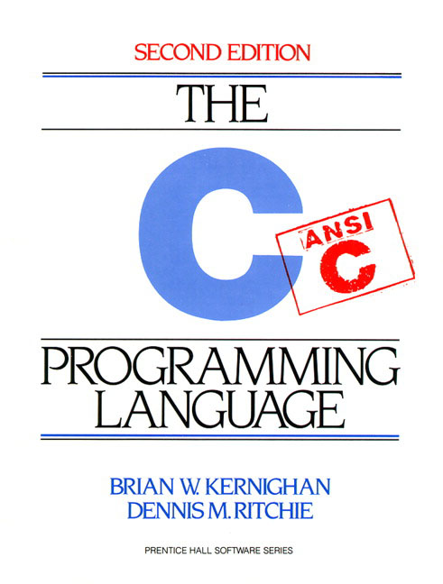
Text
Kernighan, Ritchie. Second Edition
C Course, Programming club, Fall 2008

Slide 5
Course website
Website (slides, important updates)
http://students.iitk.ac.in/programmingclub/course/
Discussion page (lecture clash, doubts)
http://students.iitk.ac.in/programmingclub/course/discuss.html
C Course, Programming club, Fall 2008

Slide 6
About C
GNU : GNU's Not Unix
  GNU C: gcc is a standard compiler
C is non portable
  Terms: Compiler (human -> machine [once]), Interpreter (instructions -> machine [each time the program is run])
C is a high level language
  One line in c maps to many lines of assembly code
C Course, Programming club, Fall 2008

Slide 7
My first C program!
/* thou shalt begin from somewhere*/
#include <stdio.h>
// program prints hello world
int main() {
printf ("Hello world!\n");
return 0;
}
C Course, Programming club, Fall 2008

Slide 8
More..
#include <stdio.h>
// program reads and prints the same thing
int main() {
int number;
scanf(“%d”, &number);
printf (“%d\n”, number);
return 0;
}
C Course, Programming club, Fall 2008

Slide 9
1. Programming on Linux
Linux command line: GNU-C
  Use console based editors: vi, emacs, nano
  Or text based editors: kwrite, gedit, kate
IDE
  Eclipse *
  http://www.eclipse.org/cdt/downloads.php
  * = available on windows too.
C Course, Programming club, Fall 2008

Slide 10
Linux Familiarization
Common shell commands
  Remember, commands are issued to a shell
  pwd, ls, dir, mkdir, cd, date, whoami
  touch, cp, mv, rm, chmod, cat, less, more, tail
  man
  Commands are programs (usually in /usr/bin, /bin/)
  Most commands take options and input
    ls ls -a ls -l ls -lt ls -ltr
Everything is case-sensitive
Tab completion, command history
C Course, Programming club, Fall 2008

Slide 11
Files, directories and permissions
Directory
drwxr-xr-x 2 nitinm cse 4096 2008-08-13 22:46 Pictures
File
-rw-r--r-- 1 nitinm cse 3446 2008-08-14 15:16 test.c
Special files (advanced)
  .a : static library
  .so : shared object (dynamic)
  Pipes : fifo / buffered prwx--x--x
  Device files : /dev/cdrom etc.
C Course, Programming club, Fall 2008

Slide 12
Programming on Linux contd…
Writing programs
  Use any editor (graphical, console)
  Save file as <filename>.c
Compiling programs
  gcc <filename>.c gcc funnysingh.c –o funnysingh
Running programs
  ./a.out ./funnysingh
  (executable files need to have executable permissions. $chmod +x <executable>)
C Course, Programming club, Fall 2008

Slide 13
Compilation is not a single stage
Pre process : cpp (C Preprocessor) gcc –E
  Removes comments, includes #include files
Compile : gcc –c (GNU compiler)
  main step, compilation, change into machine code
Link : ld (GNU linker)
  link executables
gcc does all the above steps
C Course, Programming club, Fall 2008

Slide 14
2. C on windows
Use a text editor
  install notepad++
  compiler : MinGW
  how to install and work- http://csjava.occ.cccd.edu/~gilberts/mingw/
IDE
  Eclipse *
  Microsoft Visual C++ Express Edition 2008
C Course, Programming club, Fall 2008

Slide 15
Or 3. Work on windows, yet use gcc
Install SSH Secure Shell or Putty
  Connect to cc servers: webhome.cc.iitk.ac.in or linserv.cc.iitk.ac.in etc.
Want to see GUI too?
  Install Xming
    And then, enable X11 tunnelling
C Course, Programming club, Fall 2008

Slide 16
Why doesn’t my windows binary run on linux?
  File format: exe and elf
    man elf
  In linux, program does system calls.
  Libraries are different
C Course, Programming club, Fall 2008

Slide 17
Good programming practices
Indentation
#include <stdio.h>
int main() {
printf("Hello World!\n");
return 0;
}
#include <stdio.h>
int main() {
printf("Hello World!\n");
return 0;
}
C Course, Programming club, Fall 2008

Slide 18
Good programming practices contd..
Variables names
  Not too short, not too long
  Always start variable names with small letters
  On work break
    Capitalize: myVariable, OR
    Separate: my_variable
C Course, Programming club, Fall 2008

Slide 19
Good programming practices contd...
Put comments
#include <stdio.h>
int main() {
/* this program adds
two numbers */
int a = 4; //first number
int b = 5; //second number
int res = 0; //result
res = a + b;
}
C Course, Programming club, Fall 2008

Slide 20
Good programming practices
Your code may be used by somebody else
The code may be long
Should be easy to understand for you and for others
Saves lot of errors and makes debugging easier
Speeds up program development
C Course, Programming club, Fall 2008

