Slide 1
C Programming Lecture Series
16th August
IIT Kanpur

Slide 2
About ‘the’ Course
An assignment based course
More emphasis on problem solving
Instructors:
Deepak Majeti. mdeepak@
Nitin Munjal. nitinm@
Rishi Kumar. rishik@
Satendra Kumar Yadav. satendra@

Slide 3
Topics to be covered
Introduction to Programming in C & Restricted Exposure to Linux - Today
Data, Operators, I/O - Tomorrow
Conditional Expressions, Control Flow – 23rd Aug.
Loops
Functions for structure and Recursion
Pointer and Arrays
Dynamic allocation
Structures and Applications, Storage Classes
Pre-processor, File Handling, Math library
Algorithms: searching, sorting

Slide 4
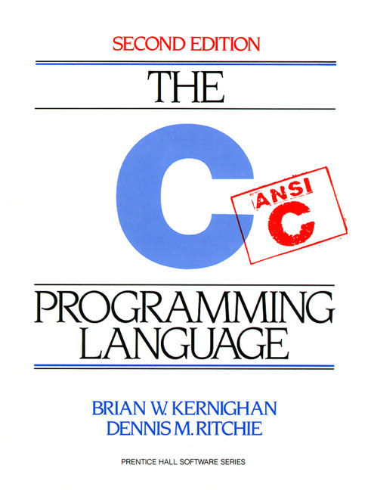
Text
Kernighan, Ritchie. Second Edition

Slide 5
Course website
Website (slides, important updates)
http://students.iitk.ac.in/programmingclub/course/
Discussion page (lecture clash, doubts)
http://students.iitk.ac.in/programmingclub/course/discuss.html

Slide 6
About C
GNU : GNU's Not Unix
GNU C: gcc is a standard compiler
C is non portable
Terms: Compiler (human -> machine [once]), Interpreter (instructions -> machine [each time the program is run])
C is a high level language
One line in c maps to many lines of assembly code

Slide 7
My first C program!
/* thou shalt begin from somewhere*/
#include <stdio.h>
// program prints hello world
int main() {
printf ("Hello world!\n");
return 0;
}

Slide 8
More..
#include <stdio.h>
// program reads and prints the same thing
int main() {
int number;
scanf(“%d”, &number);
printf (“%d\n”, number);
return 0;
}

Slide 9
1. Programming on Linux
Linux command line: GNU-C
Use console based editors: vi, emacs, nano
Or text based editors: kwrite, gedit, kate
IDE
Eclipse * http://www.eclipse.org/cdt/downloads.php
* = available on windows too.

Slide 10
Linux Familiarization
Common shell commands
Remember, commands are issued to a shell
pwd, ls, dir, mkdir, cd, date, whoami
touch, cp, mv, rm, chmod, cat, less, more, tail
man
Commands are programs (usually in /usr/bin, /bin/)
Most commands take options and input
ls ls -a ls -l ls -lt ls -ltr
Everything is case-sensitive
Tab completion, command history

Slide 11
Files, directories and permissions
Directory drwxr-xr-x 2 nitinm cse 4096 2008-08-13 22:46 Pictures
File -rw-r--r-- 1 nitinm cse 3446 2008-08-14 15:16 test.c
Special files (advanced)
.a : static library
.so : shared object (dynamic)
Pipes : fifo / buffered prwx--x--x
Device files : /dev/cdrom etc.

Slide 12
Programming on Linux contd…
Writing programs
Use any editor (graphical, console)
Save file as <filename>.c
Compiling programs
gcc <filename>.c gcc funnysingh.c –o funnysingh
Running programs
./a.out ./funnysingh (executable files need to have executable permissions. $chmod +x <executable>)

Slide 13
Compilation is not a single stage
Pre process : cpp (C Preprocessor) gcc –E
Removes comments, includes #include files
Compile : gcc –c (GNU compiler)
main step, compilation, change into machine code
Link : ld (GNU linker)
link executables
gcc does all the above steps

Slide 14
2. C on windows
Use a text editor
install notepad++
compiler : MinGW how to install and work- http://csjava.occ.cccd.edu/~gilberts/mingw/
IDE
Eclipse *
Microsoft Visual C++ Express Edition 2008

Slide 15
Or 3. Work on windows, yet use gcc
Install SSH Secure Shell or Putty
Connect to cc servers: webhome.cc.iitk.ac.in or linserv.cc.iitk.ac.in etc.
Want to see GUI too?
Install Xming
And then, enable X11 tunnelling

Slide 16
Why doesn’t my windows binary run on linux?
File format: exe and elf
man elf
In linux, program does system calls.
Libraries are different

Slide 17
Good programming practices
Indentation
#include <stdio.h>
int main() {
printf("Hello World!\n");
return 0;
}
#include <stdio.h>
int main() {
printf("Hello World!\n");
return 0;
}

Slide 18
Good programming practices contd..
Variables names
Not too short, not too long
Always start variable names with small letters
On work break
Capitalize: myVariable, OR
Separate: my_variable

Slide 19
Good programming practices contd...
Put comments
#include <stdio.h>
int main() {
/* this program adds
two numbers */
int a = 4; //first number
int b = 5; //second number
int res = 0; //result
res = a + b;
}

Slide 20
Good programming practices
Your code may be used by somebody else
The code may be long
Should be easy to understand for you and for others
Saves lot of errors and makes debugging easier
Speeds up program development

