Slide 1
5. Arrays, Pointers and Strings
7th September
IIT Kanpur

Slide 2
Arrays
An Array is a collection of variables of the same type that are referred to through a common name.
Declaration
type var_name[size]
e.g
int A[6];
double d[15];

Slide 3
Array Initialization
After declaration, array contains some garbage value.
Static initialization
Run time initialization
int month_days[] = {31, 28, 31, 30, 31, 30, 31, 31, 30, 31, 30, 31};
int i;
int A[6];
for(i = 0; i < 6; i++) A[i] = 6 - i;

Slide 4
Memory addresses
0A | 0x00001234
23 | 0x00001235
6C | 0x00001236
1D | 0x00001237
‘W’ | 0x00001238
‘o’ | 0x00001239
‘w’ | 0x0000123A
‘\0’ | 0x0000123B
. | .
. | .
. | .
 | 0x24680975
 | 0x24680976
 | 0x24680977
 | 0x24680978
Memory is divided up into one byte pieces individually addressed.
- minimum data you can request from the memory is 1 byte
Each byte has an address.
for a 32 bit processor, addressable memory is 2³² bytes. To uniquely identify each of the accessible byte you need log₂2³² = 32 bits

Slide 5
Array - Accessing an element
int A[6];
6 elements of 4 bytes each, total size = 6 x 4 bytes = 24 bytes
Read an element
Write to an element
{program: array_average.c}
A[0] | A[1] | A[2] | A[3] | A[4] | A[5]
0x1000 | 0x1004 | 0x1008 | 0x1012 | 0x1016 | 0x1020
6 | 5 | 4 | 3 | 2 | 1
int tmp = A[2];
A[3] = 5;

Slide 6
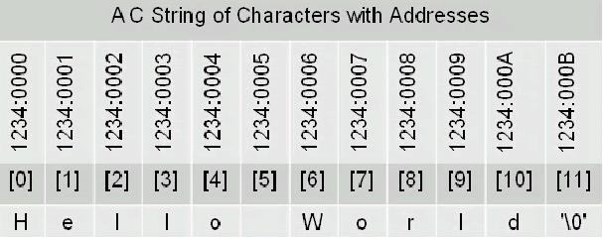
Strings in C
No “Strings” keyword
A string is an array of characters.
OR
char string[] = “hello world”;
char *string = “hello world”;

Slide 7
Significance of NULL character ‘\0’
Compiler has to know where the string ends
‘\0’ denotes the end of string
{program: hello.c}
Some more characters (do $man ascii):
‘\n’ = new line, ‘\t’ = horizontal tab, ‘\v’ = vertical tab, ‘\r’ = carriage return ‘A’ = 0x41, ‘a’ = 0x61, ‘\0’ = 0x00
char string[] = “hello world”;
printf(“%s”, string);

Slide 8
Pointers in C
A char pointer points to a single byte.
An int pointer points to first of the four bytes.
A pointer itself has an address where it is stored in the memory. Pointers are usually four bytes.
* is called the dereference operator
*p gives the value pointed by p
4 i
p
& (ampersand) is called the reference operator
&i returns the address of variable i
int *p; ⬄ int* p;
int i = 4;
p = &i;

Slide 9
More about pointers
int x = 1, y = 2, z[10];
int *ip; /* A pointer to an int */
ip = &x; /* Address of x */
y = *ip; /* Content of ip */
*ip = 0; /* Clear where ip points */
ip = &z[0]; /* Address of first element of z */
{program: pointer.c}

Slide 10
Pointer Arithmetic
A 32-bit system has 32 bit address space.
To store any address, 32 bits are required.
Pointer arithmetic : p+1 gives the next memory location assuming cells are of the same type as the base type of p.

Slide 11
Pointer arithmetic: Valid operations
pointer +/- integer → pointer
pointer - pointer → integer
pointer <any operator> pointer → invalid
pointer +/- pointer → invalid

Slide 12
Pointer Arithmetic: Example
int *p, x = 20;
p = &x;
printf("p = %p\n", p);
printf("p+1 = %p\n", (int*)p+1);
printf("p+1 = %p\n", (char*)p+1);
printf("p+1 = %p\n", (float*)p+1);
printf("p+1 = %p\n", (double*)p+1);
Sample output:
p = 0022FF70
p+1 = 0022FF74
p+1 = 0022FF71
p+1 = 0022FF74
p+1 = 0022FF78
{program: pointer_arithmetic.c}

Slide 13
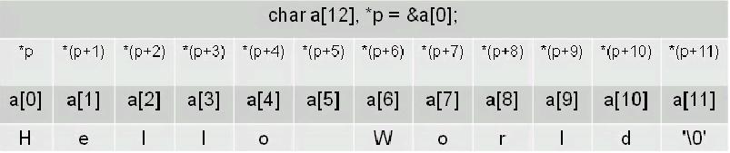
Pointers and arrays
Pointers and arrays are tightly coupled.
char a[] = “Hello World”;
char *p = &a[0];

Slide 14
Pointers and function arguments
Functions only receive copies of the variables passed to them.
{program: swap_attempt_1.c}
A function needs to know the address of a variable if it is to affect the original variable
{program: swap_attempt_2.c}
Large items like strings or arrays cannot be passed to functions either.
What is passed is the address of “hello world\n” in the memory.
printf(“hello world\n”);

Slide 15
2-Dimensional Arrays (Array of arrays)
int d[3][2];
Access the point 1, 2 of the array: d[1][2]
Initialize (without loops):
int d[3][2] = {{1, 2}, {4, 5}, {7, 8}};

Slide 16
More about 2-Dimensional arrays
A Multidimensional array is stored in a row major format.
A two dimensional case:
➔ next memory element to d[0][3] is d[1][0]
d[0][0] | d[0][1] | d[0][2] | d[0][3]
d[1][0] | d[1][1] | d[1][2] | d[1][3]
d[2][0] | d[2][1] | d[2][2] | d[2][3]
What about memory addresses sequence of a three dimensional array?
➔ next memory element to t[0][0][0] is t[0][0][1]

