Slide 1
KPIM · CUSTOMER ANALYTICS
AUTHOR: LINH NGUYEN
01 / 13
RFM SEGMENTATION REVIEW
Winmart Promotional Analysis Report
Where to spend promotional budget, based on the RFM Customer Segmentation dashboard, and an honest look at where the dashboard itself still needs work.
18.36K
8
17.91bn
2020 to 2022
Customers scored
RFM segments
Revenue analyzed
Transaction window

Slide 2
EXECUTIVE SUMMARY
02 / 13
Four things worth acting on this quarter
The numbers describe a promotional program that grew by habit rather than design: one discount type, run on an irregular schedule, offered to everyone instead of the segments most likely to respond.
01
02
One discount type, offered to everyone
23% of revenue sits in at-risk segments
Nearly every discount in the data is the same quantity-based offer. It works: promo orders average 4.7x the basket size of full-price orders, but it goes to every customer equally, not to the segments that respond most.
4,818 customers (26%) are in at-risk segments, holding 4.05bn (23%) of revenue. Cooling-Down customers are the easiest group to win back, and a filter bug means the dashboard currently misses them (p.12).
03
04
Promotions ran in bursts, not on a schedule
We measure sales, not profit
Promo's share of revenue went from 1.1% to 54.3% to 16.1% across three years. Swings that large give customers a reason to wait for the next sale instead of buying steadily.
The model holds discount rates and unit costs, but nothing joins them into a margin view, so a promotion that sold a lot at a loss looks the same as one that made money.

Slide 3
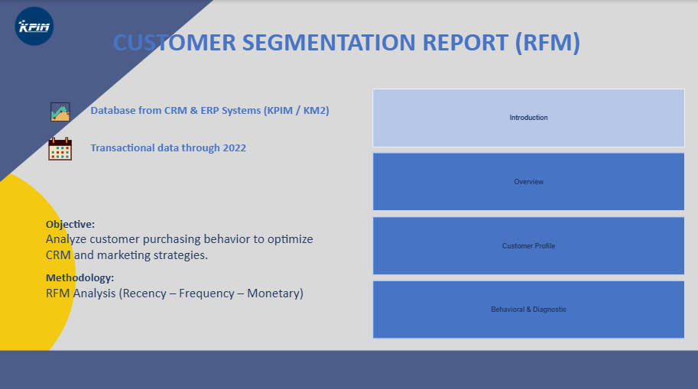
THE DASHBOARD, TAB BY TAB
03 / 13
Introduction
The dashboard opens by stating its scope: CRM and ERP transaction data through 2022, scored on Recency, Frequency, and Monetary value, with one goal: better CRM and marketing decisions.
WHAT'S ON THIS TAB
Source line: KPIM/KM2 CRM & ERP systems, transactional data through 2022.
Stated method: RFM Analysis (Recency, Frequency, Monetary), the same scoring this playbook builds on.
Navigation: four working tabs, Introduction, Overview, Customer Profile, Behavioral & Diagnostic.

Slide 4
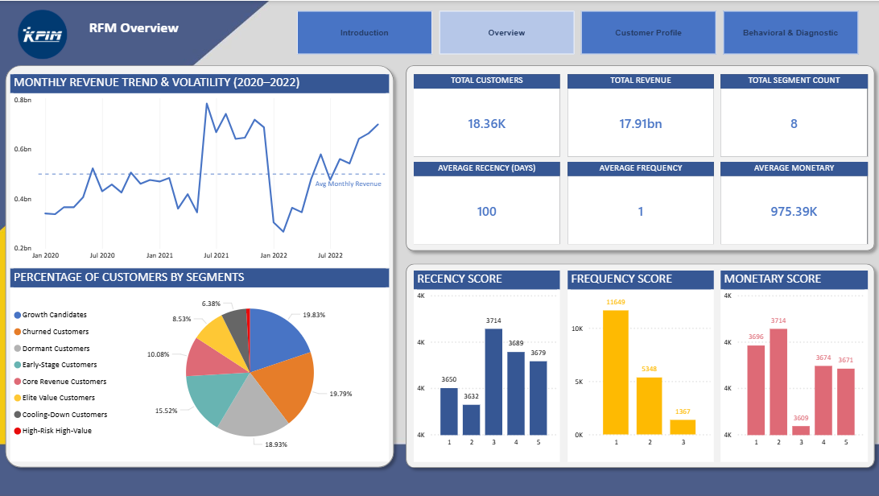
THE DASHBOARD, TAB BY TAB
04 / 13
Overview
The company at a glance: customer base size, average RFM scores, segment mix, and a three-year revenue trend.
READING IT
18.36K customers, 17.91bn revenue, 8 segments, the totals every other tab drills into.
The revenue trend shows a mid-2021 spike that lines up with that year's promotional surge (p.02).
Average Recency (100 days) mixes very different segments into one number, and p.12 explains why that misleads.

Slide 5
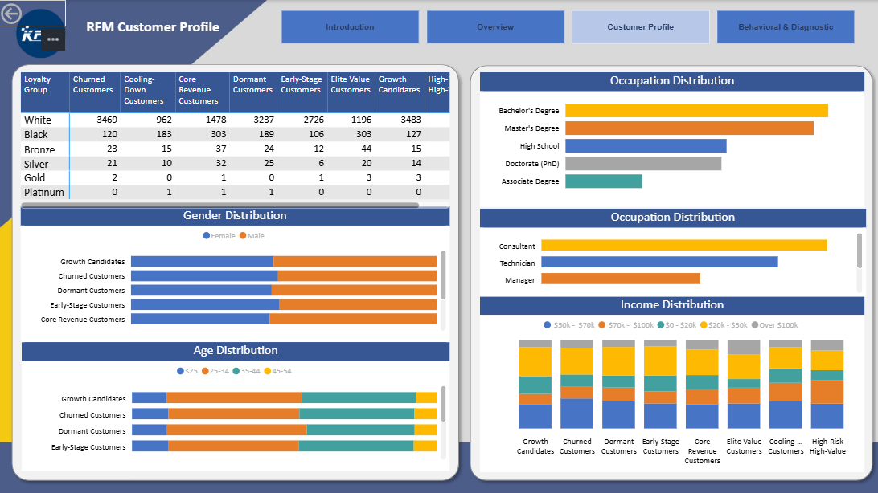
THE DASHBOARD, TAB BY TAB
05 / 13
Customer Profile
Demographics broken out by segment: loyalty tier, gender, age, income, education, and occupation, so a promotion can match who is actually in each segment, not just how they scored.
READING IT
Loyalty-tier crosstab shows almost no one above Silver, Gold and Platinum rows are single digits.
The left "Occupation Distribution" matrix is mislabeled: it's actually education level (p.12).
Gender and Age bars only show 5 of 8 segments before scrolling, also flagged on p.12.

Slide 6
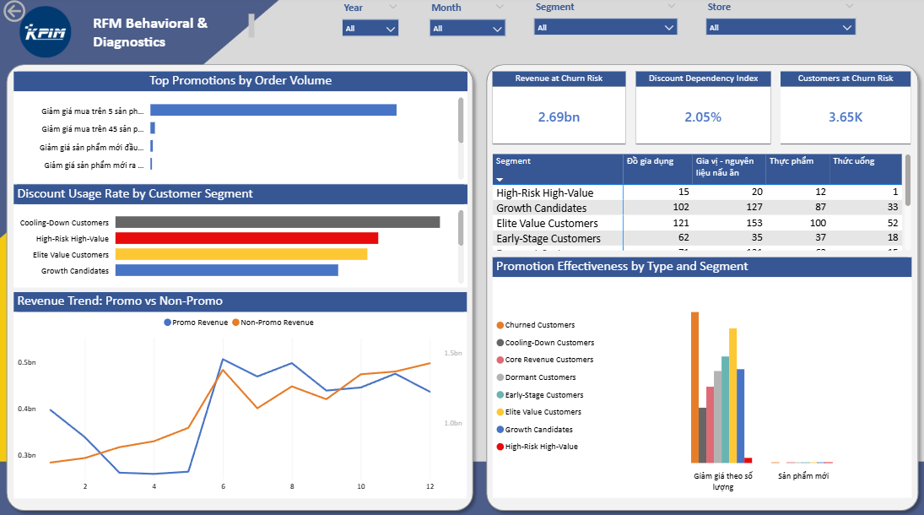
THE DASHBOARD, TAB BY TAB
06 / 13
Behavioral & Diagnostic
The tab most relevant to promotions: discount usage by segment, promo vs. full-price revenue over time, promotion effectiveness, and the churn-risk cards this deck corrects on p.12.
READING IT
"Top Promotions by Order Volume" is almost entirely one bar: the shallow, 2%-off quantity tier.
"Customers at Churn Risk: 3.65K" / "Revenue at Churn Risk: 2.69bn" are both undercounts. See p.12.
Cooling-Down customers show the highest discount usage rate of any segment on this tab, a sign they respond to price.

Slide 7
07 / 13
THE PLAYBOOK
Recommendations

Slide 8
THE SEGMENT MAP
08 / 13
Eight segments, two strategies
Grow and protect the segments already producing revenue; win back the ones going quiet. Promo Dependency combines how often a segment uses discounts with how much of its revenue comes from them.
Segment | Customers | % Base | Revenue | % Rev. | Avg Rec. | Avg Freq. | Avg Mon. | Promo Dep.
Elite Value | 1,566 | 8.5% | 4.33bn | 24.2% | 15d | 2.9 | 2.77M | 1.9%
Core Revenue | 1,852 | 10.1% | 2.35bn | 13.1% | 39d | 2.4 | 1.27M | 1.6%
Growth Candidates | 3,642 | 19.8% | 2.57bn | 14.4% | 27d | 1.2 | 0.71M | 1.9%
Early-Stage | 2,851 | 15.5% | 1.82bn | 10.2% | 63d | 1.0 | 0.64M | 2.0%
Cooling-Down | 1,171 | 6.4% | 1.36bn | 7.6% | 72d | 2.0 | 1.16M | 3.1%
Dormant | 3,476 | 18.9% | 2.40bn | 13.4% | 132d | 1.2 | 0.69M | 1.6%
High-Risk High-Value | 171 | 0.9% | 0.29bn | 1.6% | 123d | 3.0 | 1.68M | 1.1%
Churned | 3,635 | 19.8% | 2.78bn | 15.5% | 250d | 1.1 | 0.76M | 2.6%

Slide 9
RECOMMENDATIONS, GROW & PROTECT
09 / 13
Spend on perks, not discounts
These four segments already produce 62% of revenue. The goal is to grow them further without teaching them to expect a discount.
Elite Value
24.2% of revenue
Core Revenue
2.4 orders avg
They already use the quantity discount more than anyone. Instead of deeper discounts, show how close they are to the next tier ("3 more units unlocks 15% off") and offer perks that don't cut price: early access, free shipping, tier status.
They spend well but order rarely. Cross-sell bundles and "you're close to Elite" volume prompts fit this group better than blanket price cuts.
Growth Candidates
3,642 customers
Early-Stage
39% promo rev. share
The largest healthy segment: recent buyers who haven't ordered often yet. A small, time-limited incentive aimed at a second or third purchase reaches more customers than any other move on this page.
They rarely use promos (5.1% of orders), but when they do, promos make up 39% of their spend. A first-purchase volume offer can build the habit before they drift toward Dormant.

Slide 10
RECOMMENDATIONS, WIN BACK
10 / 13
Win back at-risk customers, cheapest first
4,818 customers holding 4.05bn in revenue, all inactive to different degrees. Work through them in the order below, cheapest recovery first.
Cooling-Down
Dependency 3.1%, highest
Dormant
3,476 customers, largest
Inactive only 72 days, and the most price-responsive segment in the base. They should get the first reactivation offer, and note the dashboard's own risk cards currently miss them entirely (p.12).
After 132 days away, a percentage off alone probably isn't enough. Pair the discount with free shipping or a bundle to make a return order worth the trip.
High-Risk High-Value
1.68M avg spend
Churned
36% promo rev. share
Only 171 customers, but the second-highest average spend and the least discount-dependent. A discount isn't the right tool here. Personal outreach is, and with 171 people that's affordable.
Gone 250 days, but when they did buy, promos drove 36% of their spend, the second highest of any segment. Test discount depth on a small sample before writing them off.

Slide 11
FIX THE MECHANIC ITSELF
11 / 13
Before targeting better, run it better
Four changes to how promotions are planned and measured, regardless of which segment they target.
01
Stabilize the calendar
Promo's share of revenue swung from 1.1% to 54.3% to 16.1% across three years. A planned, steady schedule gives customers less reason to hold out for the next big sale.
02
Retire or relaunch "new product" offers
33 orders on an average 17% discount does not cover its cost. Either drop the offer or re-test its placement and messaging before spending more on it.
03
Show customers the deeper discount tiers
91% of quantity-discount orders stop at the shallowest tier (11-14 units, 2% off). The 5%, 10%, 15% and 20% tiers already exist but barely get used. Telling customers how close they are to the next tier costs little to try.
04
Measure profit, not just revenue
Discount percent and unit cost are both already in the model. Join them, and "promotion effectiveness" can report profit contribution instead of just sales.

Slide 12
WHERE THE DASHBOARD STILL FALLS SHORT
12 / 13
Fix the model before trusting the KPI cards
Each of these can be verified against the dashboard's own DAX and data, and two of them change numbers a viewer would act on.
CONFIRMED BUG
DATA LIMITATION
MEASUREMENT GAP
Churn-risk cards undercount by 1,171 customers
9 of 16 promotions predate the data
Effectiveness is revenue, not profit
The "at-risk" filter looks for "Cooling Down Customers" (no hyphen); the real segment name has a hyphen. The mismatch silently drops the whole segment.
Their validity windows run 2010-2013, but every transaction on record is from 2020-2022. "Promotion Effectiveness by Type" really covers 2 promotion types, not the full catalog it implies.
unit_cost and discount_percent both exist in the model, but no measure combines them, so a deep, unprofitable discount looks identical to an efficient one.
Shown 3.65K/2.69bn -> actual 4,818/4.05bn
MEASUREMENT GAP
PRESENTATION SLIP
One average hides eight different segments
A mislabeled matrix, and clipped visuals
"Average Recency: 100 days" averages Elite Value (15 days) with Churned (250 days). No real customer looks like that number until a segment filter is applied.
Customer Profile shows two tables titled "Occupation Distribution", but the left one is actually education level. The Gender/Age charts and segment table also scroll internally, hiding rows in a static export.

Slide 13
NEXT STEPS
13 / 13
Three moves, in this order
Fix the measurement first: every recommendation in this deck depends on trusting the segment numbers behind it.
1
2
3
Fix the naming typo in the At-Risk measures. It's a one-line DAX change, and the KPI cards become accurate immediately.
Pilot a win-back offer with Cooling-Down customers, the most price-responsive group and the cheapest to recover, and measure the lift before extending it to Dormant.
Add cost data to the promo measures so the next version of the dashboard reports profit, not just revenue.
RFM Customer Segmentation Report: Promotional Analysis
Source: RFM_Updated_2.pbix

