Slide 1

20XX
创意民宿主题动态模板
Creative Home Theme
用于商务报告 / 工作总结 / 项目介绍 / 投资融资 / 商业计划书 /

Slide 2
创意民宿
Part 01
Creative home theme
Part 02
Creative home theme
CONTENT
Part 03
Creative home theme
Part 04
Creative home theme

Slide 3
创意民宿
Part
01
Creative home theme

Slide 4
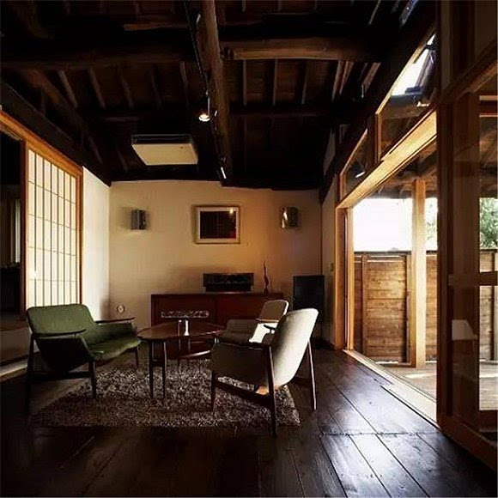
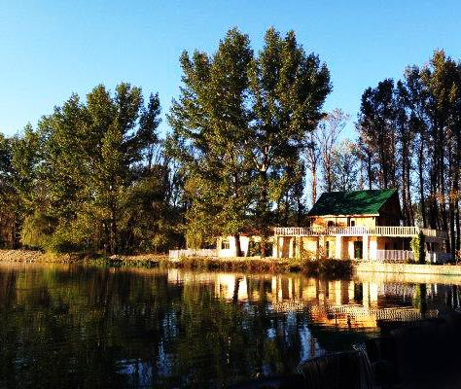
Creative home theme
We’re here to connect people to higher education in the UK. We’re a people-focused business and everything we do is designed to help applicants reach their potential. It’s a great feeling.
We’re here to connect people to higher education in the UK. We’re a people-focused business and everything we do is designed to help applicants reach their potential. It’s a great feeling.

Slide 5
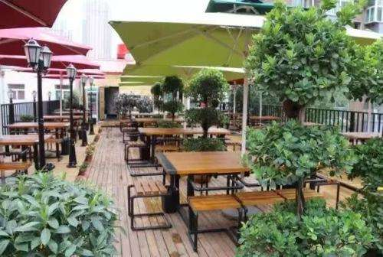
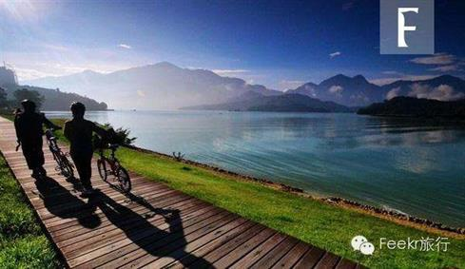
Creative home theme
We’re here to connect people to higher education in the UK. We’re a people-focused business and everything we do is designed to help applicants reach their potential. It’s a great feeling.

Slide 6
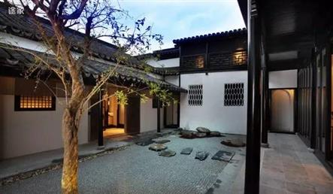
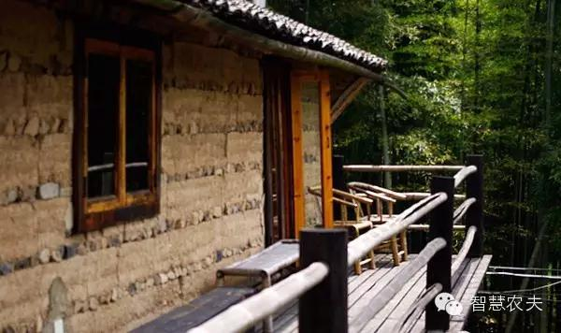
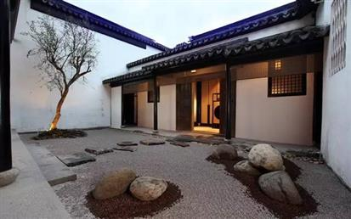
We’re here to connect people to higher education in the UK. We’re a people-focused business and everything we do is designed to help applicants reach their potential. It’s a great feeling.
Creative home theme
We’re here to connect people to higher education in the UK. We’re a people-focused business and everything we do is designed to help applicants reach their potential. It’s a great feeling.

Slide 7
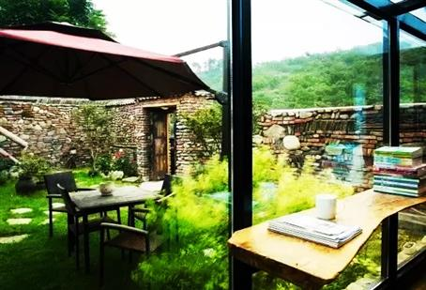
Creative home theme
We’re here to connect people to higher education in the UK. We’re a people-focused business and everything we do is designed to help applicants reach their potential. It’s a great feeling.
1
Creative home theme
2
We’re here to connect people to higher education in the UK. We’re a people-focused business and everything we do is designed to help applicants reach their potential. It’s a great feeling.
3
Creative home theme
We’re here to connect people to higher education in the UK. We’re a people-focused business and everything we do is designed to help applicants reach their potential. It’s a great feeling.

Slide 8
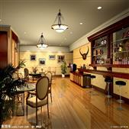

Creative home theme
We’re here to connect people to higher education in the UK. We’re a people-focused business and everything we do is designed to help applicants reach their potential. It’s a great feeling.
Creative home theme
We’re here to connect people to higher education in the UK. We’re a people-focused business and everything we do is designed to help applicants reach their potential. It’s a great feeling.

Slide 9


Creative home theme
Creative home theme
We’re here to connect people to higher education in the UK. We’re a people-focused business and everything we do is designed to help applicants reach their potential. It’s a great feeling.
We’re here to connect people to higher education in the UK. We’re a people-focused business and everything we do is designed to help applicants reach their potential. It’s a great feeling.

Slide 10
创意民宿
Part
02
Creative home theme

Slide 11

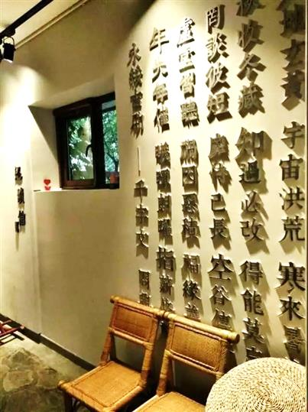
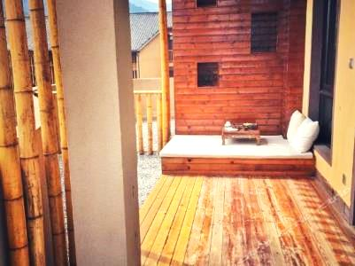
Creative home
theme
We’re here to connect people to higher education in the UK. We’re a people-focused business and everything we do is designed to help applicants reach their potential. It’s a great feeling.

Slide 12
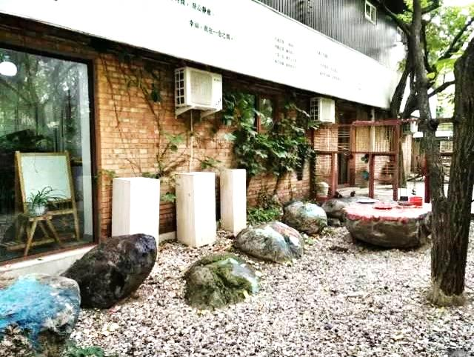
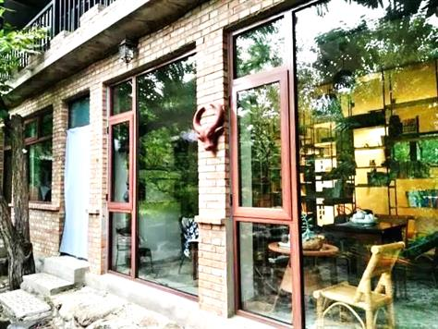
Creative home theme
We’re here to connect people to higher education in the UK. We’re a people-focused business and everything we do is designed to help applicants reach their potential. It’s a great feeling.

Slide 13
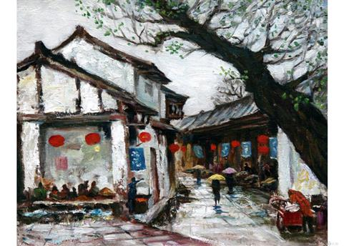
Creative home theme
Creative home theme
We’re here to connect people to higher education in the UK. We’re a people-focused business
Creative home theme
We’re here to connect people to higher education in the UK. We’re a people-focused business
Creative home theme
We’re here to connect people to higher education in the UK. We’re a people-focused business

Slide 14
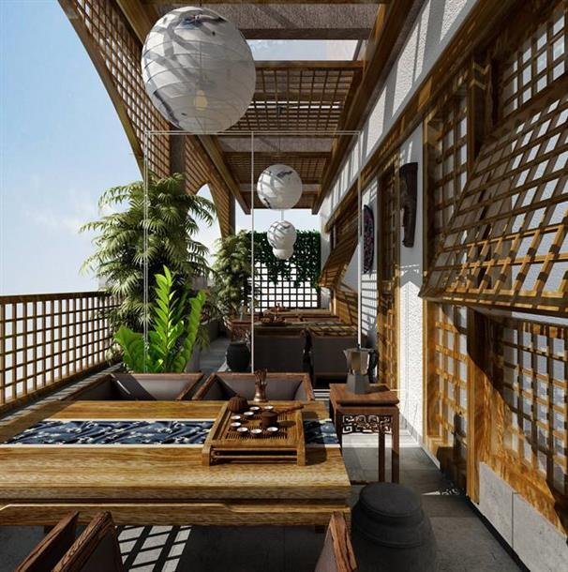
1
Creative home theme
We’re here to connect people to higher education in the UK. We’re a people-focused business and everything we do is designed to help applicants reach their potential. It’s a great feeling.
2
Creative home theme
We’re here to connect people to higher education in the UK. We’re a people-focused business and everything we do is designed to help applicants reach their potential. It’s a great feeling.
3
Creative home theme
We’re here to connect people to higher education in the UK. We’re a people-focused business and everything we do is designed to help applicants reach their potential. It’s a great feeling.

Slide 15
Creative home theme
Creative home theme
We’re here to connect people to higher education in the UK. We’re a people-focused business
项目1 | 项目2 | 项目3 | 项目4 | 项目5
xx | xx | xx | xx | xx
xx | xx | xx | xx | xx
xx | xx | xx | xx | xx
xx | xx | xx | xx | xx
xx | xx | xx | xx | xx
xx | xx | xxx | xx | xx
xx | xx | xx | xx | xx
xx | xx | xx | xx | xx
xx | xx | xx | xx | xx
xx | xx | xx | xx | xx
xx | xx | xx | xx | xx

Slide 16
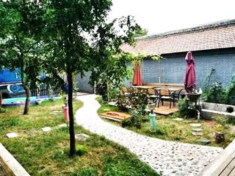
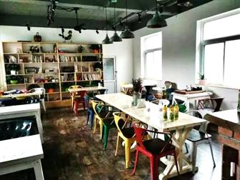
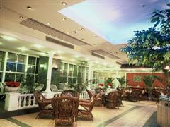
Creative home theme
Creative home theme
78
93
We’re here to connect people to higher education in the UK. We’re a people-focused business and everything we do is designed to help applicants reach their potential. It’s a great feeling.
We’re here to connect people to higher education in the UK. We’re a people-focused business and everything we do is designed to help applicants reach their potential. It’s a great feeling.

Slide 17
创意民宿
Part
03
Creative home theme

Slide 18
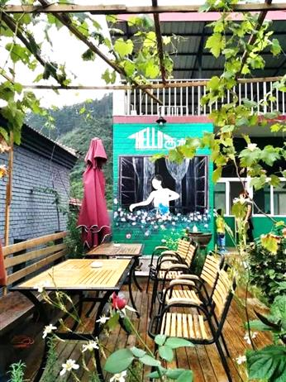
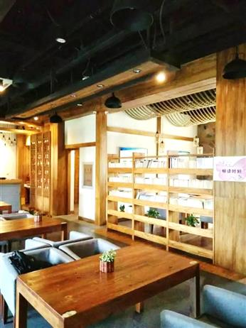
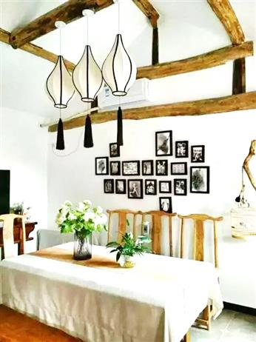
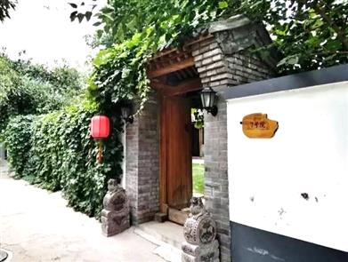
Creative home theme
We’re here to connect people to higher education in the UK. We’re a people-focused business and everything we do is designed to help applicants reach their potential. It’s a great feeling.
Creative home theme
We’re here to connect people to higher education in the UK. We’re a people-focused business and everything we do is designed to help applicants reach their potential. It’s a great feeling.

Slide 19
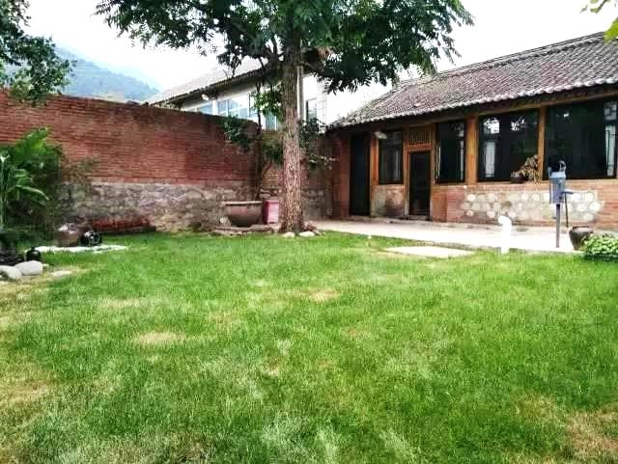
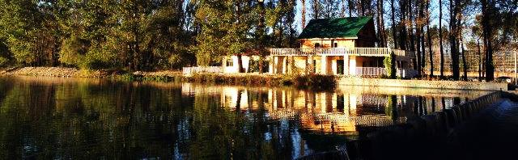
Creative home theme
We’re here to connect people to higher education in the UK. We’re a people-focused business and everything we do is designed to help applicants reach their potential. It’s a great feeling.

Slide 20
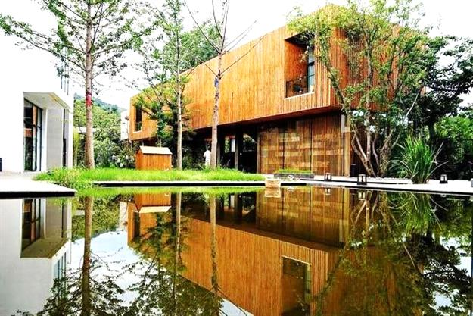
Creative home
theme
A
C
Creative home
theme
We’re here to connect people to higher education in the UK. We’re a people-focused business and everything we do is designed to help applicants reach their potential. It’s a great feeling.
We’re here to connect people to higher education in the UK. We’re a people-focused business and everything we do is designed to help applicants reach their potential. It’s a great feeling.
B
Creative home theme
We’re here to connect people to higher education in the UK. We’re a people-focused business and everything we do is designed to help applicants reach their potential. It’s a great feeling.

Slide 21
1
2
3
Creative home
theme
Creative home
theme
Creative home
theme
We’re here to connect people to higher education in the UK. We’re a people-focused business and everything we do is designed to help applicants reach their potential. It’s a great feeling.
We’re here to connect people to higher education in the UK. We’re a people-focused business and everything we do is designed to help applicants reach their potential. It’s a great feeling.
We’re here to connect people to higher education in the UK. We’re a people-focused business and everything we do is designed to help applicants reach their potential. It’s a great feeling.

Slide 22

Creative home
theme
Creative home
theme
We’re here to connect people to higher education in the UK. We’re a people-focused business and everything we do is designed to help applicants reach their potential. It’s a great feeling.
We’re here to connect people to higher education in the UK. We’re a people-focused business and everything we do is designed to help applicants reach their potential. It’s a great feeling.
1
2
We’re here to connect people to higher education in the UK. We’re a people-focused business and everything we do is designed to help applicants reach their potential. It’s a great feeling.
We’re here to connect people to higher education in the UK. We’re a people-focused business and everything we do is designed to help applicants reach their potential. It’s a great feeling.

Slide 23
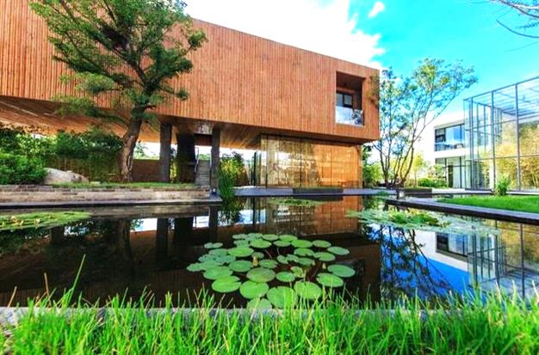
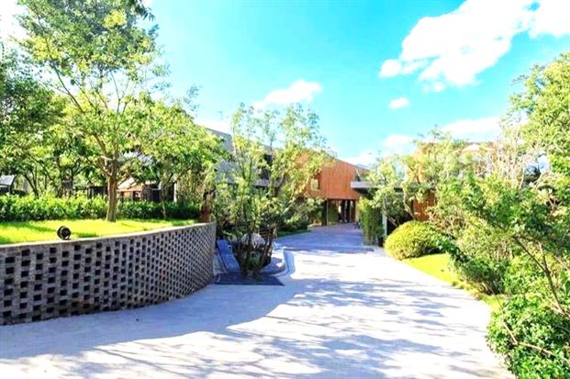
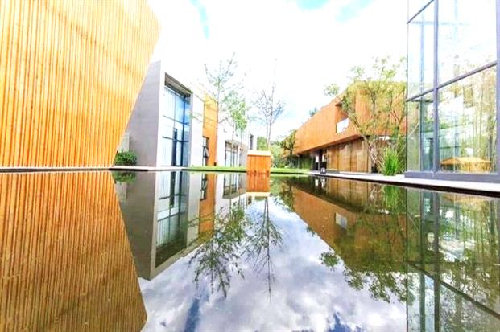
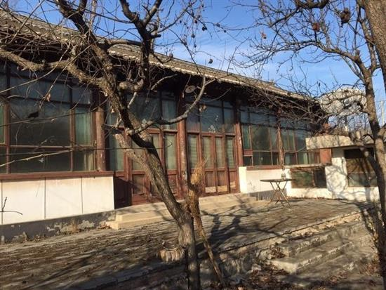
Creative home
Creative home
Creative home
Creative home
1
2
3
4
We’re here to connect people to higher education in the UK. We’re a people-focused business and everything we do is designed to help applicants reach their potential. It’s a great feeling.

Slide 24
创意民宿
Part
04
Creative home theme

Slide 25
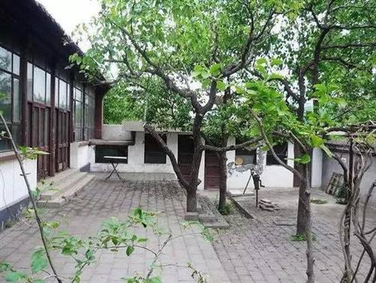
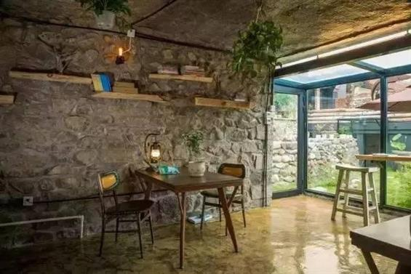
We’re here to connect people to higher education in the UK. We’re a people-focused business and everything we do is designed to help applicants reach their potential. It’s a great feeling.
Creative home

Slide 26
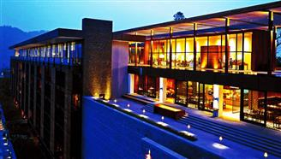

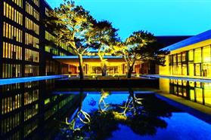
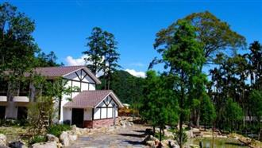

Creative home
Creative home
We’re here to connect people to higher education in the UK.
We’re here to connect people to higher education in the UK. We’re a people-focused business and everything we do is designed to help applicants reach their potential. It’s a great feeling.

Slide 27
Creative
home
Creative
home
Creative
home
We’re here to connect people to higher education in the UK. We’re a people-focused business and everything we do is designed to help applicants reach their potential. It’s a great feeling.
We’re here to connect people to higher education in the UK. We’re a people-focused business and everything we do is designed to help applicants reach their potential. It’s a great feeling.
We’re here to connect people to higher education in the UK. We’re a people-focused business and everything we do is designed to help applicants reach their potential. It’s a great feeling.
We’re here to connect people to higher education in the UK. We’re a people-focused business and everything we do is designed to help applicants reach their potential. It’s a great feeling.

Slide 28
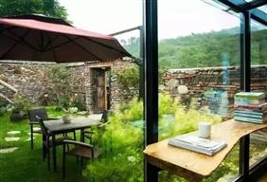
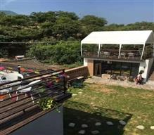
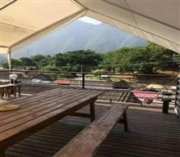
Creative home
Creative home
Creative home
We’re here to connect people to higher education in the UK. We’re a people-focused business and everything we do is designed to help applicants reach their potential. It’s a great feeling.
We’re here to connect people to higher education in the UK. We’re a people-focused business and everything we do is designed to help applicants reach their potential. It’s a great feeling.
We’re here to connect people to higher education in the UK. We’re a people-focused business and everything we do is designed to help applicants reach their potential. It’s a great feeling.

Slide 29

1
2
Creative home
Creative home
We’re here to connect people to higher education in the UK. We’re a people-focused business and everything we do is designed to help applicants reach their potential. It’s a great feeling.
We’re here to connect people to higher education in the UK. We’re a people-focused business and everything we do is designed to help applicants reach their potential. It’s a great feeling.

Slide 30
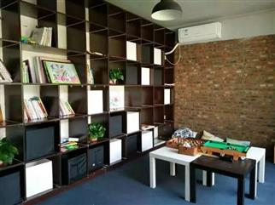
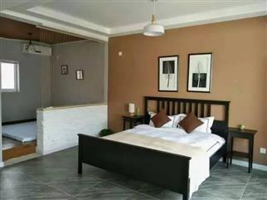
Creative home
Creative home
Creative home
We’re here to connect people to higher education in the UK. We’re a people-focused business and everything we do is designed to help applicants reach their potential. It’s a great feeling.
We’re here to connect people to higher education in the UK. We’re a people-focused business and everything we do is designed to help applicants reach their potential. It’s a great feeling.
We’re here to connect people to higher education in the UK. We’re a people-focused business and everything we do is designed to help applicants reach their potential. It’s a great feeling.

Slide 31
感谢下载

