Slide 1



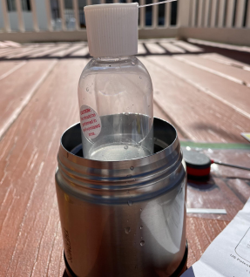
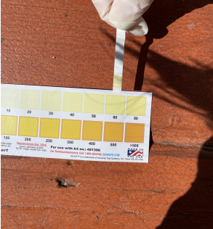
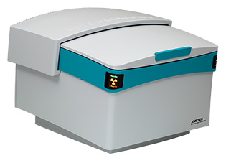
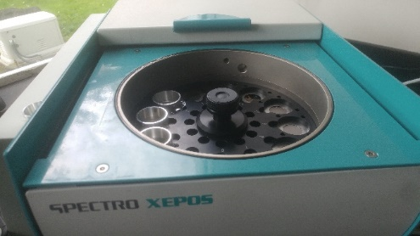
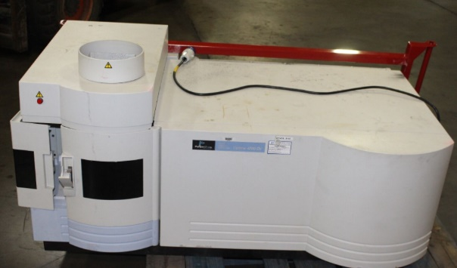
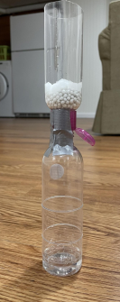
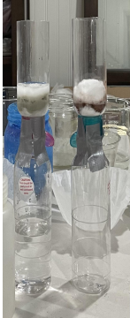
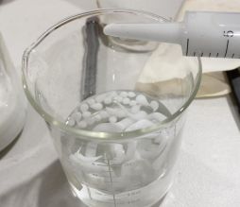
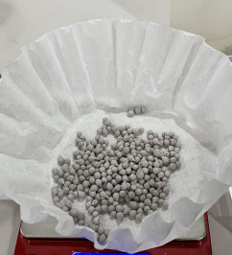
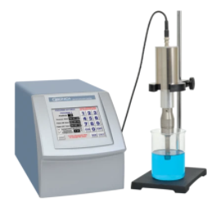
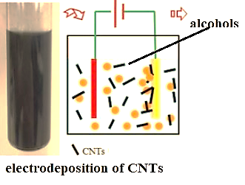
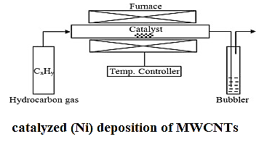
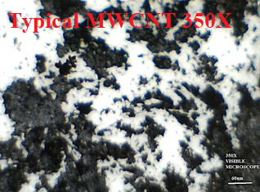
Laboratory exercises in arsenic remediation for engineering and environmental sciences
Linh Nguyenª, James Masi^{b}, ª Former student, Deering H.S. (Now MIT Engineering), ^{b}Depts. of Engineering & Env. Sci., University of Southern Maine, Gorham, ME 04038
2021 ASEE NE Conference, October 21-22. Worcester Polytechnic Institute, Worcester, MA
(Work in Progress)
Abstract/Objectives-
The scarcity of clean water hinders the public health and economic productivity of communities around the world. The quality of water sources is threatened by harmful pollutants, of which, arsenic contamination acts as the most significant concern (WHO, 2019). Although arsenic naturally occurs within water, historical and current industrial use of arsenic have further contributed to widespread soil and groundwater contamination, which exacerbates issues of improper sanitation and safety in drinking water globally. Moreover, prolonged arsenic exposure can lead to acute public health concerns, such as skin damage, circulation problems, and eventually even cancer. Due to the costly price of remediation treatments, arsenic contamination disproportionately threatens the health and equality for marginalized communities who have limited resources. Thus, the rationale of this research is to find a cost-efficient and effective sorbent that can remove arsenic from water to meet the lower-level arsenic drinking water standards, ensuring both an affordable and equitable alternative to commercialized sequestration of arsenic from water. Recent studies have shown that carbon nanotube (CNT) technology has been successful in water remediation methods due to their inertness, porous structure, and affinity for pollutants; however, an added support can be advantageous as it enhances immobilization and high surface area. The main sorbent medium is calcium alginate bead composites embedded with carbon nanotubes. Modifications of the sorbent bead composite include impregnating previously tested adsorption materials such as various metal oxides (Iron Oxide and Titanium Oxide) in order to increase the arsenic binding spots. The sorbents are deployed through an inexpensive column filtration system that enables arsenic adsorption from a local polluted water source in order to stimulate real world operations of the tested treatment system. The feasibility of the studied technologies depends heavily on site-specific factors and final treatment, thus remedy decisions require further analysis, expertise, and possibly treatability studies. CNT fabrication methods, sorbent incorporation, analysis methods, and analyses before and after filtration are presented. The body of the poster will describe the research as a series of laboratory exercises.
Corresponding Author: james.masi@maine.edu
Absorbent composite
The adsorbent was composed of carbon nanotubes housed within calcium alginate bead composites. Additional modifications of the sorbents include impregnating the sorbent bead composite with various metal oxides, such as iron oxide and/or titanium dioxide. Calcium alginate beads are a low cost, water compatible, and carbon nanotube compatible substance.
Calcium Alginate
Because of the microscopic size of CNTs, the CNT adsorbents alone require additional filtration systems such as syringe filters in order to remove the sorbents after absorption of the pollutant. This contributes to issues of cost and sustainability. To compensate for this issue, the CNTs are housed within an inexpensive matrix derived from algae, Calcium Alginate. In this study, Calcium Alginate was used due to its low cost, high water permeability, and abundance of raw materials in the environment [7].
Metal Oxides
In order to increase the arsenic absorption characteristics of the adsorbents, the impregnation of various metal oxides will be employed.
Iron-Oxide
Iron-based sorbents have the capability to oxide arsenite (As III) to arsenate (As V). Arsenite is a form of Arsenic that is common within well water and is more prone to mobilization. Oxidizing Arsenite to Arsenate will increase the Arsenic absorbency because Arsenate is easier to remove than Arsenite [8]. In addition, Iron-based sorbents have a strong affinity for Arsenic due to their electrostatic attractions, making it a suitable choice to remove Arsenic from well water. These sorbents are inexpensive, which means mass production of these sorbents can be scaled up and distributed to under-resourced communities. Iron-oxide naturally occurs within the environment in the form of rust.
Titanium Dioxide
Previous studies have shown that Titanium Dioxide is a suitable candidate for arsenic absorption due to its low toxicity, chemical and physical stability, easy preparation, low-cost, environment friendly and high affinity for both inorganic forms of As (arsenite and arsenate) [3, 11] Attempts have also been made to immobilize fine TiO₂ particles on supporting materials like chitosan beads or to granulate it to facilitate its separation from water.
Column Filtration Method
In this study, both column filtration and batch filtration were investigated. Both filtration methods used the same As contaminated stock solution. The column filter body was made out of a travel-sized shampoo bottle with its bottom cut off (1cm) in order to allow water to run through the bottle as shown in figure. In the column filter, the tested adsorbent was kept between sandwiched layers of cotton balls for stabilization. The column filter was taped to a 50mL plastic vial to collect the filtrate as the As contaminated water freely passed through the column filter with the adsorbent layers inside. Each tested adsorbent (Calcium Alginate beads, CNT beads, TiO₂-CNT beads, and Fe₂O₃-CNT beads) had its own column filter to avoid cross-contamination.
Removal of Adsorbent beads
After the batch adsorption experiments, the sorbent beads were removed from the filtrate through pouring the filtrate over filter paper, collecting the filtrate in a 50mL vial. The resultant was tested for arsenic content by both colorimetric strips and XRF (shown below). Note: the colorimetric strips give neither the resolution nor the accuracy of the XRF. More detailed work is needed in the future.
Color strips Trial 2 XRF
Initial Arsenic 150ppb 150ppb 165ppb SolutionControl)
Calcium 150ppb 150ppb 148ppb Alginate (CA)
beads
CNT-CA beads 125ppb 150ppb 115ppb (0.35g CNT)
Background/Arsenic Removal and Treatment
In areas where the drinking water contains unsafe levels of arsenic, the immediate concern is finding a safe source of drinking water. There are two main options: Finding a new safe source or removing arsenic from the contaminated source. If an arsenic safe water source cannot be established, the short-term goal is to reduce arsenic levels. There are several methods available for removal of arsenic from water. [6] The following important methods are listed below:
Oxidation
Coagulation, precipitation and filtration
Adsorption (sorptive filtration)
Ion exchange
Membrane techniques
Since the purpose of this study was to choose a relatively simple, safe, and potentially inexpensive method to remove and treat arsenic contaminated water, the Adsorption and hybrid filtration methods have been chosen.
Fe-CNT-CA 50ppb 60ppb 50ppb beads
(20wt%Fe +
0.35g CNT)
Ti-CNT-CA beads 80ppb 100ppb 80ppb
0.35g CNT)
Fe/TiO2-CNT-CA 80ppb 70ppb 68ppb (beads10wt%Fe + 10wt%Ti)
Conclusion
With the impregnation of 0.35g of CNTs within Calcium Alginate beads, the arsenic concentration was reduced by 17% (~30%). The arsenic removal was accredited to the CNTs because the Calcium Alginate beads with no impregation revealed to be ineffective at removing arsenic from the polluted well water sample, which showed that the alginate acted as a supporting material to the CNTs as opposed to a competing material for arsenic removal. Furthermore, the studies of doping the CNT-Calcium Alginate beads with different metal oxides was shown to enhance the absorption characteristics of the sorbents. At just 20wt% , the CNT-Calcium Alginate beads doped with Titanium Dioxide was able to remove upwards of 47% of the arsenic and the beads doped with Iron Oxide at 20wt% was able to remove up to 66% (69%)of the arsenic. The beads doped with both Iron Oxide and Titanium dioxide showed absorption capacities lower than the Fe-CNT-Calcium Alginate beads, which is possibly due to the lower wt% of Fe, limiting the binding sites available for the arsenic. This study conveyed that CNT applications do have high arsenic absorption characteristics when combined with different metal oxides. Further, more detailed studies will test different weight percent of metal oxides to enhance absorption. The research findings of CNT-based sorbents can be a baseline for future work and scaled-up sorbent productions for commercial use and within water-remediation systems. These exercises are safe, understandable, environmentally and pedagogically sound.
Heat bath colorimetric AS strips SPECTROS XEPOS XRF closed(L) & open (R) ICP-OES
Materials
The materials employed in the absorption/filtration of the arsenic in water are critically important from both the efficacy and cost points of view. The following is a list and description of the materials, their fabrication, complexity, and their cost.
Preparing the Column Filters
To bridge the issues of accessibility to treatment systems, the column filters were made from easily available house-hold materials. The column filter body was made out of a travel-sized shampoo bottle with its bottom cut off (1cm) in order to allow water to run through the bottle as shown in figure below. In the column filter (below), the tested adsorbent was kept between sandwiched layers of cotton for stabilization. The column filter was taped to a 50mL plastic vial to collect the filtrate as the Arsenic contaminated water freely passed through the column filter with the adsorbent layers inside. As contaminated water ran freely through the layer of cotton and adsorbent material(s) of the column filter, filtered water was collected in a 50mL plastic vile that was taped to the column. The filtrates collected from the experimental investigation were analyzed by both the colorimetric strips and by the XRF instrumentation. Each filtration cycle consisted of 50mL of Arsenic contaminated water and 1g of adsorbent.
Filter apparatus Alginate beads Impregnated
Carbon Nanotubes, MWCNT
Carbon Nanotubes (CNT), derived from graphene sheets rolled into cylindrical tubes, have been an emerging technology for absorption of heavy metals from water. [7] Their chemical properties provide exceptional sorption characteristics toward many organic compounds and inorganic compounds [5].
In particular, the sidewall functionalization and surface modifications of CNTs make them a suitable candidate to act as a support phase for water remediation treatments [6]. Their cost is high ($2-$15/gram, dependent on size and quality). [7] The multiwalled carbon nanotubes (MWCNT) can be produced by a number of techniques, as listed below:
Plasma arc method (graphite rods w/wo hydrocarbon gas)
Laser impact method
Catalyzed (usually Ni catalyst) CVD method
Ball milling
Electrochemical deposition [8]
A mixture of 40 vol% methanol (CH₃OH) and 60 vol% benzyl alcohol (C₆H₅CH₂OH) was used as the electrolyte. The sizes of counter and working electrodes were about 2.5 cm. The distance between cathode and anode was kept at 5 mm, which was precisely controlled by a SiC spacer. The potential difference applied between the anode and cathode was kept nominally at 100-1000 V. The depositions were carried out at room temperature and magnetic stirring was employed to achieve a uniform distribution of carbonaceous/MWCNT deposit on the cathode. No deposits were found on the anode.
Flame synthesis (with hydrocarbon gas) [9]
Ultrasonic of graphite rods [10]
Due to the complexity, safety considerations, temperature of treatment, and cost of the process, equipment, and lab space commonly available, 1. catalyzed (usually Ni catalyst) CVD method, 2. Electrochemical deposition using 40% methanol and 60% benzyl alcohol [8], and 3. Ultrasonic sonication of graphite rods [10] were chosen as methods for production of the MWCNTs.
References
Introduction
https://www.who.int/news-room/fact-sheets/detail/arsenic
https://news.yale.edu/2021/02/01/study-shows-consequences-arsenic-tainted-well-water-across-bangladesh
Bissen Frimmel Arsenic 2-21 Arsenic – a Review Part I: Occurrence, Toxicity, Speciation, Mobility
Arsenic Removal Using Multiwall Carbon Nanotubes
https://sci-hub.se/https://ieeexplore.ieee.org/document/8636691
Proven Alternatives for Aboveground Treatment of Arsenic in Groundwater
Raju Shrestha, Environment and Public Health Organisation, ENPHO Dorothee Spuhler (seecon international gmbh), 2019
“Nanotechnology: Basic Science and Emerging Technologies”, M. Wilson et al, Chapman and Hall (2002) ISBN 1­58488­339­1
“Synthesis of carbon nanotubes by electrochemical deposition at room temperature”, Dan Zhou et al., 2006 Carbon 44, 1013-1024,
Yuan, L. M., Saito, K., Pan, C. X., Williams, F. A., & Gordon, A. S. (2001). Nanotubes from methane flames. Chemical Physics Letters, Vol. 340, No. 3-4, pp. 237-241, ISSN 0009- 2614
https://www.youtube.com/watch?v=gAEulvRS1mI
https://www.sciencedirect.com/science/article/abs/pii/S0304389412002592#fig0005
Making Adsorbent Beads
The base of the adsorbent beads consisted of MWCNTs immobilized within calcium alginate gel beads. In order to test for absorbance of arsenic with regards to the calcium alginate gel, a control of calcium alginate beads with no impregnation of other nanomaterials was made. Calcium alginate–MWCNTs composite beads (CaAlg/MWCNTs) were prepared by adding 0.10g of MWCNTs into 2-wt.% alginate solution (1g sodium alginate and 50mL deionized water). The resulting mixture was dripped into a 0.5 M calcium chloride solution with a syringe. The beads were aged in the calcium solution overnight, washed and stored in distilled water. For the MWCNT-metal oxide beads, the previous procedure was followed except a suspension of the metal oxide was added to the alginate solution for a 20wt% metal loading. For the titanium dioxide beads, 0.15g was added, while 0.1g was added for the Fe₂O₃ beads. The mixture was uniformly mixed with a magnetic stirrer for 4 h. The mixture contained sodium alginate and metal in a proportion of 8:2 (2 g alginate/0.34 g Fe) for 20 wt% iron loading. The produced hydrous iron oxide was immobilized using alginate with calcium ion via entrapment. Briefly, 3 wt% alginate gel matrix was prepared. A suspension of hydrous iron oxide precipitate containing 0.34 g of Fe was added into the 100 mL of the alginate gel matrix, and then DI water was added until the final volume of the mixture was 150 mL. The mixture was uniformly mixed with a magnetic stirrer for 4 h. The mixture contained sodium alginate and iron in a proportion of 9:1 (3 g alginate/0.34 g Fe) for 10 wt% iron loading.
Batch Filtration Method
Batch adsorption experiments were carried out in 300mL beakers for each adsorbent type. The same amount of the adsorbent beads were added to 50mL of the As contaminated water, and a magnetic stirrer was used to stir the beads inside the water for varying amounts of time (30min, 1 h, 2 h) to observe the effect of adsorbent contact time on arsenic absorption. The stirring speed was kept constant for all filtration cycles.
sonicator
Data/Formulation/Methodology
Water Sample
In order to test real world applications of remediating arsenic contaminated water, the water source was local well water in Standish, Maine. Due to the pH of the water, there are limitations within this study with respect to arsenic absorption efficacy of the adsorbents at higher arsenic concentrations. An x-ray fluorescence apparatus was used to measure the arsenic concentration of the filtrate and the control solutions of the water sample.
1. Microwave heating of the arsenic testing bottle and using a thermometer to make sure the water sample is 27-28°C were the first steps in the process. 2. Microwave distilled water to match the temperature range of 27-28°C to make a warm water bath. 3. Place the water testing bottle in a thermos and use the color test kit (below, L) to measure the arsenic concentration of the water sample. This test kit was the first test used prior to the x-ray fluorescence testing (below, R)
.
Water bottle sample Arsenic color test kit Spectros XEPOS XRF closed (L) & open (R)
Carbon Nanotubes, MWCNT
Carbon Nanotubes (CNT), derived from graphene sheets rolled into cylindrical tubes, have been an emerging technology for absorption of heavy metals from water. [7] Their chemical properties provide exceptional sorption characteristics toward many organic compounds and inorganic compounds [5].
In particular, the sidewall functionalization and surface modifications of CNTs make them a suitable candidate to act as a support phase for water remediation treatments [6]. Their cost is high ($2-$15/gram, dependent on size and quality). [7] The multiwalled carbon nanotubes (MWCNT) can be produced by a number of techniques, as listed below:
Plasma arc method (graphite rods w/wo hydrocarbon gas)
Laser impact method
Catalyzed (usually Ni catalyst) CVD method
Ball milling
Electrochemical deposition [8]
A mixture of 40 vol% methanol (CH₃OH) and 60 vol% benzyl alcohol (C₆H₅CH₂OH) was used as the electrolyte. The sizes of counter and working electrodes were about 2.5 cm. The distance between cathode and anode was kept at 5 mm, which was precisely controlled by a SiC spacer. The potential difference applied between the anode and cathode was kept nominally at 100-1000 V. The depositions were carried out at room temperature and magnetic stirring was employed to achieve a uniform distribution of carbonaceous/MWCNT deposit on the cathode. No deposits were found on the anode.
Flame synthesis (with hydrocarbon gas) [9]
Ultrasonic sonication of graphite rods [10]
Due to the complexity, safety considerations, temperature of treatment, and cost of the process, equipment, and lab space commonly available, 1. catalyzed (usually Ni catalyst) CVD method, 2. Electrochemical deposition using 40% methanol and 60% benzyl alcohol [8], and 3. Ultrasonic sonication of graphite rods [10] were chosen as methods for production of the MWCNTs.
Notes:
Engineering department logo

