Slide 1


Quantitative BOLD modeling of brain oxygenation during vasodilation
ISMRM-Endorsed Workshop – Quantitative Imaging
Linh Le
UC Davis

Slide 2
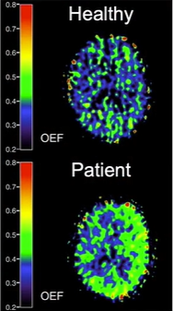
Oxygen Extraction Fraction
¹⁵O PET OEF measurements
OEF is a measurement of oxygen consumed by metabolism
Function of perfusion and oxygen metabolism
Can be combined with perfusion to measure oxygen metabolism
Arterial-venous difference in blood oxygen saturation
OEF is dimensionless
Healthy resting brain range: 0.3-0.4
Bremmer JP, et al. Mol. Imaging Biol. 2011; 13:759-768

Slide 3
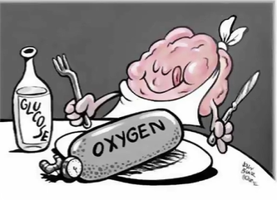
Oxygen Extraction Fraction
OEF consumption in brain
Altered during disease/activity
Current benchmark
Triple oxygen PET
Highly specialized, invasive, expensive and difficult to perform
Alternative quantitative technique
Clinical applicable

Slide 4
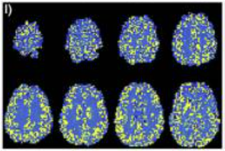

Quantitative BOLD (qBOLD)
Quantitative BOLD
Models MR signal decay in microvessels
qBOLD signal is influenced by concentration of deoxyhemoglobin, which is relatively sensitive to OEF
Quantified through the reversible transverse relaxation rate R2’
Cherukara et al., Neuroimage 2019; 202: 116106

Slide 5
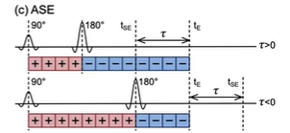
Methods
ASE data: Asymmetric Spin Echo
Acquires only a single TE
Refocusing pulse is moved
Participants
3 healthy controls
Received ASE before and after acetazolamide (dose of 15mg/kg) (i.e. vasodilator)
Notes:
we expect OEF to decrease after vasodilation because of increase amount of blood in artery
In clinical practice, the CBF response to vasodilatory stimuli, which may reflect the degree of cerebral autoregulatory vasodilation in response to reduced perfusion pressure in patients with major cerebral arterial occlusive disease, can be used as an alternative parameter for predicting stroke risk

Slide 6
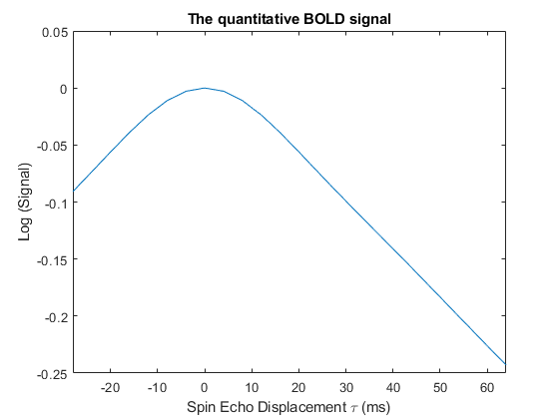
How do we quantify OEF?
Acquire R2’-weighted data
Asymmetric Spin Echo
Achieve gradient echo sampling of spin echo
Estimate R2’ from long tau data
Log-linear fit to tau>15ms data
R2’ ∝ OEF x DBV
Estimate DBV from spin echo
Difference between intercept and measured SE signal
Estimate OEF from R2’ and DBV
Known constants of proportionality used to quantify OEF
Linear
DBV
R2’ ∝ OEF x DBV
Stone and Blockley, NeuroImage (2017); 147:79-88
Notes:
Fix the animation for this slide

Slide 7
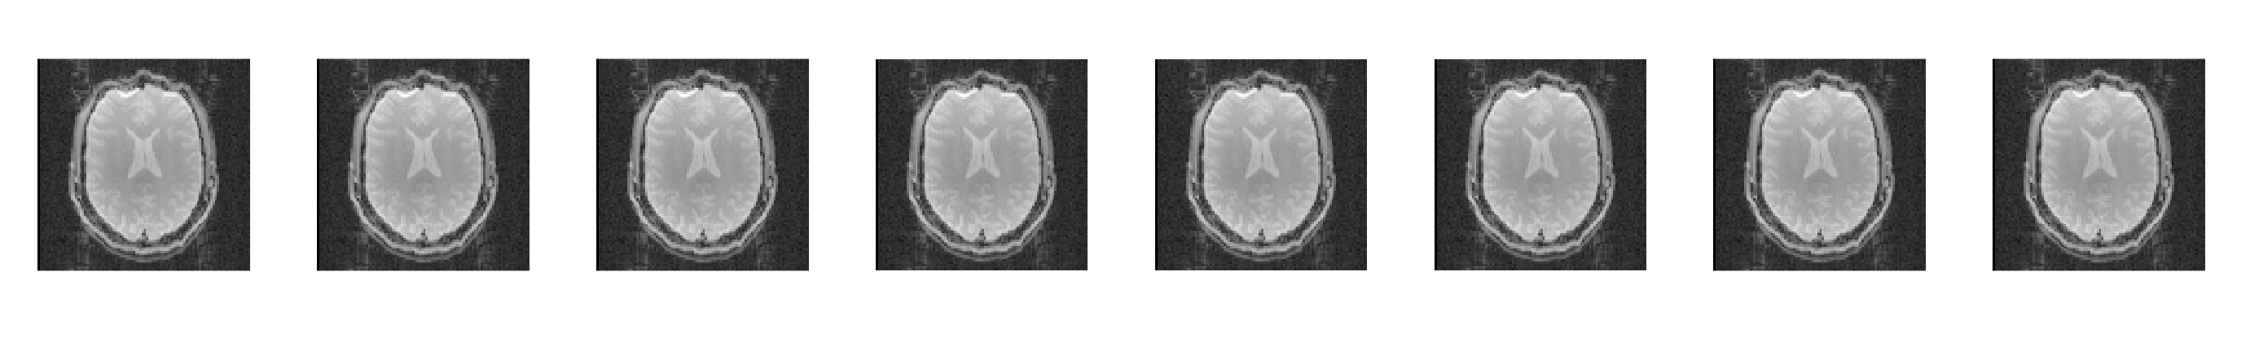
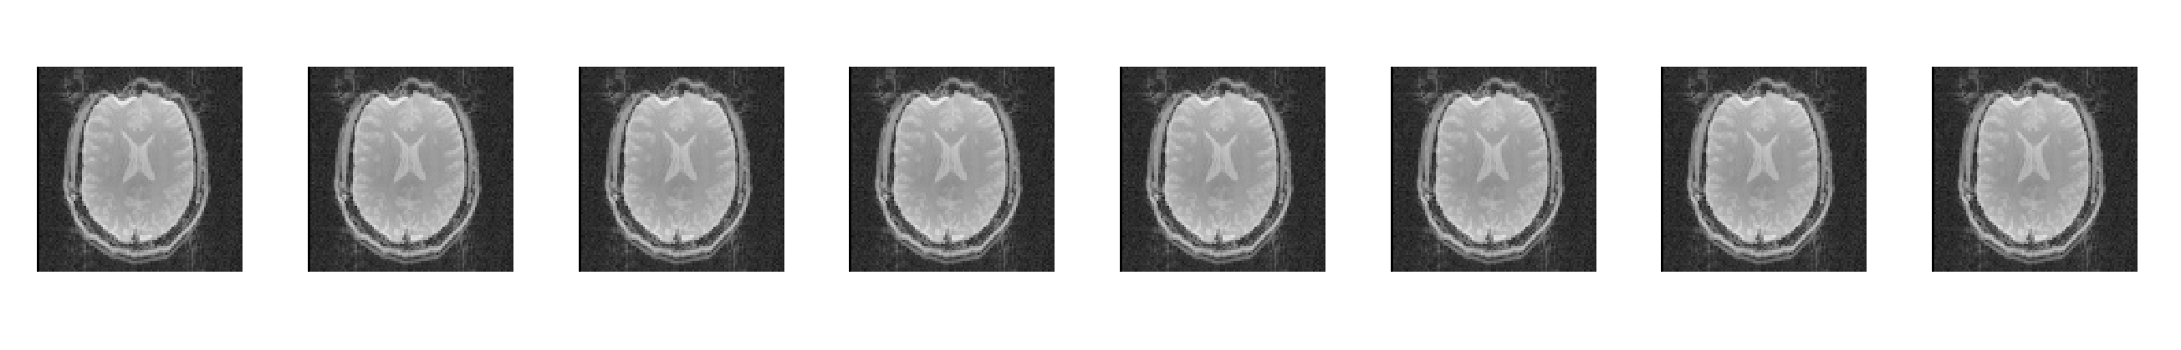
ASE Images during vasodilation
Displacement from SE - τ
SE
τ =16
τ =20
τ =24
τ =28
τ =32
τ =36
τ =40
PRE-ACZ
POST-ACZ
Notes:
Same scale
Rotate
Show more te

Slide 8
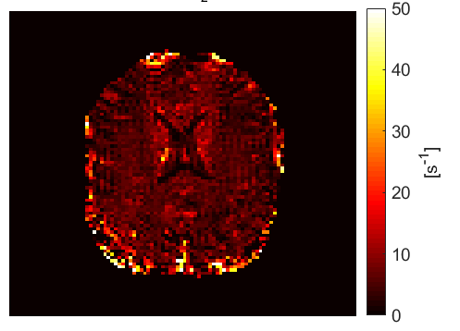
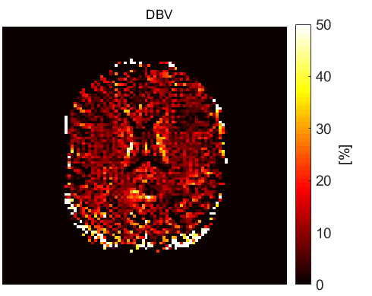
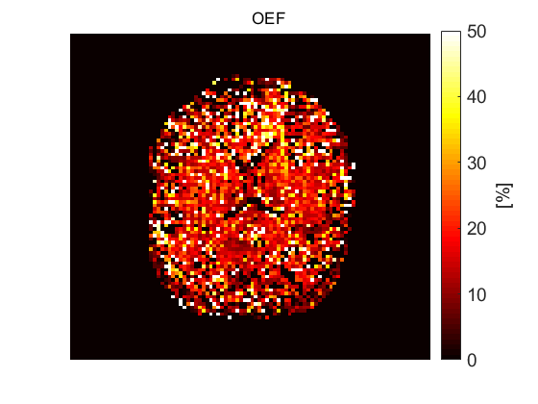
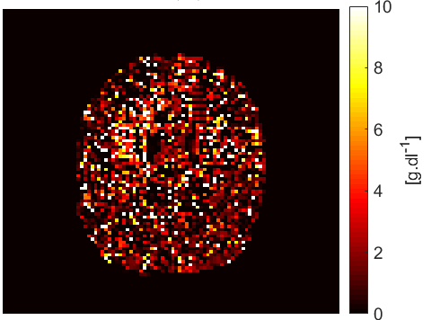
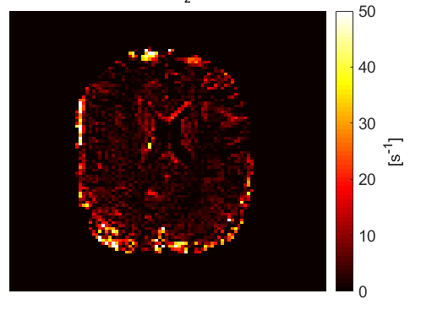
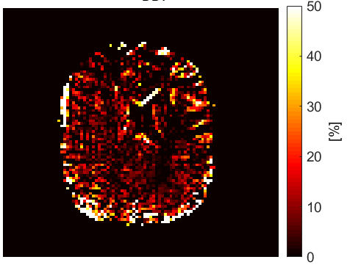
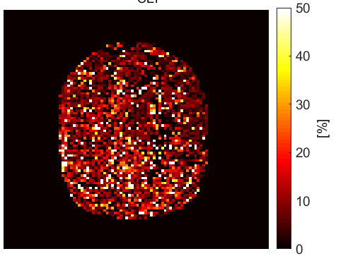
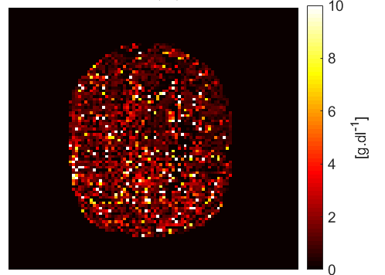
Results - OEF decreased during vasodilation
R2’
DBV
OEF
dHb
PRE-
ACZ
POST-ACZ
Notes:
HC 15
OEF =R2p/DBV
R2p decrease
DBV increase because of increase in perfusion
OEF decrease

Slide 9
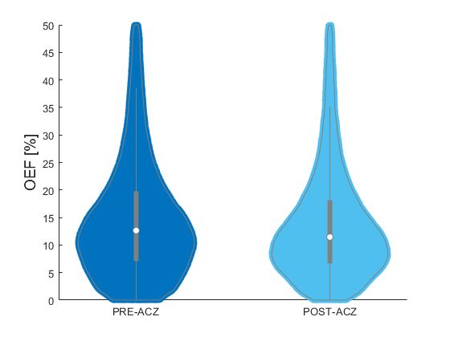
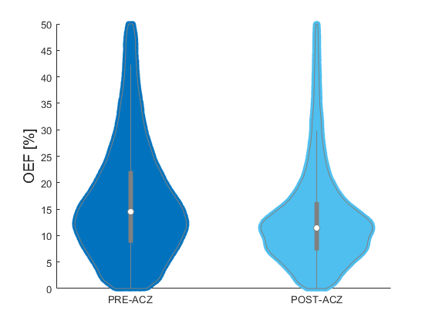
Results – Whole brain analysis
Subject #1
Subject #2
%OEF change = 9.4%
%OEF change = 21.2%
Notes:
Stats: voxel wise or ROI analysis to show the trend
Remove artificial voxels

Slide 10
Conclusion
qBOLD is efficient in computational time, non-invasive
There was a downward trend of OEF with increasing acetazolamide response
Future steps:
Linear model is noisy
Consider Bayesian framework

Slide 11
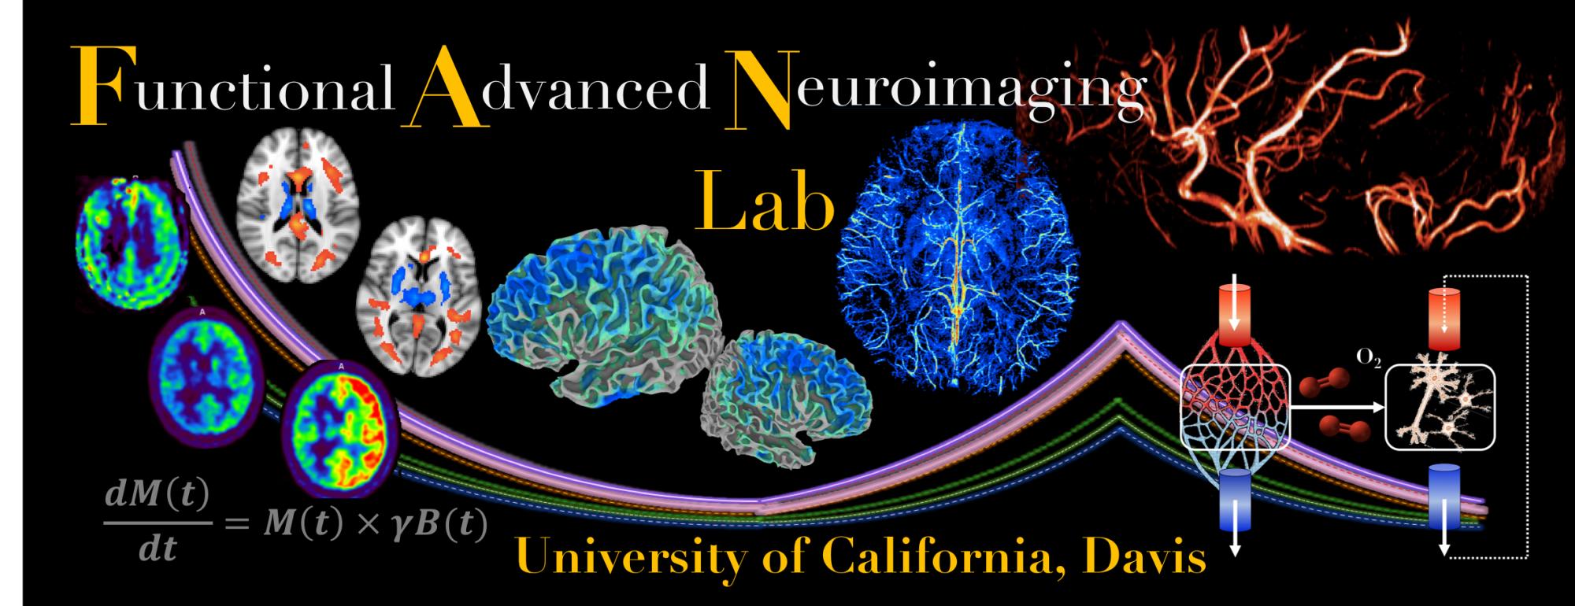

Acknowledgement
Thanks to
Prof. Nick Blockley (University of Nottingham)
UC Davis Fan’s Lab
Corinne Alison Donnay (UC Davis)
Emily Holy (UC Davis)
Greg Wheeler (UC Davis)

