Slide 1
JavaScript
Linh.Pham@sensis.com.au

Slide 2

Outline
Characteristics
Constructs
Object Oriented
Events
jQuery
Ajax
Unit Testing
Assessment in two weeks time

Slide 3
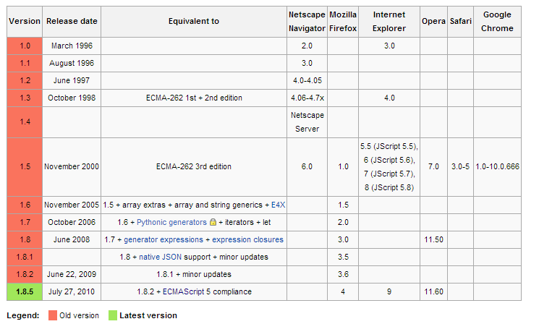
A Brief History
1995: developed by Netscape (was named Mocha, and LiveScript), with Sun’s involvement, name changed to JavaScript
1996: Microsoft developed a compatible dialect: JScript
1997: standardised by Ecma International (European Computer Manufacturers Association): ECMAScript

Slide 4
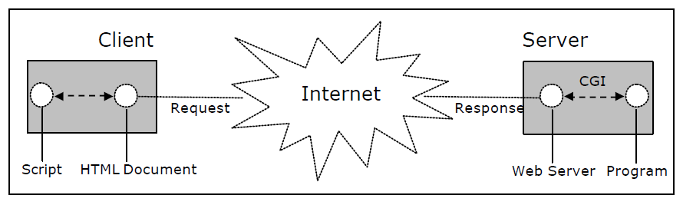
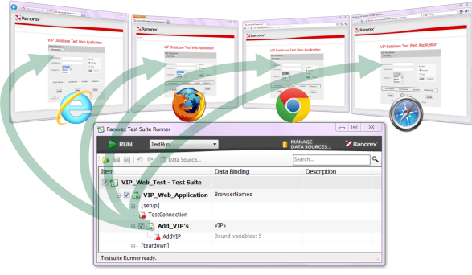
JavaScript Characteristics
Interpreted language, run in JavaScript engine – the most popular is Browsers (Client side)
Dynamic typing
Object based
var a = 1;
a = “a string”;
var emsMap = new EMS.Map(“emsMapId”);
var layer = EMS.Layer.Markers(“markerLayer”);
emsMap.addLayer(layer);

Slide 5
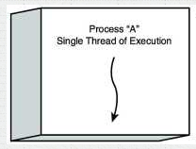
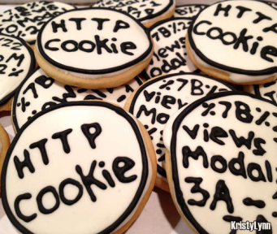
JavaScript Characteristics
Single threaded in running code (no parallel)
No file access – only has access to cookies: track user information, shopping cart, etc.
Is NOT Java

Slide 6
Uses
Browsers:
Dynamic HTML: change the content / appearance of the site
Animation: fade in/out, resizing, moving – example: http://flintmaker.com/sandpit/alert-boxes.html, https://yammer.com
Validating inputs
Ajax: make request to server and reload part of the page
Others:
PDF documents
Desktop widgets
Chrome’s and Safari’s extensions (plugins)
Server side: e.g. Node.js

Slide 7
Constructs
Variable declaration
Loops
If-then-else
Functions
Objects
Ref: http://www.w3schools.com/js/default.asp

Slide 8
Examples
Dynamic HTML
Structures
Changing / deleting existing elements
Check errors in Console
Loops
jQuery selector
Events
Functions
Loops
Alert, Console.log, debugger: only for debugging
Error handling

Slide 9
JSON
JSON: JavaScript Object Notation
Example
SAPI search results, business listing
JSON vs XML: compact, parsing speed, readability, bandwidth…
JSON: The Fat-Free Alternative to XML (http://www.json.org/xml.html), but XML has its own advantage

Slide 10
JSON vs XML
{
"persons": [
{ "name": "Ford Prefect",
"gender": "male"
},
{ "name": "Arthur Dent",
"gender": "male"
},
{ "name": "Tricia McMillan",
"gender": "female"
}
]
}
<persons>
<person>
<name>Ford Prefect</name>
<gender>male</gender>
</person>
<person>
<name>Arthur Dent</name>
<gender>male</gender>
</person>
<person>
<name>Tricia McMillan</name>
<gender>female</gender>
</person>
</persons>

Slide 11
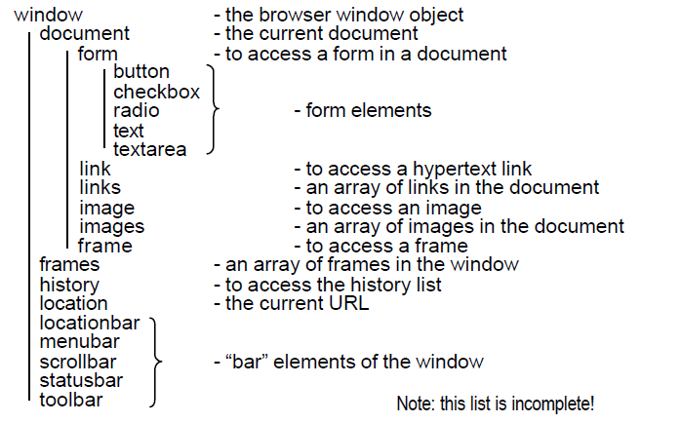
Object
Object: states + behaviours (instance variables + methods)
Examples
Predefined objects: (rarely use directly – jQuery selector is more common)

Slide 12
Events
Click, resize, blur, keyup, keydown, mouseup, mousedown, touch, etc.
Event handlers
Document.ready:
DOM is downloaded and ready to be manipulated
Window.onLoad:
All contents are loaded (includes images, styles, etc.)
Examples: http://mobile.yellowpages.com.au

Slide 13
jQuery
Document traversal and manipulation:
Selectors: by CSS class or by ID
Functions: html(), val(), append(), delete(), etc.
Event binding
Animation
http://api.jquery.com/animate/
Simpler Ajax
jQuery plugins, jQuery UI
http://jqueryui.com/
Cross-browsers

Slide 14
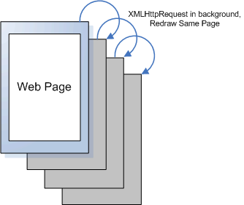
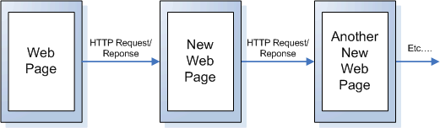
Ajax
Asynchronous JavaScript and XML
Simpler explanation: dynamic HTML → make request, modify part of the page
Not just XML, JSON is more popular
Example: http://www.tutorialspoint.com/ajax/ajax_examples.htm
One single request, big data v.s. lots of requests, smaller chunks of data
Images from: http://work.lauralemay.com/samples/yahoo/howto-ajax.html

Slide 15
Ajax
Content loaded depends on user inputs
Only part of the page changes → faster rendering
Search engine (SEO) does NOT like Ajax
Examples: example 05: Ajax and Ajax by jQuery

Slide 16
QA: Unit Test JavaScript
Options:
QUnit: unit testing used by jQuery
Jasmine: Behavioural Driven Development (BDD) approach (given, when, then)
YUI Test: developed by Yahoo
Ref: http://en.wikipedia.org/wiki/List_of_unit_testing_frameworks#JavaScript

Slide 17
QA: QUnit
JavaScript depends on: data, DOM, events
Examples

Slide 18
QA: JsLint
Static analysis of JavaScript
Help to reduce errors
http://www.jslint.com/
Yellow Page Evolution: part of the full-build

Slide 19
Takeaways
Manipulate the HTML
Rich user interactions (event handlings)
Look out for JavaScript errors: view the console
Excessive JavaScript can be slow on mobile devices

Slide 20
References / More reading
http://www.w3schools.com/js/
http://www.w3schools.com/json/
http://www.w3schools.com/js/js_objects.asp
http://www.w3schools.com/jsref/dom_obj_event.asp
http://www.w3schools.com/jquery/jquery_events.asp
http://www.w3schools.com/ajax/
http://en.wikipedia.org/wiki/Json
http://en.wikipedia.org/wiki/Ajax_(programming)

