Slide 1
Java in 90 mins
Linh Pham

Slide 2
Outline
The basics
Constructs
Object and Class
Arrays
JUnit
Inheritance and Polymorphism
Acknowledgement: some materials are from Swinburne University

Slide 3
Strengths
Portable byte code: cross-platform
Java source code byte code machine code
Garbage collection
Object Oriented
Cleaner design
More reusable
compilation
JVM

Slide 4
The basics
Download, install Java: Oracle website, SE version, JDK not JRE
Set up the bin/ directory in path: environment variables
Java naming convention:
ClassName
variableName (camel case)
CONSTANT
Hello World example

Slide 5
Basic Data Types
Primitives:
Ref: http://docs.oracle.com/javase/tutorial/java/nutsandbolts/datatypes.html
Type |  | Value | Default value
boolean | 1 bit | true / false | false
byte | 8 bits | -2⁷ to 2⁷ - 1 (-128 to 127) | 0
short | 16 bits | -32,768 to 32,767 | 0
int | 32 bits | ~ -2bil to 2bil | 0
long | 64 bits |  | 0
float | 32 bits |  | 0
double | 64 bits |  | 0
char | 16 bits | Unicode, 0 – 65,535 | '\u0000'

Slide 6
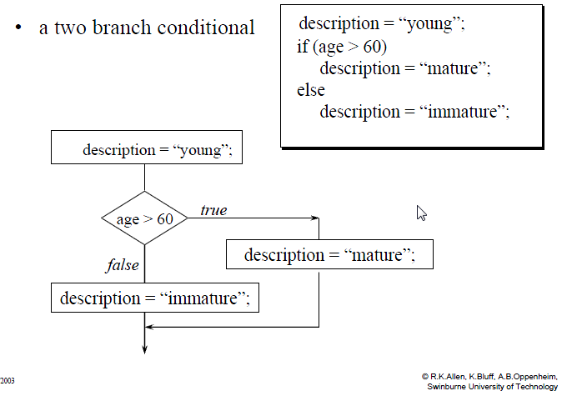
Constructs
Statements: ends in semi-colon
If-then-else
System.out.println(“Hello World”);

Slide 7
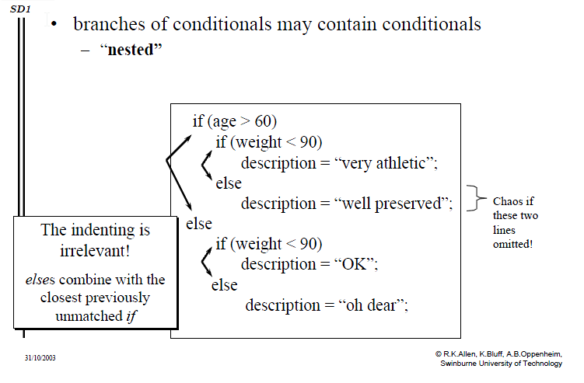
Nested ifs

Slide 8
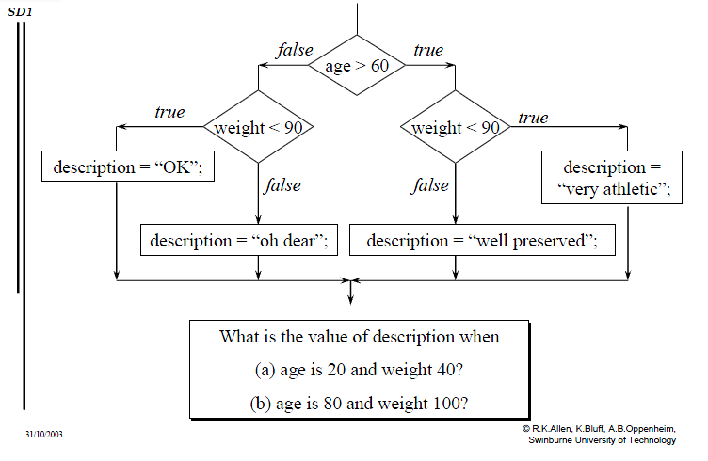
Nested ifs

Slide 9
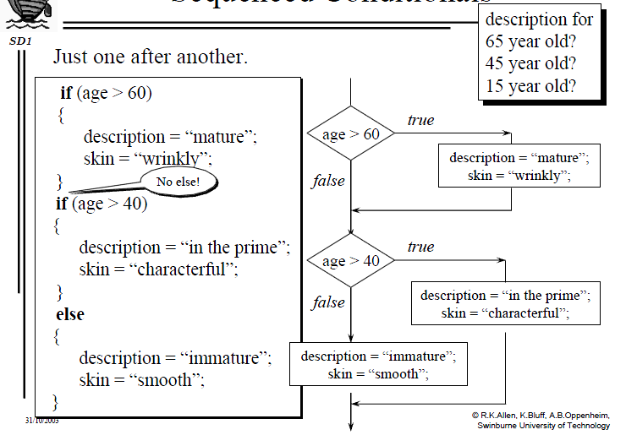
Sequenced Conditions

Slide 10
Conditions
Logical AND:
c1 && c2 : true when BOTH are true
Short-circuit: when c1 is false, c2 is not evaluated
Logical OR:
c1 || c2 : true when EITHER is true
Short-circuit: when c1 is true, c2 is not evaluated
Logical NOT:
! c1 : true when c1 is false
Non short-circuit version: c1 & c2, and c1 | c2

Slide 11
Constructs
For loop:
For-each loop:
for(initialization; condition; update) {
}
for(int i = 0; i < 10; i = i + 2) {
System.out.println(“Value of i: ” + i);
}
int[] arrayInts = {0,1,2,3,4,5,6,7,8,9};
for(int i : arrayInts) {
System.out.println(“Value of i: ” + i);
}

Slide 12
Constructs
While loop:
Do-while loop:
while (condition) {
}
int i = 0;
while (i < 10) {
System.out.println(“Value of i: ” + i);
i = i + 1;
}
do {
} while (condition);
int i = 0;
do {
System.out.println(“Value of i: ” + i);
i++;
} while (i < 10);

Slide 13
Do-while: always executed at least once
While loop:
Do-while loop:
int i = 10;
while (i < 10) {
System.out.println(“Value of i: ” + i);
i++;
}
int i = 10;
do {
System.out.println(“Value of i: ” + i);
i++;
} while (i < 10);

Slide 14
Infinite loop
int i = 0;
while(i < 10) {
System.out.println(“Value of i: ” + i);
}
while (true) {
System.out.println(“Life is beautiful”);
}
int i = 0;
while (true) {
System.out.println(“Value of i: ” + i);
i++;
if (i >= 10) {
break;
}
}

Slide 15
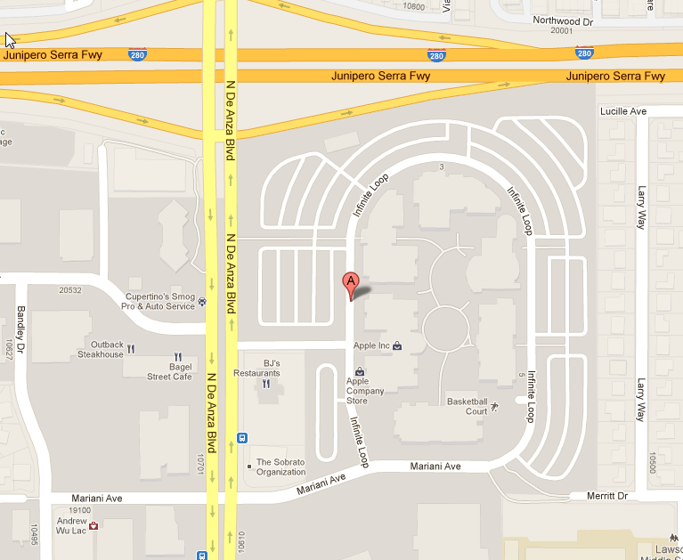

Infinite loop

Slide 16
Class
States (instance variables)
Behaviours (methods)
Method signature:
public void setName(String newName) { }
public String getName() { }
Method overloading: same name, different parameters
public String formatDate(Date date) { } // default Locale
public String formatDate(Date date, Locale locale) { }
modifier
return type
method name
parameters: type + name
method body

Slide 17
Class
Constructors:
Initialising variables
Same name as the Class name
Can have parameters
Can have multiple constructors with different parameters
public Person() { } // default or no-args constructor
public Person(String name, int yearOfBirth) { }

Slide 18
Constructor
Creating object: invoking constructor with new
static void main(String[] args) {
Person p = new Person(“Mr. Bean”, 1980);
System.out.println(“Name is: ” + p.getName());
}
public class Person {
private String name;
int yearOfBirth;
public Person(String jack, int yrOfBirth) {
name = jack;
yearOfBirth = yrOfBirth;
}
public void setName(String name) {
this.name = name;
}
public String getName() {
return name;
}
}
name = “Mr. Bean”

Slide 19
Encapsulation
Modifier: private, protected, public, default (package level)
Example 03
public static void main(String[] args) {
Person p = new Person();
//access private member
p.name = “Mr. Bean”; //WRONG
//access public interface: OK
p.setName(“Mr. Bean”);
}
public class Person {
private String name;
int yearOfBirth;
public void setName(String name) {
this.name = name;
}
public String getName() {
return name;
}
}

Slide 20

Encapsulation
public static void main(String[] args) {
Car car = new Car();
car.setGear(1);
int speed = car.currentSpeed();
while (speed < 10) {
car.accelerate();
speed = car.currentSpeed();
}
car.setGear(2);
while (speed < 20) {
car.accelerate();
speed = car.currentSpeed();
}
}
Car
public int currentSpeed()
public void setGear(int)
public void accelerate()
1. What is the internal structure of Car?
2. How does it work?
Do we care?
Does it matter?
➔ Encapsulation

Slide 21
Object – variable is pointer
Person p;
p.setName(“Jean”); // NullPointerException
p = new Person(“Jean”);
p
n
null
p
6f3e
name = “Jean”

Slide 22
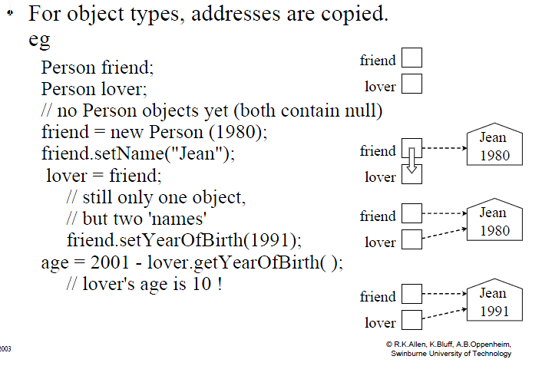
Object assignment

Slide 23
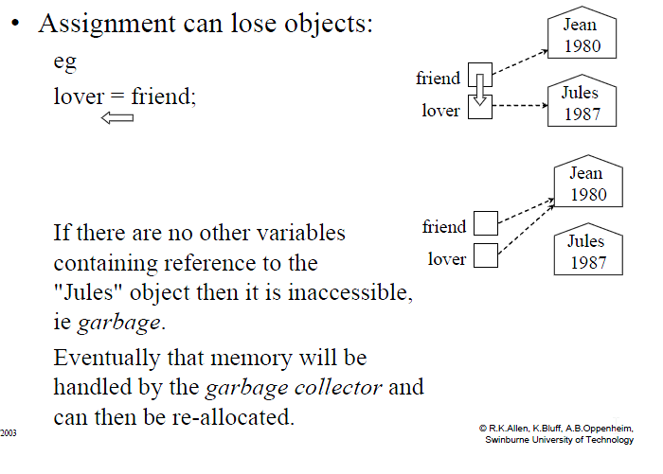
Garbage collection

Slide 24
Array of Primitives
Declaring:
int[] array;
String[ ] array = new String[4];
Creating:
array = new int[7]; // fixed length
OR: int[] array = new int[7];
OR: int array[] = new int[7]; //C++ like syntax, not preferable.
Each element will have default value
Accessing element:
array[4] = 10; // 0-based
Creating and assign values:
int[] firstFiveEvens = {0, 2, 4, 6, 8}
array
null
6e3f
0
1
2
3
4
5
6
0
0
0
0
0
0
0
0
1
2
3
4
5
6
0
0
0
0
10
0
0

Slide 25
Array assignment
int[] array2 = array;
array2[4] = 70; // same as array[4] = 70
Copying array by creating a new array and assign each element
array
6e3f
0
1
2
3
4
5
6
10
11
12
13
70
15
16
14
array2
6e3f
int[] array2 = new int[array.length];
for(int i = 0; i < array.length; i++) {
array2[i] = array[i];
}
array
6e3f
0
1
2
3
4
5
6
10
11
12
13
14
15
16
array2
7d2s
0
1
2
3
4
5
6
10
11
12
13
14
15
16

Slide 26
Array of Objects
array
null
Declaring
Person[] array = new Person[7];
array[0] = new Person(“Jean”);
array[0].setName(“new name”);
array[1].setName(“my name”); // NullPointerException
array[1] = new Person();
array[1].setName(…);
0
1
2
3
4
5
6
null
null
null
null
null
null
null
name = “Jean”

Slide 27
Array
ArrayIndexOutOfBoundsException:
int[] array = new int[7];
array[-1]
array[7]

Slide 28
JUnit
Unit Test:
Test the intended behaviour of classes / methods
Make sure components “work as advertised”
Benefits:
Reduce (human) errors early on (decrease software cost)
Lower defect rate, more reliable software
Much much quicker turn around time (run test vs. run app)
Automated tests
Catch early regression problems → encourage changes
Safety net during maintenance later on
Much much better investment in writing unit test vs. fixing defects + severity 1 issues in Production

Slide 29
Inheritance
Classes with common states, behaviours
B can inherit from A
Re-use common code
Polymorphism

Slide 30
Example
base class / super class / parent class
sub class / child class
class Person {
protected String name;
protected int yearOfBirth;
//getter and setter: getName, setName, getYearOfBirth, setYearOfBirth
public void walk() {
System.out.println(“I can walk at the pace of 4 km/h”);
}
}
class Trainer extends Person {
//name, yearOfBirth, getter and setter are inherited
//override
public void walk() {
System.out.println(“I can walk at the pace of 8 km/h”);
}
//something extra
public void run() {
System.out.println(“I can run as well”);
}
}

Slide 31
Constructors in Inheritance
class Person {
protected String name;
protected int yearOfBirth;
//public Person() {
//
//}
//getter and setter
public void walk() {
System.out.println(“I can walk at the pace of 4 km/h”);
}
}
class Trainer extends Person {
//name, yearOfBirth are inherited
//public Trainer() {
// super();
//}
//getter and setter are inherited
//... walk method, run method
}

Slide 32
Constructors in Inheritance
class Person extends Object {
protected String name;
protected int yearOfBirth;
//not a default constructor
public Person(String name, int yearOfBirth) {
this.name = name;
this.yearOfBirth = yearOfBirth;
}
//getter and setter
// ... walk method
}
}
class Trainer extends Person {
//name, yearOfBirth are inherited
//case 01:
//public Trainer() {
// super();
//}
//case 02:
public Trainer(String name, int yearOfBirth) {
super(name, yearOfBirth);
this.name = name;
this.yearOfBirth = yearOfBirth;
}
//getter and setter are inherited
//... walk method, run method
}

Slide 33
Constructors in inheritance
Example

Slide 34
The Object class
All Java classes (implicitly) extends from the Object class
Class Object is the root of the class hierarchy

Slide 35
Polymorphism
Definition: of different form
In Java: method invocation depends on type of object created at runtime.

Slide 36
Polymorphism
class Person {
protected String name;
protected int yearOfBirth;
//getter and setter
public void walk() {
System.out.println(“I can walk at the pace of 4 km/h”);
}
}
class Trainer extends Person {
//name, yearOfBirth, getter and setter are inherited
//override
public void walk() {
System.out.println(“I can walk at the pace of 8 km/h”);
}
//something extra
public void run() {
System.out.println(“I can run as well”);
}
}
public class Main {
public static void main(String[] args) {
Person p1 = new Person();
p1.walk(); // 4 km/h
Trainer p2 = new Trainer();
p2.walk(); // 8 km/h
p2.run(); //valid
}
}
public class Main {
public static void main(String[] args) {
Person p1 = new Person();
p1.walk(); // 4 km/h
Person p2 = new Trainer();
p2.walk(); // 8 km/h, the walk() version of Trainer, not Person. -> Polymorphism
p2.run(); //INVALID, only have access to the public interface of Person!
}
}

Slide 37
Why is Polymorphism important?
class Shape {
public double getCalculatedArea() {
}
public Pixel[] getPixels() {
}
}
class Rectangle extends Shape {
public double getCalculatedArea() {
//width * height
}
public Pixel[] getPixels() {
}
}
class Circle extends Shape {
public double getCalculatedArea() {
//PI * r * r
}
public Pixel[] getPixels() {
}
}
class Main {
public static void main(String[] args) {
Shape[] shapes = new Shape[numberOfShapes];
shapes[0] = new Rectangle(...);
shapes[1] = new Rectangle(...);
shapes[2] = new Circle(...);
shapes[3] = new Circle(...);
for(Shape s : shapes) {
System.out.println(s.getCalculatedArea());
draw(s);
}
}
public static void draw(Shape s) {
Pixel[] pixels = s.getPixels();
//draw the shape s out on the screen pixel by pixel.
//→ We based on the common behaviour across Shape, wrote just one draw method that could work with all types of Shape.
}
}

Slide 38
Summary
Java byte code: cross-platform
JUnit: test method’s contract, branch coverage
Use of Mock during testing
Class, Object
Encapsulation
Inheritance and Polymorphism

Slide 39
References
http://www.cafeaulait.org/course/
http://docs.oracle.com/javase/tutorial/java/TOC.html

