Slide 1
ASE Mini Project: Windows Azure Marketplace
Daniel Moldovan
d.moldovan@dsg.tuwien.ac.at
1227559

Slide 2
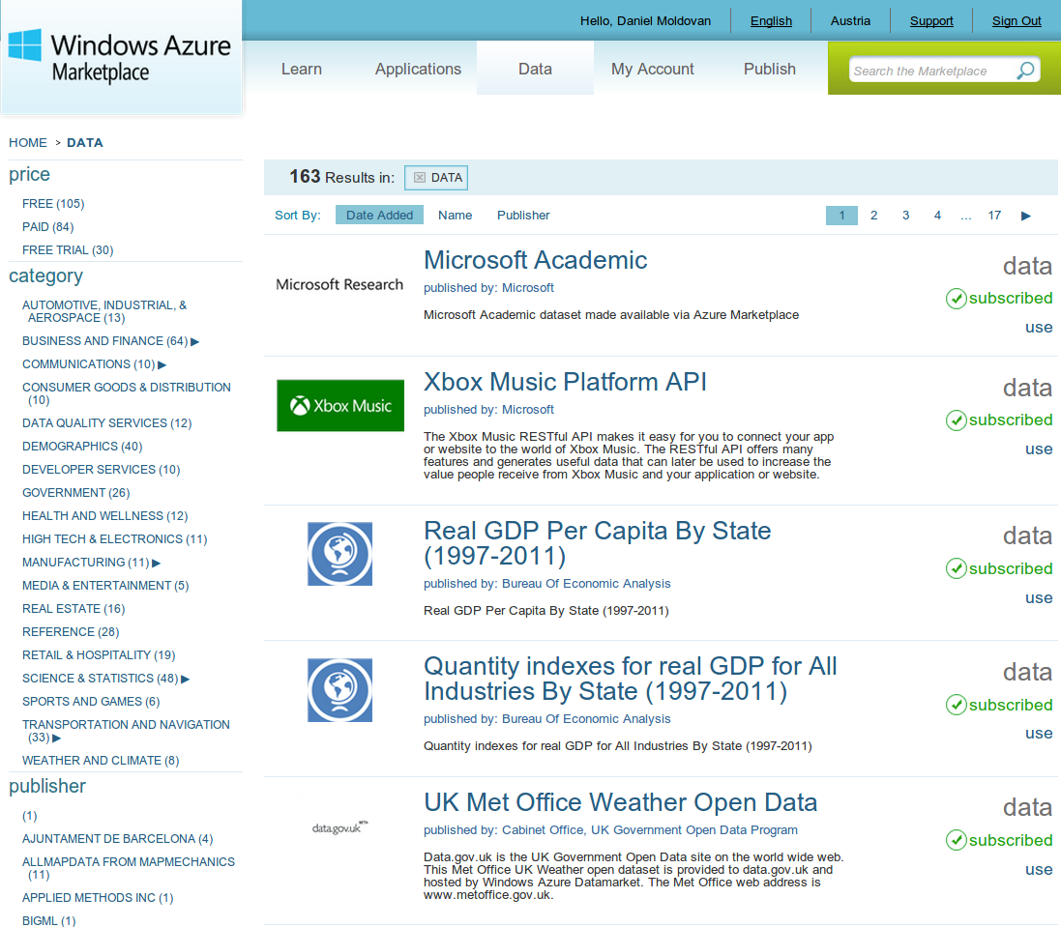
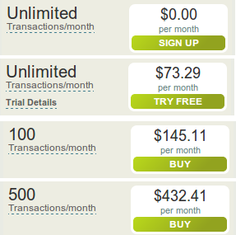
Windows Azure Marketplace Overview

Slide 3
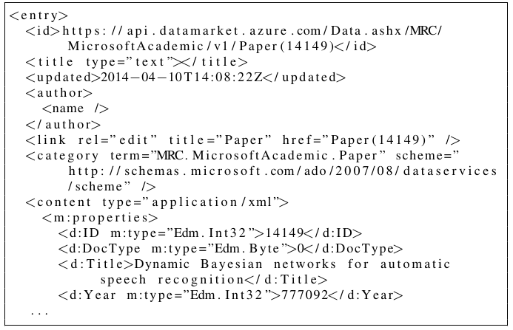
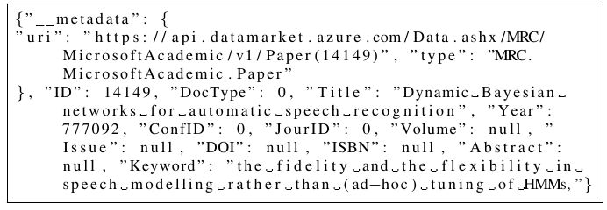
Windows Azure Marketplace Overview
ATOM Data Format
JSON Data Format

Slide 4
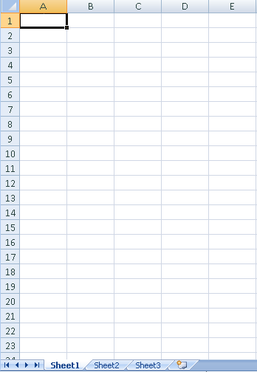
Windows Azure Marketplace Overview

Slide 5
Objective
Queue as a Service
Queue
notifyClients()
notifyClients()
Data as a Service
getData()
Data Analytics Service
Data Analytics Client
Data
putDataAndAnalytics()
getDataAndAnalytics()
Storage as a Service
DB

Slide 6
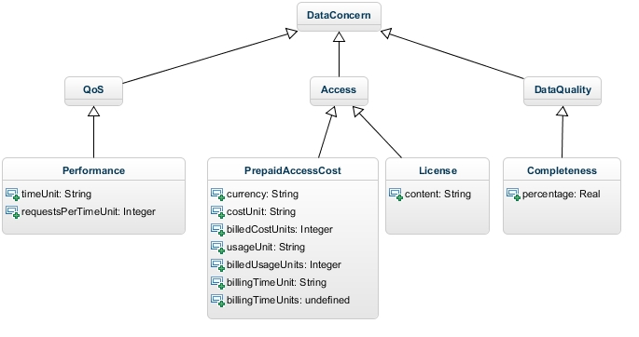
Data Analytics: Data Concerns

Slide 7
Implementation
Queue as a Service
Queue
CloudAMQP (RabbitMQ )
notifyClients()
notifyClients()
Data Services
Provider
getData()
Data Analytics Service
Data Analytics Client
JAXB
Java Web+ RESTful API
getData()
Java Web+ RESTful API
Java SE
putDataAndAnalytics()
getDataAndAnalytics()
Data as a Service
Data
Storage as a Service
DB
Windows Azure Marketplace
MongoDB

Slide 8
Implemented Data Concerns
QoS:
Performance:
Computed and updated by Data Service Provider at each service invocation
Access
Prepaid Access Cost
Provided by Data As a Service (Windows Azure Marketplace)
License
Provided by Data As a Service (Windows Azure Marketplace)
Data Quality
Completeness
Computed by Data Service Provider
Computes for each data sheet percentage of empty rows
Improved by Data Analytics Service
Removes duplicate records and records with empty values
Data Services
Provider
Data Analytics Service

Slide 9
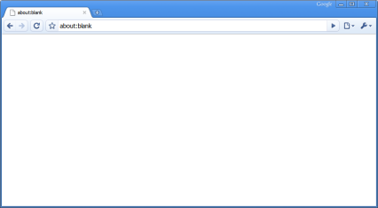
Communication Flow
1. analyzeDataSet(DataSet)
Queue as a Service
Queue
4. computeConcerns(DataSet)
7. notifyClients(DataSet)
8. notifyClients(DataSet)
5. cleanData(DataSet)
Data Services
Provider
Data Analytics Service
Data Analytics Client
2. getData(DataSet)
3. getData(DataSet)
6. putDataAndAnalytics(Data, Analytics)
9. getDataAndAnalytics(DataSet)
Storage as a Service
Reject DataSheet
If completeness < 60%
DB
Data as a Service
Data

Slide 10
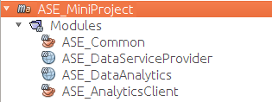
Live Demo ☺

