Slide 1
Evaluating Crime Data for UK Police
Erum Naz
Le Duc Hung

Slide 2
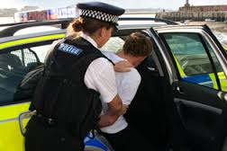


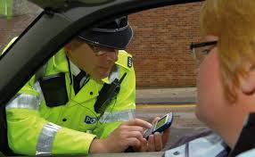



Scanario
Notes:
Ratio of crime rate is increasing day by day. Automated systems get data every milliseconds. In this presentation we evaluated the open data

Slide 3
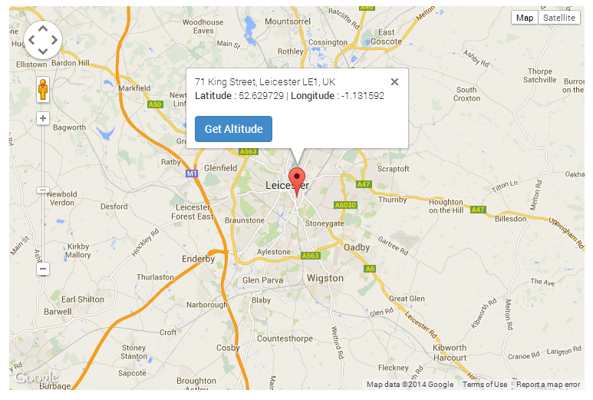
Selecting Data

Slide 4
DaaS and Data Concerns
Open data is taken from http://data.police.uk/
Data metric concerns are address by Quality of data (QoD) and Quality of service (QoS)
QoD
Seriousness: How serious the criminal is shown in the data.
Newness: The updating status of the data
Hot zone: The data is at the location of many criminals
Fairness: Human based evaluation to see how good the justice.
QoS
Performance: The service by force are good or bad.
Privacy: The data can be published to specific clients.

Slide 5






Flow
(2) Query
+ fetch data
data.police.uk
DaaS
(7) Get data + concerns
(1) Request
data
(3) Send
data +
concerns
(4) Save
ID + data
+ concerns
Users
(1’) Subscribe
Users’
Clients
(5) Publish
the ID
(6) Get
notification
Evaluator

Slide 6
Prototype
Language: Java
Tools: Maven + Apache CXF + Spring
Components:
DaaS service: http://128.130.172.215:8080/PoliceDaaS/rest/
Evaluator service: http://128.130.172.215:8080/PoliceDaaS/rest/evaluator
Client: java –jar PoliceDaaS.one-jar.jar
User interface: HTML + PHP
Other tools, APIs:
Postman RestClient
MongoDB java driver.
AMQP client.
Json viewer: http://jsonviewer.stack.hu/

Slide 7
Demo

Slide 8
Thank You

