Slide 1

ASE Mini-project presentation
Georgiana Copil

Slide 2
Overview
Design
Data Concerns
Implementation
Experiments
Conclusions

Slide 3
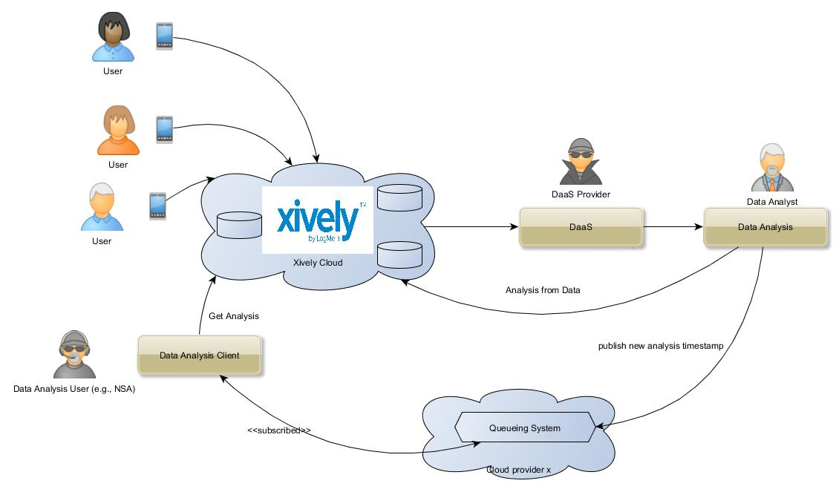
Design

Slide 4
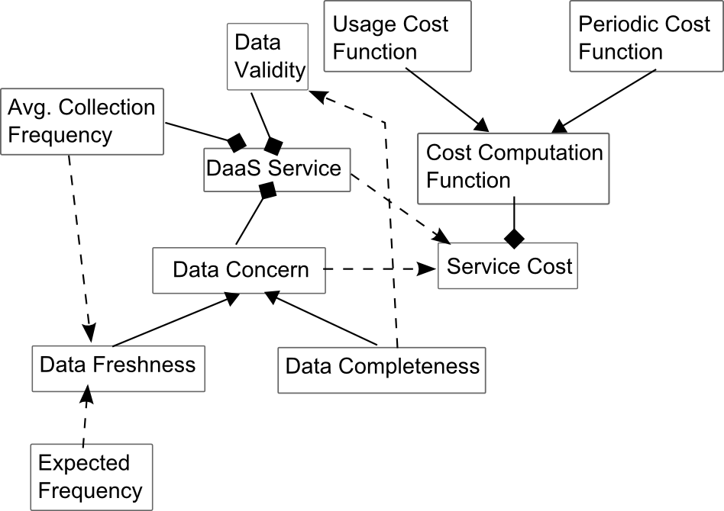
Data Concerns - Overview

Slide 5
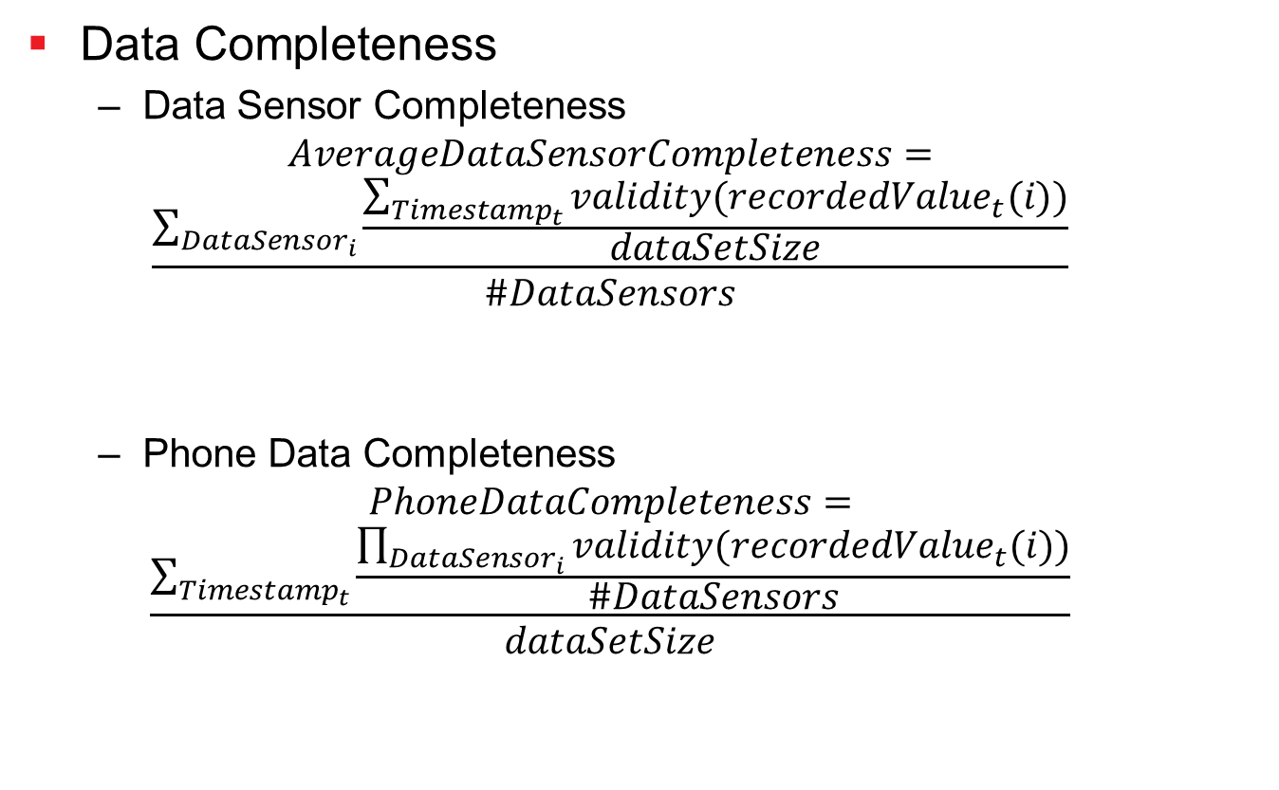
Data Concerns – Data Completeness
Data Completeness
Data Sensor Completeness
$$AverageDataSensorCompleteness=$$
$$\frac{\sum_{{DataSensor}_{i}}{\frac{\sum_{{Timestamp}_{t}}{validity({recordedValue}_{t}(i))}}{dataSetSize}}}{\#DataSensors}$$
Phone Data Completeness
$$PhoneDataCompleteness=$$
$$\frac{\sum_{{Timestamp}_{t}}{\frac{\prod_{{DataSensor}_{i}}{validity({recordedValue}_{t}(i))}}{\#DataSensors}}}{dataSetSize}$$

Slide 6
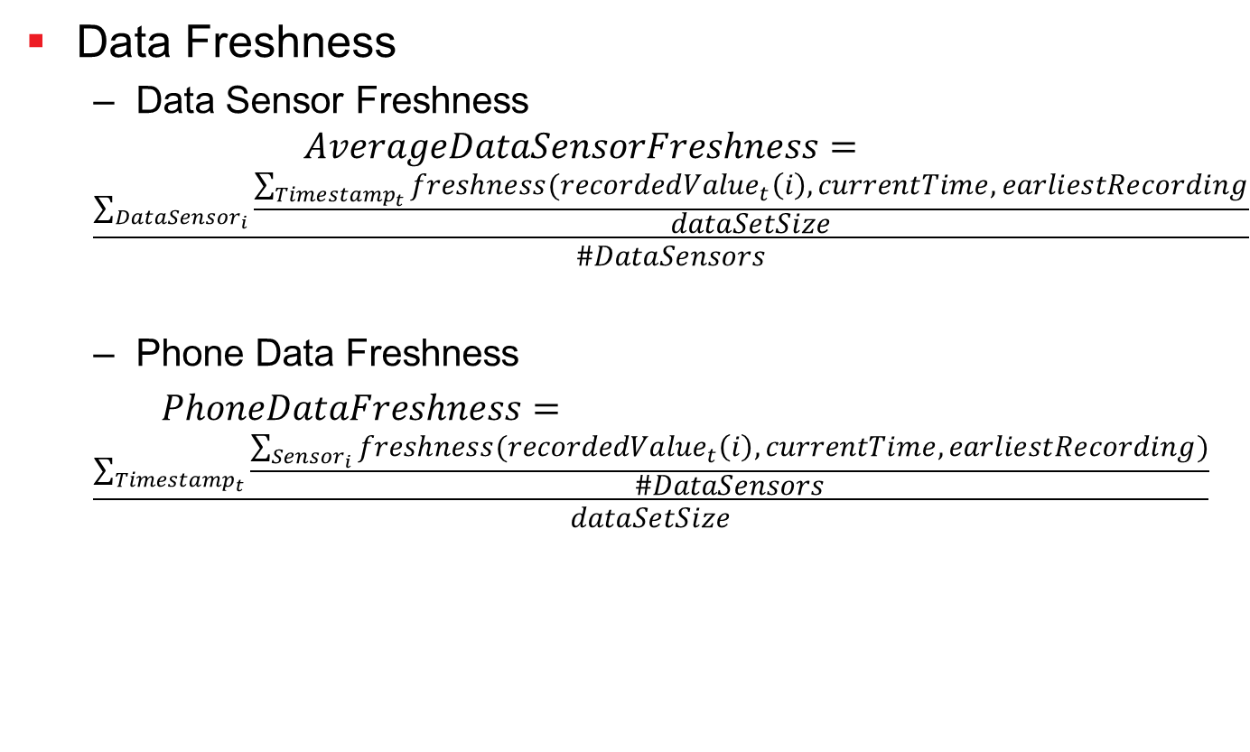
Data Concerns – Data Freshness
Data Freshness
Data Sensor Freshness
$$AverageDataSensorFreshness=$$
$$\frac{\sum_{{DataSensor}_{i}}{\frac{\sum_{{Timestamp}_{t}}{freshness({recordedValue}_{t}\left(i\right),currentTime,earliestRecording}}{dataSetSize}}}{\#DataSensors}$$
Phone Data Freshness
$PhoneDataFreshness=$
$$\frac{\sum_{{Timestamp}_{t}}{\frac{\sum_{{Sensor}_{i}}{freshness({recordedValue}_{t}\left(i\right),currentTime,earliestRecording)}}{\#DataSensors}}}{dataSetSize}$$

Slide 7
Data Concerns - Analysis
NSA Guy/ Data Analysis Client
Interested in analysis result only when
Phone Data Completeness > 60%
Average Sensor Freshness > 30%
Analysis Result
Evaluates values for:
Accelerometer
Linear acceleration sensor
Magnetic field
Rotation
Analyzes user’s behavior:
Moving
Playing
Checking the phone

Slide 8



Implementation
2 Versions:
As possible part of Xively, improving Xively DaaS
As separate DaaS provider
Xively python
Xively python
pika 0.9.13
pika 0.9.13

Slide 9
Demo ☺

Slide 10
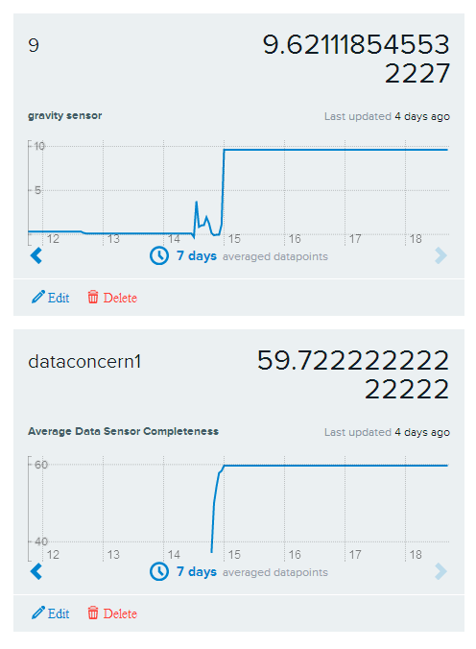
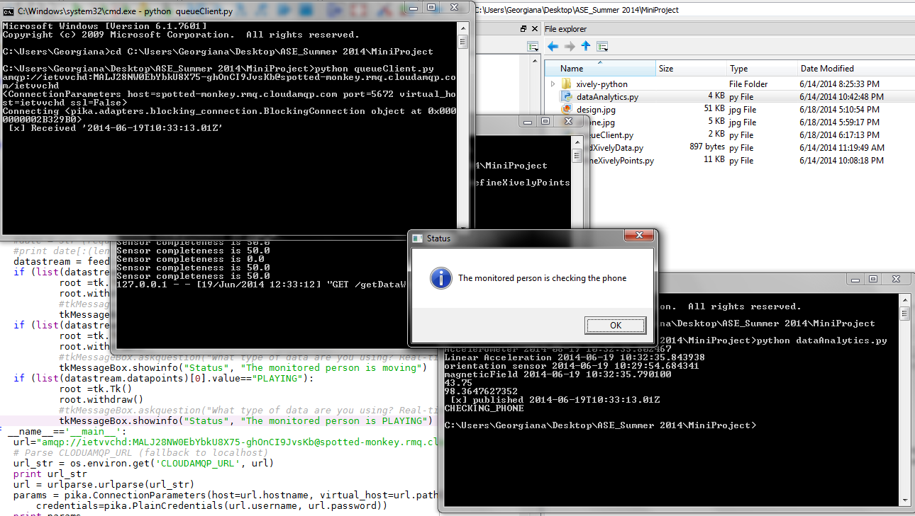
Experiment

Slide 11

Thanks for your attention!
Georgiana Copil
e.copil@dsg.tuwien.ac.at
http://www.infosys.tuwien.ac.at/staff/ecopil
Distributed Systems Group Vienna University of Technology
Austria

