Slide 1

Xively
Engineering Complex Data Analytics Services
Advanced Services Engineering - Summer 2014
Juraj Čík

Slide 2
Outline
Technologies
DaaS design
Introduced data concern
Data analytics service
Demo
Conclusion

Slide 3






Technologies
Data provider:
REST (XML)
DaaS:
REST (XML)
Storage:
Message Queue:
Data analytics service:
REST (json)
Java (jersey, apache math3)

Slide 4
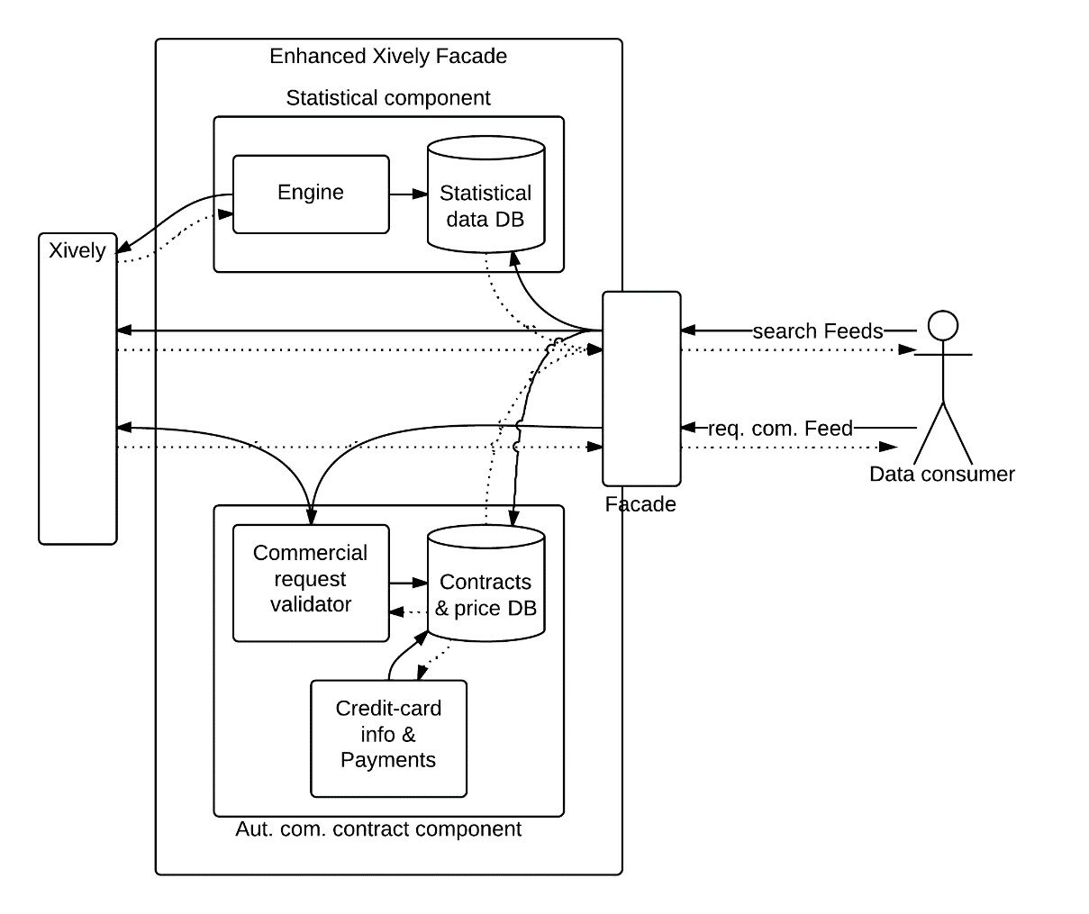
DaaS design
implemented DaaS
Xively partial data model:
Feed
metadata
Datastream
metadata
value
Datastream
metadata
value

Slide 5
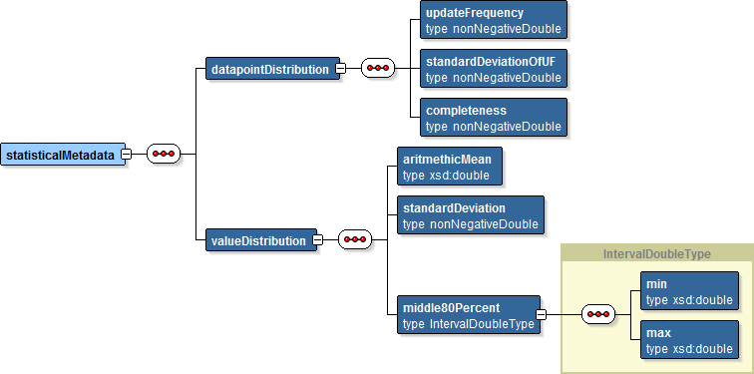
Data concern - statistical metadata (Datastream)

Slide 6
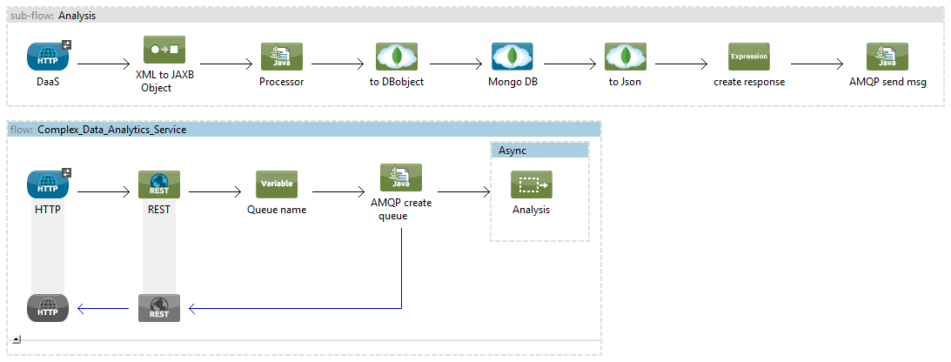
Data analytics service – flow in Mule
DaaS -> analysis of data
results to DB
notify MQ
synchronous response

Slide 7
Demo

Slide 8
Conclusion
mixed feelings about Mule (connectors, MEL, documentation)
comfortable work with cloud services
Xively has huge potential for extensions (feed discovery, sharing)

