Slide 1
Optimizing Service Requests in Big Data Platforms
Hong-Linh Truong
Department of Computer Science
linh.truong@aalto.fi, https://rdsea.github.io

Slide 2
Schedule
Understanding some common problems
Optimizing service requests
Throttling
Tasks and queue-based load leveling
Elasticity of service instances
Assignment
Summary
Notes:
Key principles for designing and engineering platforms.

Slide 3
Recall: our common architecture
Big data platform
Client
Client
Client
Service
Data Store
Client
Read/write
Client
Notes:
Back-pressure: new protocol
Or multiple storage nodes
Or whatelse? Disconnect
Then what if the service continues → circuite breaker
Anybody can tell a tool that we can use? For every slide
https://www.ververica.com/blog/how-flink-handles-backpressure

Slide 4

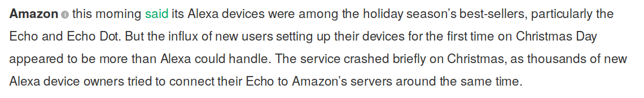
Real world situations
Source: https://www.cbsnews.com/news/healthcaregov-plagued-by-crashes-on-1st-day/
Source: https://techcrunch.com/2018/12/26/alexa-crashed-on-christmas-day/

Slide 5
Abstracting the problem
100000 requests/s
Client
Service
Solutions for the design?
Notes:
But if the client just retries and retries ….? → circuit breaker
Drop messages
Buffer messages
backpressure

Slide 6
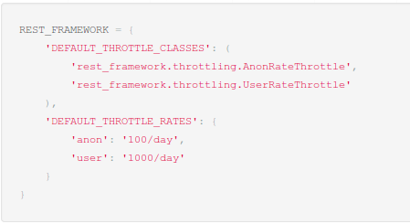
Throttling
Drop strategy: disable too many accesses and disable unessential services
Client
API Management Service (Gateway)
Service
E.g., using API Gateway Kong, Kubernetes
Code: http://www.django-rest-framework.org/api-guide/throttling/#how-throttling-is-determined

Slide 7
Using tasks and queue-based load leveling pattern
New Service
request
Client
E.g., using RabbitMQ for message queue
Figure source: https://msdn.microsoft.com/en-us/library/dn589783.aspx

Slide 8
Elasticity of instances of services
Elasticity Controller
control
monitor
Figure source: https://msdn.microsoft.com/en-us/library/dn568101.aspx

Slide 9
Assignment
“A big data platform monitors network usage of devices from million+ customers. We have different levels: Sensors from customers, Node (concentrator of multiple customers), Agent (concentrator of multiple Nodes) and the Database for the whole network. In a region, the real operator can generate 1.4 billion records per day ~ 72GB per day”

Slide 10
Design your scalable solutions!
Client
Client
Service
Data Store
Client
Client
Service
Client
Client
Service
Client
Client
Agent
Sensors
Node
Use the techniques you learn to avoid concurrent contention and slow read/write

Slide 11
Summary
Problems:
100000 requests/s
Client
Service
Techniques: throttling, tasks+queue loadbalancing, and elasticity
Think: Which technique requires few changes of the service implementation? When we should use which techniques?

Slide 12
Thanks! Hong-Linh Truong Department of Computer Science rdsea.github.io

