Slide 1
Deep Learning / Chapter 6
Architectures Based
on RNNs
Can a recurrent neural network recall the first signal?
Notes:
Ask the audience to remember the first of two colored signals. The task becomes harder when more readings arrive before the answer is requested. The talk connects that small experiment to the choice of recurrent cell, the direction of information flow, and the shape of the output.
Sources
Nguyen Thi Khanh Tien, Chapter 6. Recurrent Neural Networks, course slides. Pages 2–8.
Companion notebook, Architectures-based-on-RNNs.ipynb.

Slide 2
Which signal came first?
Read each sequence left to right. Predict the first color.
red tick blue hum tap
red first
blue tick red hum tap
blue first
The token counts match. A classifier using only counts gives both sequences the same label and gets exactly one right.
Notes:
Pause after the first line and ask for the label. Swap only red and blue in the second line. The pair contains the same tokens, the same last token, and the same sequence length. Complete pairs also occur in every data split, so 50% is an exact count-only baseline. Red and blue are tokens in a controlled experiment, not sensor measurements.
Sources
Companion notebook, Architectures-based-on-RNNs.ipynb. Section “An order question that token counts cannot answer.”

Slide 3
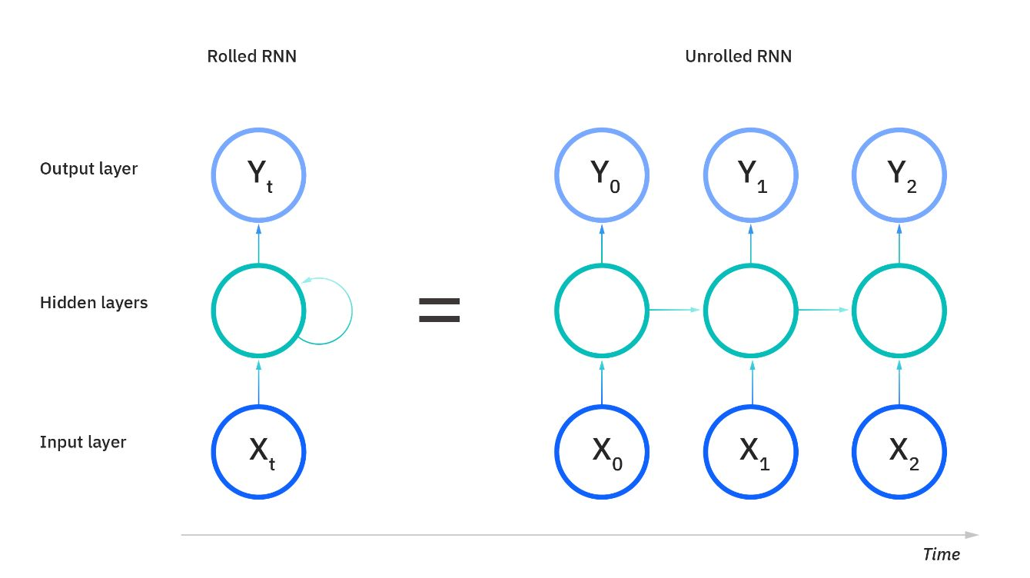
The same cell reads every time step
hₜ = tanh(Wₓ xₜ + Wₕ hₜ₋₁ + b)
The next state combines the current input with the previous state. The weights stay fixed as the sequence advances.
For one label per sequence, the classifier reads the final valid state.
Notes:
Read h sub t as the hidden vector after token t. The two matrices map the current input and previous hidden state into the same space. The bias combines the two bias vectors in PyTorch’s implementation. During training, backpropagation follows this chain in reverse. Repeated Jacobian products can shrink or amplify a gradient. Gradient clipping limits large gradients. Gating creates another path for a memory signal.
Sources
Nguyen Thi Khanh Tien, Chapter 6. Recurrent Neural Networks, course slides. Pages 3–5 and 9–10. Diagram excerpt from p. 4.
https://d2l.ai/chapter_recurrent-neural-networks/bptt.html
https://docs.pytorch.org/docs/stable/generated/torch.nn.RNN.html

Slide 4
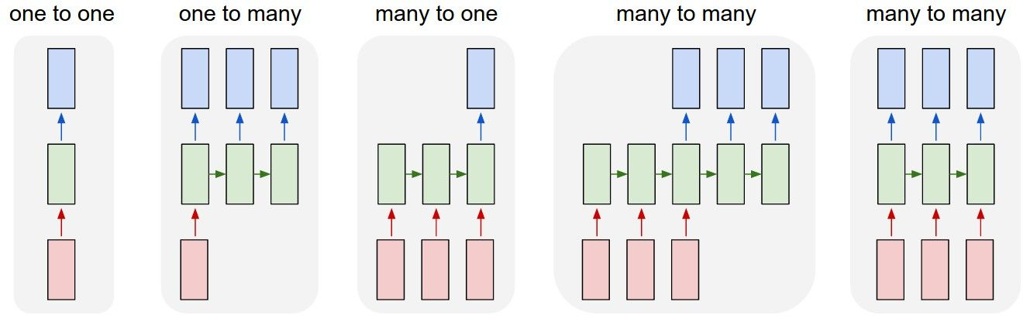
When does the network produce an output?
Red = input Green = recurrent state Blue = output
Captioning emits words. Sentiment gives one label. Tagging gives one label per token.
Notes:
Read the diagram from left to right. The one-to-one frame is a feedforward reference. One-to-many can caption an image. Many-to-one is our signal-order classifier. In unaligned many-to-many translation, input and output lengths can differ. In aligned tagging the model emits one output per input position. These are output arrangements. Any of several recurrent cells can serve inside an arrangement.
Sources
Nguyen Thi Khanh Tien, Chapter 6. Recurrent Neural Networks, course slides. Page 7, diagram and discussion.
Andrej Karpathy (2015). https://karpathy.github.io/2015/05/21/rnn-effectiveness/

Slide 5
How LSTM and GRU keep a memory
Long short-term memory (LSTM)
Gated recurrent unit (GRU)
A forget gate scales old cell memory. An input gate admits new content. An output gate controls what is exposed.
A reset gate shapes the candidate state. An update gate mixes the candidate with the previous hidden state.
cₜ = fₜ ⊙ cₜ₋₁ + iₜ ⊙ gₜ
hₜ = zₜ ⊙ hₜ₋₁ + (1 − zₜ) ⊙ nₜ
Each gate acts on individual coordinates. A value near one lets its term pass through.
Notes:
In an LSTM, the cell state c is distinct from the exposed hidden state h. The forget coefficient f close to one and the input coefficient i close to zero preserve old cell content. The exposed hidden state is o multiplied elementwise by tanh(c). A GRU keeps one state. In PyTorch’s convention z close to one preserves the old hidden state. The reset gate affects construction of the candidate n. The symbol with a circled dot is elementwise multiplication.
Sources
Nguyen Thi Khanh Tien, Chapter 6. Recurrent Neural Networks, course slides. Pages 6, 11 and 13–15.
https://docs.pytorch.org/docs/stable/generated/torch.nn.LSTM.html
https://docs.pytorch.org/docs/stable/generated/torch.nn.GRU.html

Slide 6
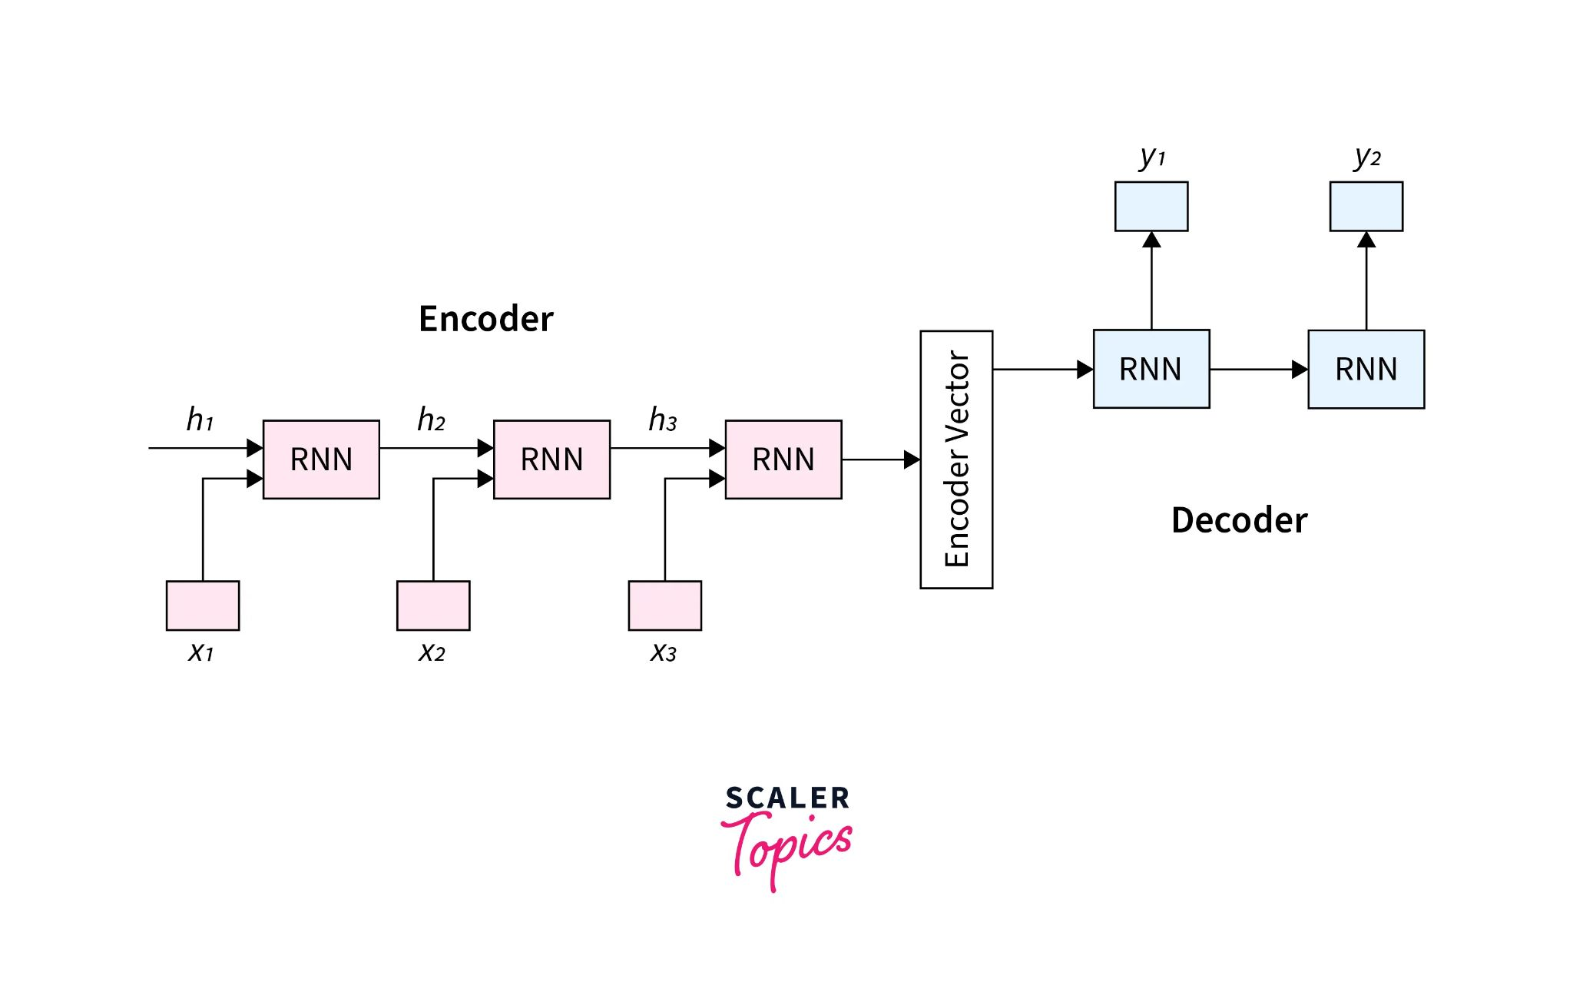
Direction and sequence length
Bidirectional RNN
A forward and a backward pass give each token context on both sides. This suits offline tagging of a complete sentence.
Encoder–decoder
An encoder reads the source. A decoder starts from its context and emits tokens until an end token or a length limit.
A live forecaster can use only observations available so far.
Notes:
Direction controls which observations a prediction may use. Output alignment controls when predictions are made. For translation, output length can differ from input length. A basic encoder compresses input into its final state. Attention can instead give the decoder access to individual encoder states at each output step. The notebook runs an untrained bidirectional GRU and encoder–decoder to show these tensor shapes.
Sources
Nguyen Thi Khanh Tien, Chapter 6. Recurrent Neural Networks, course slides. Pages 6, 11 and 16. Encoder–decoder diagram from p. 16 (Scaler Topics).
https://d2l.ai/chapter_recurrent-modern/encoder-decoder.html
Companion notebook, Architectures-based-on-RNNs.ipynb.

Slide 7
How the notebook represents a sequence
red tick tap blue hum ping
Token representation
Variable lengths
Each token has an integer ID. Red has ID 1 and one-hot vector [0, 1, 0, 0, 0, 0, 0]. The model learns eight numbers per ID.
Pad a batch with ID 0 and pass the true lengths to the RNN. Keeping only the last two tokens here would discard both colors.
The scored experiment uses every token. Padding has no effect on its predictions.
Notes:
Point out that integer IDs act as lookup keys. Their numerical distances have no meaning. One-hot encoding represents each item in its own coordinate, whereas a learned embedding updates a compact vector during training. PyTorch pack_padded_sequence makes the recurrent final state correspond to the last real token. The notebook demonstrates right truncation and checks padding invariance on a prediction pair.
Sources
Nguyen Thi Khanh Tien, Chapter 6. Recurrent Neural Networks, course slides. Page 17, Practice.
Companion notebook, Architectures-based-on-RNNs.ipynb. Section “Representing variable-length sequences.”
https://docs.pytorch.org/docs/stable/generated/torch.nn.utils.rnn.pack_padded_sequence.html

Slide 8
Training and testing the memory task
768
192
256
training sequences
validation sequences
sequences per test set
Model comparison
Memory delay
One layer, 16 hidden units, the same minibatches and 10 epochs. Select each checkpoint by lowest validation loss.
Training and standard tests use 2–10 neutral tokens after the second signal. The longer test uses 18–26.
Notes:
Both test sets contain 128 balanced swap pairs and share no examples with training or validation. Score correct predictions divided by the total number of sequences. The embedding size is eight, batch size is 48, Adam learning rate is 0.008, and gradient-norm clipping threshold is 1.0. Training uses a single fixed seed of 27. Equal hidden width gives different parameter counts because each gate has weights.
Sources
Companion notebook, Architectures-based-on-RNNs.ipynb. Sections “An order question that token counts cannot answer” and “Training and checkpoint selection.”
Course Chapter 3, pp. 7–11, 16. Chapter 4, pp. 8, 22–23.

Slide 9
What happened when the delay grew?
All three models scored 256/256 on standard tails. On longer tails, the LSTM missed one sequence.
Notes:
Each bar reports held-out sequence accuracy for one checkpoint. Both test sets have 256 sequences and a 50% count-only baseline. Read the two bars for a model as a response to a change in the number of neutral tokens following the cues. The raw correct counts in standard/long order are Count baseline 128/128, RNN 256/256, LSTM 256/255, GRU 256/256. The notebook prints the counts and plots both conditions. One seed and unequal parameter counts limit comparisons across cells.
Sources
Companion notebook, Architectures-based-on-RNNs.ipynb. Section “Held-out accuracy at two memory delays.” Original experiment.

Slide 10
One long sequence fooled the LSTM
22 neutral tokens followed the second signal.
Blue came first. The LSTM predicted red. Because each color appeared exactly once, a correct answer could come from remembering either signal.
A stronger follow-up would include repeated signals, match parameter counts, and repeat training with several seeds.
Notes:
The actual wrong example begins ping, tap, blue, ping, red. The following 22 neutral tokens separate the second signal from the readout. Ask the audience whether a perfect score proves the model stored the first token itself. The paired design proves that token counts alone cannot solve the task, but seeing the second color is also sufficient. A repeated-cue dataset would separate these strategies. Multiple seeds and matching model sizes would help estimate variability and compare the role of gating.
Sources
Companion notebook, Architectures-based-on-RNNs.ipynb. Sections “Inspect a prediction pair” and “Interpreting the comparison.”

Slide 11
Sources and notebook
Course reading
Chapter 6, pp. 2–17, covers recurrent cells, input and output patterns, and sequence representation.
Architecture references
PyTorch documentation for RNN, LSTM and GRU. Karpathy (2015) illustrates input and output arrangements. Dive into Deep Learning explains backpropagation through time.
Reproduce the experiment
Open Architectures-based-on-RNNs.ipynb and select Restart Kernel and Run All. The notebook generates the data locally.
Notes:
The notebook includes clickable references, saved plots and the exact training code. No model files or dataset downloads are needed once the Python packages are installed.
Sources
Nguyen Thi Khanh Tien, Chapter 6. Recurrent Neural Networks, course slides.
https://docs.pytorch.org/docs/stable/generated/torch.nn.RNN.html
https://docs.pytorch.org/docs/stable/generated/torch.nn.LSTM.html
https://docs.pytorch.org/docs/stable/generated/torch.nn.GRU.html
https://karpathy.github.io/2015/05/21/rnn-effectiveness/
https://d2l.ai/chapter_recurrent-neural-networks/bptt.html
Companion notebook, Architectures-based-on-RNNs.ipynb.

