Slide 1
Deep learning
TENSORFLOW

Slide 2
MNIST Dataset
MNIST is a labeled set of images of handwritten digits.
Google’s AI tool TensorFlow is used in this project to train the traditional dataset MNIST where the model looks at images and predict what digits they are.
TensorFlow
This presentation is not necessarily building the best model, but rather showing my first training model leveraging powerful tool TensorFlow directly on my computer.
OVERVIEW

Slide 3
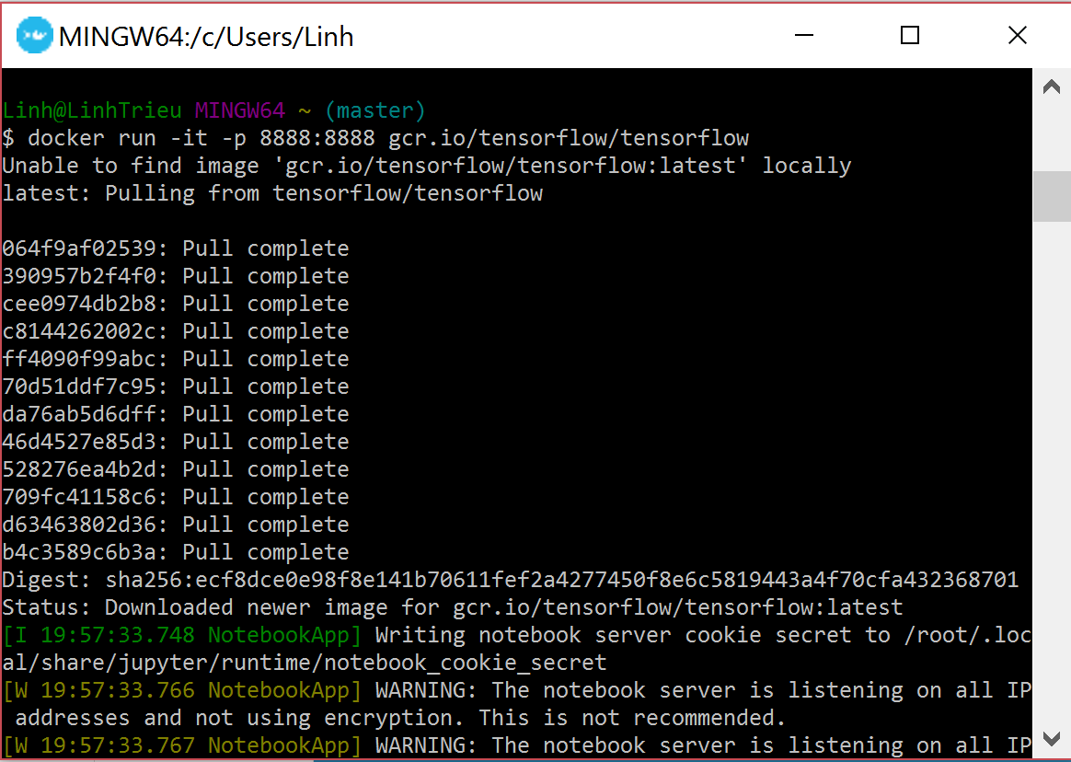
Docker
On Windows environment, I installed Docker, launched docker container, and ran Ipython Notebook

Slide 4
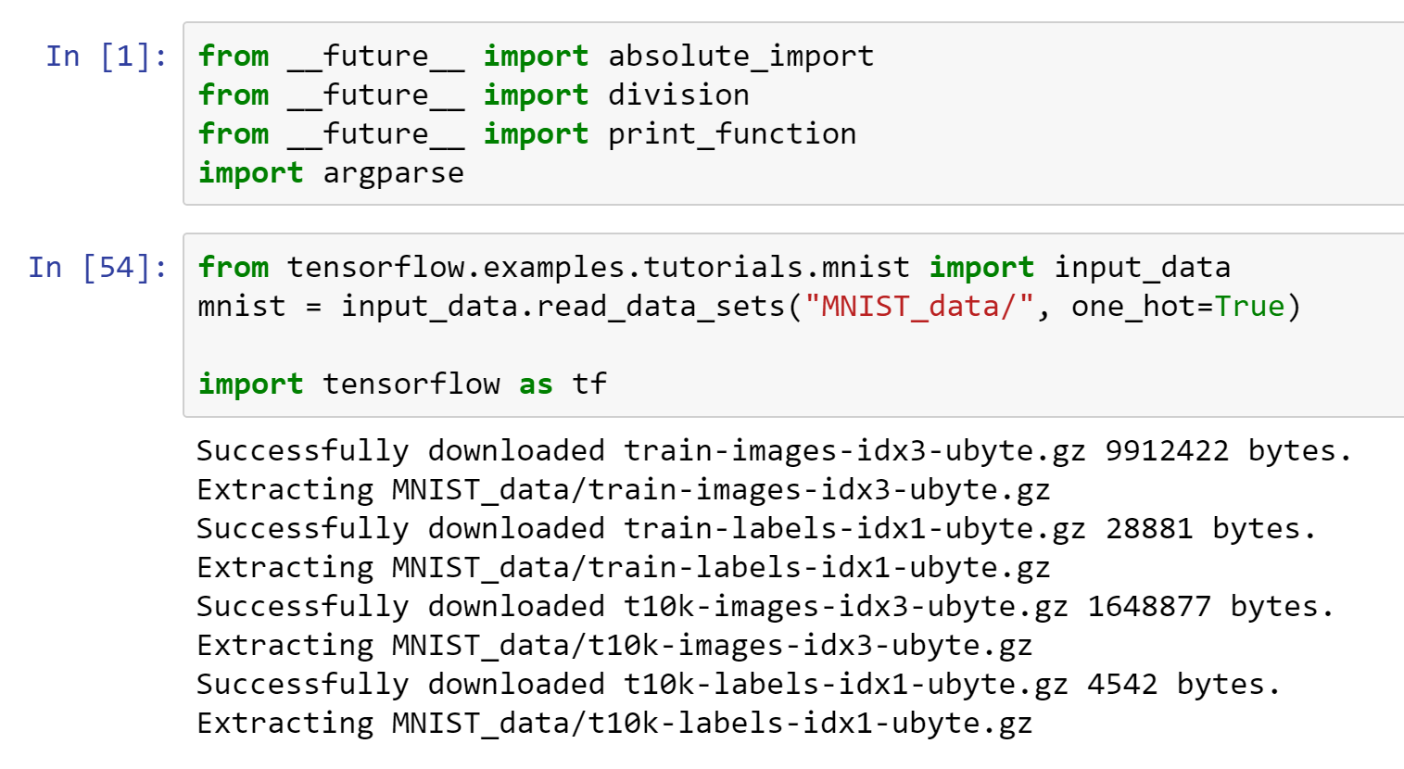
LOAD DATASET MNIST
Imported tensorflow into ipynb
Loaded dataset as mnist
55k
mnist.test
5k
mnist.validation
mnist.train
10k
MNIST

Slide 5
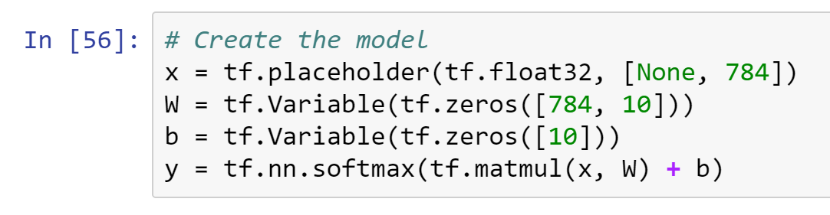
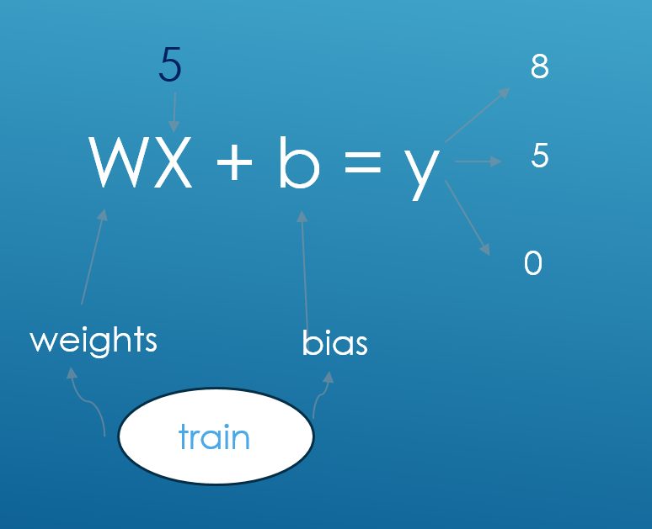
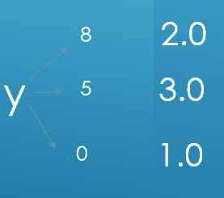
SOFTMAX
Flattened array into a vector of
28*28 = 748 numbers
Each image has 28pixels by 28 pixels.
Model function:
Declared variables to the model for recognizing digits by looking at every pixel in the image
SCORE
2.0
PROBABILITY
3.0
P=0.3
1.0
SOFTMAX
P=0.8
from SCORE TO PROBABILITY
P=0.1

Slide 6
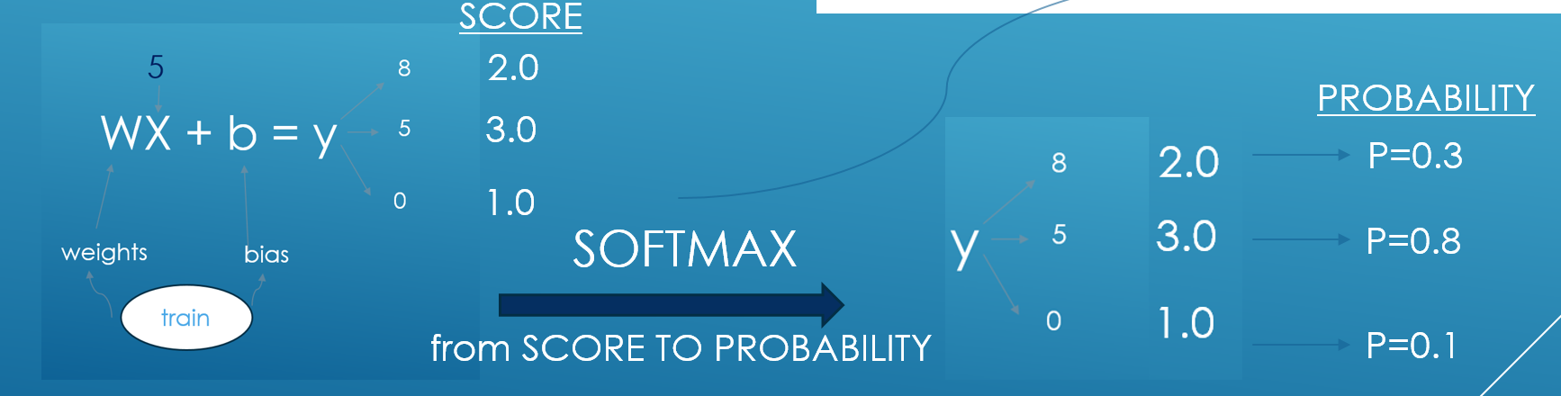
ONE-HOT ENCODING
Set the probability of the correct class (P=0.8) be close to 1
For all others, be close to 0
one_hot=True
0.0
1.0
= 5
0.0

Slide 7
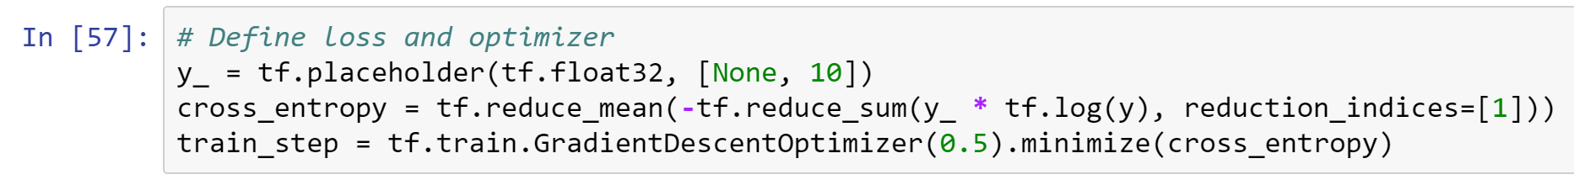
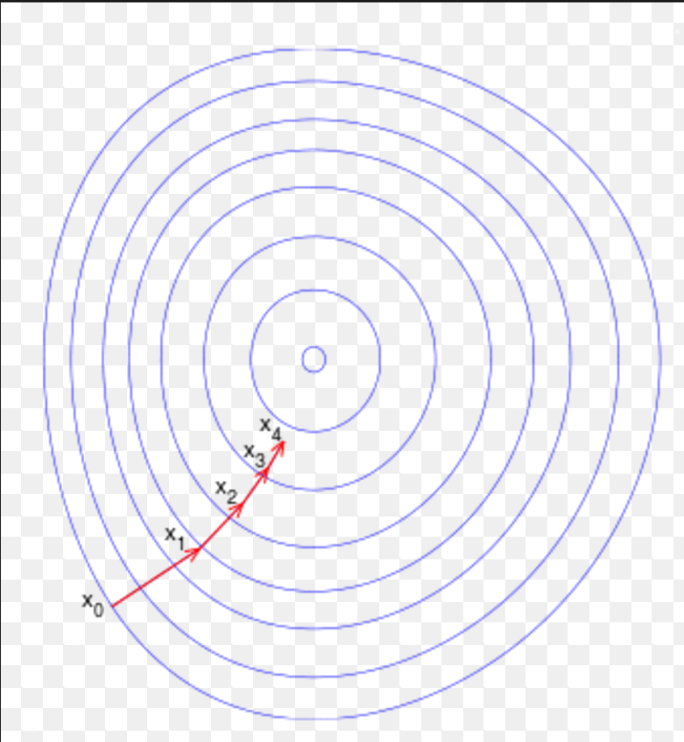
Cross-Entropy
input
logit
softmax
one-hot
So far, model looks like this
Cross-entropy
WX+b
S(Y)
The step above is called Multinomial Logistic Classification
Cross-entropy function: distance D(S(WX+b), L)
Loss is the average of cross-entropy, which is lots of sums and matrices
Gradient descent algorithm is chose to find the least loss with learning rate at 0.5

Slide 8
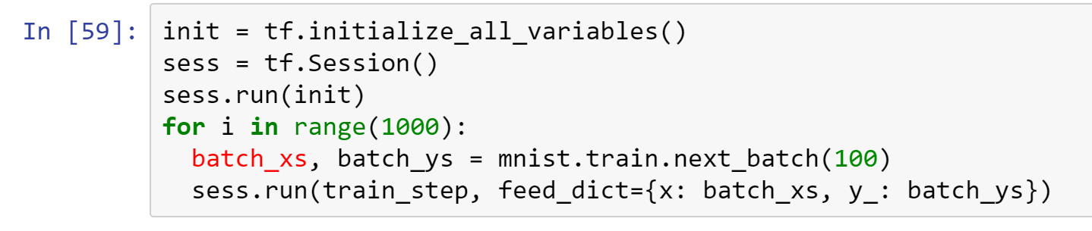
Scholastic gradient descent
As loss function is very huge and dependent on all single element in the training set, it uses lots of compute to train the data.
Instead, batch included 100 random data points was used, many times, to increase efficiency.
TensorFlow session was initialized

Slide 9
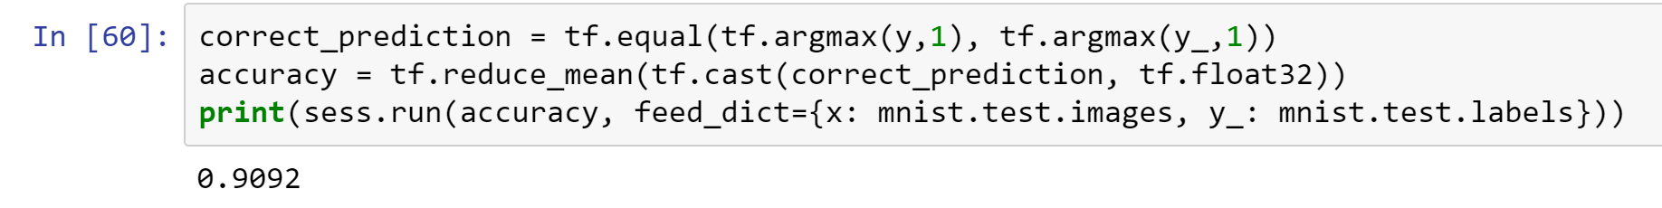
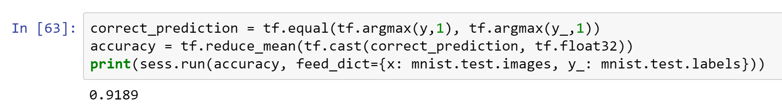
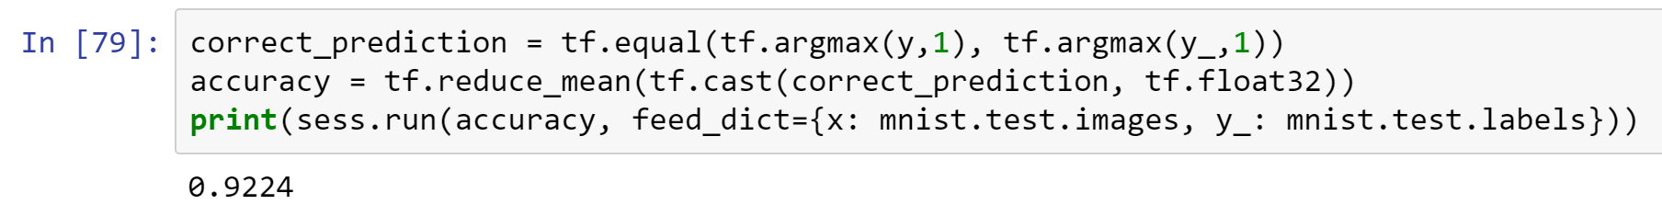
Model evaluation
First time: 90.9% accuracy
Second time: 91.9% accuracy
Third time: 92.2% accuracy

Slide 10
Reference
This project follows instructions on www.tensorflow.com
Linh Trieu
Advanced Business Intelligence
The University of Texas at Dallas

