Slide 1
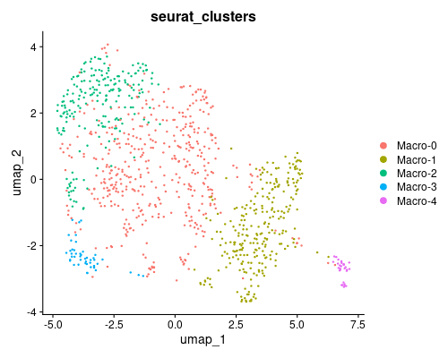
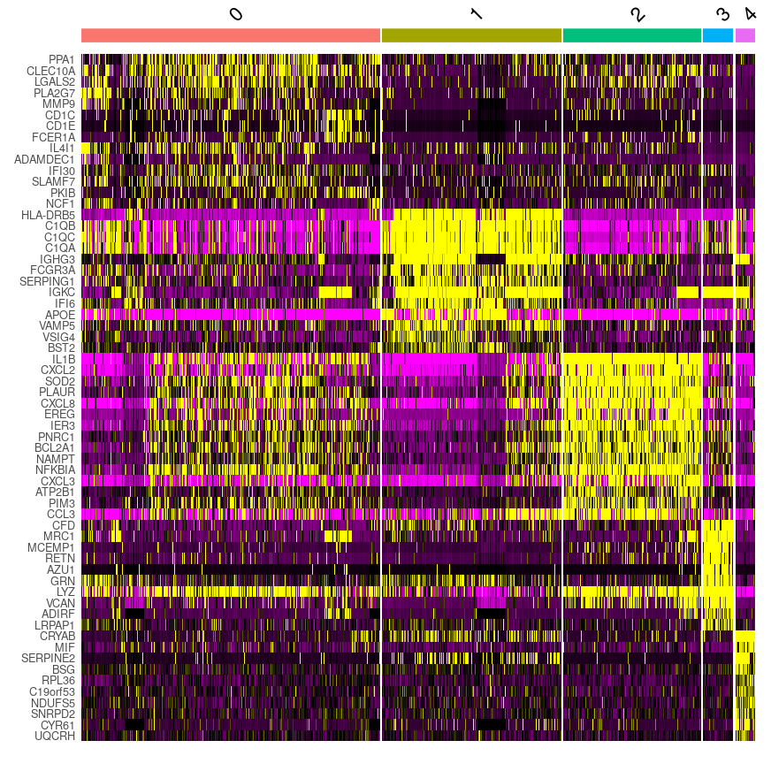
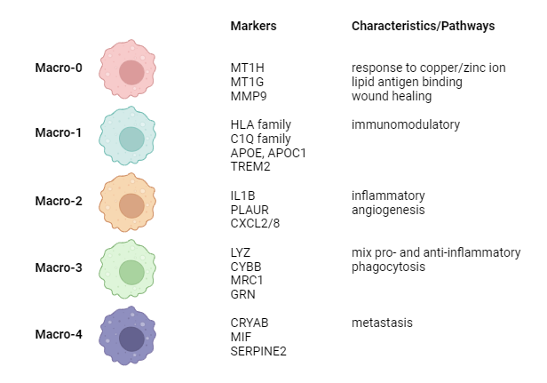
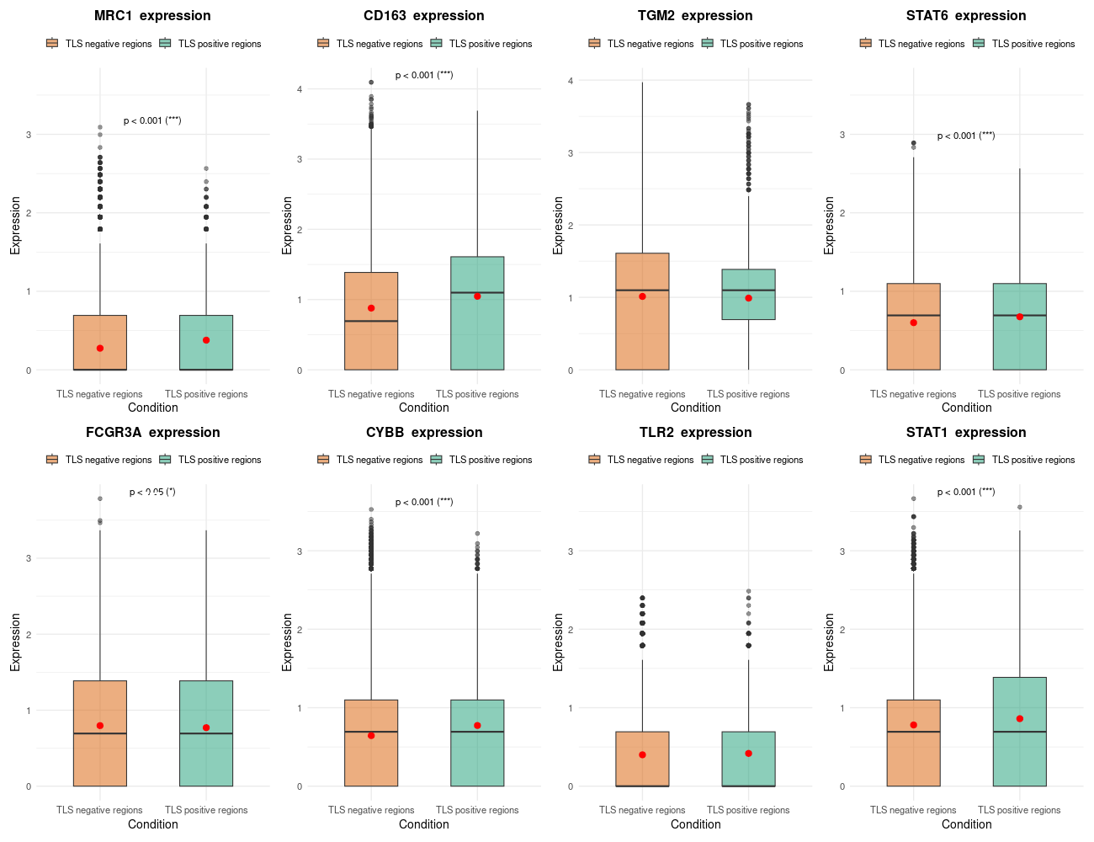
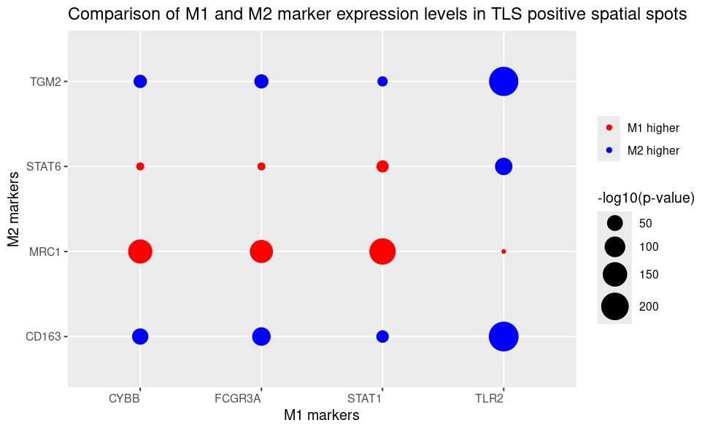
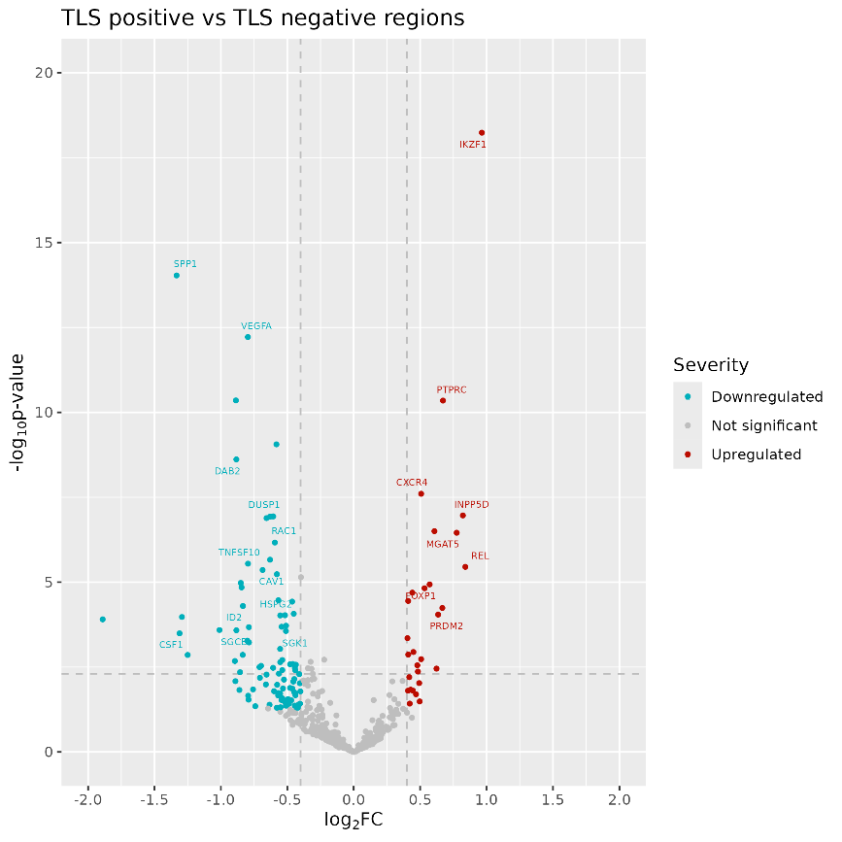
a)
b)
c)
d)
e)
f)
g)
Overexpressed genes | Frequency | Underexpressed genes | Frequency
IKZF1 | 9 | SPP1 | 13
PTPRC | 9 | ANPEP | 11
CIITA | 8 | APP | 10
ETS1 | 8 | MIF | 10
LCP1 | 8 | PLIN2 | 10
LYZ | 8 | VEGFA | 10
ZFP36L2 | 8 | EGFR | 9
CXCR4 | 7 | LGALS3BP | 9
CYBB | 7 | MET | 9
DCN | 7 | PRXL2A | 9
JAK3 | 7 | TNFSF10 | 9
MPEG1 | 7 | FTH1 | 8
RAC2 | 7 | HSPD1 | 8
CCL19 | 6 | SPON2 | 8
CD44 | 6 | VCAM1 | 8
CYBA | 6 | CAV1 | 7
ERN1 | 6 | CD81 | 7
FOS | 6 | CITED2 | 7
IL10RA | 6 | CTSD | 7
INPP5D | 6 | DAB2 | 7
ITGA4 | 6 | DDT | 7
ITGAX | 6 | DUSP1 | 7
PRDM2 | 6 | IL32 | 7
SOCS3 | 6 | LGALS1 | 7
THEMIS2 | 6 | MGLL | 7
VWF | 6 | MME | 7
 |  | SCARB1 | 7
 |  | SLC22A5 | 7
 |  | SOD1 | 7
 |  | TXN | 7
 |  | VIM | 7
Key findings of the study. a UMAP of macrophages in the TLS-positive samples showed five MAMs subpopulations. b Heatmap showing 15 most differentially expressed markers for each MAM subpopulation. c Summary of the markers and characteristics for the five phenotypes identified. d Distribution of M1 and M2 markers’s expression inside and outside TLS areas. P- values indicate whether there is significant change in expression of those markers between different regions. Mean values are also visualized as a red dot. (*) means the p-values are smaller than 0,05. P-values smaller than 0.005 and 0.001 are indicated by (**) and (***), respectively. e Comparision of four M1 and 4 M2 markers across TLS spatial spots. Color indicates whether M1 or M2 expression are significantly higher, while size represents the level of significance. f Up- and downregulated gene lists of TLS-associated TAMs and their corresponding frequency across the samples. g Volcano plot of differential expression analysis between TLS regions and non-TLS regions of one sample. The threshold for p-values is 0,05. Overexpressed genes have log2 foldchange larger than 0.4, while underexpressed genes have log2 foldchange smaller than -0.4.
Notes:
Key findings of the study. a UMAP of macrophages in the TLS-positive samples showed five MAMs subpopulations. b Heatmap showing 15 most differentially expressed markers for each MAM subpopulation. c Summary of the markers and characteristics for the five phenotypes identified. d Distribution of M1 and M2 markers’s expression inside and outside TLS areas. P- values indicate whether there is significant change in expression of those markers between different regions. Mean values are also visualized as a red dot. (*) means the p-values are smaller than 0,05. P-values smaller than 0.005 and 0.001 are indicated by (**) and (***), respectively. e Comparision of four M1 and 4 M2 markers across TLS spatial spots. Color indicates whether M1 or M2 expression are significantly higher, while size represents the level of significance. f Up- and downregulated gene lists of TLS-associated TAMs and their corresponding frequency across the samples. g Volcano plot of differential expression analysis between TLS regions and non-TLS regions of one sample. The threshold for p-values is 0,05. Overexpressed genes have log2 foldchange larger than 0.4, while underexpressed genes have log2 foldchange smaller than -0.4.

