Slide 1
Student Grade Calculator using RMI
Supervisor - Daw Ohmar Hlaing

Slide 2
Presented by
5CS- 1 Ma Myint Myat Moe
5CS- 4 Ma Ei Phyu Thin
5CS-7 Ma Chue Thinzar
5CS-55 Mg Lin Htut Kyaw
5CS-57 Mg Arnt Thu Kyaw

Slide 3
Contents
Introduction
What is RMI?
Why Do We Use RMI?
System Requirements
Implementation
Conclusion

Slide 4
Introduction
The purpose of the RMI Student Scoring System is to provide a distributed application that calculates grades for students based on their scores in various subjects. The system also determines if a student qualifies as a special pass, requiring scores above a certain threshold.
This project focuses on creating a simple RMI-based application for educational purposes. It is designed to demonstrate the basic concepts of Remote Method Invocation in Java. The project consists of two main components: the RMI server (StudentServer) and the RMI client (StudentClient).

Slide 5
What is RMI?
RMI stands for Remote Method Invocation.
Allows an object residing in one system (JVM) to access/invoke an object running on another JVM.
Having two programs, a server program and a client program.
Such an application is sometimes referred to as a distributed object application.

Slide 6
Why Do We Use RMI?
To minimize the complexity of the application.
To preserve type safety.
Minimize the difference between working with local and remote objects.

Slide 7
System Requirements
Calculates grades for students based on their scores in various subjects
Remote method invocation server for storing sensitive function
A material design template for better user experience
A client app to invoke the protected function from the server

Slide 8
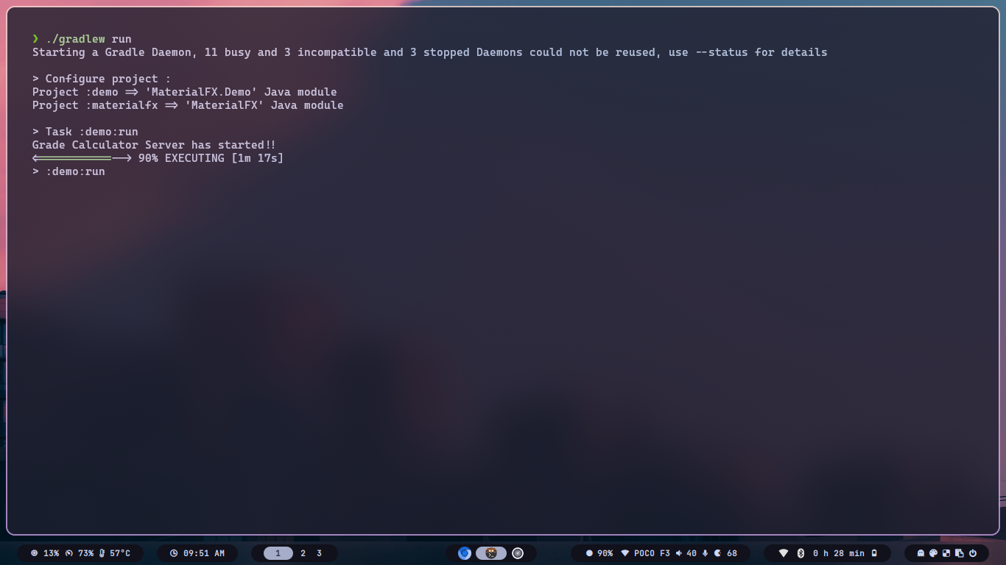
Show Server Ready
Implementation
Here is a simple Student Grade calculator application by RMI.

Slide 9
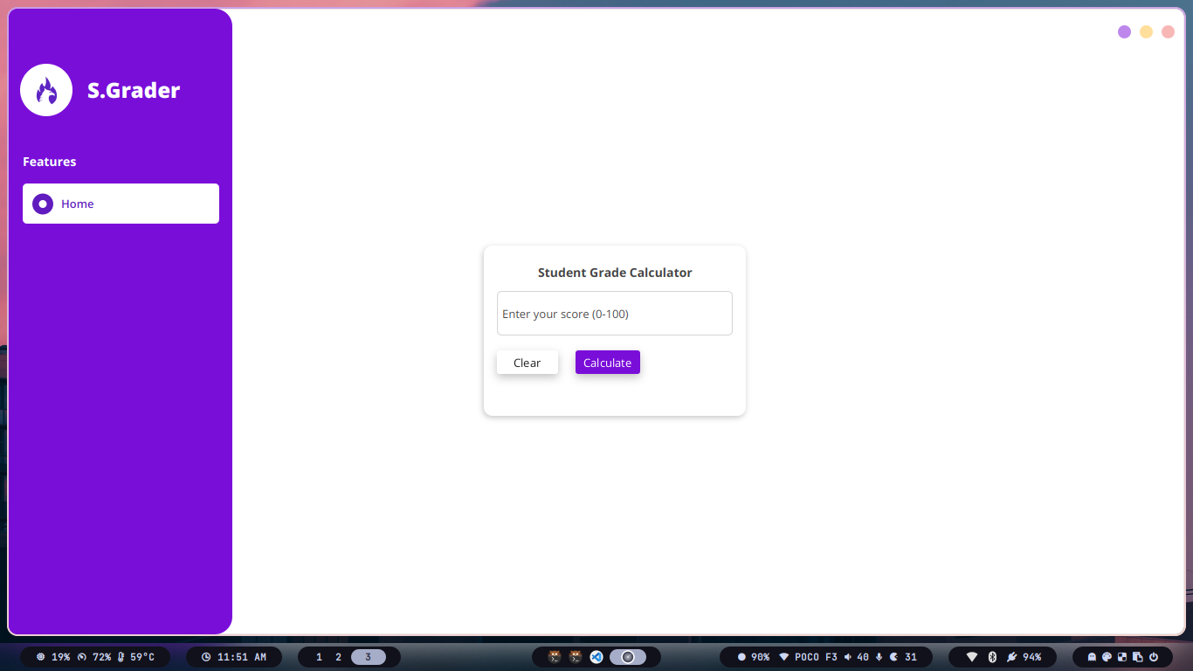
Show Form for Student Grade Calculator

Slide 10

Show The Result for Student Grade

Slide 11
Conclusion
In summary, the RMI Student Grade Calculation System provides a basic framework for calculating grades and determining special pass status in a distributed environment.
Potential enhancements include improving security measures, refining grading algorithms, and extending the system with additional features.

Slide 12
Thank you!
Do you have any questions?

