Slide 1
2022 影像處理 Image Processing
Homework 1
Instructor: Dist Prof Sun, Yung-Nien

Slide 2
Problem
 1) RGB Extraction & transformation (10%)
 2) Smooth filter (mean and median) (10%)
 3) Histogram Equalization (10%)
 4) A user-defined thresholding (5% + slider 5%)
 5) Sobel edge detection (10%)
 6) Edge overlapping (5%)
 7) Connected Component (15%)
 8) Image registration (15%)
※ Program functionality (cascade several steps + undo one step, 15 %)

Slide 3
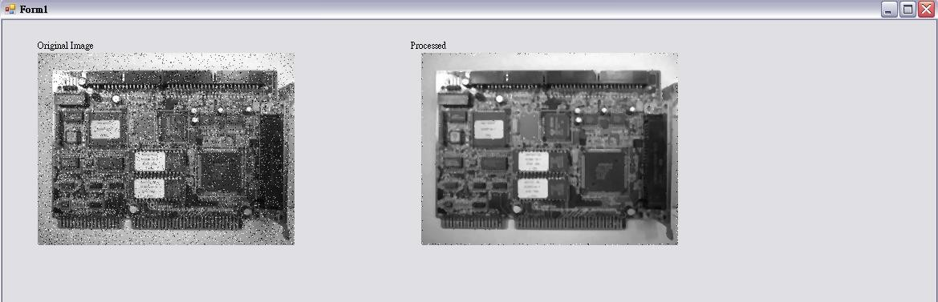
Basic requirement
 Using C++ or C# to write the program. You can download visual studio software on the web page of computer and network center of NCKU. (2015 or above version is recommended; if you are not familiar with both C++ and C#, C# is suggested)
 Your program must show the results as before and after the processing step on the screen simultaneously.
Smooth filter
 Program functionality : Each function can be processed independently, following the previous step, and “undo”. （e.g. Performing sobel edge detection after smooth filter, and then undo)
 Problem (1) deals with the color input images, the others problems handle gray level images.
Before
After

Slide 4
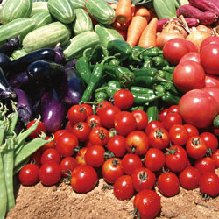
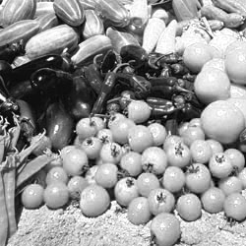
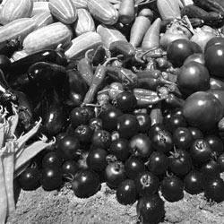
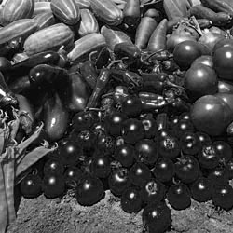
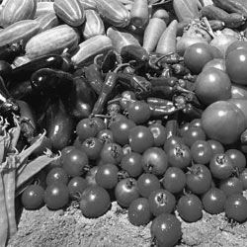
1. RGB Extraction & Transformation
 Requirement - Extract the R, G, B channel from the color image and transform it to gray scale image.
Color extraction (6%)
Extract R、G、B channel to each image
Color transformation (4%)
Change color image to gray scale image
Source
R channel
G channel
B channel
Grayscale

Slide 5
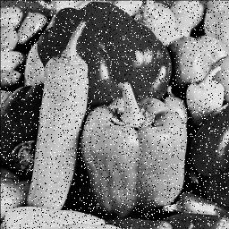
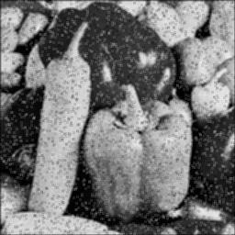
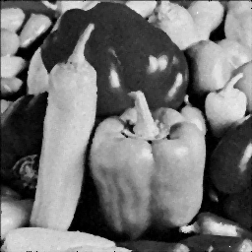
2. Smooth filter (mean and median)
 Requirement – Implement mean(5%) and median(5%) filter
＊Filter size : 3x3
Source
Mean
Median

Slide 6
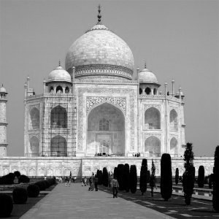
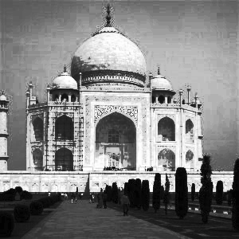
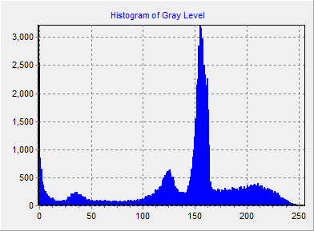
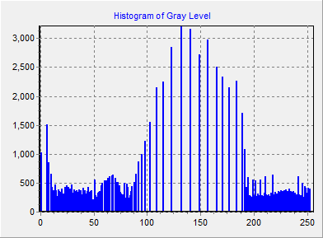
3. Histogram Equalization
 Requirement – Implement histogram equalization (15%)
need to show histogram of image before and after processing (5%)
Original
Result

Slide 7

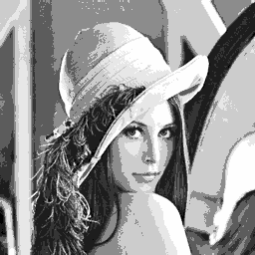
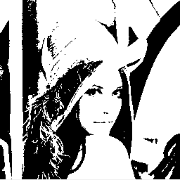
4. A user-defined thresholding
 Requirement – Given a threshold t. The intensity of a pixel which is higher
than or equal to t will be set as white (255), otherwise set as black (0).
※ The threshold should be input from slider (1 ~ 255) on the interface.
Defined threshold value t

Slide 8
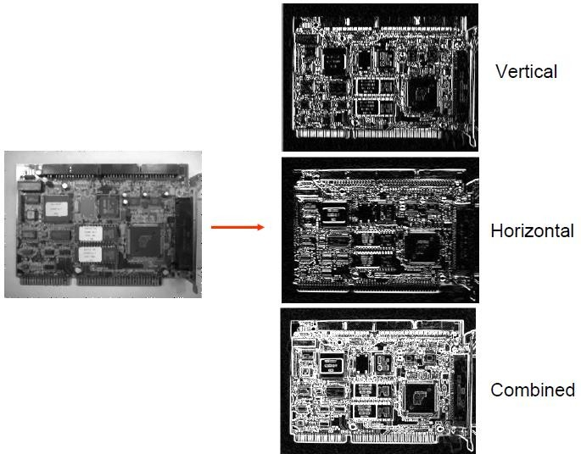
5. Sobel edge detection (vertical, horizontal, and combined)

Slide 9
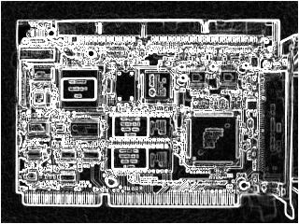
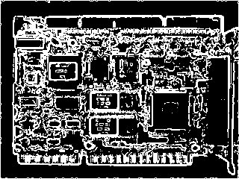
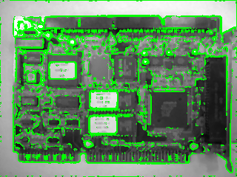
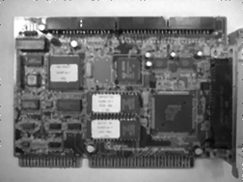
6 Threshold the result of (5) to binary image and overlap on the original image
The result of (5)
The result after thresholding
Overlap on the original image
by green color
(The threshold should be adjusted on the interface)
original image

Slide 10
7. Connected Component : Count the number of connected regions in a binary image and paint it with different colors
Input image : Foreground(black), background(white)
Hint : Section 2.5
Using 8-adjacency
The pixel on the border of the image should be considered.
Adjacent region should display in different colors.
Num of Connected region : 3
Input Image
Result

Slide 11
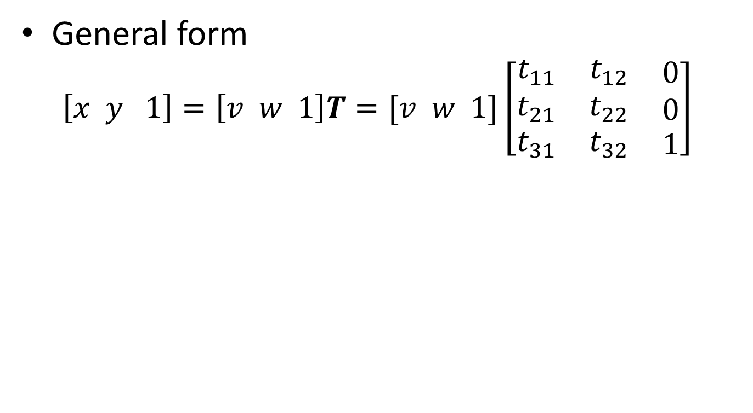
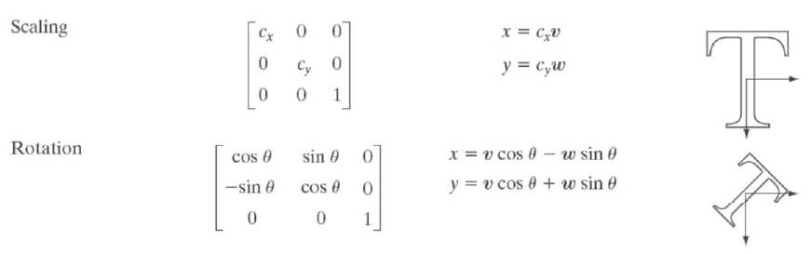
8. Image registration

Slide 12
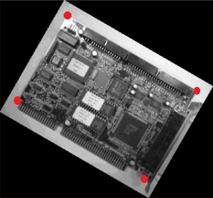
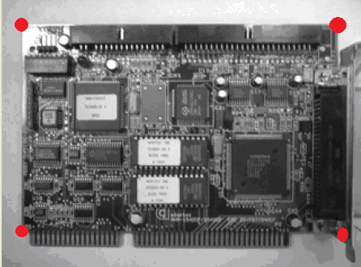
8. Image registration
Requirement – Given two images A and B, B is a transformation of A by scaling and rotation.
Please register image B to image A.
A
B
Registered

Slide 13
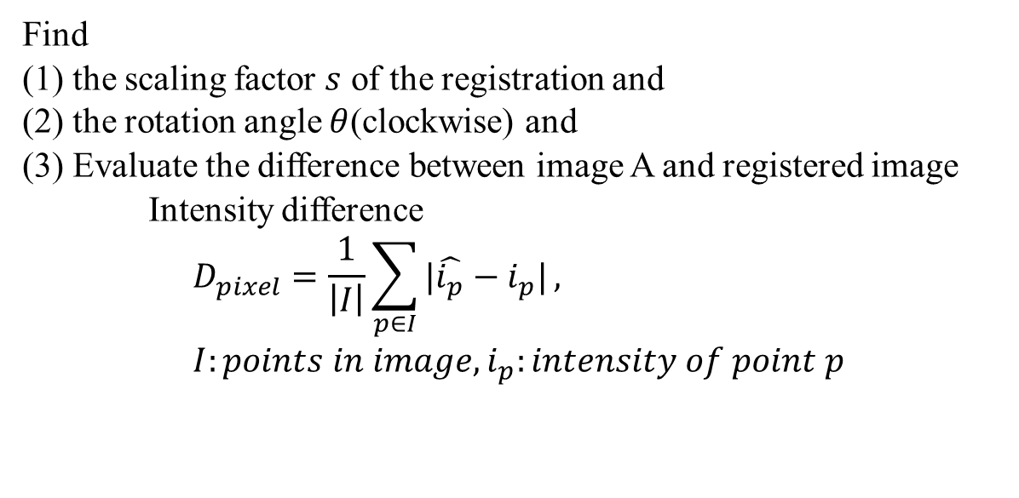
8. Image registration
Find
(1) the scaling factor $s$ of the registration and (2) the rotation angle $θ$(clockwise) and
(3) Evaluate the difference between image A and registered image
Intensity difference $$D_{pixel}=\frac{1}{\left|I\right|}\sum_{p∈I}{|\hat{i_{p}}−i_{p}|}, \\ I:points in image, i_{p}:intensity of point p$$

Slide 14
Notice
 The report should be written in Chinese or English, and 4 pages in length at least.
The report should include the problems, methods, results, discussion and
conclusion. Please print it out and hand in at the demonstration.
 The demonstration will be held in Room 65702 during 11/3(Thur). The schedule will be announced in advance on NCKU moodle.
 Please inform the teaching assistant if you cannot attend the demonstration one week earlier.
 Image processing related library cannot be used and it is not allowed to copy homework.

Slide 15
File Upload
 Please compress the program source code, execution file(release mode) and
report as a zip file and upload it to FTP before 11:59 p.m. of 11/01(Tue.).
 ftp://140.116.247.97, port:102
 id: imagehw
 password: imagehw
 The format of the zip file name :
 [VS version]_[student id].zip
 e.g VS2015_P78901234.zip.
 Please add your version number if you have any new update
 e.g. VS2015_P78901234_v02.zip

Slide 16
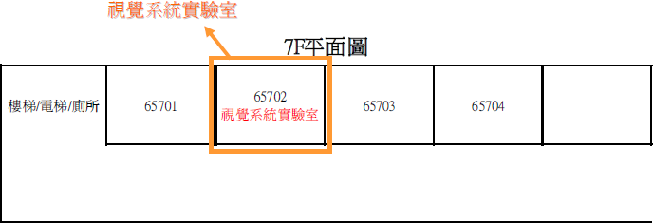
Vision System Lab (Room 65702)

Slide 17
Information
 NCKU moodle
TA :
willy123301@gmail.com
johnson210140@gmai.com
chenxuan0511@gmail.com

