Slide 1















Voluntary
Free applications
No contract or subscription
New or competitive market
Eg: Customer-facing apps
Long-term contract or auto-pay is signed
Lost the competition edge
Eg: Telecom companies
Non-contractual
Contractual
Free applications
No contract or subscription
Ineligible customers or illegitimate actions
Eg. Reported account on SM
A contract is needed to be continued or auto-paid
Customer is forced out
Eg: Discourteous free trial
Non-Voluntary

Slide 2
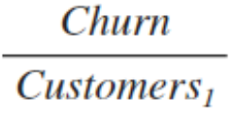

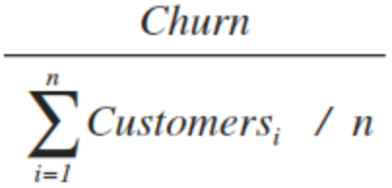
Customer Churn Rate
 | Function | Pros | Cons
First day of the month |  | Simple to calculate and understandable | High growth or decline can distort the resulting rate Hard to tell where the churned group are from
Adjusted for each month |  | Easy to calculate Account for the growth | Assuming churn rate are even during the window - not able to scale to different time windows
Adjusted for each day |  | Able to scale at different time windows | Will be affected by turbulence on a specific day
Cohort | Churn After X Days / Cohort Size | Helpful to test the effect of product changes

Slide 3
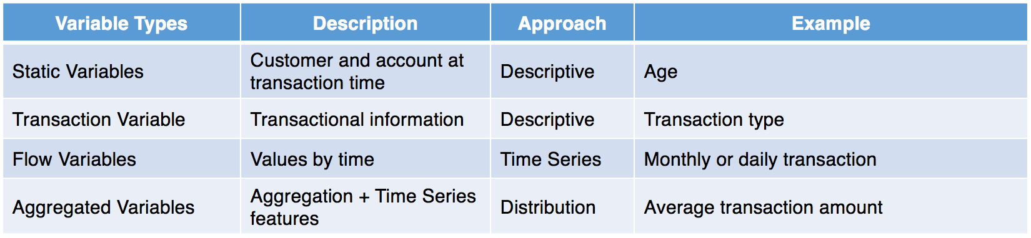
Variable Types | Description | Approach | Example
Static Variables | Customer and account at transaction time | Descriptive | Age
Transaction Variable | Transactional information | Descriptive | Transaction type
Flow Variables | Values by time | Time Series | Monthly or daily transaction
Aggregated Variables | Aggregation + Time Series features | Distribution | Average transaction amount

