Slide 1
STRATEGIC THINKING CA2
CCT COLLEGE DUBLIN
HIGHER DIPLOMA IN SCIENCE IN DATA ANALYTICS FOR BUSINESS
Eduardo Saldivar
Lais Ameno
Línika Almeida

Slide 2
INTRODUCTION
For this project we chose a Hearth Stroke dataset collected from the Kaggle platform.
The dataset is based on lifestyle choices, hobbies and daily routine of people who had and not had hearth stroke.
The company object of this project consist in a insurance health company that want to create customized policies for each customer by mining and analyzing customer data to find patterns and trends in consumer behavior.
This individualized strategy can reduce expenses, aid the insurance company in retaining clients and boosting client satisfaction, creating a win-win scenario for both the client and the business.

Slide 3
BUSINESS DESCRIPTION
Considering that the company is a health insurance company and wants to reduce customer expenses by creating a customized health plan that identifies which possible illnesses the customer may have. We will develop a project where the company can previously identify this before closing a contract with the client.
We will take as a starting point the analysis of a predisposition for this type of serious illness such as hearth stroke. And our main goal is to improve health outcomes and reduce healthcare costs for the company, and avoid possible costs with patients that might have this disease.

Slide 4
WHAT HAS BEEN ACCOMPLISHED
EXPLORATORY ANALYSIS
- It was enhanced and restructured to make it more understandable
- All plots received titles and were modified
- Code was further explained
DATA PREPROCESSING
- Normalization, Log transformation, Hot ecoding
MODELING
- Hyperparameter in SVM
- LDA + Under Sampling + ROC AUC
- Random Forest + Shap

Slide 5
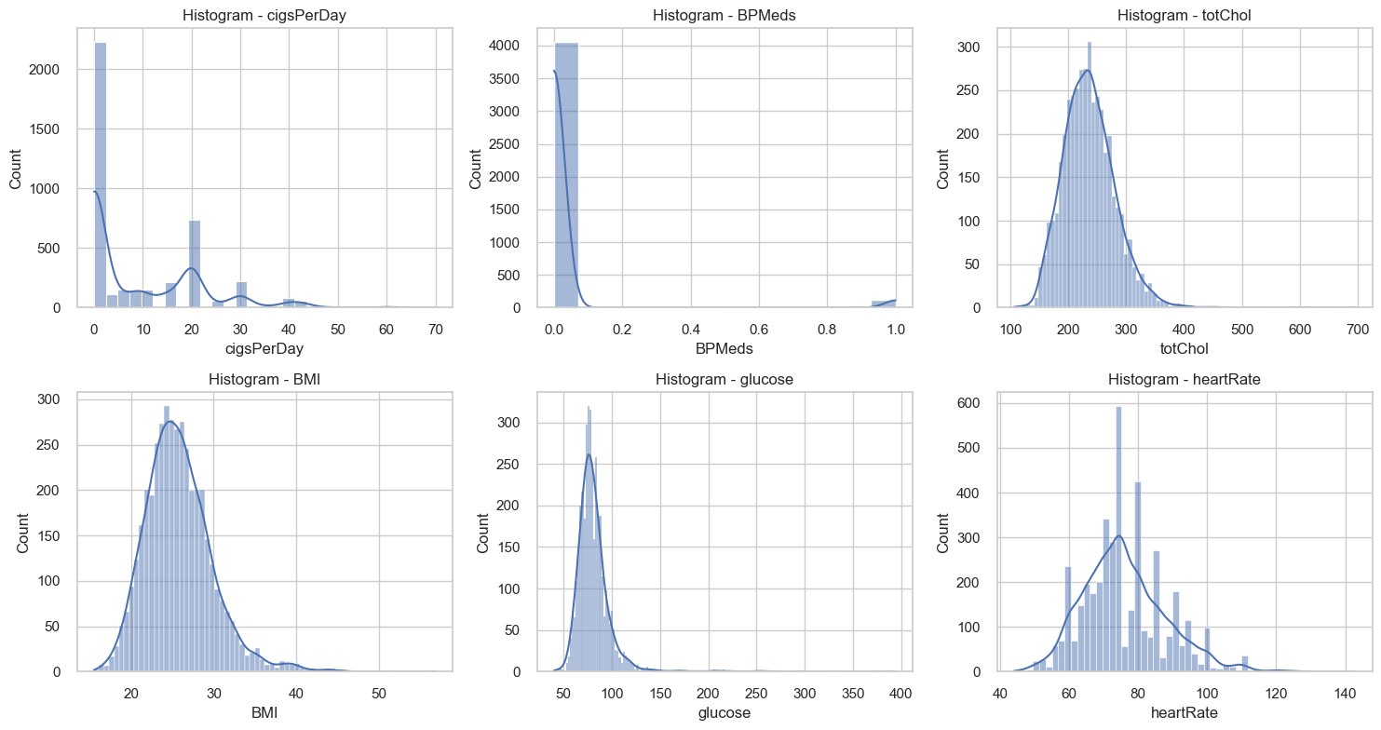
HISTOGRAM CONTINUOUS DATA

Slide 6
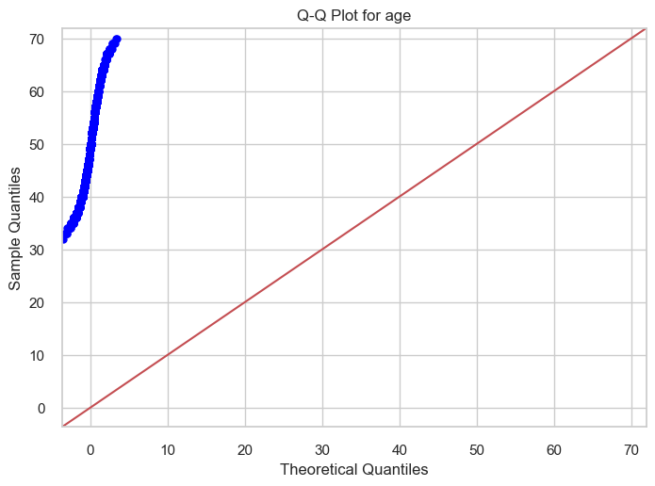
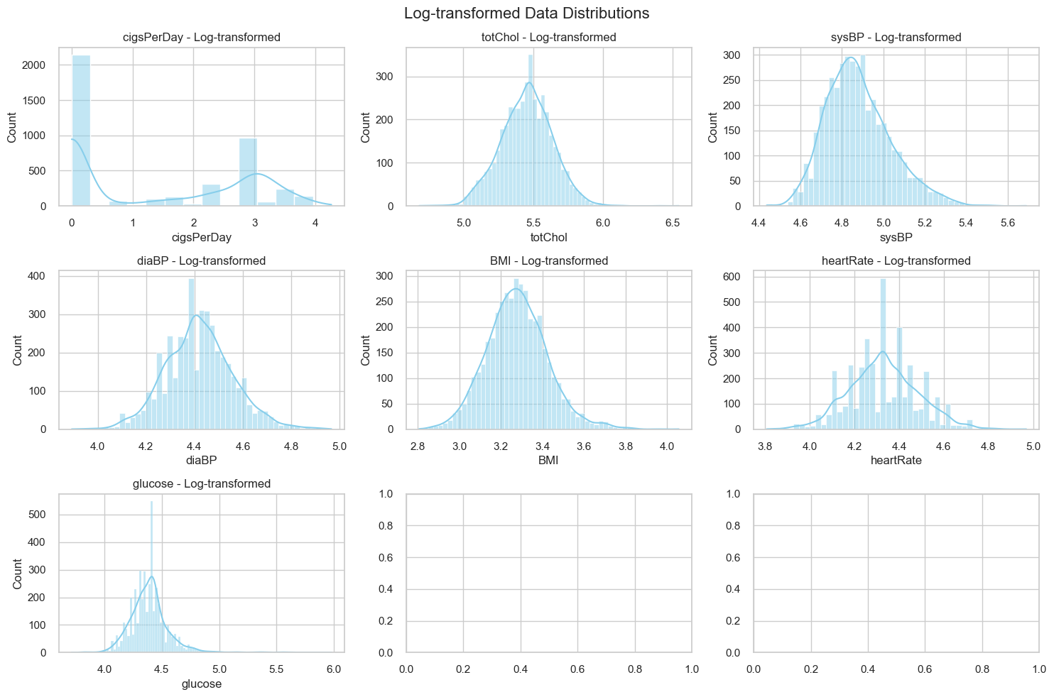
DATA TRANSFORMATION
Normalization
Logarithmical Transformation

Slide 7
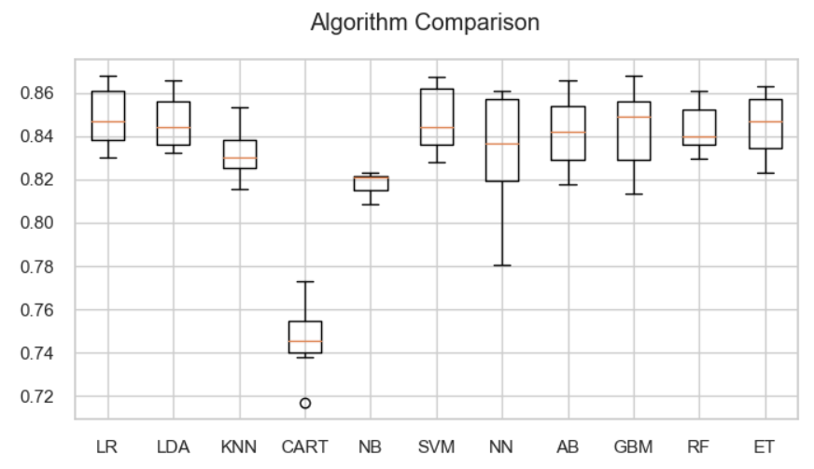
TECHNOLOGIES USED
SVM
MODEL | ACCURACY
Logistic Regression | 84,79%
SVM | 84,89%
KNN | 83,24%
Random Forest | 84,38%
Decision Tree | 74,64%
GaussianNB | 81,79%
MLP Classifier | 83,31%
AdaBoost | 84,15%
Gradient Boosting | 84,28%
LDA | 84,65%

Slide 8
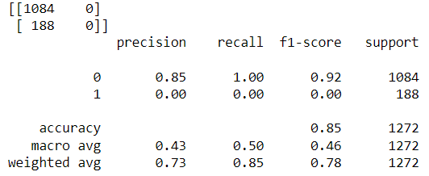
Model evolution
It has developed the model best fitted
MODEL | ACCURACY | AFTER HYPARAMETER
SVM | 84,89% | 85,2%
The precision for Class 1 is low

Slide 9
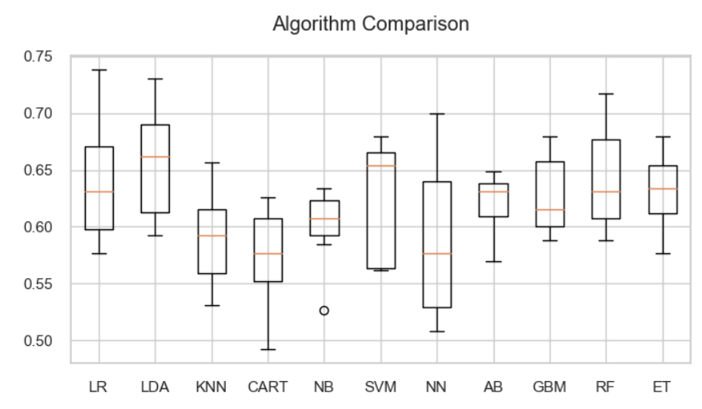
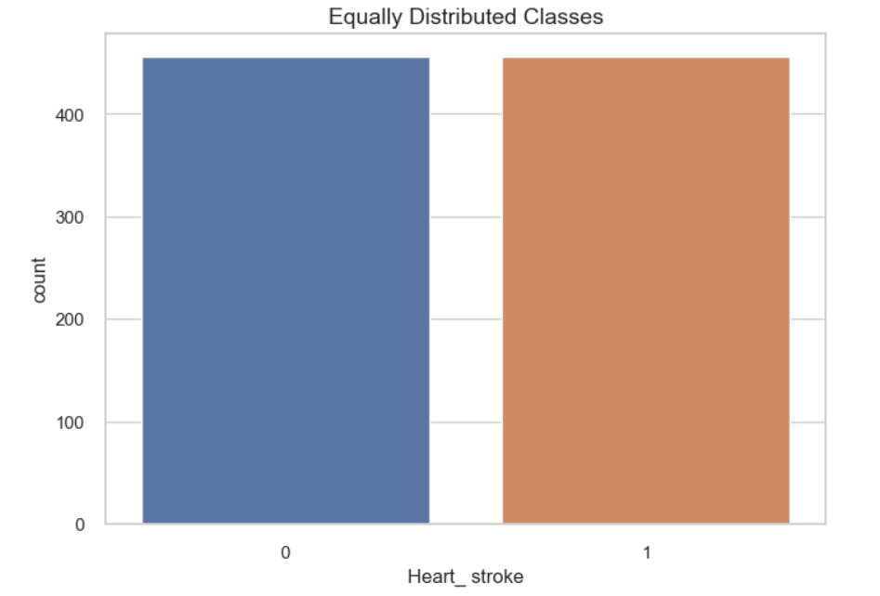
CHALLENGES ENCOUNTERED
Imbalanced Data
Once the classes are balanced in the training set, we ran the classification models again to identify which one would have the best fit.
Approach: Under sampling
We observed a drop in accuracy across all models after balancing the training set, and one possible cause for this performance decrease is that by balancing of the classes in the training set.

Slide 10
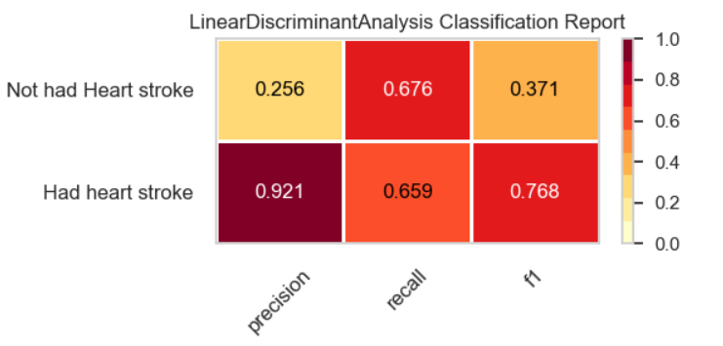
Model evolution After balanced data
LDA
MODEL | ACCURACY | AFTER HYPARAMETER
LDA | 65,57% | 66%
The recall metrics for both classes are similar, indicating that the model is not favouring one specific class over the other. However the precision for Class 1 is relatively low, indicating that many positive predictions for Class 1 are incorrect. The F1-score is moderate influenced by the negative classes.

Slide 11
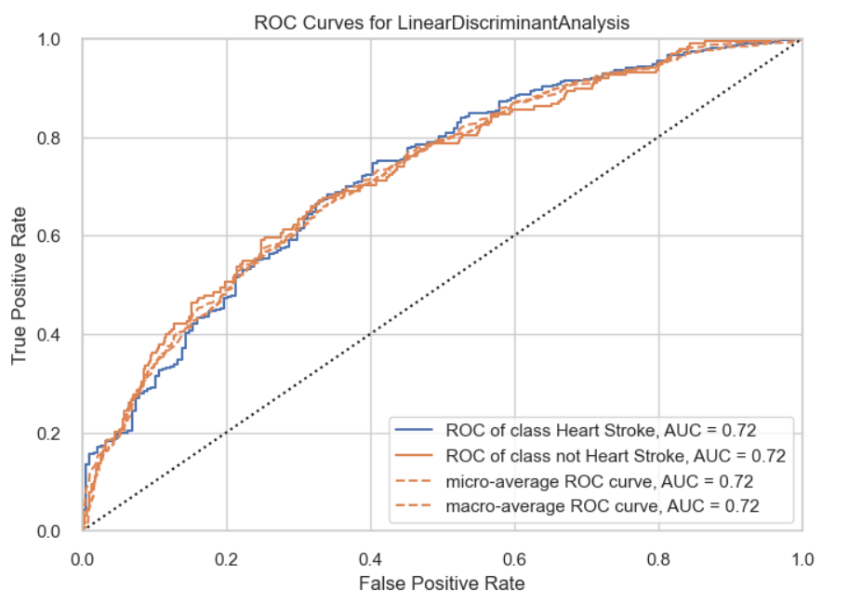
The ability of a model to distinguish between positive and negative classes
O ROC-AUC (Receiver Operating Characteristic - Area Under the Curve)
0.72 suggests that the model has a moderate ability

Slide 12
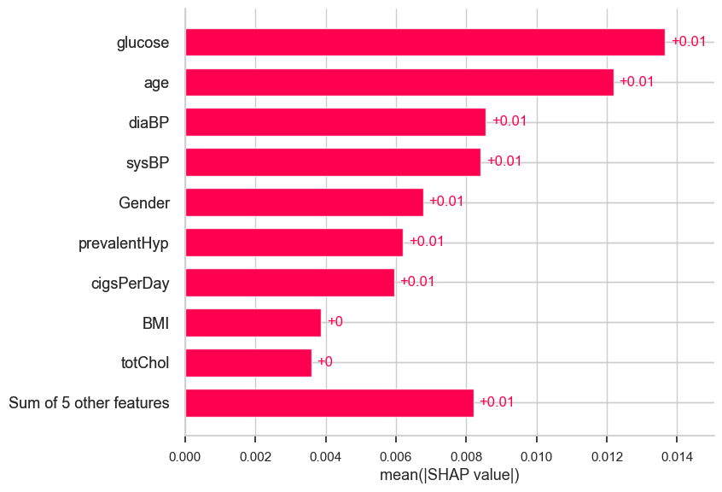
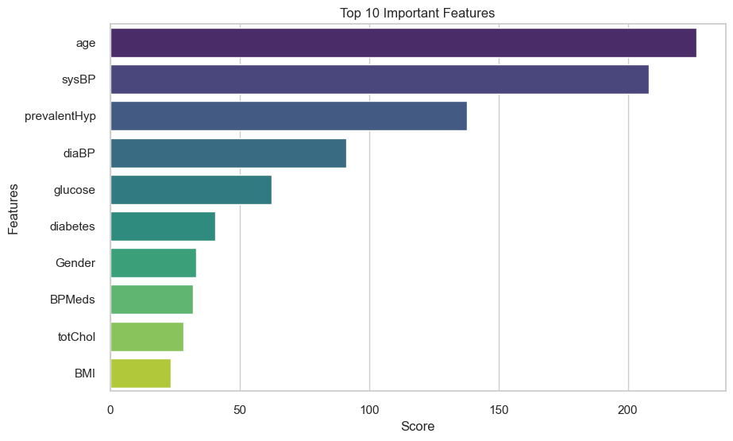
CHALLENGES ENCOUNTERED
SHAP: Exploring the library to see the impact of thee features in our data.
SHAP
Feature importance
VS

Slide 13
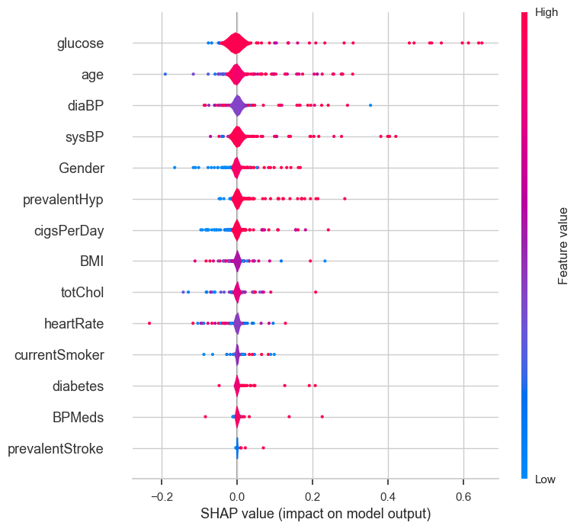
SHAP SUMMARY PLOT
All the little dots on the plot represent a single observation. The horizontal axis represents the SHAP value, while the color of the point shows us if that observation has a higher or a lower value, when compared to other observations.

Slide 14
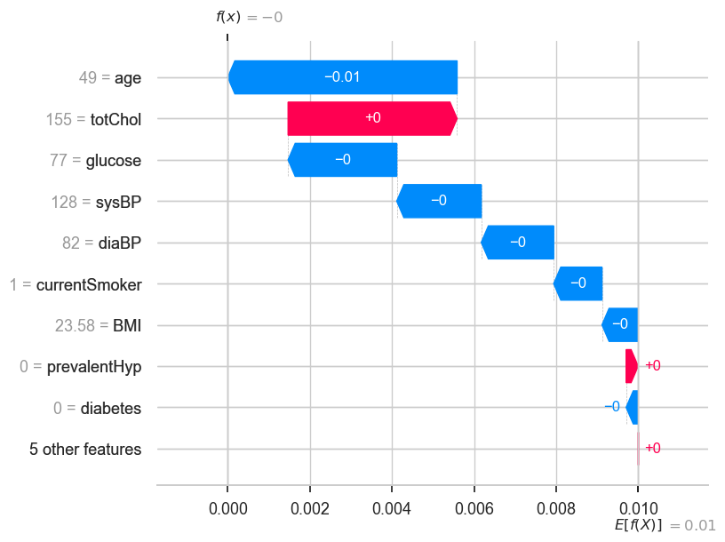
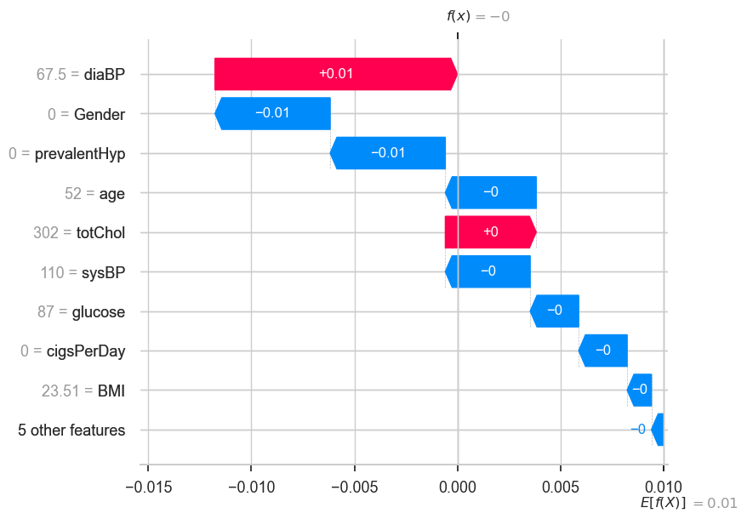
Value 1
Value 20
VS

Slide 15
CONCLUSION
After improve all the process in our project and apply a different hyper-tuning parameters we got to improve the machine learning results. The model most fit for the purpose of this project was SVM Model have changer the accuracy from 65.50% to 85.2%.
MODEL | ACCURACY - CA1 | ACCURACY – CA2
KNN | 61.29% | -
LOGISTIC REGRESSION | 63.97% | -
SVM | 65.50% | 85.2%
LDA | - | 66%

