Slide 1

Coronavirus vaccine collection, annotation, and ontology representation analysis
Anthony Huffman, Lauren Austin, Mei u Wong, Edison Ong, YonGqun “OLIVER” He

Slide 2
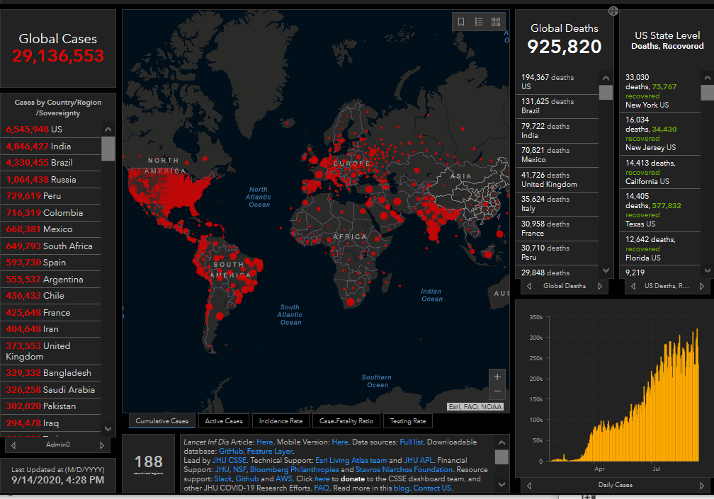
COVID-19
Coronavirus Disease - 2019
First reported in Wuhan
Rapid spread across globe
WHO declared Pandemic
188 Countries
29 million confirmed cases
926 thousand confirmed deaths
US, India, Russia, Brazil ~58 % Cases
John Hopkins COVID-19 Tracker from https://coronavirus.jhu.edu/map.html. Image taken on 9/14/2020.

Slide 3
Coronaviruses
SARS (Severe Acute Respiratory Syndrome)
SARS Virus emerged in 2002
CFR 11%
MERS (Middle Eastern Respiratory Syndrome)
MERS Virus emerged in 2012
CFR 34%
Common HCoV
229E, OC43, HKU1 (Common Cold)
NL63 (Croup)

Slide 4
Coronavirus Vaccine Development
: Fizzled Out
SARS
Last Recorded Case 2004
MERS
Low Infection Number
Intermittent Outbreaks
Common HCoV
Common Cold general category for 200+ viruses
Seasonal Variances
Low Pressure for Successful Coronavirus Vaccine Development
: Less Priority
: Impractical

Slide 5
Risks of Fast Development
Vaccine Name | Developer | Phase (up to Aug) | Phase starting time
Ad5-nCoV | CanSinoBIO (Academy of Military Medical Sciences) | III | I(May), II(Jul), III(Aug)
Sputnik V(Gam-Covid-Vac- Lyo) | Gamaleya Research Institute | I | I(June)
mRNA-1273 | Moderna | III | I&II(March), III(Jul)
BNT162b1 | BioNTech, Pfizer, Fosun Pharma | II&III | I&II(May), II&III(Jul)
ChAdOx1 | AstraZeneca, University of Oxford | II&III | I(May), II&III(Aug)
COVID-19 inactivated virus | Wuhan Institute of Biological Products, Sinopharm | III | I&II, III(Jul)
COVID-19 inactivated virus | Beijing Institute of Biological Products, Sinopharm | III | III
PiCoVacc | sinovac | III | I&II(June), III(Jul)
ZyCoV-D | Zydus Cadila | II | II(Jul)
saRNA | Imperial College London, Morningside Ventures | I&II | I&II(June)
AG0301-COVID19 | AnGes, Osaka University, Takara Bio | I&II | I&II(June)
Lunar-Cov19(ARCT-021) | Arcturus Therapeutics, Duke-NUS Medical School | I&II | I&II(Aug)
Ad26COVS1(JNJ-78436735) | Beth Israel Deaconess Medical Center, Johnson&Johnson | I&II | I&II(Jul), III(Sep)
RBD-Dimer | Anhui Zhifei Longcam, Chinese Academy of Medical Sciences | II | II(Jul)
NVX-CoV2373 | Novavax | I&II | I&II(May), III(Oct)
COVID-19 inactivated virus | Institute of Medical Biology at the Chinese Academy of Medical Sciences | II | II(June)
Covaxin/BBV152 | Indian Council of Medical Research and the National Institute of Virology, Bharat Biotech | I&II | I&II(Jul)
INO-4800 | Inovio | I | I(June), II&III(end of summer)
CVnCoV | CureVac | I | I(June)
GX19 | Genexine | I | I(June), II(fall)
ARCoV | Academy of Military Medical Sciences, Suzhou Abogen Biosciences, Walvax Biotechnology | I | I(June)
GRAd-COV2 | ReiThera, Lazzaro Spallanzani National Institute for Infectious Diseases | I | I(Jul)
TMV-083 | Merck, Themis Bioscience, Institut Pasteur | I | I(Aug)
SCB-2019 | Clover Biopharmaceuticals, GSK, Dynavax | I | I(Jul), II(Sep)
Recombinant spike protein with Advax™ adjuvant | Vaxine | I
Plant-derived VLP | medicago, GSK, Dynavax | I | I(July), II&III(Oct)
UQ-1-SARS-CoV-2-Sclamp | University of Queensland, CSL | I
KBP-COVID-19(RBD-based) | Kentucky BioProcessing | I | I(July)
MVC-COV1901 | Medigen, Dynavax | I | I(Sep)
Vaccine Development
Efficacy (Immunogenicity)
Safety (Immune Response)
Efficiency (Optimal Dosage)
Fast Track Development
Six Vaccines in Phase III since August
US Operation Warp Speed
Russia Sputnik Vaccine

Slide 6
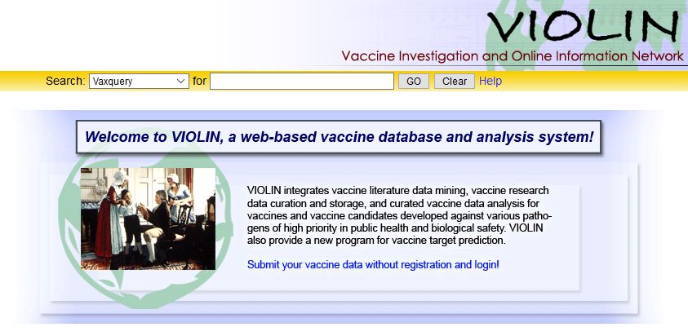
VO & VIOLIN
Vaccine Ontology
OBO Compliant
VIOLIN
2008 Release
4136 Vaccine Candidates
Research, Clinical, Licensed
58* Coronavirus Vaccines
218 Pathogens
Manual Curation

Slide 7
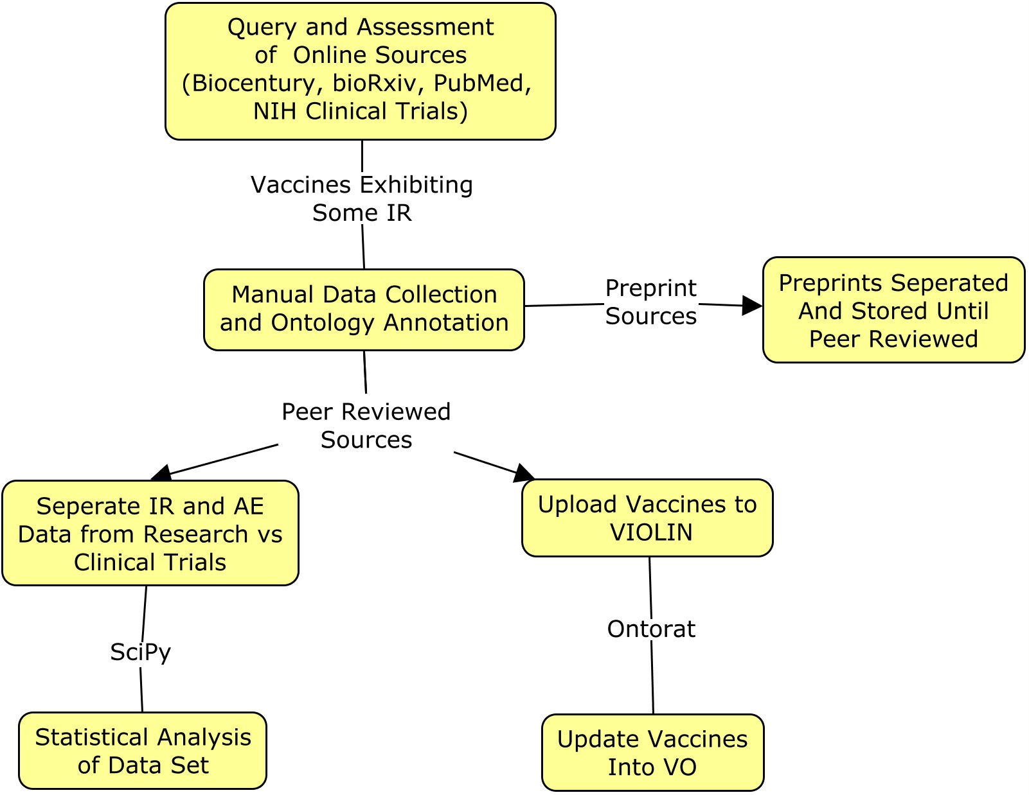
Workflow Diagram

Slide 8
Vaccine Collection
Manual Query into BioRxiv, PubMed, NIH Clinical Trials, etc.
Inclusion Category
Vaccine Published Immune Response [or follow up with Adverse Events]
Many vaccines announced with no information on above traits
Separate Preprints from Peer-reviewed Sources
Utilize VO for IR and OAE (Ontology of Adverse Events) for AE
VIOLIN Curation
Peer Reviewed Sources Added, Reviewed, and Approved
Pre-Prints Added are not Approved Until Peer Reviewed

Slide 9
Immune Response and Adverse Event Analysis
Split Data Between Research and Clinical Trials
5 Vaccines had Clinical Trials Results
Statistical Analysis of Distribution of IR and AE types
Prevalence of Immune Response Types induced by Vaccines
Prevalence of Adverse Events caused by Vaccination
One-tailed Fisher’s Test using SciPy for Analysis

Slide 10
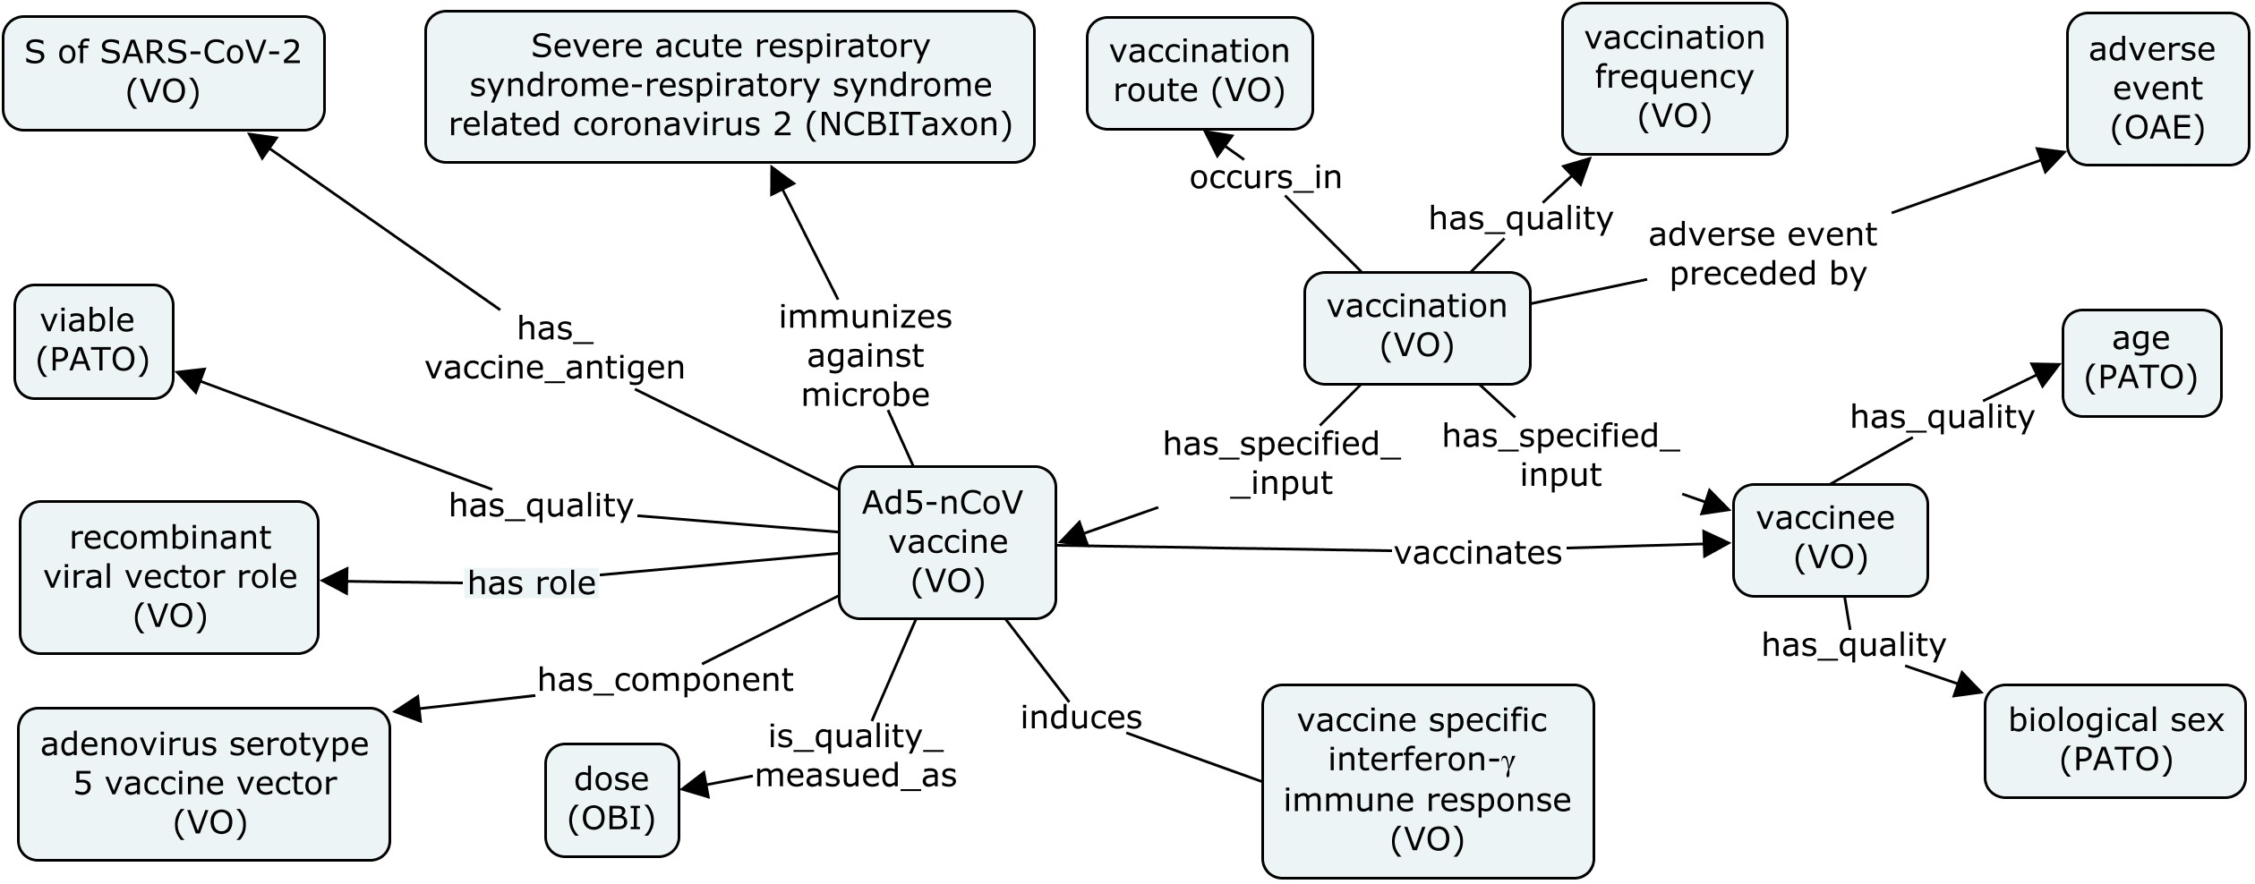
Ontology Representation of Ad5-nCoV
OBO Compliant Ontologies: NCBI Taxonomy (NCBITaxon), Vaccine Ontology (VO), Phenotype And Trait Ontology (PATO), Ontology of Adverse Events (OAE), Ontology of Biomedical Investigations (OBI)

Slide 11
58 Vaccines Collected in VO
Vaccines Total Left / Right
Reported Vaccines
DNA / Recombinant Vector
Novel Vaccine Types
VLP (Virus-Like Particle)
RNA (RNA) Vaccines
S protein / Whole Virus Most Frequent Antigen Target
 | S | M | N | Whole Virus | Mixed Antigens⁺
DNA | 5/3/0 | 1/0/0 | 3/0/0 | - | 1/0/0
Subunit | 1/5/0 | - | - | - | 0/1/0
Recombinant Vector | 7/8/1 | - | 1/2/0 | - | 2/0/0
Inactivated Virus | - | - | - | 4/1/1 | -
Live Attenuated | - | - | - | 4/0/0 | -
VLP | 2/1/1 | - | - | - | -
RNA | 0/0/1 | - | - | - | -
Mixed Vaccine* | 1/1/0 | - | - | - | -
Table of Vaccines: SARS / MERS/ COVID-19

Slide 12
Immune Response
Reported Vaccines Tend to Report Some Antigen-Specific IR
Exception is M protein vaccine, while N+M protein did
9/58 Shown Some Protection
Several Vaccines Only Demonstrate Antigens Reducing Viral Titer Count
Issues with Model Organism Viral Susceptibility
Common Immune Responses
Presence of virus-specific IFN-gamma and antigen-specific IgG or IgA
Increased IL-2, IL-4, IL10
Immune Response may be route dependent
Rarely report on Th1 or Th2 Cytokine Response

Slide 13
Mouse Research Adverse Events
Vaccine Name | Vaccine Type | Antigen | VIOLIN ID | Age | Adverse Event
rDNA-expressed S protein + alum vaccine | DNA | Ectodomain of S protein | 5745 | 6-8 weeks | Lung infiltration (Neu and Eos)
SARS-CoV pCI-N DNA from vaccine | DNA | S protein | 5745 | 6 weeks | Delayed hypersensitivity response
Double Inactivated whole SARS-CoV vaccine + alum | Inactivated | Whole virus | 5744 | 6-8 weeks | Lung infiltration (Neu and Eos)
β-propiolactone-inactivated SARS-CoV vaccine | Inactivated | Whole virus | 5730 | 6 weeks | Lung infiltration (Neu and Eos)
UV-Inactivated SARS-CoV + TLR Agonist Vaccine | Inactivated | Whole virus | 5740 | 10 weeks | Lung infiltration (Eos, minor)
Double-Inactivated Whole SARS-CoV Vaccine | Inactivated | Whole virus | 5742 | 6-8 weeks | Lung infiltration (Neu and Eos)
MA-ExoN vaccine | Live Attenuated | MA-ExoN | 5729 | 10 weeks | Weight loss (in immunodefici-ent mice)
rMA15-ΔE vaccine | Live Attenuated | rMA15-ΔE | 5728 | 6 weeks - 18 months | Peribronchiolar and perivascular infiltration
UV Inactivated SARS-CoV vaccine | Live Attenuated | Whole virus | 5741 | 10 weeks | Lung infiltration (Eos) and Death
VRP-SARS-N vaccine | Recombinant Vector | T cell epitope of N protein | 5749 | 6 weeks | Peribronchiolar and perivascular infiltration
SARS-CoV VLP-MHV + alum vaccine | Virus Like Particle | S protein of SARS-CoVN, E, M proteins from MHV | 5747 | 6-8 weeks | Lung infiltration (Neu and Eos)
BALB/C Female Mice
Unbalanced Th2 Immune Response
Non-DNA vaccine has N protein presence as possible explanation for event

Slide 14
Spotlight: ADS-MVA
SARS-Vaccine ADS-MVA vaccine (VO_0005110)
Mice exhibit no recorded AEs
Ferrets exhibit several severe AEs
Liver Inflammation
Hepatic Parenchymal Lesions
Liver Necrosis

Slide 15
Human Clinical AEs
AE | AD5-nCoV [108]⁺ | GLS-5300 [75]⁺ | VRC-SRSDNA015-00-VP [10]⁺ | ChAdOx 1 MERS-S [24]⁺ | MVA-MERS [26]⁺ | Sum of AE cases associated with 5 vaccines
Abdominal Cramps (OAE_0000402) | 0 | 0 | 0 | 0 | 0 | 5
Arthralgia (OAE_0000385) | 9 | 4 | 0 | 8* | 5 | 25
Bruising (OAE_0000650) | 0 | 4** | 0 | 0 | 0 | 4
Cough (OAE_0000398) | 6* | 0 | 0 | 0 | 0 | 6
Decreased Appetite (OAE_0000396) | 17* | 0 | 0 | 0 | 0 | 17
Diarrhea (OAE_0000616) | 12* | 0 | 0 | 0 | 1 | 13
Erythema (OAE_0000645) | 0 | 5 | 0 | 5* | 0 | 10
Fatigue (OAE_0000034) | 47 | 14 | 0 | 17* | 17 | 95
Fever (OAE_0000361) | 50* | 0 | 1 | 6 | 2 | 59
Headache (OAE_0000377) | 42 | 23* | 1 | 16 | 16 | 98
Hematoma at Injection Site (OAE_0000322) | 0 | 0 | 0 | 0 | 7* | 7
Induration (OAE_0002039) | 4 | 2 | 0 | 0 | 10* | 16
Injection Site Pain (OAE_0000369) | 58 | 69 | 10 | 18 | 17 | 172
Itch (OAE_0000373) | 5 | 0 | 0 | 0 | 0 | 5
Loose Stool (OAE_0001917) | 0 | 0 | 0 | 0 | 5* | 5
Malaise (OAE_0000390) | 0 | 14 | 4 | 13* | 7 | 37
Myalgia (OAE_0000390) | 18 | 11 | 3 | 12* | 5 | 39
Nausea (OAE_0000600) | 6 | 9 | 0 | 7* | 2 | 24
Pruritus (OAE_0000373) | 3 | 8 | 0 | 6* | 0 | 17
Redness (OAE_0001546) | 4 | 0 | 4 | 0 | 11* | 19
Swelling (OAE_0000368) | 8 | 2 | 2 | 0 | 2 | 22
Tenderness (OAE_0001547) | 0 | 63* | 10 | 0 | 63 | 73
Throat Pain (OAE_0000601) | 8* | 0 | 0 | 0 | 0 | 8
Warmth (OAE_0000326) | 0 | 0 | 0 | 4* | 0 | 4
Common Adverse Events
Most Mild to Moderate
14 Grade 3 Events Recorded
Injection Site Pain Universal
Unique Statistically Significant AEs
Mean AE of ~5
Range 2-9

Slide 16
Conclusion
Most reported vaccines demonstrated some measure of immune response
Fewer reported some protective efficacy
Research less reported adverse events than clinical trials
Mostly mild but some severe
Differences in animal models occlude potential adverse events
Caution to Vaccine Development

Slide 17

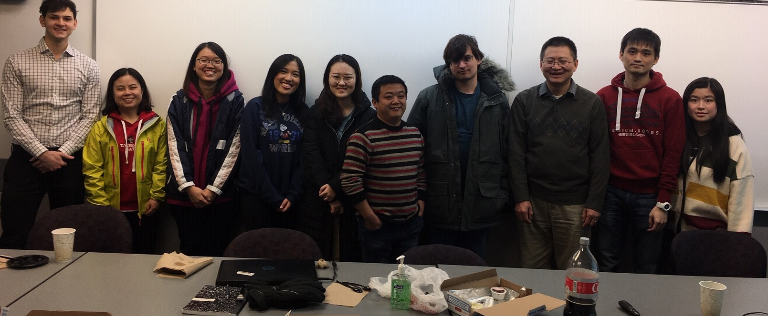





He Group
NIH-NIAID ImmPort UH01 grant (1UH2AI132931)

