Slide 1
The Rosetta Method for Protein Structure Prediction

Slide 2
The Rosetta Approach
(David Baker lab, Univ. of Washington)
In contrast to threading, Rosetta does de novo prediction
– doesn’t use templates/homologous structures
instead performs Monte Carlo search through space of conformations to find minimal energy conformation

Slide 3
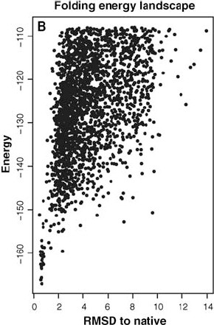
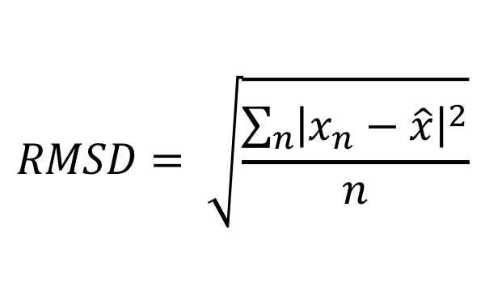
The Folding Energy Landscape
energies of conformations considered in Rosetta’s Monte Carlo minimization procedure for a given protein
$$RMSD= \sqrt{\frac{\sum_{n}{{\left|x_{n}−\hat{x}\right|}^{2}}}{n}}$$
x_{n}
xˆ_{n}
coordinate of nth ! carbon
predicted coordinate of nth ! carbon

Slide 4
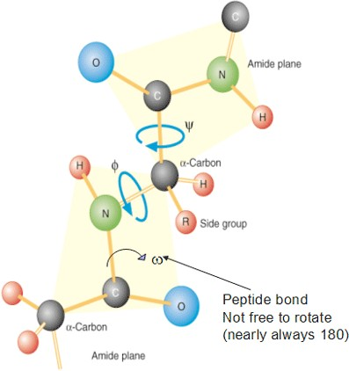
Representing Protein Structures
the predicted structure of a protein is represented in terms of the torsion angles of the polypeptide backbone

Slide 5
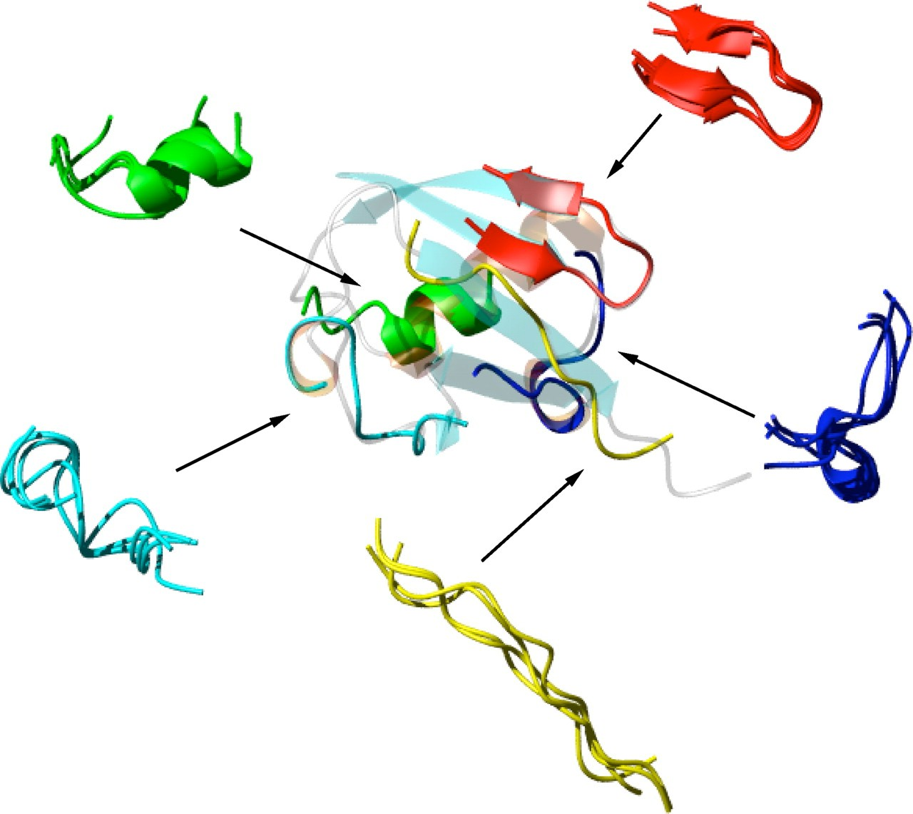
Overview of the Rosetta Approach
Rosetta searches structure space by replacing the torsion angles of a fragment in the current model with torsion angles from known structure fragments

Slide 6
The Rosetta Approach
Given: protein sequence P
for each window of length 9 in P assemble a set of structure fragments
M = initial structure model of P (fully extended conformation)
S = score(M)
while stopping criteria not met
randomly select a fixed width “window” of amino acids from P
randomly select a fragment from the list for this window
M’ = M with torsion angles in window replaced by angles from fragment
S’ = score(M’)
if Metropolis criterion(S, S’) satisfied
M = M’ S = S’
Return: predicted structure M

Slide 7
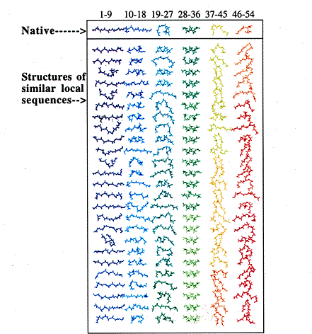
Fragment Selection
fragments are selected from known structures
the window-fragment matches are calculated using
PSI-BLAST to build a profile model of the sequence
the predicted secondary structure of the sequence

Slide 8
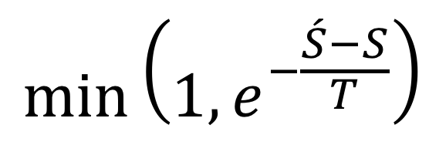
Metropolis Criterion
given the previous structure model with score S and the new one with score S’, accept the new one with probability
$$min⁡\left(1,e^{−\frac{\acute{S}−S}{T}}\right)$$
“temperature” parameter that is varied during the search

Slide 9
Scoring Function Takes Into Account
residue environment (solvation)
residue pair interactions (electrostatics, disulfides)
strand pairing (hydrogen bonding)
strand arrangement into sheets
helix-strand packing
steric repulsion
etc.

Slide 10
Some Details
scoring function search progressively adds terms during search
initially on the steric overlap term is used
then all but “compactness” terms are used
etc.
search is initiated from different random seeds
for some applications, an atomic-level scoring function is used

Slide 11
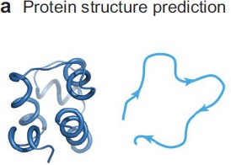
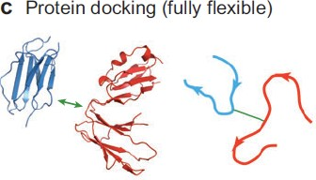
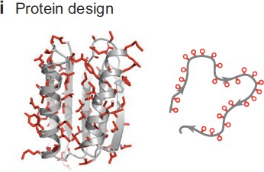
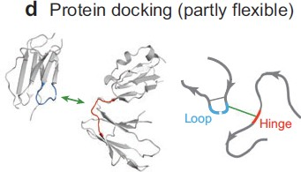
Applications of the Rosetta Approach

Slide 12
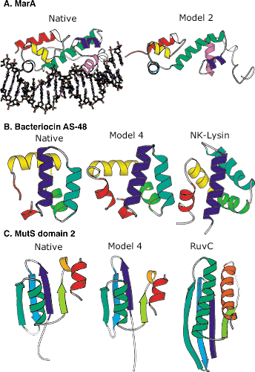
Some Rosetta-Predicted Structures
Native indicates the real structure
Model indicates the predicted structure
the rightmost structures in cases
B. and C. show similar structures identified by searching a structure database with the model

Slide 13

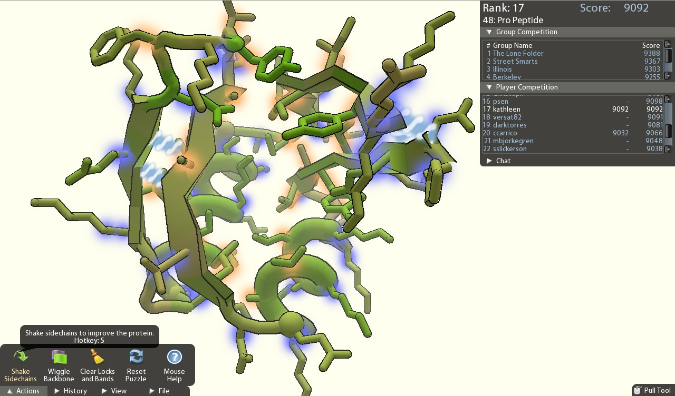
Want to Help Predict Structures?
Rosetta@home http://bioinc.bakerlab.org/
Foldit http://fold.it/portal/info/science

