Slide 1

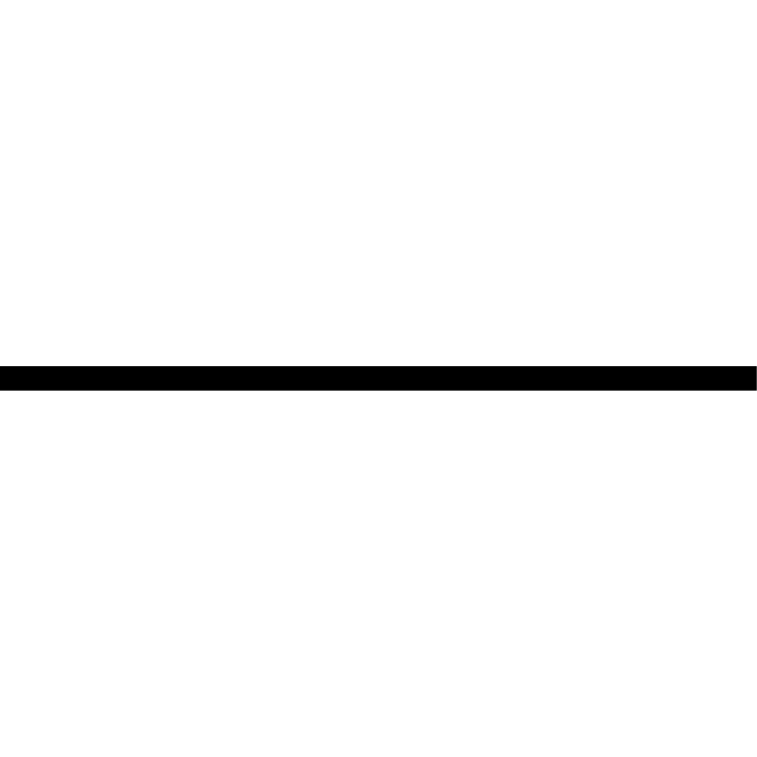














Entities
Similar to $s_{q}$
Evolving Lines of $s_{q}$
More Relations
Between $s_{q}$ and $x_{i}$
Notes:
Note:
Using the same visual components from before and a few new custom ones, I was able to come up with the Transformer architecture
This is a reproduction of the Transformer architecture figure presented in the work of Vaswani et al. 2017
You can further customize it however you want
Author: Elvis Saravia (ellfae@gmail.com)

