Slide 1
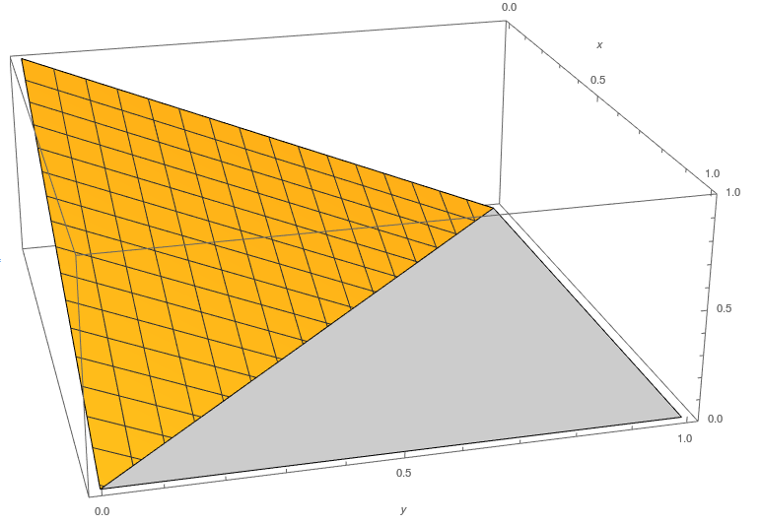
Isoform Comp. Model
1
Data Generation Specifics
Jiahuang Lin

Slide 2
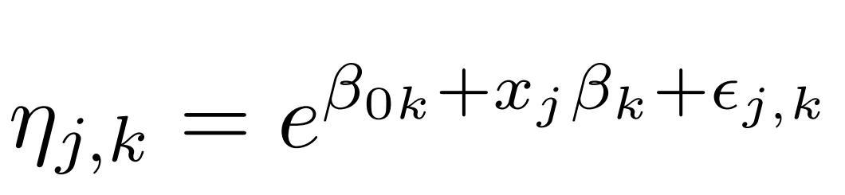
Isoform Comp. Model
1
Data Generation Overview
Data is generated with a Python script
Suppose we want to generate data for n individuals
Input:
n, the number of individuals
K, the number of isoforms
maf, the minor allele frequency
Output:
Isoform proportion of each individual
Generate genotype data for each individual
Generate values for noise + intercept + effect
Generate Dirichlet pdf parameter using intercept, noise, effect and genotype
Generate isoform proportions for each individual using Dirichlet pdf parameter

Slide 3
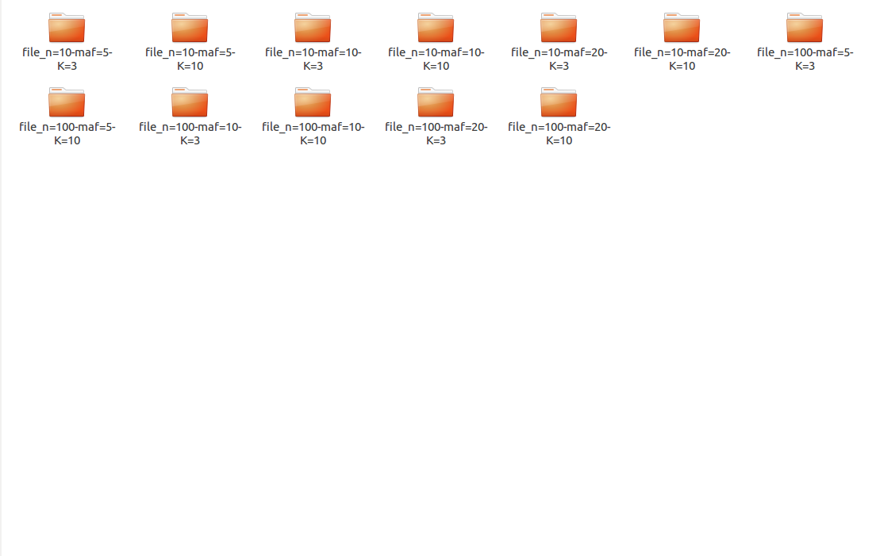
Isoform Comp. Model
1
Overall Folder Structure
n = [10, 100]
maf = [0.05, 0.10, 0.20]
K=[3, 10]

Slide 4
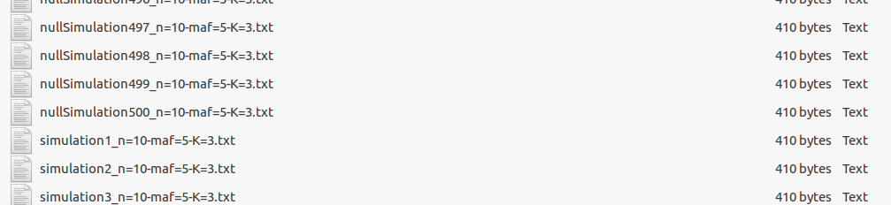
Isoform Comp. Model
1
Within each Folder
500 alternative hypothesis files
500 null hypothesis files
1 specification file
For the intercept and the effect
This means that for within each file, all 1000
documents have the same intercept and effect values

Slide 5
Isoform Comp. Model
1
Data Generation: Step 1
The rest of the slides talk about generating data for each folder i.e. for each combination of n, maf and K.
Given n (number of individuals), perform 2n Binomial draws, each with probability=maf.
Sample output for n=10, maf=0.2:
[0, 0, 0, 0, 1, 0, 0, 0, 0, 2]
Generate genotype data for each individual
Generate values for noise + intercept + effect
Generate Dirichlet pdf parameter using intercept, noise, effect and genotype
Generate isoform proportions for each individual using Dirichlet pdf parameter

Slide 6
Isoform Comp. Model
1
Data Generation: Step 2
Draw noise and effect from normal distribution.
Draw intercept from uniform distribution from [-1, 1]
Note that effect and intercept will be fixed for one folder (across all 1000 files). The values for the effect and intercept are specified in the specifications file in each folder.
Generate genotype data for each individual
Generate values for noise + intercept + effect
Generate Dirichlet pdf parameter using intercept, noise, effect and genotype
Generate isoform proportions for each individual using Dirichlet pdf parameter

Slide 7
Isoform Comp. Model
1
Data Generation: Step 3
Generate genotype data for each individual
Generate values for noise + intercept + effect
Generate Dirichlet pdf parameter using intercept, noise, effect and genotype
Generate isoform proportions for each individual using Dirichlet pdf parameter

Slide 8
Isoform Comp. Model
1
Data Generation: Step 4
Draw isoform proportions from Dirichlet pdf.
Generate genotype data for each individual
Generate values for noise + intercept + effect
Generate Dirichlet pdf parameter using intercept, noise, effect and genotype
Generate isoform proportions for each individual using Dirichlet pdf parameter

Slide 9
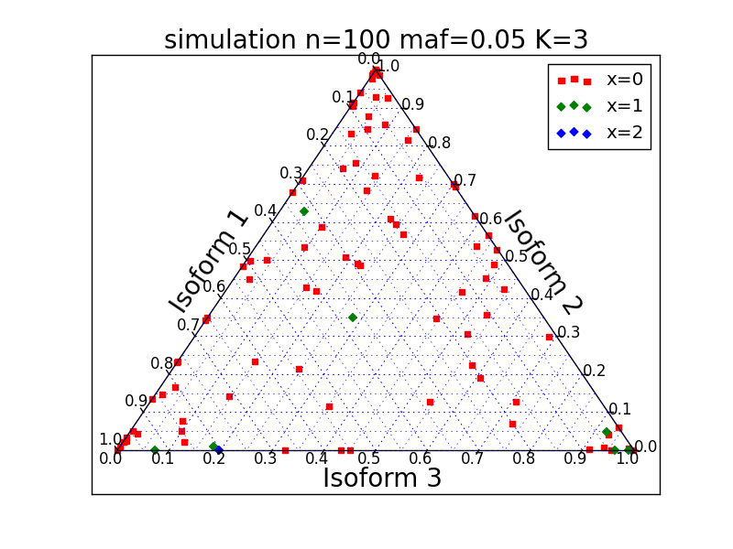

Slide 10
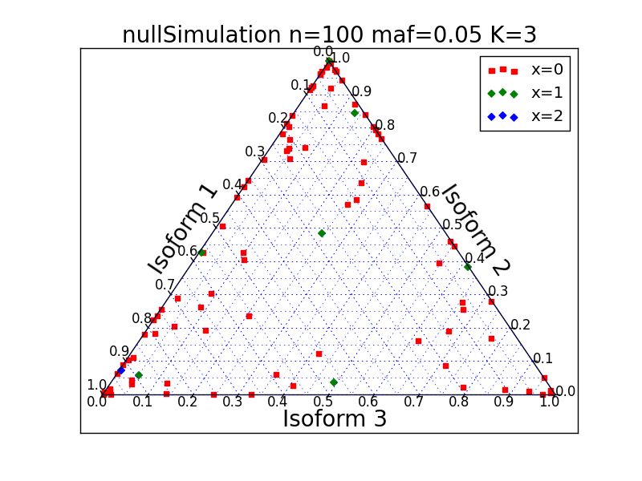

Slide 11
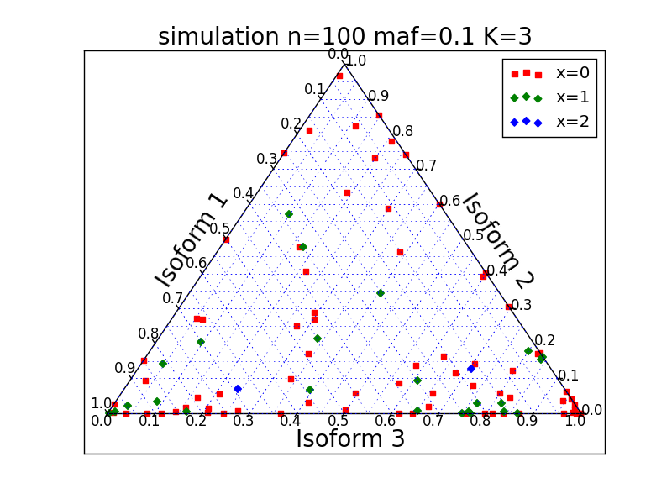

Slide 12
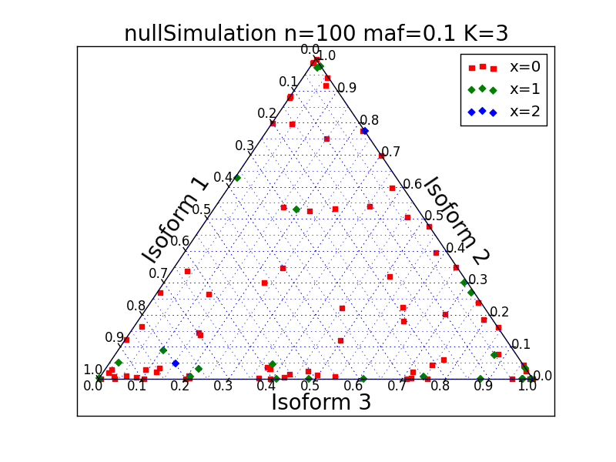

Slide 13
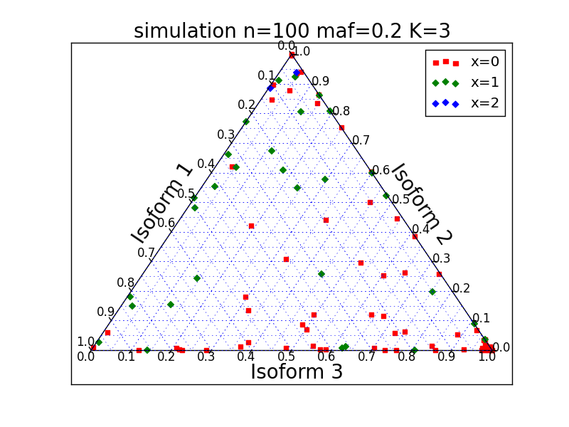

Slide 14
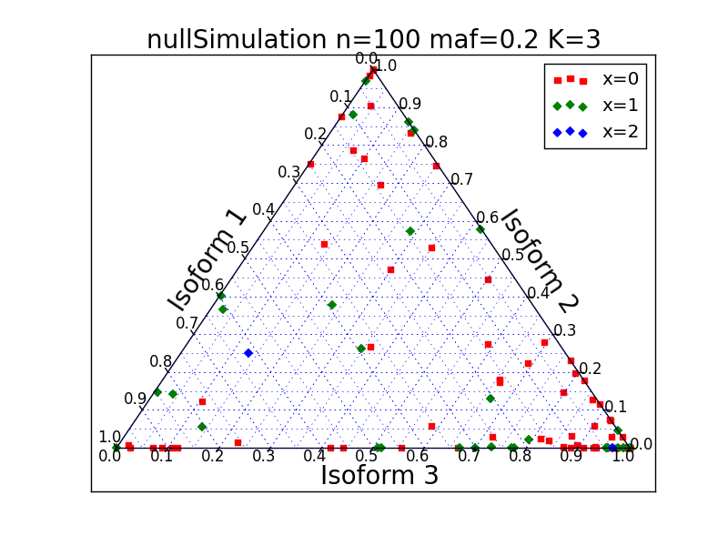

Slide 15
Isoform Comp. Model
1
sQTLseekeR Method
Main Idea: compare variance of splicing ratio within genotypes with the variance between genotypes
To quantify variance, we need to quantify
distance between points. We use the Hellinger
distance

Slide 16
Isoform Comp. Model
1
sQTLseekeR Method
With the Hellinger distance, we define the centroid as the point that minimizes the sum of squared distance between itself and each point in the sample
Variability is then then sum of squared distances
Within group variability
SS_W
Between group variability
SS_A

Slide 17

Isoform Comp. Model
1
sQTLseekeR Method
We do not need to actually find the centroid to compute SS_A and SS_W. (Note that SS_T = SS_A + SS_W)

Slide 18
Isoform Comp. Model
1
sQTLseekeR Method
For each set of data, we can calculate the F-score
For each folder, for each file, through permutations, we can calculate the P value
We next plot the Precision
recall curve

Slide 19
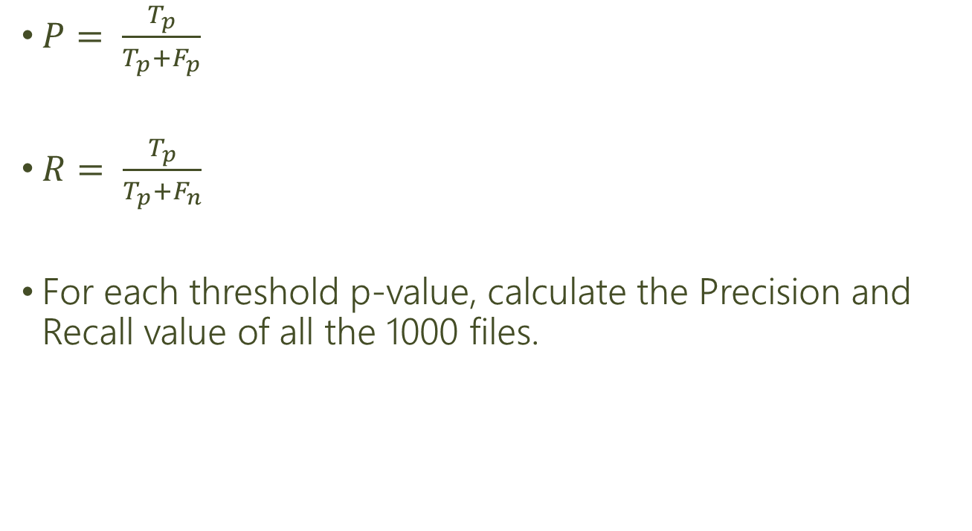
Isoform Comp. Model
1
Precision Recall
Now, we have a P value for each file in each folder. By varying the threshold significance level, we can calculate the true positive, true negative, false positive and false negative.

Slide 20
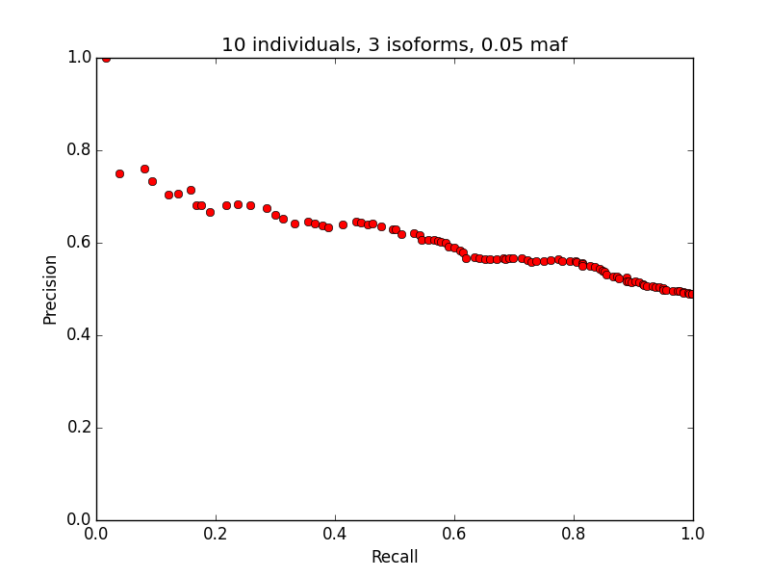
Isoform Comp. Model
1
Precision-Recall curve

Slide 21
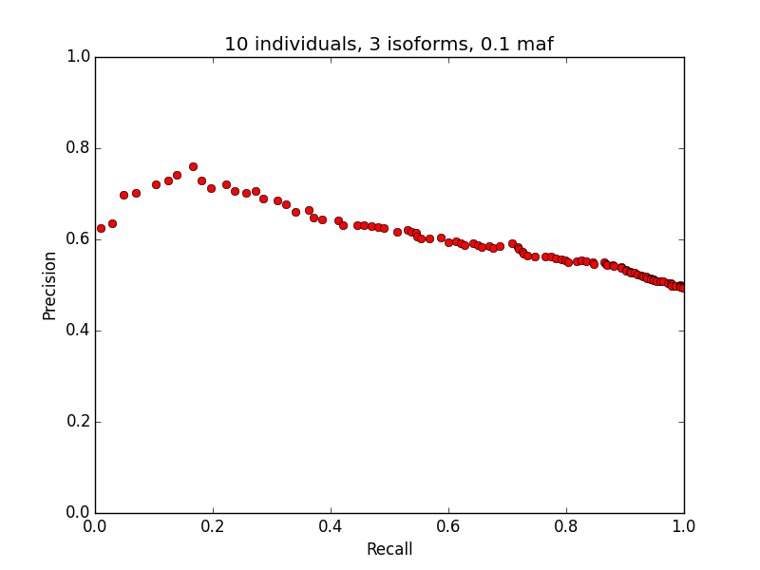
Isoform Comp. Model
1
Precision-Recall curve

Slide 22
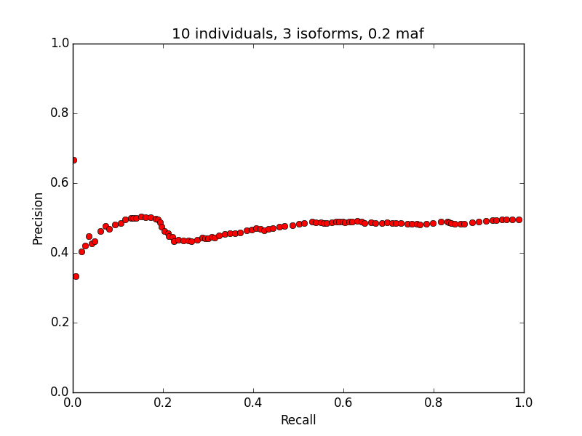
Isoform Comp. Model
1
Precision-Recall curve

Slide 23
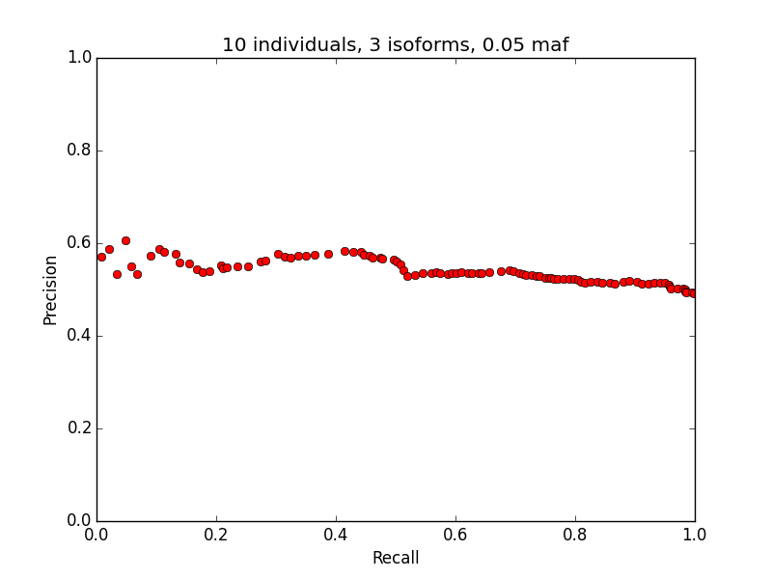
Isoform Comp. Model
1
Precision-Recall curve(Old)

Slide 24
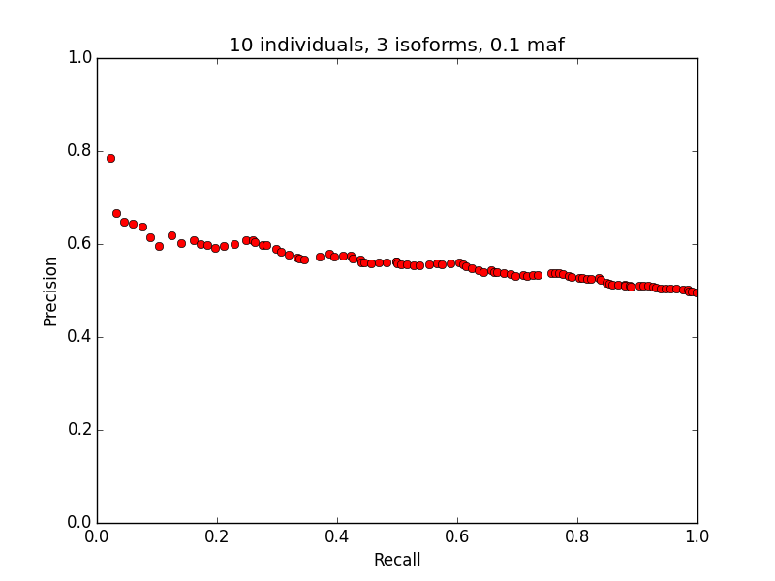
Isoform Comp. Model
1
Precision-Recall curve(old)

Slide 25
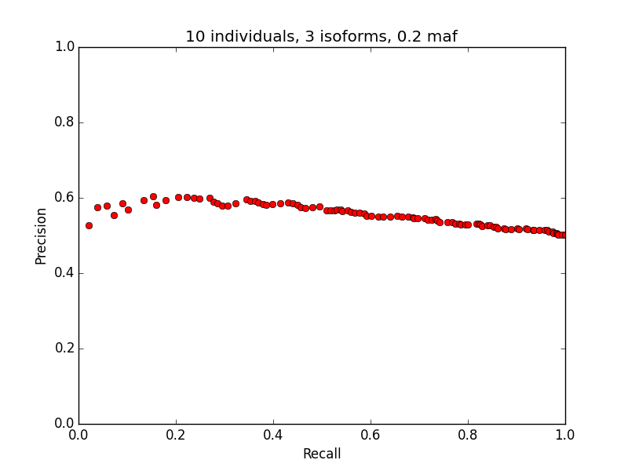
Isoform Comp. Model
1
Precision-Recall curve(old)

Slide 26
Isoform Comp. Model
1
Assumptions
Under the null hypothesis, the rows are interchangeable.
Each row(observation) is independent
Sensitive to the differences in the dispersion of points, even if the locations do not differ(unclear what this means)

Slide 27
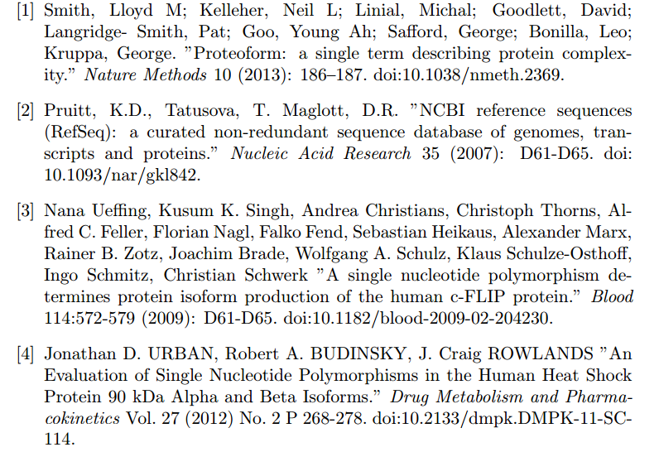
Isoform Comp. Model
1
Acknowledgements

Slide 28
Isoform Comp. Model
1
[5] Anderson, Marti J. "A New Method for Non-parametric Multivariate Analysis of Variance." Austral Ecology 26, no. 1 (2008): 32-46. doi:10.1111/j.1442-9993.2001.tb00081.x.
[6] Monlong, Jean, Miquel Calvo, Pedro G. Ferreira, and Roderic Guigó. "Identification of Genetic Variants Associated with Alternative Splicing Using SQTLseekeR." Nature Communications Nat Comms 5 (2014): 4698. doi:10.1038/ncomms5698.

