Slide 1
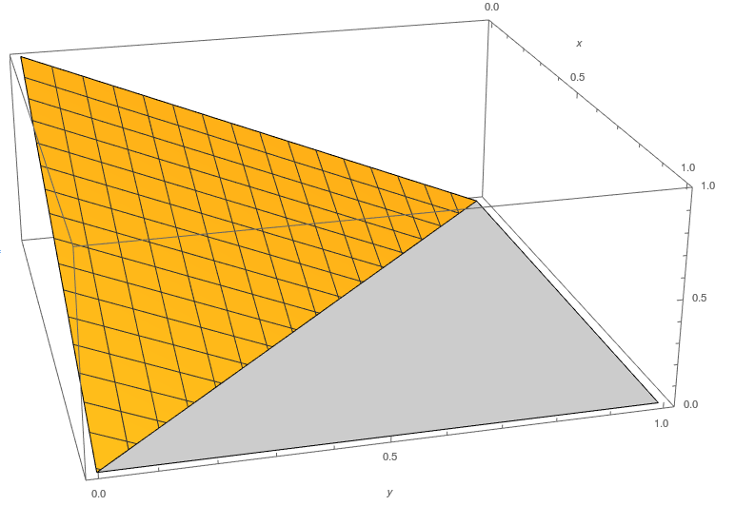
Statistical test for genotype association with a compositional phenotype
Jiahuang Lin, Bianca Dumitrascu

Slide 2
Overview of Presentation
Background
Motivation behind project
1
Theoretical model
Notations, Dirichlet Model
2
Implementation
Approximation Methods and Test Data Generation
3
Discussion
Alternative method
4

Slide 3
Compositional data
Data that consists of a finite number of proportions that sum to 1
Examples include
Chemical composition of rocks and sediment samples
Household expenditure on various commodity groups
Bacteria proportions in a given sample
RNA isoform proportions of a given gene

Slide 4
RNA Isoform Proportions
Exon
Intron
DNA
1
2
3
4
Transcription
Pre-mRNA
1
3
1
2
1
2
3
4
4
Post-Transcription
mRNA 1
mRNA 2
mRNA 3

Slide 5



Genotype Association with RNA Isoform
We want to study how RNA isoform proportions are determined by the genotype
Dependent Variable: RNA isoform proportions
Independent Variable: Genotype (major-major, major-minor, minor-minor)
$$x=0$$
$$x=1$$
$$x=2$$

Slide 6
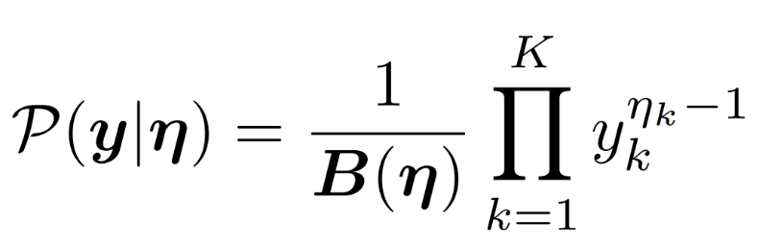
Relating x to y
First, find a probability function that naturally describes compositional data y.
Then, express the parameters of this probability distribution as a function of x.
Dirichlet distribution:

Slide 7
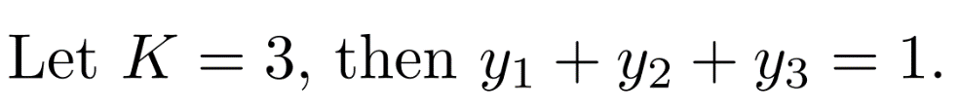



Properties of the Dirichlet distribution

Slide 8
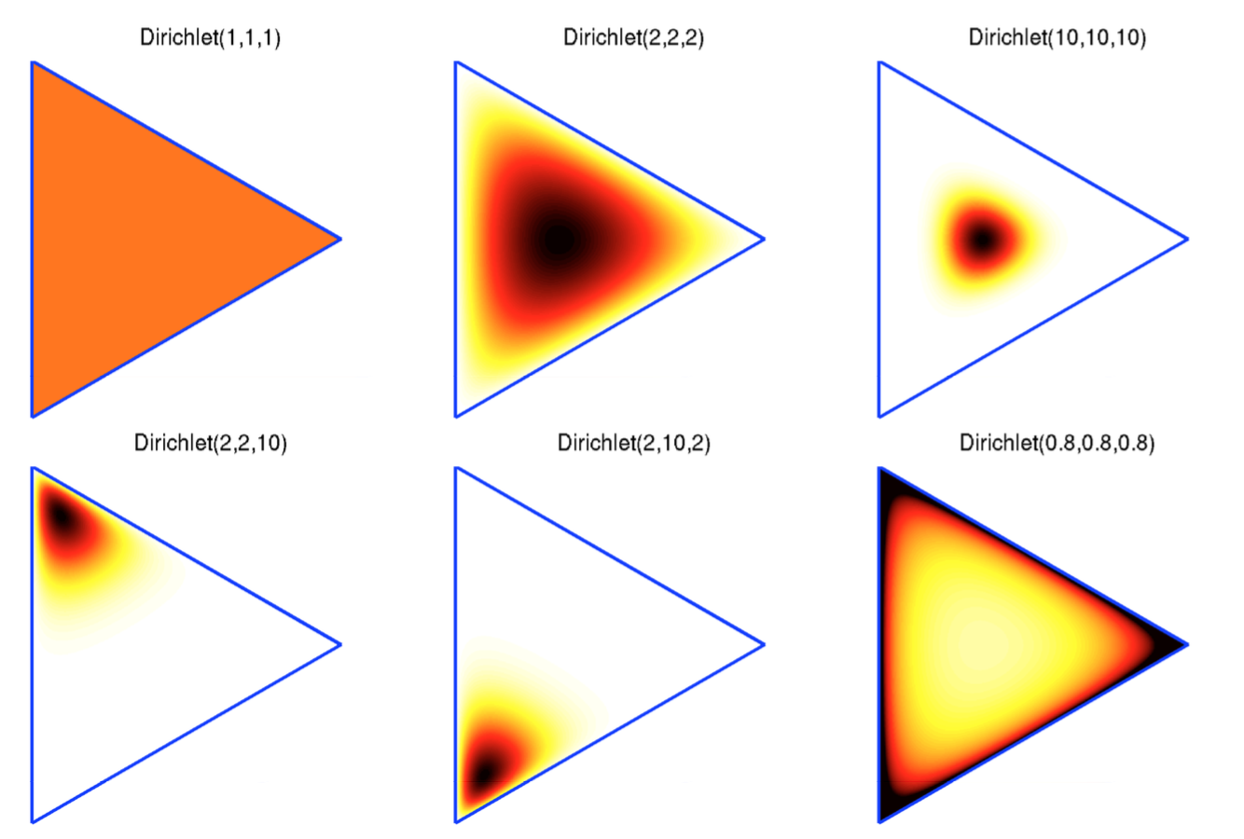
Dirichlet distribution on a 2-simplex
Source: http://enginius.tistory.com/513

Slide 9
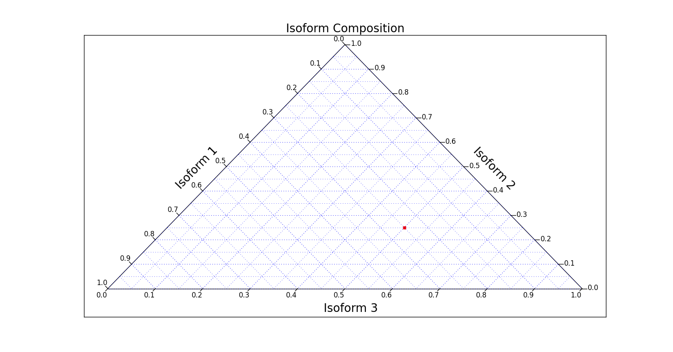
2-Simplex Plot

Slide 10
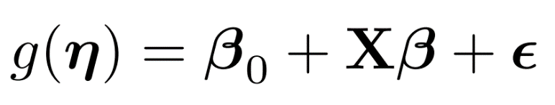
Relating x to y
First, find a probability function that naturally describes compositional data y.
Then, express the parameters of this probability distribution as a function of x.
Generalized Linear Model:

Slide 11
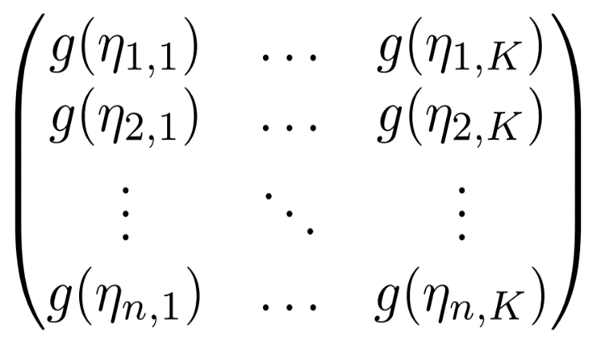
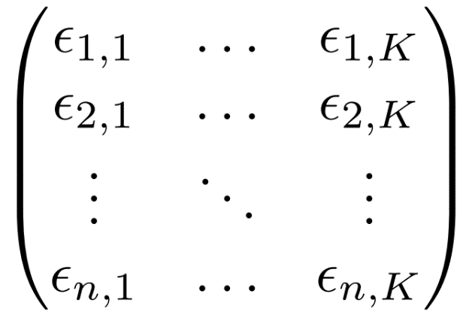
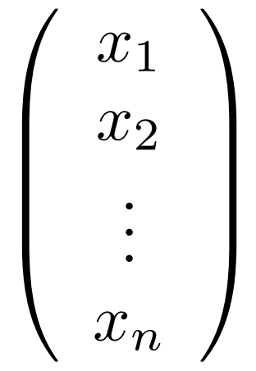
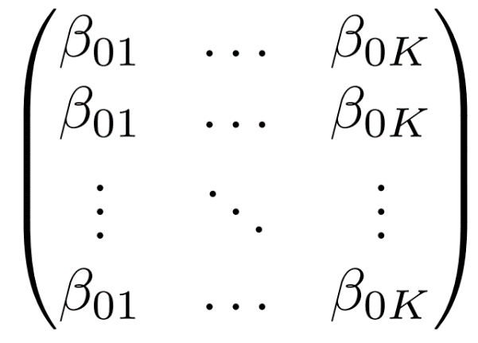
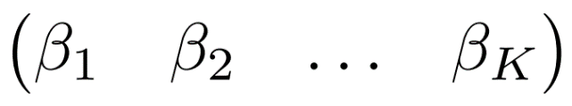
Generalized Linear Model

Slide 12

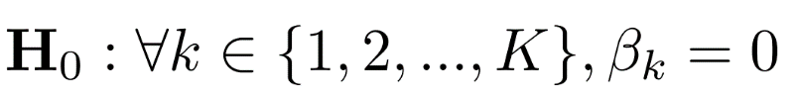
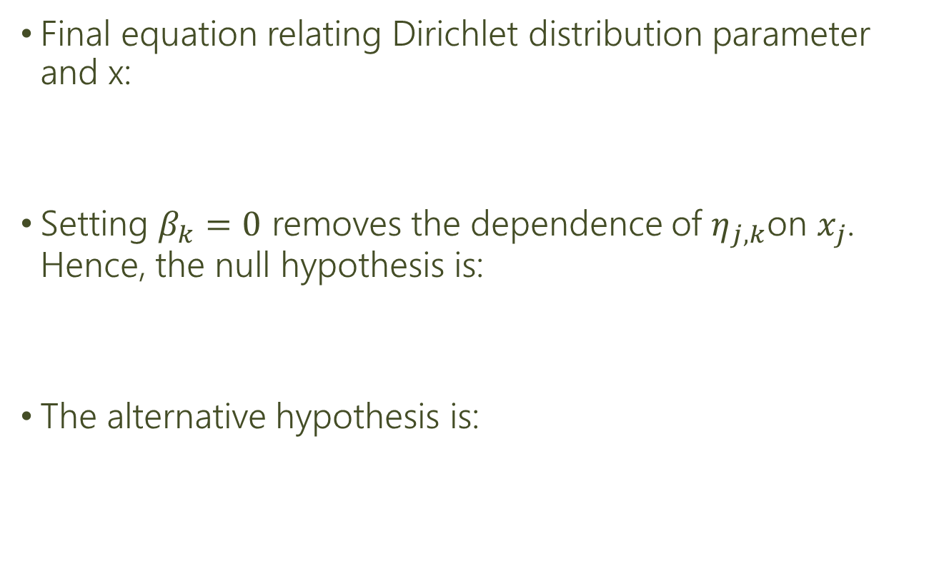
Generalized Linear Model
Final equation relating Dirichlet distribution parameter and x:
Setting $β_{k}=0$ removes the dependence of $η_{j,k}$on $x_{j}$. Hence, the null hypothesis is:
The alternative hypothesis is:

Slide 13
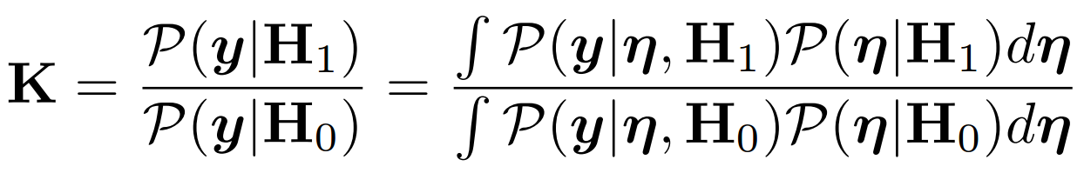
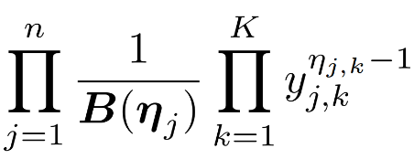
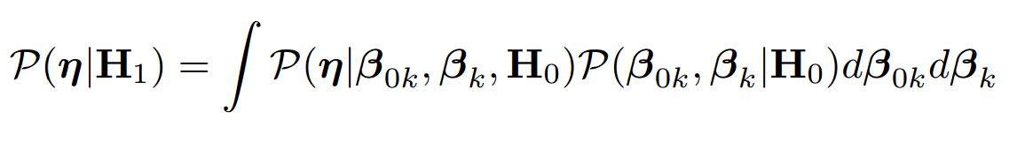
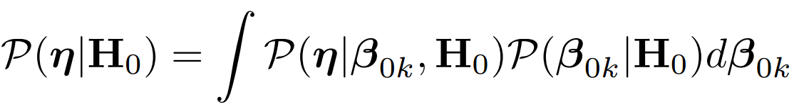
Bayes Factor
Bayes Factor is a numerical value used in Bayesian model comparison:

Slide 14

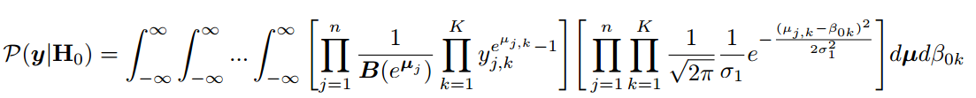
Denominator of Bayes Factor
The full form:
After substitution:

Slide 15
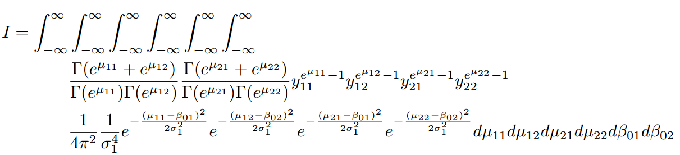
Specific Example (Denominator)
n=2, K=2

Slide 16
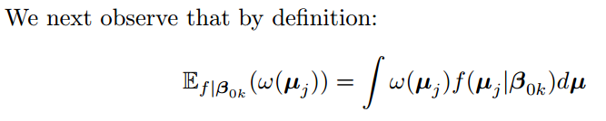
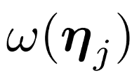

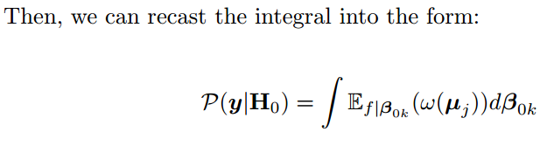
Method 1: Monte Carlo Simulation

Slide 17
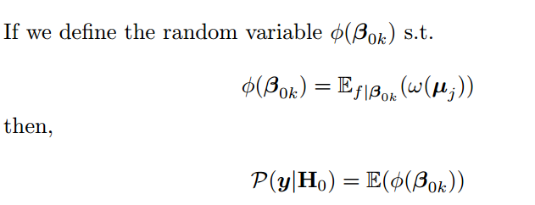
Method 1: Monte Carlo Simulation

Slide 18
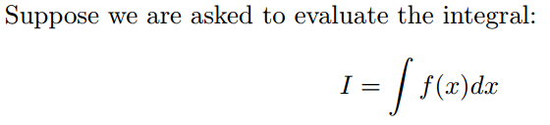
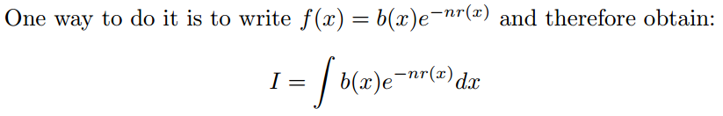

Method 2: Laplace Method

Slide 19
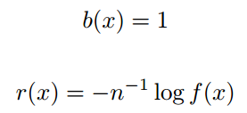
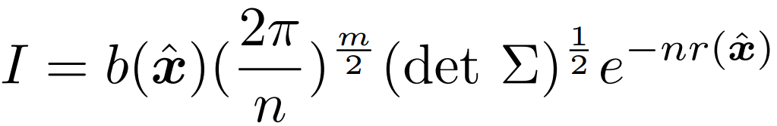
Method 2: Laplace Method

Slide 20
Justifications for using Laplace’s Method
Integrand is uni-modal, which one maxima.
Integrand can be approximated by a Gaussian near the maxima.

Slide 21
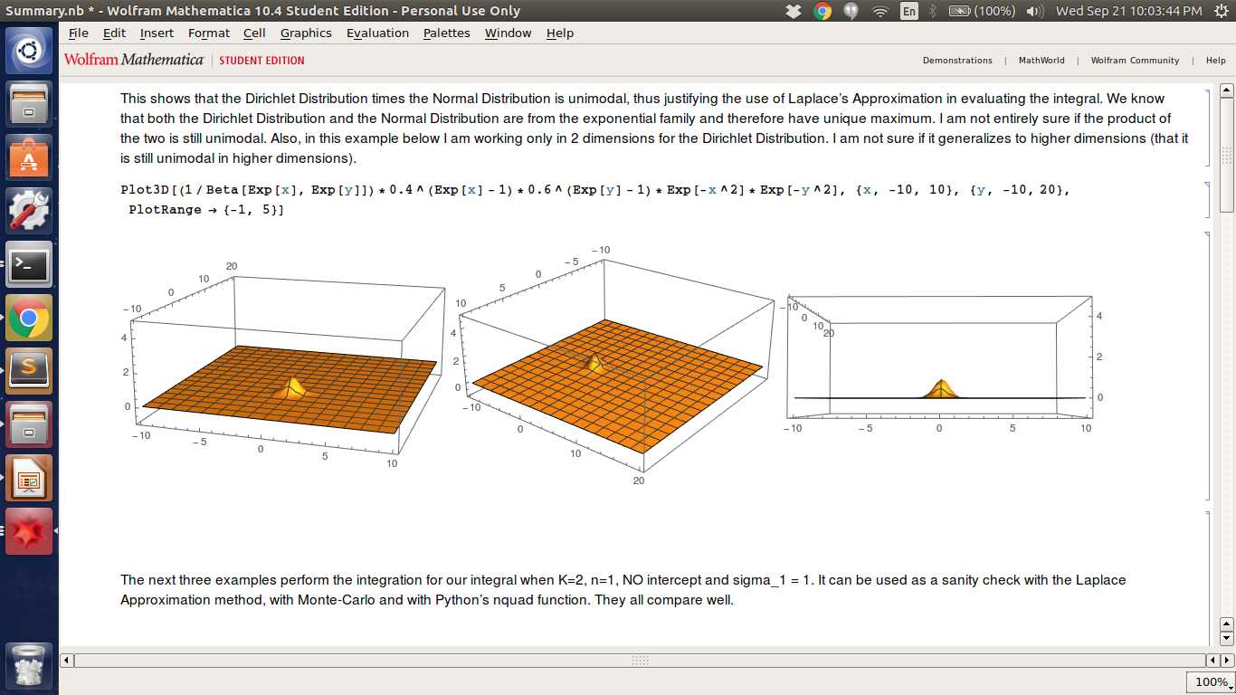

Slide 22
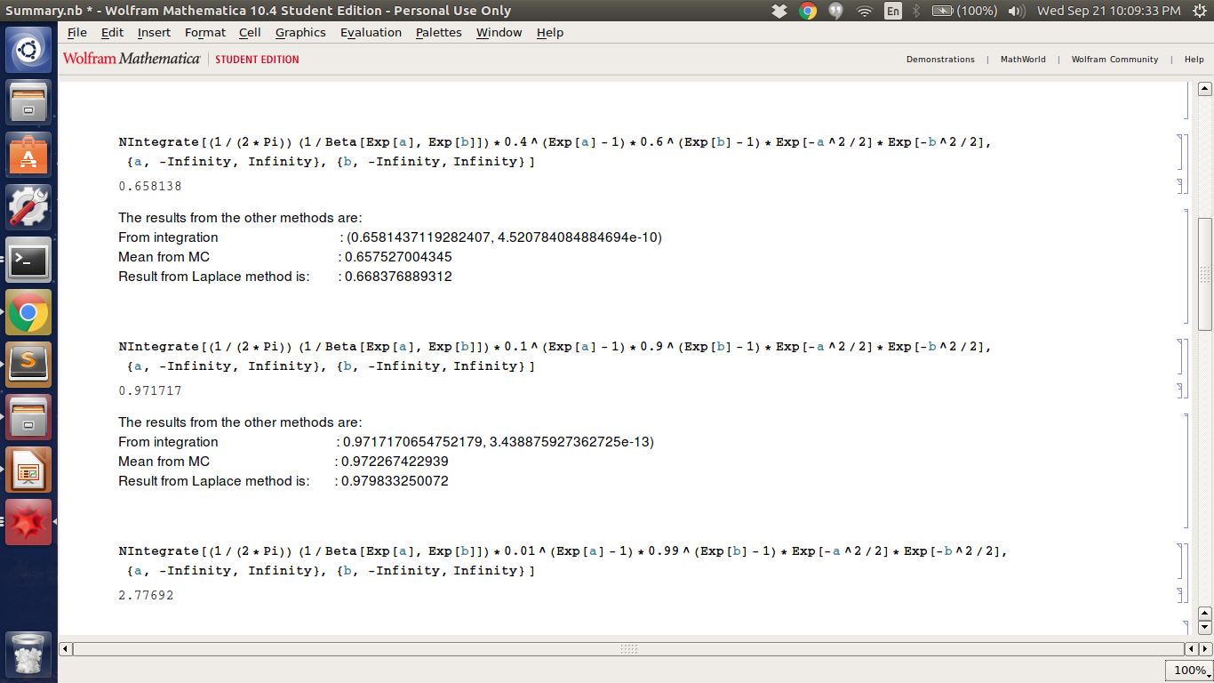
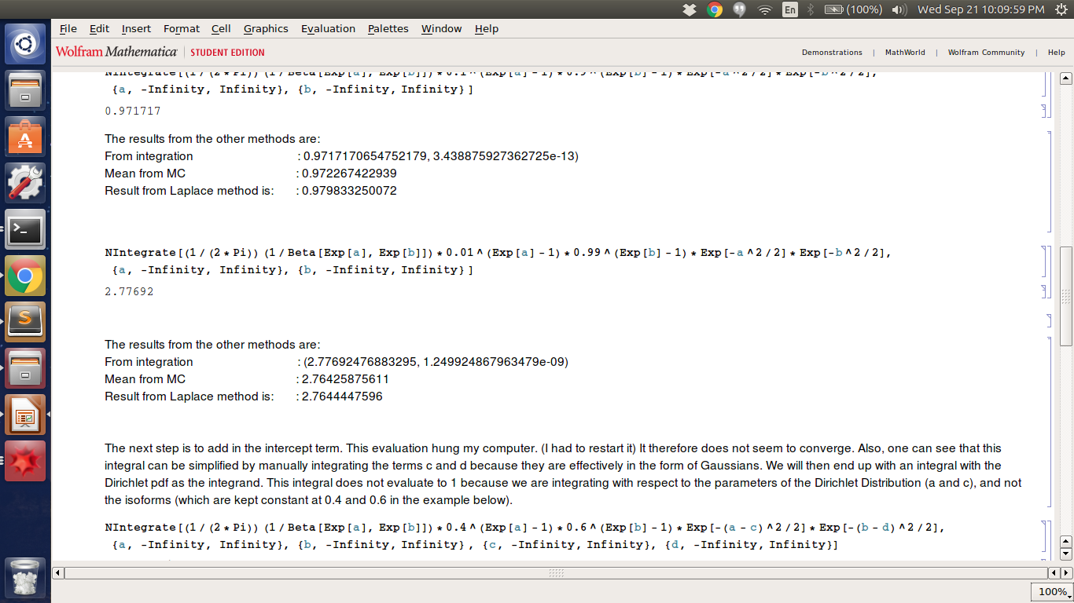
Sanity Check for the various methods
Not the actual integrals that we need to evaluate.
Just some samples.

Slide 23
Specific Example
Python’s nquad function run for 10+ min without result.
I then turned to Laplace’s Method because maybe Python is not good at evaluating 6-integral.

Slide 24
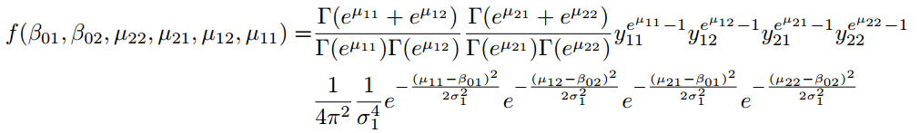

Specific Example

Slide 25
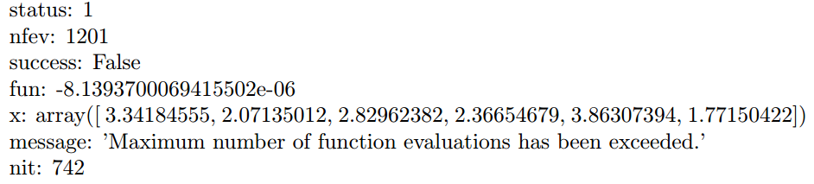
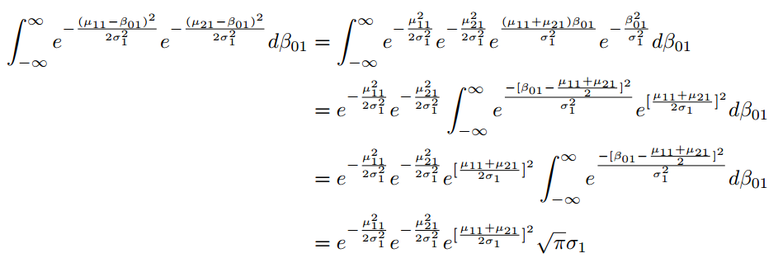
Specific Example
Used scipy.optimize.minimize
Dimension of integral can be reduced:

Slide 26
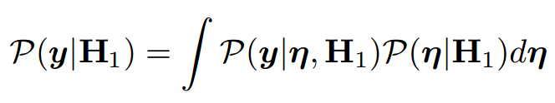
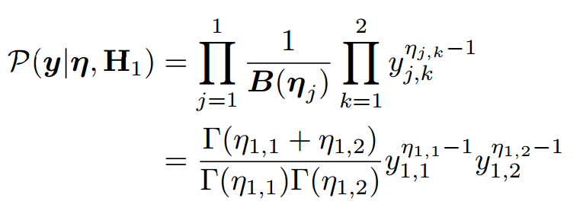
Reason it does not work
Consider n=1, K=2

Slide 27
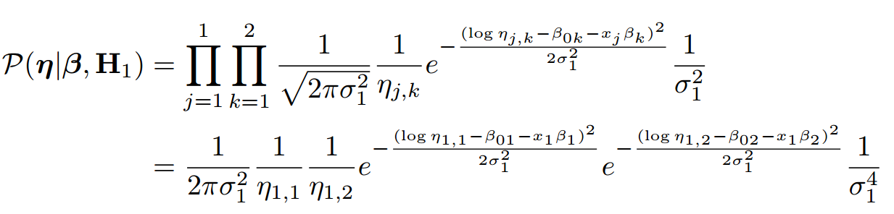
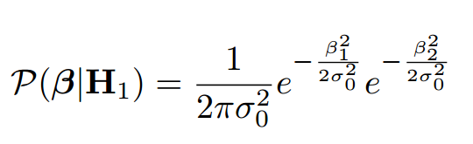
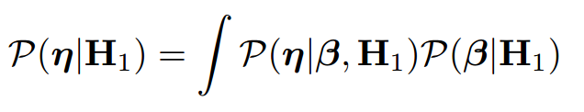
Reason it does not work

Slide 28
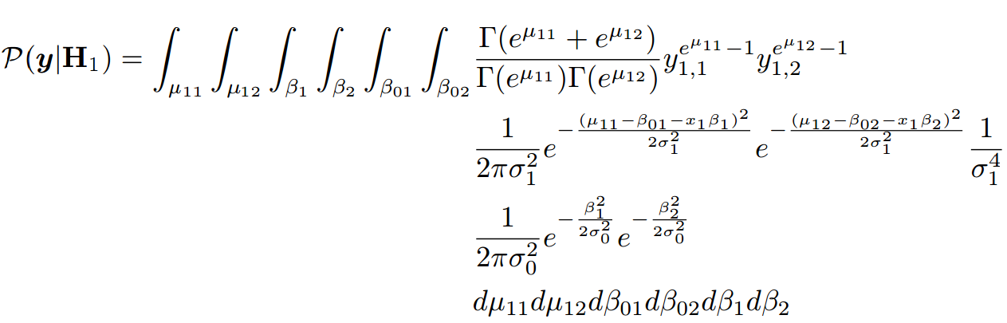
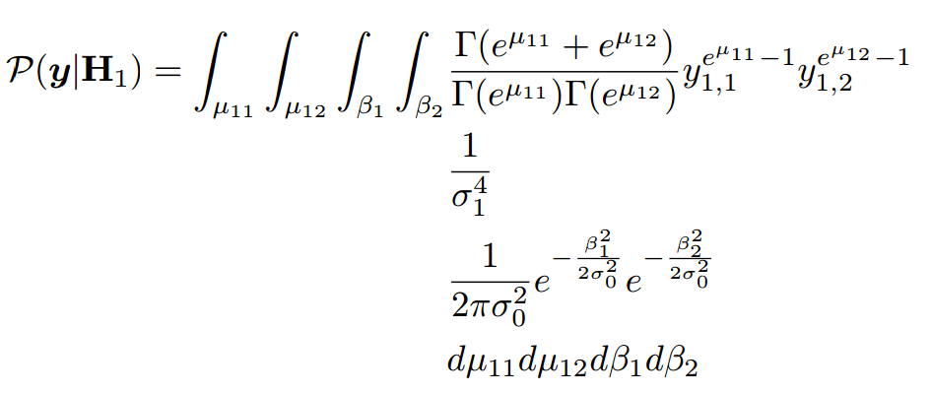
Reason it does not work

Slide 29
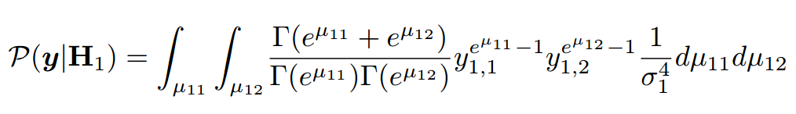
Reason it does not work

Slide 30
Data Generation
Data is generated with a Python script
Input:
n, the number of individuals
K, the number of isoforms
maf, the minor allele frequency
Output:
Isoform proportion of each individual
Generate genotype data for each individual
Generate values for noise + intercept + effect
Generate Dirichlet pdf parameter using intercept, noise, effect and genotype
Generate isoform proportions for each individual using Dirichlet pdf parameter

Slide 31
Data Generation: Step 1
Given n (number of individuals), perform 2n Binomial draws, each with probability=maf.
Generate genotype data for each individual
Generate values for noise + intercept + effect
Generate Dirichlet pdf parameter using intercept, noise, effect and genotype
Generate isoform proportions for each individual using Dirichlet pdf parameter

Slide 32
Data Generation: Step 2
Draw noise and effect from normal distribution.
Draw intercept from uniform distribution from [-1, 1]
Generate genotype data for each individual
Generate values for noise + intercept + effect
Generate Dirichlet pdf parameter using intercept, noise, effect and genotype
Generate isoform proportions for each individual using Dirichlet pdf parameter
Background
Theoretical model
Implementation
Result

Slide 33
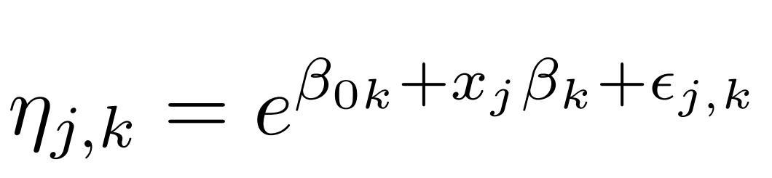
Data Generation: Step 3
Generate genotype data for each individual
Generate values for noise + intercept + effect
Generate Dirichlet pdf parameter using intercept, noise, effect and genotype
Generate isoform proportions for each individual using Dirichlet pdf parameter

Slide 34
Data Generation: Step 4
Draw isoform proportions from Dirichlet pdf.
Generate genotype data for each individual
Generate values for noise + intercept + effect
Generate Dirichlet pdf parameter using intercept, noise, effect and genotype
Generate isoform proportions for each individual using Dirichlet pdf parameter

Slide 35
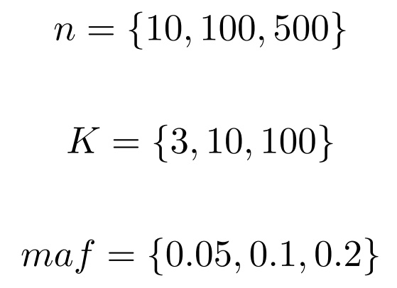
Data Generation
Parameters varied:
27 folders created, each containing:
500 files for simulated data
500 files for permutations of simulated data
1 file for results

Slide 36
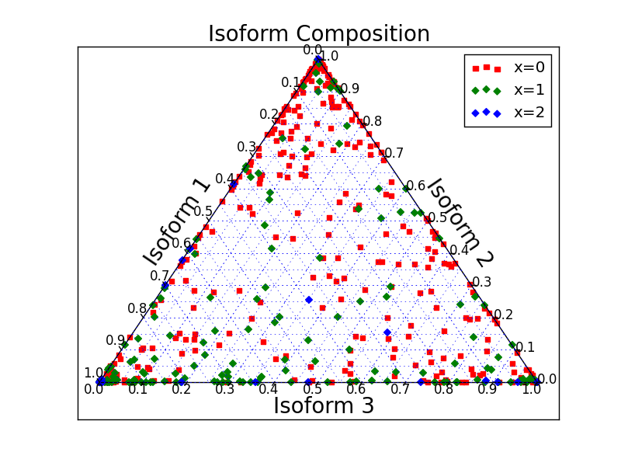
Plots of Data Generated
n = 500
maf = 0.1

Slide 37
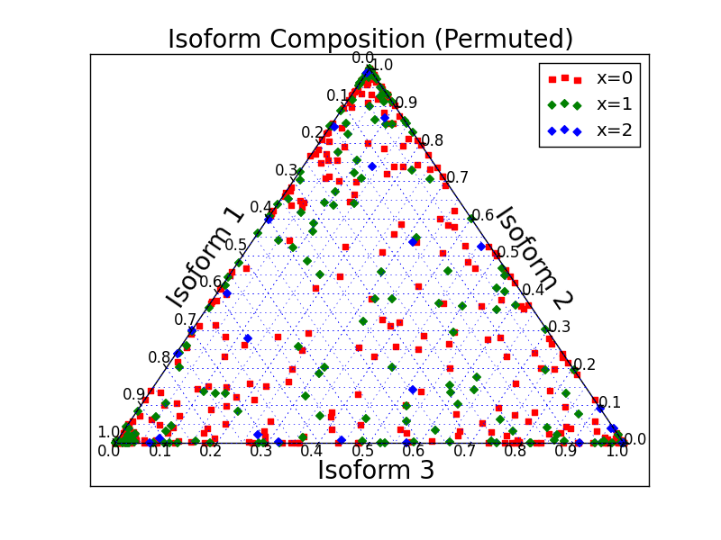
Plots of Data Generated
n = 500
maf = 0.1

Slide 38
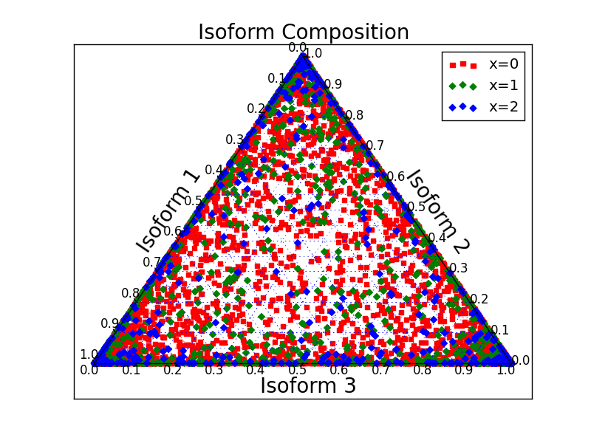
Plots of Data Generated
n = 10
maf = 0.1

Slide 39
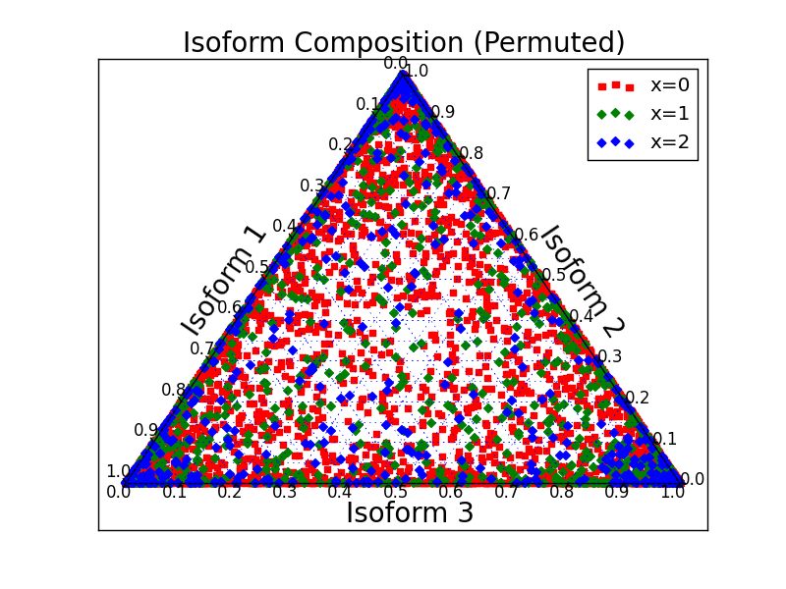
Plots of Data Generated
n = 10
maf = 0.1

Slide 40
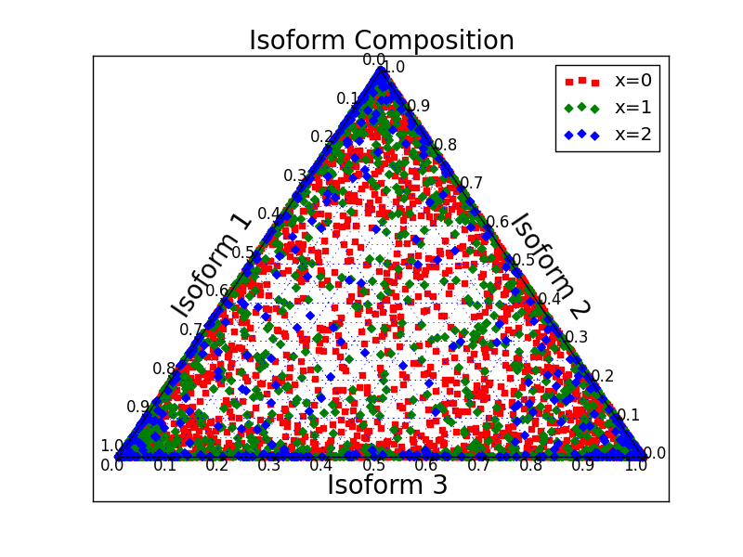
Plots of Data Generated
n = 10
maf = 0.2

Slide 41
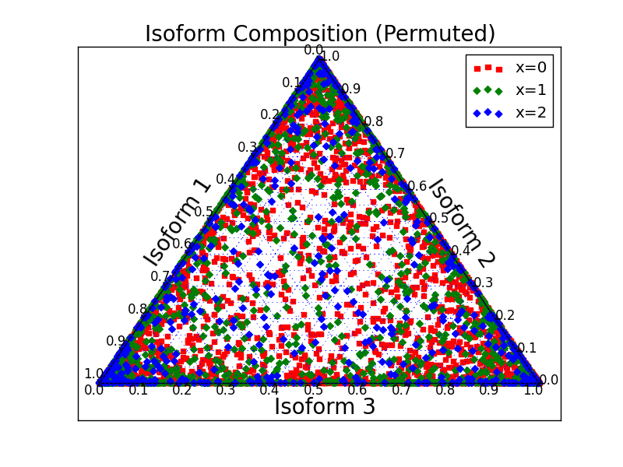
Plots of Data Generated
n = 10
maf = 0.2

Slide 42




Implemented Alternative Method
Computed Pseudo F-Ratio (All theoretical results come from “A new method for non-parametric multivariate analysis of variance” by Anderson)

Slide 43

Precision Recall Curve
$P= \frac{T_{p}}{T_{p}+F_{p}}$
$R= \frac{T_{p}}{T_{p}+F_{n}}$
For each threshold p-value, calculate the Precision and Recall value of all the 1000 files.

Slide 44

Precision-Recall curve

Slide 45

Precision-Recall curve

Slide 46

Precision-Recall curve

Slide 47

Acknowledgements

Slide 48
[5] Anderson, Marti J. "A New Method for Non-parametric Multivariate Analysis of Variance." Austral Ecology 26, no. 1 (2008): 32-46. doi:10.1111/j.1442-9993.2001.tb00081.x.
[6] Monlong, Jean, Miquel Calvo, Pedro G. Ferreira, and Roderic Guigó. "Identification of Genetic Variants Associated with Alternative Splicing Using SQTLseekeR." Nature Communications Nat Comms 5 (2014): 4698. doi:10.1038/ncomms5698.

