Slide 1
gpio ctrl
Version | Author | DateTime
v1.0 - 初稿 | jielong.lin@tpv-tech.com (林杰龙) | xx-xx-xx

Slide 2
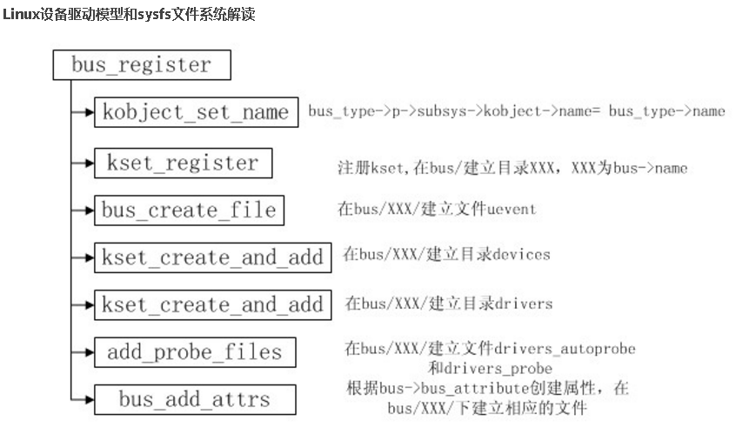
driver_create_file()创建drv下的属性文件，调用sysfs_create_file()实现
Notes:
driver_create_file()创建drv下的属性文件，调用sysfs_create_file()实现

Slide 3
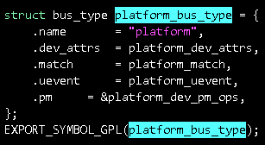
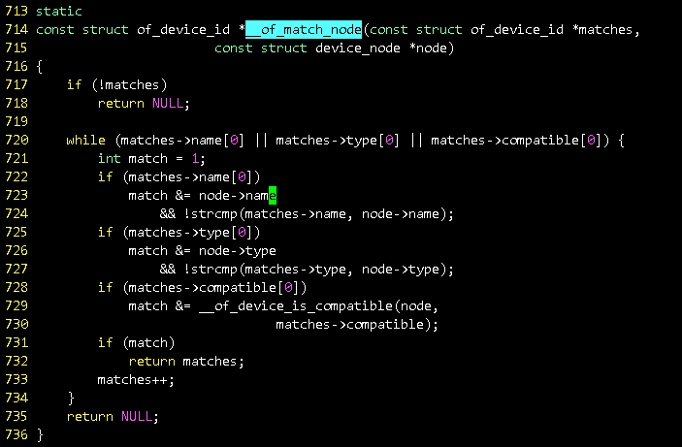
Init flow : assumpe all devices has already added to the bus
kernel_init(…)
static struct platform_driver gpio_keys_device_driver = {
.probe = reach_gpio_ctl_probe,
.remove = reach_gpio_ctl_remove,
.driver = {
.name = "reach-gpio-ctl",
.owner = THIS_MODULE,
.of_match_table = of_match_ptr( reach_gpio_ctl_of_match ),
}
};
kernel_init_freeable(…)
do_one_initcall(…)
gpio_ctrl_init(void)
platform_driver_register( &gpio_keys_device_driver )
gpio_keys_device_driver.driver.bus = &platform_bus_type;
gpio_keys_device_driver.driver.probe = platform_drv_probe;
… //device_driver is set
driver_register( &(gpio_keys_device_driver.driver) )
bus_add_driver( &(gpio_keys_device_driver.driver) )
1.bus = bus_get( drv->bus ) //bus有很多类型，这里用的是SOC内部的系统总线，也就是platform_bus_type
2.kzalloc and initialize driver_private, and bind driver_private with device_driver ; finally add driver_private into tail of bus list
3.bus->p->drivers_autoprobe is set true by default,so call:
driver_attach( &(gpio_keys_device_driver.driver) )
bus_for_each_dev( (gpio_keys_device_driver.driver.bus), NULL, &(gpio_keys_device_driver.driver), __driver_attach )
__driver_attach( (struct device*)dev, &(gpio_keys_device_driver.driver) ) //Iterate over bus->p->klist_devices
driver_match_device( drv, dev ) => drv->bus->match( dev, drv ) => platform_match( dev, drv )
of_driver_match_device(dev, drv) //Attempt an OF style match first
of_match_device(drv->of_match_table, dev) != NULL
of_match_node(matches, dev->of_node)
match = __of_match_node (matches, node)
//IF OF style match failure, try ACPI style match
acpi_driver_match_device(dev, drv)
//IF ACPI style match failure, try to match against the id table)
//id_table is defined first
platform_match_id (pdrv->id_table, pdev
//IF above failure, fall-back to driver name match
strcmp (pdev->name, drv->name)
节点名不为空，并且与matches表的名字一样，match就为1
Retrieve
platform_device
from platform bus
driver_probe_device (drv, dev)
really_probe (dev, drv)
节点类型不为空，并且与matches表的类型一样，match就为1
dev->driver = drv;
pinctrl_bind_pins (dev)
//在sysfs中建立从driver指向device的链接文件
driver_sysfs_add (dev))
//dev->bus->probe 为空，因为平台总线不设置probe
platform_drv_probe ( _dev )
struct platform_driver *drv = to_platform_driver(_dev->driver)
struct platform_device *dev = to_platform_device(_dev);
drv->probe(dev) ⬄ reach_gpio_ctl_probe( dev )
driver_bound ( dev ) //driver与device绑定处理
klist_add_tail(&dev->p->knode_driver, &dev->driver->p->klist_devices); //device is added to tail of driver list
节点与matches表兼容，match就为1
Notes:
http://blog.csdn.net/richard_liujh/article/details/48245715
drivers_kset：内核注释是驱动相关的列表，实际上我查了它的有关引用，它用于driver_find(…)
它的创建过程： priv->drivers_kset = kset_create_and_add("drivers", NULL, &priv->subsys.kobj);
在bus/XXX/建立目录drivers

Slide 4




struct bus_type {
…
struct subsys_private *p;
…
}; //such as platform_bus_type
struct subsys_private {
…
struct klist klist_drivers;
…
struct klist klist_devices;
...
} *p;
struct driver_private {
…
struct klist_node knode_bus;
…
struct klist klist_devices;
…
} *priv;
struct device_private {
…
struct klist_node knode_bus;
…
struct klist_node knode_driver;
…
} *priv;
New Driver is added to tail of bus list
Next, Study How the device is added to bus ?
Device is added to tail of driver list

Slide 5
Init flow : device_register(dev) is responsible for adding a device into dev->bus
➔ device_register (struct device *dev)
➔ device_initialize(dev) //initialize kobject, kset,some locks, some queue or list and so on, except for hardware initialized by registers.
➔ device_add(dev)
➔ set device name from init_name or dev_name of bus append dev id
➔ build kobject list by kobject_add device kobject belong to its parent
➔ device_create_file(dev, &dev_attr_uevent)
➔ device_create_file(dev, &dev_attr_dev)
➔ device_create_sys_dev_entry(dev)
➔ devtmpfs_create_node(dev)
➔ device_add_class_symlinks(dev)
➔ device_add_attrs(dev)
➔ bus_add_device(dev)
➔ klist_add_tail(&dev->p->knode_bus, &bus->p->klist_devices)
➔ kobject_uevent(&dev->kobj, KOBJ_ADD)
➔ bus_probe_device(dev)
➔ IF dev->bus->p->drivers_autoprobe is set to true
➔ device_initial_probe(dev)
➔ __device_attach(dev, true)
➔ bus_for_each_drv (dev->bus, NULL, &data, __device_attach_driver ) // try to match each driver in bus by __device_attach_driver

Slide 6
compat_sys_ioctl(…)
snd_pcm_ioctl_compat(…)
snd_pcm_playback_ioctl1(…)
snd_pcm_common_ioctl1(…)
snd_pcm_action_single(…)
snd_pcm_do_prepare(…)
dpcm_fe_dai_prepare(…)
dpcm_be_dai_prepare_async(…)
soc_pcm_prepare(…)
snd_soc_dapm_stream_event (…)
dapm_power_widgets(…)
dapm_seq_run.isra.18(…)
dapm_seq_run_coalesced(…)
dapm_seq_check_event(…)
msm8x16_wcd_hph_pa_event(…)
gpio_set_value_cansleep(…)
gpio_to_desc(…)
warn_slowpath_fmt(…)
warn_slowpath_common(…)

Slide 7
目录索引1
目录索引2 (当前)
目录索引3
标题
简要
xxx
xxx
xxx

Slide 8
页标题
内容解说
void MediaExtractorSource::start ( )
{
...
float vendorConfidence = 0;
String8 mime("");
sp<AMessage> vendorMeta (NULL);
if (!sniffVendorFormat (mDataSource, &mime, &vendorConfidence, &vendorMeta)) {
ALOGD("[%s:%d] sniffed VendorFormat vendorConfidence = %f",__FUNCTION__,__LINE__,vendorConfidence);
vendorConfidence = 0;
}
...
}
小标题
内容解说
小标题
小标题
MediaPlayer
Java API
Native API
Object1
Object2
Xxx( )
注释
Interface_
Xxx( )
xxx(...)
X( )
Base_Class
_Class_
解说
xx_x(...)
xx_x(...)
Sub_Class
_Class
xx_x(...)
xx_x(...)
归纳：
1: xxxx；
2: xxxx;
3: xxxx;
解说

