Slide 1
Android.PowerAndTVPower.1

Slide 2
INTRODUCE
After pressing the RC-Power key (DC-OFF),
Introduce the flow about how to enter DDR-Standby from Full-On
Input Manager to be Initialized
Where do the Android Read the KEY After Pressing RC-Power Key.
How to handle the RC Power Key and trigger the system to enter DDR-Standby

Slide 3
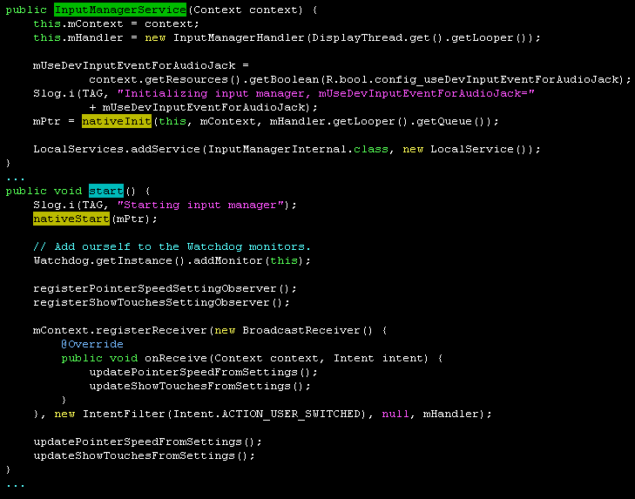
Input Manager 初始化
base/core/java/android/hardware/input/InputManager.java
Android系统初始化
时,会先后去调用这
两个JAVA函数
这是个标准的Service组件，在JAVA层和JNI层都需要实现一些任务

Slide 4
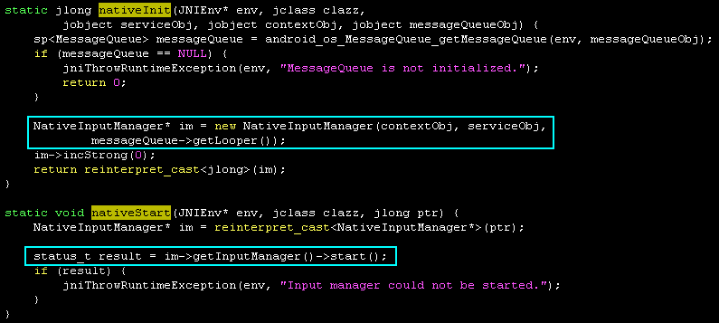
Input Manager 初始化
frameworks/base/services/core/jni/com_android_server_input_InputManagerService.cpp
在JNI层需要跟Linux输入子系统交互，即读取信息或注入信息。NativeInputManager实现这些主要功能

Slide 5
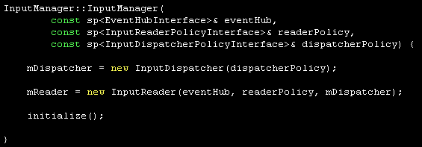

Input Manager 初始化
InputManager是frameworks下负责管理输入事件的组件
frameworks/base/services/core/jni/
com_android_server_input_InputManagerService.cpp
NativeInputManager::NativeInputManager
在EventHub用于为NativeInputManager
处理与Linux的交互信息
sp<EventHub> eventHub = new EventHub()
new InputManager(eventHub, this, this);
dispatcherPolicy 原来是 NativeInputManager
InputManager有四大组件：
InputDispatcher及InputDispatcherThread
InputReader及InputReaderThread

Slide 6
Input Manager 初始化
InputReaderThread inherit from Thread, when it is started, the loopOnce( ) is called
Thread::run(...)
system/core/libutils/Threads.cpp
Thread::_threadLoop(...)
self->threadLoop( ) // virtual bool Thead::threadLoop() = 0;
<=> InputReaderThread::threadLoop( )
InputReader::loopOnce( )
InputReader::loopOnce( )会在InputReaderThread 线程循环体中调用
当InputReader::loopOnce( )运行起来后，假设用户按下RC Power， 而且 Key 被 MTK IR 驱动转发到 Linux 输入子系统当中， Android 会从哪里开始接收这个 Key 并且正确处理它 ？

Slide 7
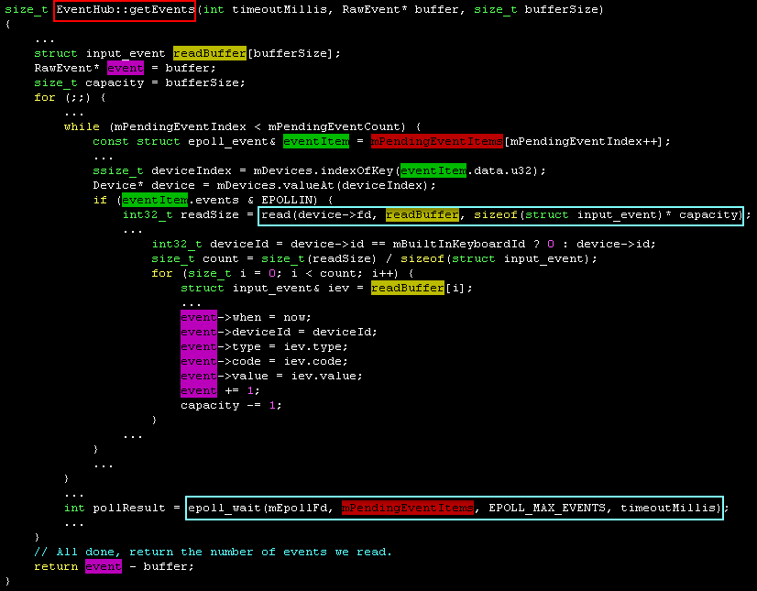

Slide 8

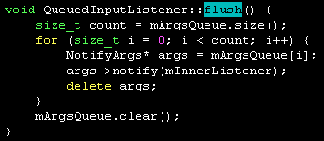
Input Manager 处理RC Power Key
InputReader::loopOnce( )
EventHub::getEvents(... rawEvent[ ], ...)
基于epoll的IO复用并调用read(...)获取到rawEvent信息
InputReader::processEventsLocked(rawEvent[ ], ...)
InputReader::processEventsForDeviceLocked ( deviceId,rawEvents[ ],count )
InputDevice::process( rawEvents,count)
JoystickInputMapper::process( ... )
SwitchInputMapper::process( ... )
VibratorInputMapper::process( ... )
CursorInputMapper::process( ... )
TouchInputMapper::process( ... )
遍历rawEvent[ ]
KeyboardInputMapper::process(rawEvents, count)
KeyboardInputMapper::processKey(...)
KeyboardInputMapper::getListener()->notifyKey(&args)
<=> QueuedInputListener::notifyKey(...)
QueuedInputListener::flush( )
将遍历QueuedInputListener
队列并取出rawEvent信息进行
处理

Slide 9
Input Manager 处理RC Power Key
NotifyKeyArgs对象封装了rawEvent[ ]信息
NotifyKeyArgs对象被压入mArgsQeue队列当中
listener 指向的是 InputDispatcher
QueuedInputListener::flush( )
=> InputDispatcher::notifyKey( NotifyKeyArgs )

Slide 10
Input Manager 处理RC Power Key
InputDispatcher::notifyKey(const NotifyKeyArgs* args)
mPolicy->interceptKeyBeforeQueueing( KeyEvent, ... )
<=> NativeInputManager::interceptKeyBeforeQueueing( ... )
android/view/KeyEvent.java
KeyEvent::obtain(...)
基于Java反射机制调用JAVA类函数封装keyEvent
android_view_KeyEvent_fromNative( env, keyEvent )
JNIEnv::callIntMethod(..., gServiceClassInfo.interceptKeyBeforeQueueing, ...)
FIND_CLASS(clazz, "com/android/server/input/InputManagerService");
// 说明 clazz 映射了InputManagerService
GET_METHOD_ID(gServiceClassInfo.interceptKeyBeforeQueueing, clazz,
"interceptKeyBeforeQueueing", "(Landroid/view/KeyEvent;I)I");
// 说明gServiceClassInfo.interceptKeyBeforeQueueing 映射了InputManagerService:: interceptKeyBeforeQueueing
只有PhoneWindowManager实现了WindowManagerPolicy接口类
android/internal/policy/impl/PhoneWindowManager.java
PhoneWindowManager::interceptKeyBeforeQueueing (...)
InputDispatcher::enqueueInboundEventLocked ( ... )
将keyEvent压入mInboundQueue队列末尾 （ignore）

Slide 11

Input Manager 处理RC Power Key
event.getKeyCode( ) return KeyEvent.KEYCODE_POWER
event.getAction( ) return KeyEvent.ACTION_DOWN
PhoneWindowManager::
public int interceptKeyBeforeQueueing( KeyEvent event, int policyFlags )
... ...
recogniseKeyEvent(
KeyEvent.KEYCODE_POWER
)
switch ( keyCode )
... ...
KeyEvent.KEYCODE_POWER
Handle AMBILIGHT key event in semi-standby state : request for lounge mode ambilight toggling.
powerKeyStandbySemiStandby( event )

Slide 12
Input Manager 处理RC Power Key
PhoneWindowManager::
public void powerKeyStandbySemiStandby( KeyEvent event )
String sCurrentState = SystemProperties.get("persist.sys.power_currentstate")
Yes
mPower = IPowerManager.Stub.asInterface(
ServiceManager.getService("power")
)
sCurrentState.equals("FULL")
No
Over
mPower.shutdown( true, false );
Yes
mPower = IPowerManager.Stub.asInterface(
ServiceManager.getService("power")
)
sCurrentState.equals("SEMI_STANDBY")
No
Over
mPowerManager.isScreenOn( )
Yes
No
mPower.wakeUp(SystemClock.uptimeMillis( ) )

Slide 13
Android.PowerAndTVPower.1
OVER!!!
Thank you

