Slide 1
Android.Thread.Looper.Handler

Slide 2
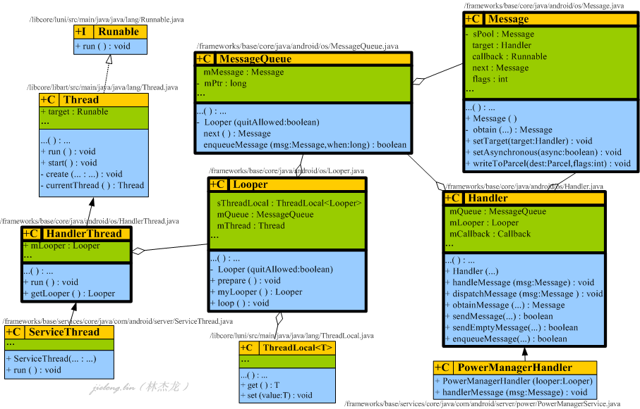
JAVA Classes UML

Slide 3
As the above the java classes UML, get the following objects details:
Looper offer the MessageQueue
Thread create the Looper and run the Looper:loop( ) to handle the Message
Handler need to get the Looper first and then send the Message to MessageQueue
Looper
It is the loop for the Message to be handled.
And its mQueue is an MessageQueue for enqueue the Messages by Handler.
MessageQueue
It is the Message queue, the Messages are enqueued by Handler, and the Messages are removed by
Looper::loop( ).
ThreadLocal<T>
Looper::myLooper( ) is a static method of the class, namely it doesn't need to be instantiated first before
it is used. Hence the Looper use ThreadLocal<T> to push the Looper to the likely stack associated with
the current thread by set(T), and use ThreadLocal<T> to pop the Looper from the likely stack by get( )

Slide 4
Thread or HandlerThread
Why do we need to use the Thread or HandlerThread for implementing our task ?
It is only a simple reason that we need another thread to do some tasks rather than the current thread.
So Thread will create another thread, and then run the Looper:loop( ) to handle every Message
Handler Or PowerManagerHandler
It encapsulates the strategy about how to handle the every Message. In general, the strategy should be
implemented on the child class which extends the Handler. However, some tasks are implemented in
Runnable::run( ) . Then then Runnable::run( ) is binded to the Message::callback and is called by the
Looper::loop( )
Sure, it also offers the sendMessage method about how to send the Message to the message queue
named MessageQueue.
The related Handler APIs as follows:
PowerManagerHandler::handleMessage(…)
Handler::sendEmptyMessage(…)
Handler::sendMessage(…)

Slide 5
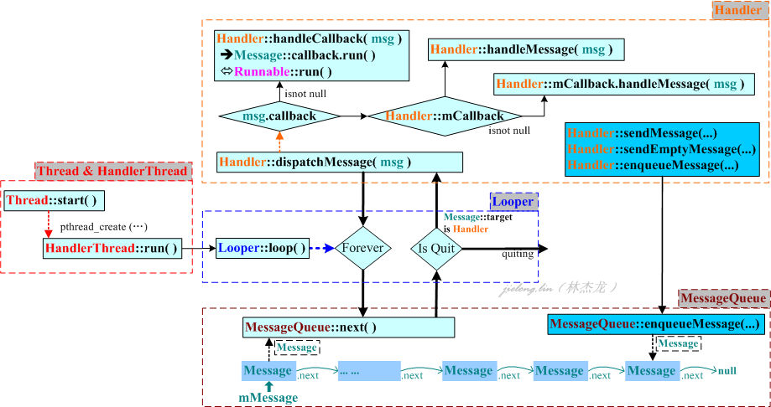
The Flowchart Surrounded By Thread, Looper, Handler

Slide 6
Thread start a new POSIX thread to run its Looper::loop( )
Looper::loop( ) is that:
When nothing is in MessageQueue, the Looper thread will be suspended and blocked
When some Message is sent to MessageQueue and the Looper thread is resumed,
the every Message is got from MessageQueue and is dispatched to Handler.
Handler call the Runnable::run( ) got from the current Message

Slide 7
How to make an Instantiation
Create the Message Loop Handle Framework
HandlerThread extends Thread, and its run( ) implements the Looper framework, so

Slide 9
Thread::CreateCallback(...) #【NewThread】
|----Invoke the 'run' method of our java.lang.Thread.
<=> ServiceThread::run override HandlerThread::run override java.lang.Thread::run
<=> ServiceThread::run( )
|
|----HandlerThread::run( )
|
|----Looper.prepare( )
| |
| |----Looper.prepare(true)
| |----tempLooper = new Looper( )
| | |----mQueue = new MessageQueue( )
| |
| | #ThreadLocal<Looper> sThreadLocal
| |----sThreadLocal.set(tempLooper)
|
|----synchronized(this)
|
|----mLooper = Looper.myLooper( )
| |
| | #Return tLooper object.
| |----sThreadLocal.get( )
|
| #public final native void notifyAll( );
| #It will tell someone who call HandlerThread::getLooper( ) about mLooper is initialized successfully
|----notifyAll ( )
|----|
|
|----Looper.loop( )
|----queue = Looper.myLooper( ).mQueue
|----for(;;) <----------------------------------------------------------------|
|----Message msg = queue.next( ); //might block |
|----msg.target.dispatchMessage(msg); |
|____________________________________________|

