Slide 1
Android.PowerAndTVPower.3
<<ColdBoot>>

Slide 2
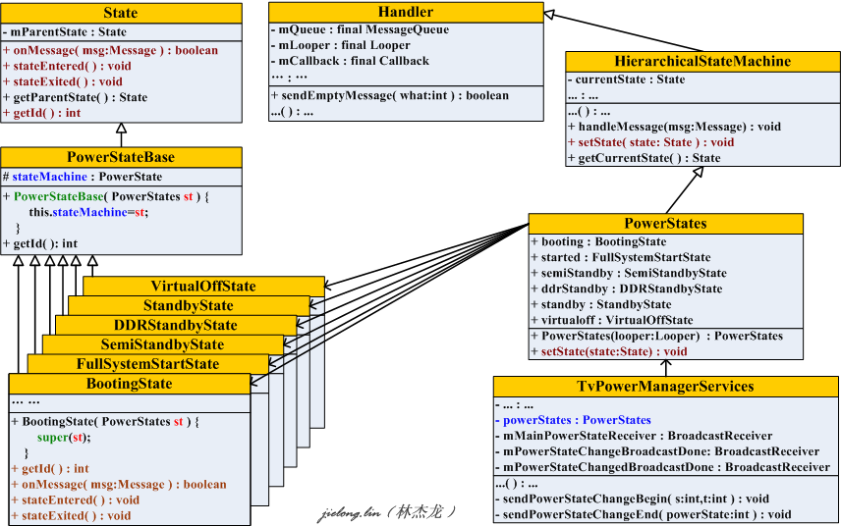
TvPower States Machine
TvPower States Class Block

Slide 3
TvPowerManagerService::sendPowerStateChangeBegin ( ... )
mContext.sendOrderedBroadcastAsUser(...mPowerStateChangeBroadcastDone...)

Slide 4
TvPowerManagerService:: sendPowerStateChangeEnd( ... )
mContext.sendOrderedBroadcastAsUser(... mPowerStateChangedBroadcastDone...)
mPowerStateChangedBroadcastDone.onReceive(...)
mDeferredShutdownRequested && bTPVSystemReady
shutdownInner(...)
mShutdownObserver = new ShutdownObserver( )
is false: 不存在 不关机的锁
RegisterTVPowerShutdownObserver( mShutdownObserver )
mHasDontShutdownLocks
lastDontShutdownLockReleased( )
TvPowerManagerService::shutdown( IShutdownObserver observer )
{
mObserver = observer;
}
mDeferredShutdownRequested
&& bTPVSystemReady
true
mDeferredShutdownHandler.sendEmptyMessage(
MSG_DEFERRED_SHUTDOWN
);
mHasShutdownInProgressLocks
is false: 关机处理进度完成
lastShutdownInProgressLockReleased( )
DeferredShutdownHandler::handleMessage(...)
mObserver != NULL
IShutdownObserver::shutdownComplete( )
<=> ShutdownObserver::shutdownComplete( )
|------ mParent.tvPowerManagerShutdownDone( )
|------- mTVPowerManagerShutdownDoneSync.notifyAll( )

Slide 5
|----- com.android.server.power.ShutdownThread.run( )
| |
| |----- while ( !mTVPowerManagerShutdownDone ) {
| ...
| mTVPowerManagerShutdownDoneSync.wait (delay);
| ...
| }
|
|----- rebootOrShutdown (mReboot, mRebootReason)
|
|-----IF Reboot: PowerManagerService.lowLevelReboot (reason);
|-----ELSE: PowerManagerService.lowLevelShutdown ( );

Slide 6
com.android.server.power.ShutdownThread::shutdownInner (final Context context, boolean confirm)
|
|----init ( )
| |----new org.droidtv.tv.server.TVSystemServerImpl
|
|----new ShutdownThread ( )
| |
| |----mShutdownObserver = new ShutdownObserver ( );
| |----mShutdownObserver.setParent (this); //Parent is ShutdownThread
|
|----RegisterTVPowerShutdownObserver( mShutdownObserver );
| |
| |----org.droidtv.tv.server.TVSystemServerImpl::RegisterTVPowerShutdownObserver( mShutdownObserver )
| |
| |----TvPowerManagerService::shutdown( mShutdownObserver )
| |
| |----mObserver = mShutdownObserver
|
|----checkShutdownAllowedInternal (context);
|
|----IPowerManager::goToSleep(...)
|
|----Invoke Java Class: org.droidtv.tv.server.TVSystemServerImpl::continueToFullShutdown( )
| |
| |----TvPowerManagerService::continueToFullShutdown( )
| |----Printf all the DontShutdownLock holders
| |----IF CurrentPowerState is FullSystemStart:
| |----PowerStates::sendEmptyMessage (MSG_SCREEN_OFF)
|----IF continueToFullShutdown Return true, namely TVPowerManager accepted full shutdown request
|
|----beginShutdownSequence (context)

Slide 7
beginShutdownSequence(Context context)
|
|----bGoDownNow is set to true if persist.sys.rebootreason is Recovery
|----bGoDownNow is set to true if persist.sys.virtualRequested is True
|----IF bGoDownNow is false
| |
| |----IF persist.sys.enableddr is True
| |
| |----ShutdownThread::mHandler.sendMessage(msg with MSG_DDR_SUSPEND)
| |----Return
|
|----ShutdownThread::run( ) //com.android.server.power.ShutdownThread
| |
|----- while (!mTVPowerManagerShutdownDone) {
| ...
| mTVPowerManagerShutdownDoneSync.wait(delay);
| ...
| }
|
|----- rebootOrShutdown(mReboot, mRebootReason)
|
|-----IF Reboot: PowerManagerService.lowLevelReboot(reason);
|-----ELSE: PowerManagerService.lowLevelShutdown( );

Slide 8
INTRODUCE
How to initialize PowerManager And TvPowerManager when coldboot
开机流程

Slide 9
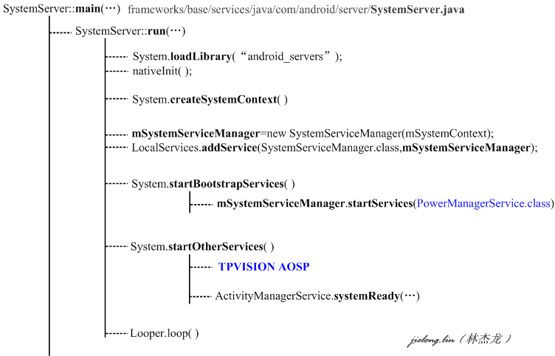
Android启动
Android Java 应用的启动流程, 从zygote的入口函数main开始.
SystemServer没有继承于Thread类也没有实现Runnable类,private void run( )方法仅仅是SystemServer的私有成员方法
SystemServiceManager to implement the startServices(...)
for PowerManagerService
1.new Instance; 2.registe service; 3.start service
for TvPowerManagerService
1.new Instance; 2.init; 3.Wait for broadcast
bootcomplete
1.when startHomeActivity is running, broadcast bootcomplete
2.setState to bootcomplete

Slide 10
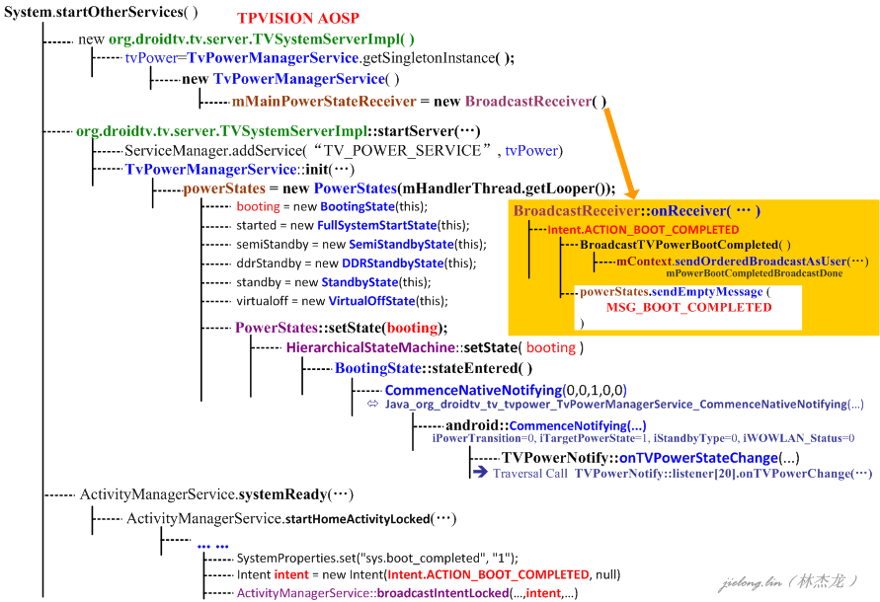


Slide 11
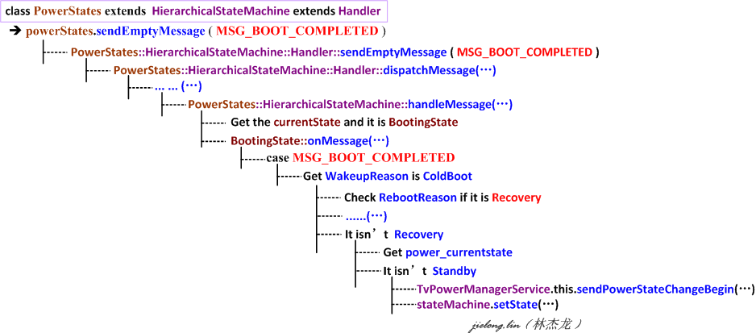
TvPower States Transition Is Implemented By The Two Following Steps:
1. TvPowerManagerService should notify the State Transition to the registed Applications
2. TvPowerManagerService make its StateMachine aligned to the new state

Slide 12
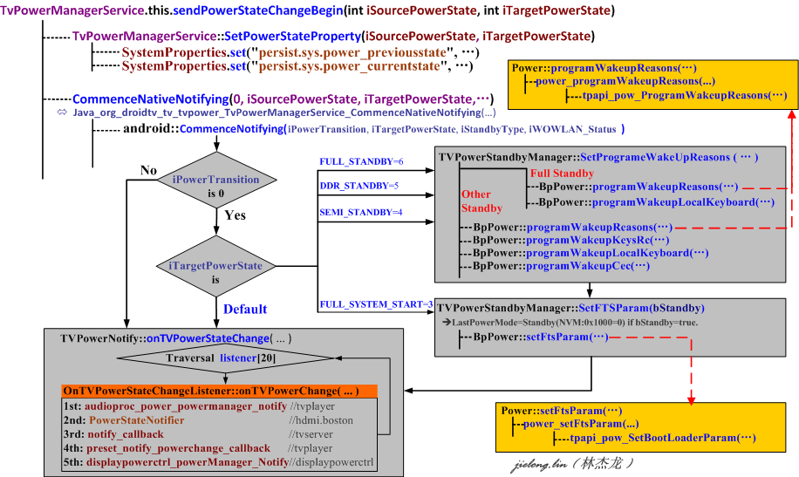
Notify the TvPower State Transition
TvPowerManagerService should notify the State Transition to the registed Applications
How To Get the TvPower States Transition For Applications?

Slide 13
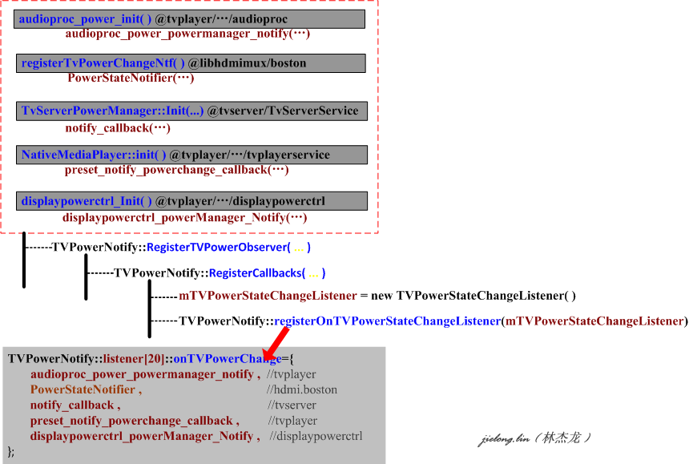

Slide 14
TvPowerManagerService make its StateMachine aligned to the new state
Who Is stateMachine From “stateMachine.setState(…)”

Slide 16
1.创建BroadcastReceiver对象.该对象用于等待接收指定ACTION的广播,
并在回调函数onReceiver(...)中处理对应的事件
2.创建TvPowerManagerService对象实例
3.初始化TvPowerManagerService对象时,创建TvPower状态机对象,并设置当前状态为booting.
4.在切换为状态为booting时,状态机会回调BootingState::stateEnterred( )

Slide 17
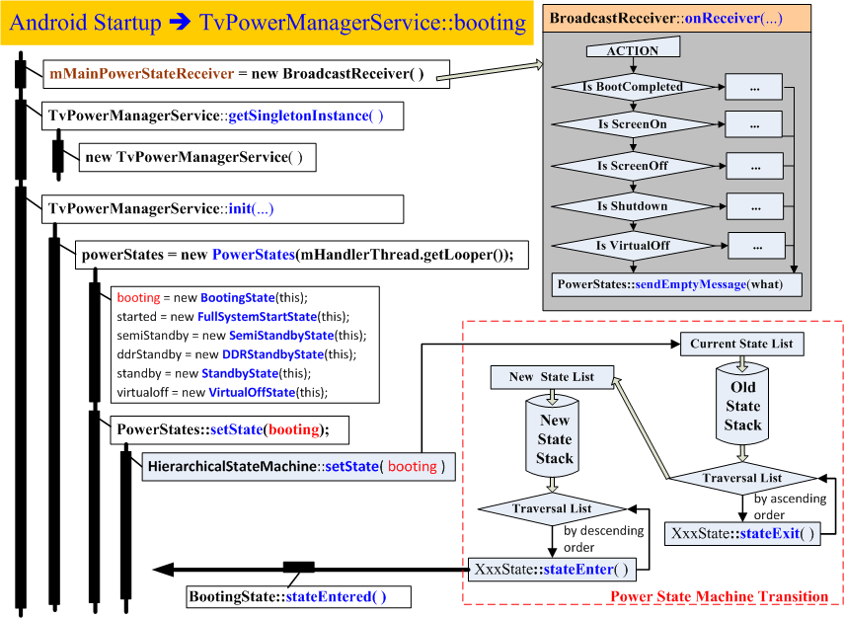

Slide 18
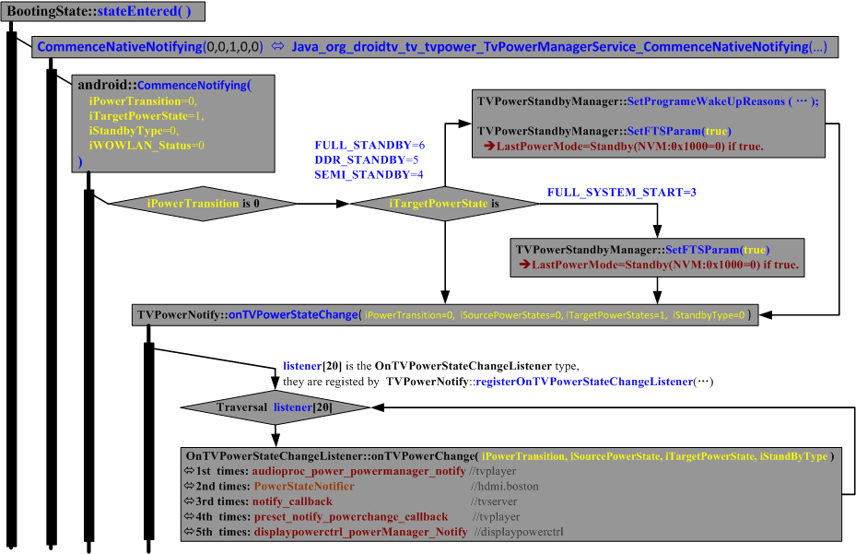

Slide 20
PowerManagerService
PowerManagerService
继承
SystemService
PowerManagerService
实现
Watchdog.Monitor

Slide 27
PowerManagerService::shutdown (true, false)
PowerManagerService::shutdownOrRebootInternal ( true, true, null, false )
PowerManagerService::shutdownOrRebootInternal ( true, true, null, false )

Slide 29

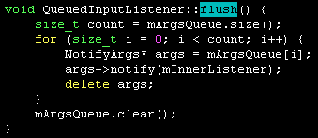
Input Manager 处理RC Power Key
InputReader::loopOnce( )
EventHub::getEvents(... rawEvent[ ], ...)
基于epoll的IO复用并调用read(...)获取到rawEvent信息
InputReader::processEventsLocked(rawEvent[ ], ...)
InputReader::processEventsForDeviceLocked ( deviceId,rawEvents[ ],count )
InputDevice::process( rawEvents,count)
JoystickInputMapper::process( ... )
SwitchInputMapper::process( ... )
VibratorInputMapper::process( ... )
CursorInputMapper::process( ... )
TouchInputMapper::process( ... )
遍历rawEvent[ ]
KeyboardInputMapper::process(rawEvents, count)
KeyboardInputMapper::processKey(...)
KeyboardInputMapper::getListener()->notifyKey(&args)
<=> QueuedInputListener::notifyKey(...)
QueuedInputListener::flush( )
将遍历QueuedInputListener
队列并取出rawEvent信息进行
处理

Slide 30

Input Manager 处理RC Power Key
event.getKeyCode( ) return KeyEvent.KEYCODE_POWER
event.getAction( ) return KeyEvent.ACTION_DOWN
PhoneWindowManager::
public int interceptKeyBeforeQueueing( KeyEvent event, int policyFlags )
... ...
recogniseKeyEvent(
KeyEvent.KEYCODE_POWER
)
switch ( keyCode )
... ...
KeyEvent.KEYCODE_POWER
Handle AMBILIGHT key event in semi-standby state : request for lounge mode ambilight toggling.
powerKeyStandbySemiStandby( event )

Slide 31
Android.PowerAndTVPower.1
OVER!!!
Thank you

