Slide 1
Mediatek Platform Initialized Sequence

Slide 2
<<序>>
这两年, 为公司, 南征北战, 忍辱负重, 亲, 我们真的很苦逼!!!

Slide 3
AC Power is On
Preloader
Preloader is only used to load the LZHS Image to an RAM buffer, and then run it.
The LZHS Image is the Mediatek Loader encapsulated with LZHS format, and it will be extracted by Preloader. Finally, CPU run the code of the Mediatek Loader in RAM.
Loader
Loader implement two important mediatek functions as follows:
1. Upgrade version from USB
2. Loading the bootloader to RAM from the specified storage such
as eMMC, SD, EEPROM and so on.

Slide 4
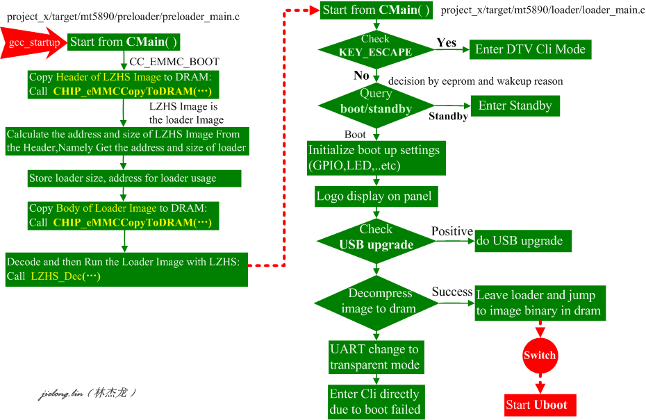

Slide 5
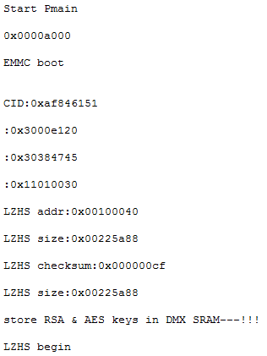
Preloader Flowchart
device/mediatek_common/vm_linux/project_x/target/mt5890/preloader/preloader_main.c
VOID CMain ( ) // CC_LZMA_DECODE isn’t defined in generally
CHIP_eMMCCopyToDRAM (
(UINT32 *)DRAM_BUFFER,
u4BSSLimit,
LZHS_HEADER
);
The Address and Size of Loader Image are got from the LZHS Image Header.
Copy the Loader Image to DRAM from eMMC by the Address and Size in LZHS Header
CHIP_eMMCCopyToDRAM (
(UINT32 *)u4DstAddr,
u4BSSLimit,
prLdrEnv->u4LoaderLzhsSize + LAODER_PADDING + LZHS_HEADER
)
1.Extract the Loader Image in DRAM with LZHS Decode Method.
2.Take CPU to run Loader in DRAM.
CHIP_DisplayString("LZHS begin \n");
u4Ret = LZHS_Dec (
u4ImageAddr+0x10,
CC_LOADER_MEM_OFFSET,
u4Size,
&u1Checksum
);

Slide 6
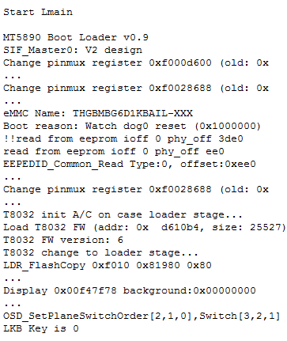
Loader Flowchart
device/mediatek_common/vm_linux/project_x/target/mt5890/loader/loader_main.c
VOID CMain ( ) // CC_LZMA_DECODE isn’t defined in generally
Initialize some setting and basic loader environment, such as :
1.Call LDR_PreInit( )
2.Call PDWNC_InitT8032 (u4Offset, u4Size)
Esc Key is pressed
LDR_IsEnterCli (BOOT_WAIT_TIME)
…
CLI_Init ( )
CLI_Input (NULL)
LDR_IsGoBootup (prLdrData) == 0
Go to Standby
LDR_EnterStandby (…)
Initialize boot up settings:
Call LDR_UpSetup (…)
Logo display no panel:
Call LDR_PanelLogo (…)

Slide 7
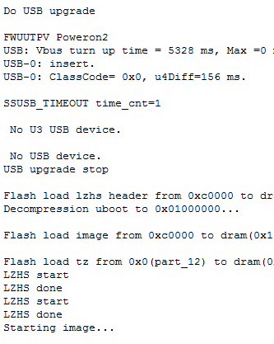
Loader Flowchart
Check USB upgrade flag and do USB upgrade if positive:
Call LDR_CheckUpgrade ( …. )
Boot Succeed
LDR_ImageDecompress(prLdrData) == 0
Boot failed
Jump to work:
Call LDR_ImpageJump (…)
UART change to transparent mode:
Call SerTransparent ( )
Uboot Flowchart
Boot failed, enter cli directly:
Call CLI_Init( )
Call CLI_Input (NULL)

Slide 8
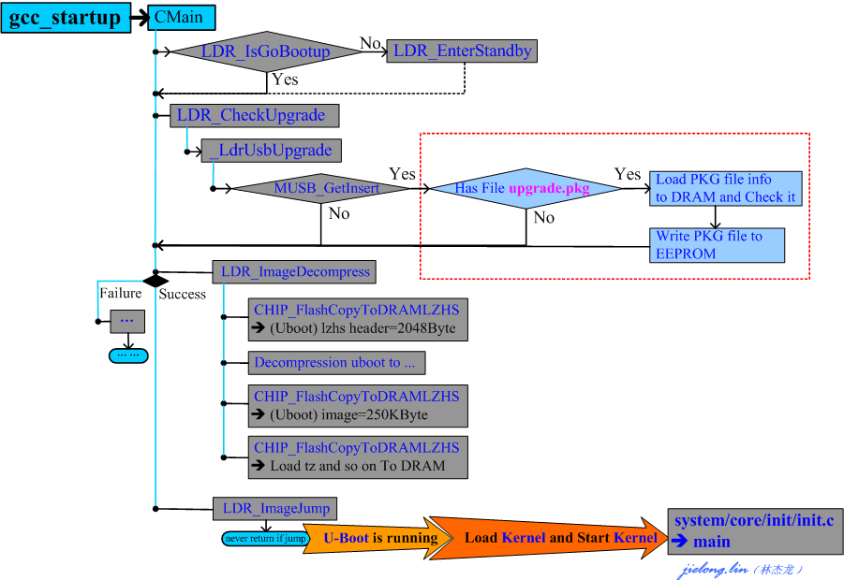
Upgrade Flowchart On Loader
Assume upgrade_loader.pkg is storaged in usb storage
Call LDR_CheckUpgrade ( …. )
Call _LdrUsbUpgrade ( …. )
Skip USB Upgrade:
1.Clear the flag;
2.Set related configuration
3.Call LDR_PanelLogo (…)
4.Return 0
Check Android upgrade flag
if it is set in eeprom
Yes
upg file is upgraded
Android is recoveried
Check if usb device is inserted:
Call MUSB_GetInsert ( ) or
Call MUSB3_GetInsert ( )
No
… …
Initialize Filesystem environment:
1.Call fm_init ( )
2.Call x_fm_fat_init (NULL)
Return 1
No pkg file
Mount the USB device
Call _LdrUsbMount( )
Read pkg file from USB device:
Call _LdrUsbFileRead( )
Find pkg file

Slide 9
Upgrade Flowchart On Loader
Call LDR_CheckUpgrade ( …. )
Disable Watchdog
Call _LdrUsbUpgrade ( …. )
Show logo:
IF U+: pull high gpio.266;
Call LDR_LogoDisplay (…)
Upgrade the NVM.bin and option.bin
Call _LdrEepUpgrade ( )
Call _LdrDlmHandler( u4Upgrade)
Call x_dlm_download_by_tag (szFileNameWithPath, “using”…)
Call x_dlm_download_by_tag (szFileNameWithPath, “cfig”…)
Call x_dlm_download_by_tag (szFileNameWithPath, “rcip”…)
Call x_dlm_download_by_tag (szFileNameWithPath, “load”…)
OK
Call _LdrLoaderUpgradeReboot ( )
NOK
Loading the PKG file to flash device from USB device:
Call x_dlm_download ((CHAR*)szFileNameWithPath, …)
Return 0
IF Return 0, Upgrade successfully
Call CHIP_Reboot ( )

Slide 10
Loader implement two important mediatek functions as follows:
1. Upgrade version from USB
2. Loading the bootloader to RAM from the specified storage such
as eMMC, SD, EEPROM and so on.
Loader
Uboot is the powerful bootloader, and its primary function is boot Linux kernel to run in RAM.
Uboot
CC_xxx Macro is defined in
device/mediatek_common/vm_linux/project_x/sys_build/tpvision/philips_MT5593Uplus_EU/philips_MT5593Uplus_EU.cfg
CONFIG_xxx Macro is defined in uboot/u-boot-2011.12/include/configs/mt5890.h
The following macro associated with Uboot are defined :
CC_EMMC_BOOT
CONFIG_MMC

Slide 11
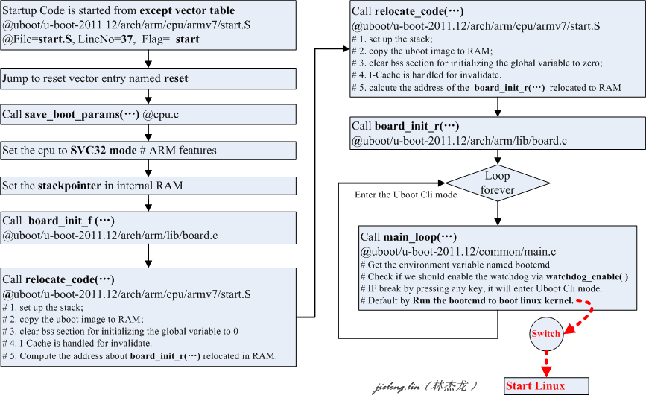

Slide 12
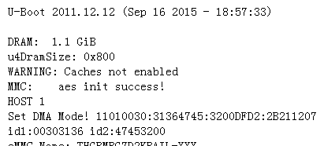
Uboot Flowchart
uboot/u-boot-2011.12/arch/arm/cpu/armv7/start.S:
[S] _start: b reset
[S] reset: bl save_boot_params
[S] ...{ Set the CPU to SVC32 mode } ...
[S] ...{ Setup vector to CP15 VBAR }...
[S] bl cpu_init_cp15
{
1.Invalidate L1 I/D cache
2.disable MMU stuff and caches
}
[S] bl cpu_init_crit
{
skip call lowlevel_init ( ) @ go setup pll,mux,memory
}
[S] call_board_init_f:
[S] ...{ call board_init_f }...
Alloc and initialize the global data struct - gd
Traversal access init_sequence[ ]
env_init ( ) //set env_addr and env_valid of gd
init_baudrate( ) //get baudrate from uboot env
serial_init( ) //u-boot-2011.12/drivers/serial/serial_mt53xx.c
hang( )
console_init_f( ) //set console related values to gd
display_banner( ) //Print uboot version information
dram_init( ) //set ram related values to gd
Arrange RAM space for stack, heap and so on

Slide 13
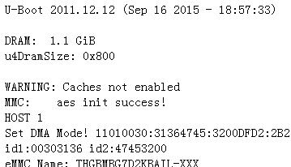
board_init_f
Call dram_init_banksize ( ) // specify the dram size to gd
Call display_dram_config ( ) // display dram information
Set the relocate related environment
Call relocate_code (addr_sp, id, addr)
Not reached due to relocate_code(…) does not return
uboot/u-boot-2011.12/arch/arm/cpu/armv7/start.S:
[S] relocate_code:
[S] …{ Set up the stack }…
[S] …{ Copy the uboot image to RAM } …
[S] …{ Fix relocations included relative and absolute }…
[S] …{ Clear bss section for initializing the global variables to 0 }…
[S] …{ Invalidate icache for cleaning all data in cache }…
[S] …{ setup parameters then jump to board_init_r in RAM }…
Call enable_caches( ) @uboot/u-boot-2011.12/arch/arm/lib/cache.c
Equal to call __enable_caches ( )
Call board_init( )
Enable unaligned access, disable alignment trap
Setup arch number and boot paramers’ address for booting kernel
Call timer_init ( )
Call turn_on_USB_power_switch( ) //turn on usb vbus control.

Slide 14
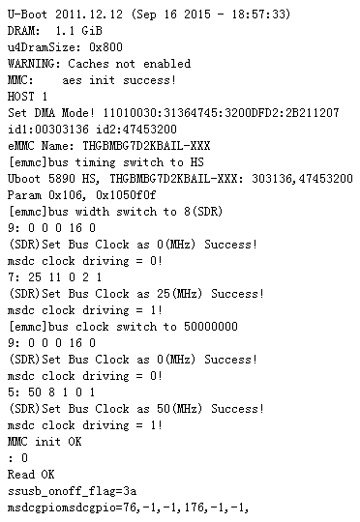
board_init_r
Call nand_init( ) //initialize the nandflash
Call mmc_initialize(gd-bd)
Call mmc_initialize(gd-bd)
Initialize the LIST_HAD for mmc_devices
Call board_mmc_init (bis)
Call mtk_mmc_init ( )
//alloc and init emmc device
Call print_mmc_devices(‘,’)
Specify the Malloc area
Call env_relocate( ) //initialize environment

Slide 15
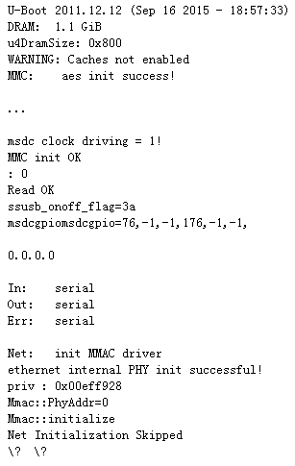
board_init_r
Get the IP and MAC address from uboot env
Call stdio_init ( ) // get the devices list going
Call jumptable_init ( ) // ignore due to not use at present
Call console_init_r ( ) // fully init console as a device
Call dtvcfg_init ( )
Call UBOOT_EEPDTV_GetCfg(&rDtvCfg )
Call interrupt_init ( ) // set up the stack address for irq or fiq interrupt
Set the load address and get bootfile name from uboot env
Call eth_initialize (gd->bd)

Slide 16
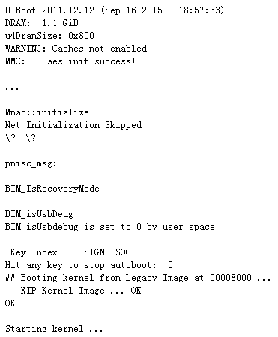
board_init_r
uboot/u-boot-2011.12/common/main.c
Call main_loop ( )
Get some uboot env such as bootdelay
Call BIM_CheckFastboot ( )
Call BIM_IsRecoryMode( ) // android boot
Call BIM_isUsbDebug( ) // TPVISION debug
Re-back to cli mode
Get the watchdog env from uboot env
Check if enable watchdog
Call watchdog_enable ( )
If not break by any
Run boot kernel command
Linux Kernel And Android

Slide 17
arch/arm/boot/uImage consist of the arch/arm/boot/compressed/zImage and 64Byte uImage header. The 64Byte uImage header is recognised by uboot.
Sample Command is as follows:
/bin/sh ~/mkuboot.sh -A arm -O linux -T kernel -C none -a 0x30008000 -e 0x30008000 -n 'Linux-2.6.14' -d arch/arm/boot/zImage arch/arm/boot/uImage
arch/arm/boot/compressed/piggy.o is created by compiling arch/arm/boot/compressed/piggy.S and arch/arm/boot/compressed/piggy.gz.
Sample Command is as follows:
arm-linux-gcc -Wp,-MD,arch/arm/boot/compressed/.piggy.o.d -nostdinc -isystem ~/crosstool/gcc-3.4.5-glibc-2.3.6/arm-linux-gnu/lib/gcc/arm-linux-gnu/3.4.5/include -D__KERNEL__ -Iinclude -mlittle-endian -D__ASSEMBLY__ -Wa,-L -gdwarf-2 -mapcs-32 -mno-thumb-interwork -D__LINUX_ARM_ARCH__=4 -march=armv4 -mtune=arm9tdmi -msoft-float -c -o arch/arm/boot/compressed/piggy.o arch/arm/boot/compressed/piggy.S
arch/arm/boot/compressed/vmlinux is the compressed linux kernel image is linked from head.o, piggy.o, misc.o in arch/arm/boot/compressed via arch/arm/boot/compressed/vmlinux.lds. Sure, the image include the uncompressed code.
Sample Command is as follows:
arm-linux-ld -EL --defsym zreladdr=0x30008000 --defsym params_phys=0x30000100 -p --no-undefined -X ~/crosstool/gcc-3.4.5-glibc-2.3.6/arm-linux-gnu/lib/gcc/arm-linux-gnu/3.4.5/libgcc.a -T arch/arm/boot/compressed/vmlinux.lds arch/arm/boot/compressed/head.o arch/arm/boot/compressed/piggy.o arch/arm/boot/compressed/misc.o -o arch/arm/boot/compressed/vmlinux
Uboot
Linux
MTK device drivers initialized sequence flowchart
Linux Kernel Image Describe
arch/arm/boot/compressed/head.o
vmlinux
arch/arm/boot/Image
arch/arm/boot/compressed/misc.o
arch/arm/boot/compressed/vmlinux
arch/arm/boot/compressed/piggy.gz
arch/arm/boot/compressed/piggy.o
arch/arm/boot/compressed/piggy.S
uImage Header : Arch,OS,ImageType,CompressType,LoadAddr,EnterAddr,ImageName
arch/arm/boot/zImage
arch/arm/boot/uImage
vmlinux is the nocompress linux kernel image with debugging information, comment, symbol table and so on. And it is created according to arch/arm/kernel/vmlinux.lds.
Sample Command is as follows:
arm-linux-ld -EL -p --no-undefined -X -o vmlinux -T arch/arm/kernel/vmlinux.lds
arch/arm/boot/zImage is the arch/arm/boot/compressed/vmlinux removed the debugging,comment,symbol table and so on.
Sample Command is as follows:
arm-linux-objcopy -O binary -R .note -R .comment -S arch/arm/boot/compressed/vmlinux arch/arm/boot/zImage
arch/arm/boot/Image is the vmlinux removed the debugging information,comment,symbol table and so on.
Sample Command is as follows:
arm-linux-objcopy -O binary -R .note -R .comment -S vmlinux arch/arm/boot/Image
arch/arm/boot/compressed/piggy.gz is compressed from arch/arm/boot/Image with gzip -9
Sample Command is as follows:
gzip -f -9 < arch/arm/boot/compressed/../Image > arch/arm/boot/compressed/piggy.gz

Slide 18


MTK Platform Linux compiled Environment Path:
out/mediatek_linux/output/tpvision/philips_MT5593Uplus_EU/rel/obj/kernel/chiling/kernel/linux-3.10/mt5890_android_smp_mod_defconfig
uncompress
debugging
symbol table
comment
vmlinux
1
arch
arm
boot
compress
debugging
symbol table
comment
compressed
vmlinux
3
Image
uncompress
2
zImage
4
compress
uImage
5
compress
uboot bootable

Slide 19

arch/arm/kernel/vmlinux.lds.S
arch/arm/boot/compressed/head.S
arch/arm/kernel/head.S
-------------------------------------
__HEAD
ENTRY(stext)
... ...
ARM( add pc, r10, #PROCINFO_INITFUNC )
ENDPROC(stext)
arch/arm/kernel/head-common.S
--------------------------------------------------
__mmap_switched:
... ...
b start_kernel
ENDPROC(__mmap_switched)

Slide 20
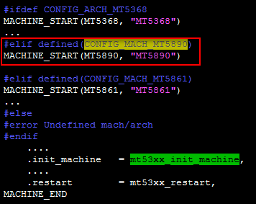
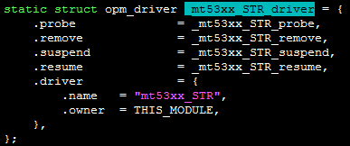
Linux Flowchart
Call mt53xx_init_machine ( )
Call _CB_Init ( )
mediatek_common/vm_linux/chiling/driver/linux/cb/cb_low.c
Call mt53xx_STR_init ( )
vm_linux/chiling/driver/linux/cb/ drvset_STR_coreoff.c

Slide 21
Compiling the Kernel From Source Code
Call start_kernel( ) @init/main.c
@arch/arm/kernel/setup.c
arch_initcall (customize_machine);
Call do_pre_smp_initcalls( ) @init/main.c
Call do_basic_setup( ) @init/main.c
customize_machine is laid out in
“.initcall3.init” section of the kernel image
Call sys_open ("/dev/console", ...) @init/main.c
# It is the first system call, and always return fd=0.
Call sys_dup(0) @init/main.c
# alloc fd=1 for /dev/console is specified by 0
Call sys_dup(0) @init/main.c
# alloc fd=2 for /dev/console is specified by 0
arch/arm/kernel/head.S
Call setup_arch (...) @ arch/arm/kernel/setup.c
Call setup_machine_fdt (...) @ arch/arm/kernel/ devtree.c
Call do_pre_smp_initcalls( ) @init/main.c
Traversal Access every initcall function from __initcall_start to __initcall0_start
Call customize_machine ( ) @arch/arm/kernel/setup.c

Slide 22
Mediatek
OVER!!!
Thank you

