Slide 1
TPAPI For Power
2015.10.26

Slide 2
Introduce Index
1. TPAPI Power APIs
2. When and How to Set LastPowerMode In Nvm
3. When and How to Use LastPowerMode In Nvm

Slide 3
Architect
TvPowerManagerService
( org.droidtv.tv.tvpower )
JAVA
( tvpower/jni/mtk )
JNI
ITVPowerNotify
( TvPower State Monitor )
nativetvpower
( TvPower Mode Flowchart )
tvpower
( Interface to power state, shutdown lock, notify callback …)
tvpowernotifier
( TvPower Mode and Callbacks )
TVPowerNotify
( Notify Client Listener to do state change)
tvpowersm
( TVPOwerStandbyManager)
( tpvision/common/plf/tvplayer/infra/api )
TvPlayer
Infra
APIs
IPower
( Binder Proxy Interfaces to Power)
Power
( Binder Native to Power)
Components Interfaces to power
( tpvision/common/plf/tvplayer/infra/comps/power )
TvPlayer Infra Comps
TPAPI Interfaces to power
( tpvision/tvsoc/tvsoc_mtk )
TVSOC MTK APAPI

Slide 4
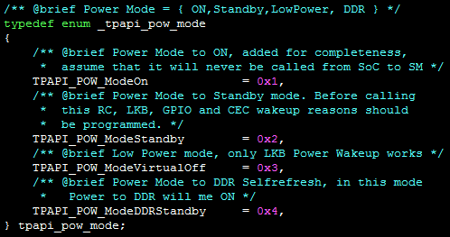
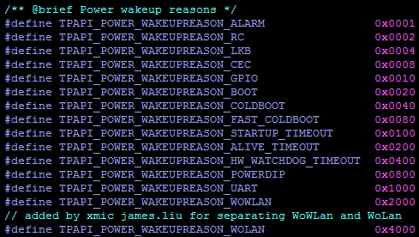
TPAPI Power Functions Classification
TPAPI Power
Power Behavior
tpapi_pow_ColdReboot
tpapi_pow_SetPowerMode
Wakeup Reason/Sources
tpapi_pow_ProgramWakeupReasons
tpapi_pow_GetWakeupInfo
tpapi_pow_ProgramWakeupKeysRc
tpapi_pow_GetWakeupDetailsRc
tpapi_pow_ProgramWakeupLocalKeyboard
tpapi_pow_GetWakeupDetailsLocalKeyboard
tpapi_pow_ProgramWakeupCec
tpapi_pow_GetWakeupDetailsCec
LastPowerMode is addressed in NVM:0x1000
NVM Access
tpapi_pow_GetBootLoaderParam
tpapi_pow_SetBootLoaderParam

Slide 5
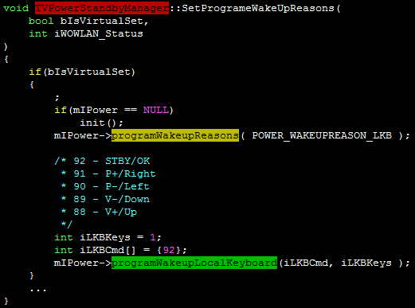
Wakeup Source/Details
Enter FullStandby
tpapi_pow_ProgramWakeupReasons(…)
Set Wakeup Source ( Or Reason )
tpapi_pow_ProgramWakeupLocalKeyboard(…)
Set Wakeup Details ( For LKB )
tpapi_pow_SetPowerMode(…)
Set Power Mode To Standby

Slide 6
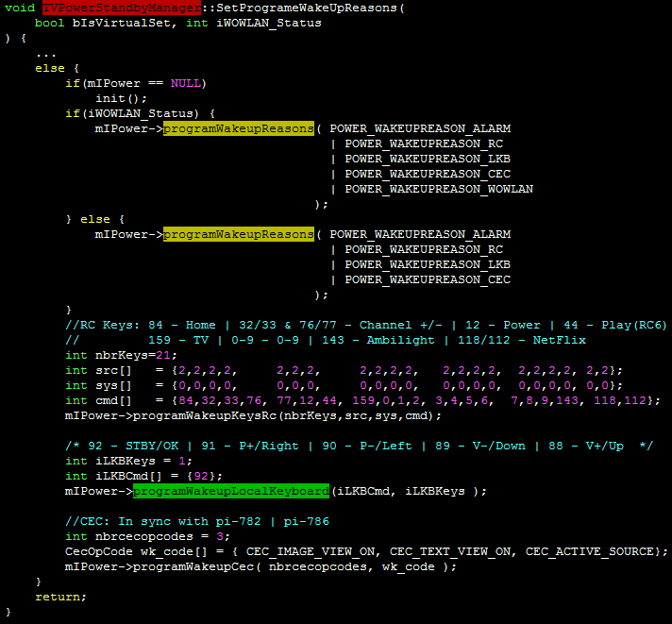
Wakeup Source/Details
Enter DdrStandby
tpapi_pow_ProgramWakeupReasons(…)
Set Wakeup Source ( Or Reason )
tpapi_pow_ProgramWakeupLocalKeyboard(…)
tpapi_pow_ProgramWakeupKeysRc(…)
tpapi_pow_ProgramWakeupCec
Set Wakeup Details
( For RC Key / LKB / CEC)
tpapi_pow_SetPowerMode(…)
Set Power Mode To Standby

Slide 7
Power Behavior
Set Power Mode(…) : Set Power To Enter FullStandby
TPAPI_POW_ModeVirtualOff
TPAPI_POW_ModeStandby
Wake Source (or
Reason) Is WoWLAN
Yes
No
Enable WOL (Wake On Lan)
Disable WOL (Wake On Lan)
Enable WoWLAN (Wake On Wifi Lan)
Disable WoWLAN (Wake On Wifi Lan)
Command=0x44
Set Wakeup Source
T8032 uP
Command=0x45
Notify T8032 to Start Watchdog 2 For monitor the Standby Flowchart
Switch Power Mode To FullStandby By MTK Mtal APIs

Slide 8
Power Behavior
Set Power Mode(…) : Set Power To Enter DdrStandby
TPAPI_POW_ModeDDRStandby
Wake Source (or
Reason) Is WoWLAN
Yes
No
Enable WOL (Wake On Lan)
Disable WOL (Wake On Lan)
Enable WoWLAN (Wake On Wifi Lan)
Disable WoWLAN (Wake On Wifi Lan)
Command=0x44
T8032 uP
Notify T8032 to Start Watchdog 2 For monitor the Standby Flowchart
Command=0x45
Request Suspend Event
For sync resume, Registe Callback Function – cb_resume( )
Wait for resume
Request Kernel to Enter Suspend By echo “mem” > /sys/power/state

Slide 9
How To Use Wakeup Reason And Details
tvplayer Infra
StartUpApp
power
TPAPI DisplayerCtrl
tpapi_pow_GetWakeupInfo(…)

Slide 10
How To Use Wakeup Reason And Details
StartUpApp: Set the Property - Setting_SysProperties(…)
tvplayer/infra/comps/StartUpApp/StartUpApp.c: main( )
Call tpapi_pow_Init( ), return res
IF res is OK, call Setting_SysProperties( )
1
Try to read
wakereason
up to 5 times
Call tpapi_pow_GetWakeupInfo( ),
Get wakeupreason
Case RC
Call tpapi_pow_GetWakeupDetailsRc( ), Get WakeupDetail
IF WakeupDetailis Ambilight Key, sys.droidtv.target_bootlevel =SemiStandby
Else sys.droidtv.target_bootlevel = FullSystemStart
Case …

Slide 11
How To Use Wakeup Reason And Details
power: It is only used to test on InfraApiTest/IPowerClient
InfraApiTest/IPowerClient
Tvplayer/infra/api: IPower BpPower::getWakeupInfo
Tvplayer/infra/api: IPower Power::getWakeupInfo
Tvplayer/infra/comps/power power_getWakeupInfo
Tpapi power tpapi_pow_GetWakeupInfo(…)

Slide 12

How To Use Wakeup Reason And Details
TPAPI DiaplayCtrl: it is only used to debug showing.
tpapi_displayctrl_requestDisplayState

Slide 13
NVM Access
What is the LastPowerMode in NVM
When System will enter standby mode included semi-standby, ddr-standby, full-standby and so on, the LastPowerMode is addressed in 0x1000 from the base address of the NVM and it will be writen to ‘0’ for representing the Last Mode Power is Standby. After System have already been in standby mode, turn off the AC power for a moment, and then turn on the AC power. Meanwhile System start to boot without any show, and it will enter the standby.
Why aren’t any shown? The Mtk Panel isn’t shown if LastPowerMode is set to ‘0’ in NVM and when System will enter standby, it has already set to ‘0’ before AC Power is off.
Hence, I am interested in two puzzles associated with how to set the LastPowerMode and when may TvPower implement it .

Slide 14
Message Dispatcher For TvPowerManagerService
Power RC Key
PowerManagerService
Handler
+ sendEmptyMessage (what:int) : boolean
- enqueueMessage (
queue:MessageQueue,
msg:Message,
uptimeMillis:long
) : boolean
+ handleMessage (msg:Message) : void
… : …
TvPowerManagerService::continueToFullShutdown(…)
Traverse All Shutdown Lock and show every shutdown Lock
IF powerStates.getCurrentState( ).getId( ) is FullSystemStart ;
Call powerStates::sendEmptyMessage( MSG_SCREEN_OFF )
Call Handler::sendEmptyMessage( MSG_SCREEN_OFF )
HierarchicalStateMachine
- currentState : State
+ handleMessage (msg:Message) : void
+ setState (state:State) : void
… : …
Where will the Message be sent to ?
Call
Handler::enqueueMessage(
mQueue, msg, uptimeMillis
)
PowerStates
+ booting : BootingState
+ started : FullSystemStartState
+ semiStandby : SemiStandbyState
+ ddrStandby : DDRStandbyState
+ virtualOffState : VirtualOffState
+ setState (state:State) : void
MessageQueue
Message
Message
Message
Who will receive and handle the Message ?

Slide 15
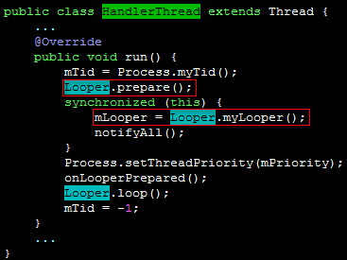
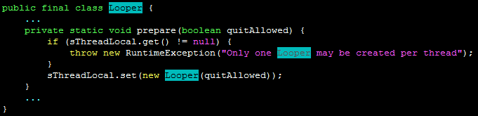

Message Dispatcher For TvPowerManagerService
TvPowerManagerService::getSingletonInstance( )
new TvPowerManagerService( )
MessageQueue is one member of Looper
TvPowerManagerService::init( )
mHandlerThread = new HandlerThread (TAG)
mHandlerThread.start( )
MessageQueue … …
Message
Message
Thead::start( )
MessageQueue::next ()
Create
pthread_create(…)
HandlerThead::run( )
Looper::loop( )
Default By Forever Loop
Forever
Is
Quit
Message::target is Handler
Handler::DispatchMessage (msg)
Two Different Handler, A Message will be handled By two Handler
mHandler = new Handler (mHandlerThread.getLooper())
powerStates= new PowerStates(mHandlerThread.getLooper())
Data Flow
Calling Flow

Slide 16
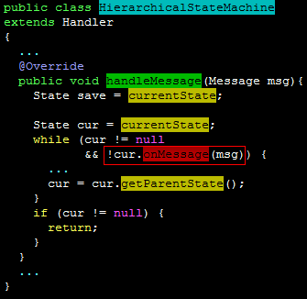
Message Dispatcher For TvPowerManagerService
Handler::DispatchMessage (msg)
Handler::handleCallback (msg)
➔Message::callback.run( )
⬄Runnable::run( )
yes
msg.callback != null
no
Handler::mCallback.handleMessage(msg)
yes
Handler.mCallback != null
no
Handler::handleMessage(msg)
HierarchicalStateMachine
::currentState
::onMessage( msg )
UML: Classes
Handler
Call
+ handleMessage (msg:Message) : void
… : …
HierarchicalStateMachine
::currentState
HierarchicalStateMachine
Traversal List
+ handleMessage (msg:Message) : void
+ setState (state:State) : void
… : …
null
mParentState
State
PowerStates
mParentState
… …
+ setState (state:State) : void
… : …
State
mParentState

Slide 17
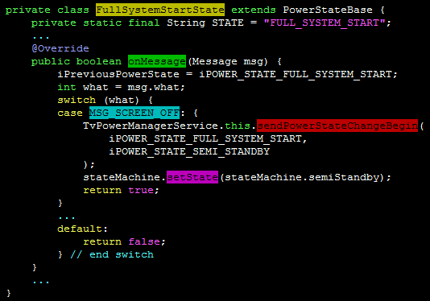
Message Dispatcher For TvPowerManagerService
State
+ onMessage (msg:Message) : boolean
+ stateEntered( ) : void
+ stateExited( ) : void
… : …
HierarchicalStateMachine::currentState::onMessage( msg )
UML: Classes
If the current state is Full System Start, the HierarchicalStateMachine::currentState will point to FullSystemStartState , and FullSystemStartState::onMessage( msg ) will be run.
PowerStateBase
… : …
VirtualOffState
StandbyState
+ onMessage (msg:Message) : boolean
+ stateEntered( ) : void
+ stateExited( ) : void
… : …
DDRStandbyState
SemiStandbyState
FullSystemStartState
BootingState
+ onMessage (msg:Message) : boolean
+ stateEntered( ) : void
+ stateExited( ) : void
… : …

Slide 18
How To Set LastPowerMode in NVM
TvPowerManagerService::sendPowerStateChangeBegin(…)
JNI: CommenceNativeNotifying(…)
⬄ Java_org_droidtv_tv_tvpower_TvPowerManagerService_CommenceNativeNotifying(…)
android::CommenceNotifying(…)
IF
iTargetPowerStates is iPOWER_STATE_STANDBY(=6)
iTargetPowerStates is iPOWER_STATE_DDR_STANDBY(=5)
iTargetPowerStates is iPOWER_STATE_SEMI_STANDBY(=4)
Call TVPowerStandbyManager::SetFTSParam( true )
BpPower::setFtsParam(“LastPowerMode”, “Standby”)
Binder Communication
BnPower::onTransact(…)
Power::setFtsParam(“LastPowerMode”,”Standby”)
power_setFtsParam(null, “LastPowerMode”,”Standby”)
tpapi_pow_SetBootLoaderParam( … )
ELSE
iTargetPowerStates is iPOWER_STATE_FULL_SYSTEM_START(=3)
Call TVPowerStandbyManager::SetFTSParam( false )

Slide 19
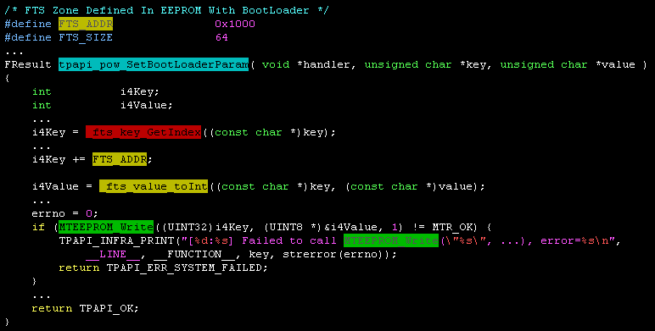
How To Set LastPowerMode in NVM
Summarize
LastPowerMode=0,namely Standby, Before the State of TvPower will be changed to Semi-Standby, Full-Standby or Ddr-Standby and so on.
LastPowerMode=1,namely Null or Not Standby, Before the State of TvPower will be changed to Full-System-Start.

Slide 20
How To Use LastPowerMode in NVM
LastPowerMode is used in vApiPanelPowerSequence(true) in order to turn on the backlight and panel.
And vPanelPowerSequence(true) is called on startup stage and on resume stage
Startup Stage
Preloader
Loader
U-boot
Linux
Copy Loader Image to Ram
Initialize environment
For boot
Linux kernel
… …
Extract Loader Image in Ram
If any press, enter CLI
Call _ParallelInitThread
Remove to Call
LDR_PmxDisplayHWInit
Run Loader Image in Ram
Else If custom, go to standby
Else initialize bootup settings
Call LDR_PanelLogo (…)
Check USB or go to upgrade if positive
Android
Load uboot image to RAM
Extract uboot image in RAM
Call vApiPanelPowerSequence(TRUE) to open the backlight and panel
Run uboot image in RAM

Slide 21
How To Use LastPowerMode in NVM
Android
BootingState::onMessage(…)
Case MSG_BOOT_COMPLETED:
…
Call TvPowerManagerService.this.sendPowerStateChangeBegin(…)
Call stateMachine.setState(…)
… …
SystemServer::main( )
SystemServer::run( )
… …
TvPowerManagerService will transite its state machine from booting to bootcomplete
System::startOtherServices(…)
TPVISION AOSP: TvPowerManagerServices initialized
BroadcastReceiver::onReceiver(…)
Case Intent.ACTION_BOOT_COMPLETED:
…
call powerStates.sendEmptyMessage(
MSG_BOOT_COMPLETED
);
AcitivityManagerService.systemReady(…)
When finish start Home Activity, ActivityManagerService will send boot complete to TvPowerManagerService
ActivityManagerService.startHomeActivityLocked(…)
… …
SystemProperties.set(“sys.boot_completed”, “1”)
Intent intent = new intent(Intent.ACTION_BOOT_COMPLETED,null)
ActivityManagerService::broadcastIntentLocked(…, intent, …)

Slide 22
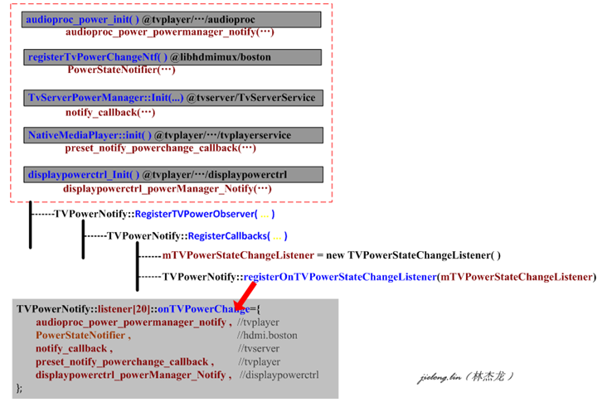
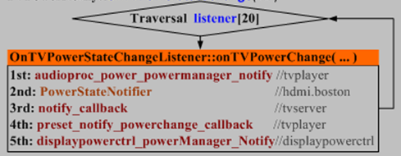
How To Use LastPowerMode in NVM
TvPowerManagerService.this.sendPowerStateChangeBegin(iSps=Booting,iTps=FullSystemStart,…)
… …
CommenceNativeNotifying(0,iSps,iTps,…)
⬄Java_org_droidtv_tv_tvpower_TvPowerManagerService_CommenceNativeNotifying(…)
android::CommenceNotifying(0,iSps,iTps,…)
If iTps is FullSystemStart(=3):
call TvPowerStandbyManager::SetFTSParam(false)
⬄LastPowerMode will be modifed to 1 (not standby)
TVPowerNotify::onTVPowerStateChange(…)
DisplayCtrl is as the client app of the TvPowerManagerService, it will registe callback to get the power state transition by calling
TvPowerNotify:: RegisterTVPowerObserver( displaypowerctrl_powerManager_Notify );
TvInfraLooper_sendMessage(
m_displaypowercontrol_looper,
displaypowerctrl_changeDisplayState_OnPowerChanged, 0, &msg1, sizeof (msg1)
);

Slide 23
How To Use LastPowerMode in NVM
displaypowerctrl_changeDisplayState_OnPowerChanged(…)
… …
tpapi_displayctrl_getCurrentDisplayState( &state )
IF state is OFF:
call displaypowerctrl_turnOnDisplay ( )
Call tpapi_displayctrl_requestDisplayState( TPAPI_DISPLAYCTRL_DISPLAYSTATE_ON )
Turn Off
Philips Logo
Call MTOSD_BASE_DisableLoaderLogo()
Call MTOSD_PLA_Enable( MTOSD_PLANE_2, TRUE );//enable android osd
Call MTPMX_PANEL_PowerSequence( (BOOL)TRUE )
… Mtal Call Flowchart …
Re-open the backlight and panel
Call vApiPanelPowerSequence(TRUE)

Slide 24
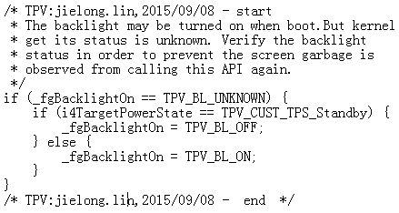
How to implement Panel and Backlight
vApiPanelPowerSequence (bgEnable=true)
Return
Panel State is bgEnable
Yes
BacklightState
is bgEnable
Yes
No
No
TPV_CUST_Get_TargetPowerState( )
Prepare
to turn on backlight and panel?
Yes
IF Backlight state is unknown
No
Yes
No
Verify and fix the Backlight state
Turn Off Panel and Backlight
TargetPowerState isnot Standby
And Backlight state is ON
No
Is Panel On
Turn Off Backlight
Yes
Panel State is updated to ON
Turn On Backlight
Yes
Return
No
TargetPowerState
isnot Standby
Implement LVDS
… …

Slide 25
How To Use LastPowerMode in NVM
TPV_CUST_Get_TargetPowerState
Eco Settings→Screen Off
LastPowerMode
is Standby
No
Yes
Confirm the behavior if it is resume or wakeup via LastPowerMode.
Get WakeupReason
WakeKey is Ambilight
No
Case IRRC:
Query WakeKey
Yes
Case RTC:
Case WIFI:
Case Ethernet:
Case AC_POWER:
Case Watchdog:
Query WakeKey
Return TargetPowerState is Standby
Default:
Wake or Resume or Startup
Return TargetPowerState is System

Slide 26
Thank you

