Slide 1
Specialty Store Marketing Campaign Analysis
Lincoln Berbert
4/16/2023

Slide 2
Introduction
Objective: Drive increased customer engagement and sales
Analyze existing customer data
1
Find informative customer segments
2
Improve marketing campaigns
3

Slide 3




Problem Summary
Customers have a wide variety of behaviors/demographics
Customer behavior is constantly changing
Traditional marketing techniques are not appealing to every consumer

Slide 4
Solution Methodology
Dataset:
Customer Demographics
Amount per Item
Purchase Streams
Previous Campaign Responses
Analysis:
Unsupervised learning
Dimensionality Reduction
Clustering Models

Slide 5
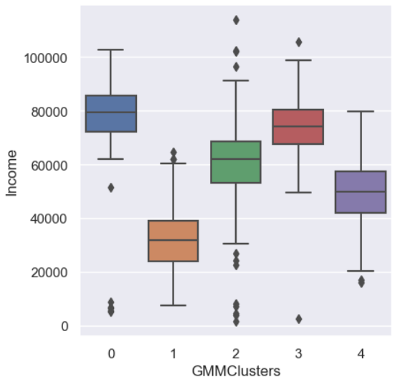
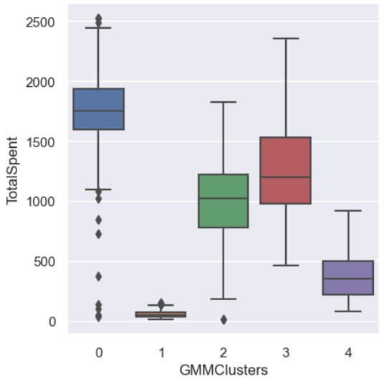
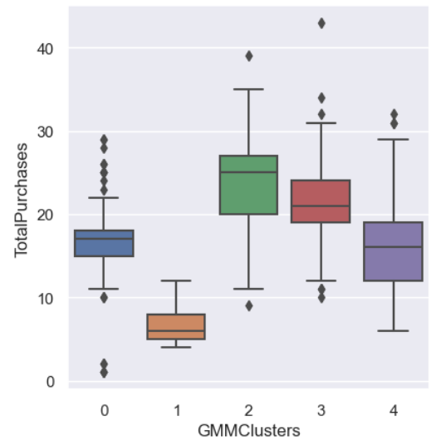
Proposed Model
Gaussian Mixture Model (5 Clusters)
Income ($)
Total Spent ($)*
Total # of Purchases*
Cluster | 0 | 1 | 2 | 3 | 4
# Customers | 104 (4.7%) | 761 (34.1%) | 261 (11.7%) | 511 (22.9%) | 593 (26.6%)
*Data from 24-month time period

Slide 6



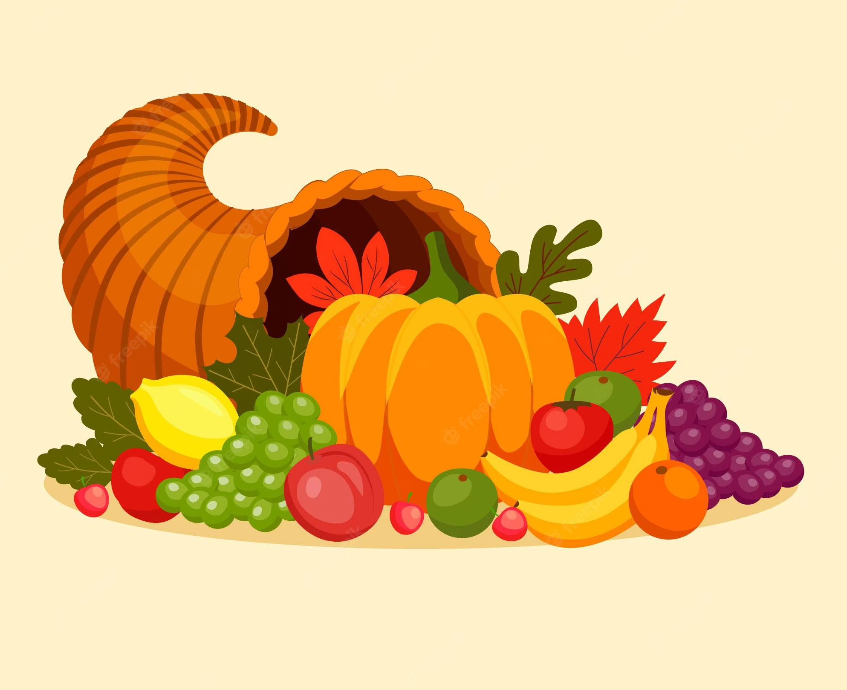
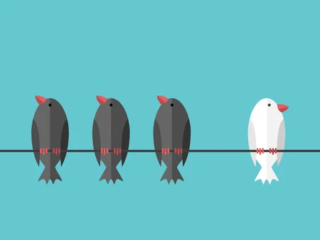
Customer Segments
Whales
Newbies
Regulars
Diverse
Irregulars
High spenders
Responsive to Campaigns
Wines + Meats (Highest earning)
Less time with company
High web Usage
Low Engagement
Frequent shoppers
Middle Income
High deal utilization
Wines + Gold
Traditional purchase streams (store + catalog)
All product categories
High Income
Budget Conscious
Prefer online + deals
Infrequent shoppers

Slide 7
Marketing Recommendations
Whales: Promote high-earning products (meats and wines) through catalogs and personalized offers.
Newbies: Increase web-based advertising, emphasizing deals and affordable products.
Regulars: Offer loyalty rewards and exclusive promotions to maintain and enhance their engagement.
Diverse: Prioritize bundling diverse product choices through traditional shopping channels.
Irregulars: Highlight online deals and promotions for wines and gold products, emphasizing value for money.

Slide 8
Other Recommendations
Examine
Explore the gold product category in detail, focusing on why sales are low
Test
Test expanded GMM clustering models and parameters
Obtain
Invest in obtaining data on product sales numbers to enhance segmentation
Optimize
Optimize product placement and visibility in stores

Slide 9
Potential Impact
Benefits:
Improve customer satisfaction
Increase revenue & sales
Enhance customer engagement
Build brand loyalty
Find new customers
Risks/Limitations:
Possible misclassification
Oversimplifying customer behavior
Alienating other segments
Difficulty adapting to new behavior
Missed opportunities elsewhere
Notes:
(These don’t have designer IDs since they were based off the default master slides already in the deck.

Slide 10

Executive Summary
Model:
Actionable Insights:
Impact:
Explored 5 different Model types in depth
Gaussian Mixture Model provided effective and interesting insights into customer segments
Identified 3 primary and 2 secondary segments
Tailor marketing & product placement to identified customer segments
Refine and expand GMM model for improved segmentation
Invest in new data collection to enhance accuracy and usefulness
Increase revenue and sales
Improve brand loyalty and customer engagement
Take care to not alienate or oversimplify customer behavior

Slide 11
Questions?

Slide 12
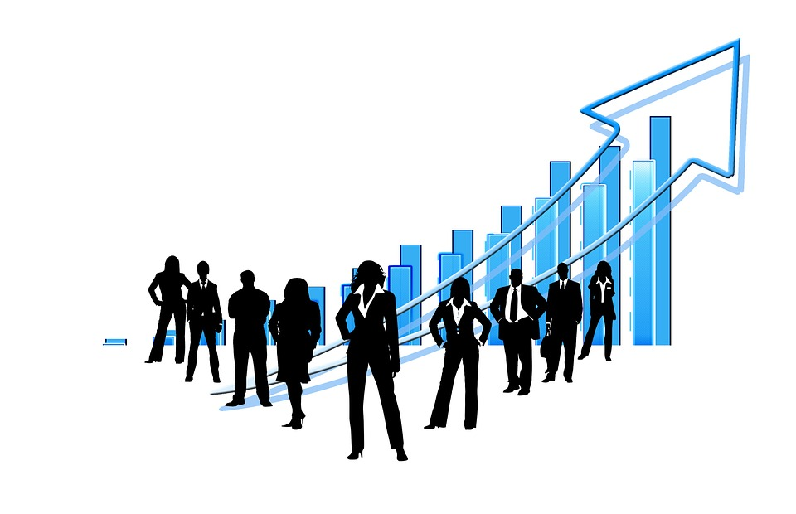

Thank You
Lincoln Berbert
berbert.lincoln@gmail.com

Slide 13
Appendix

Slide 14
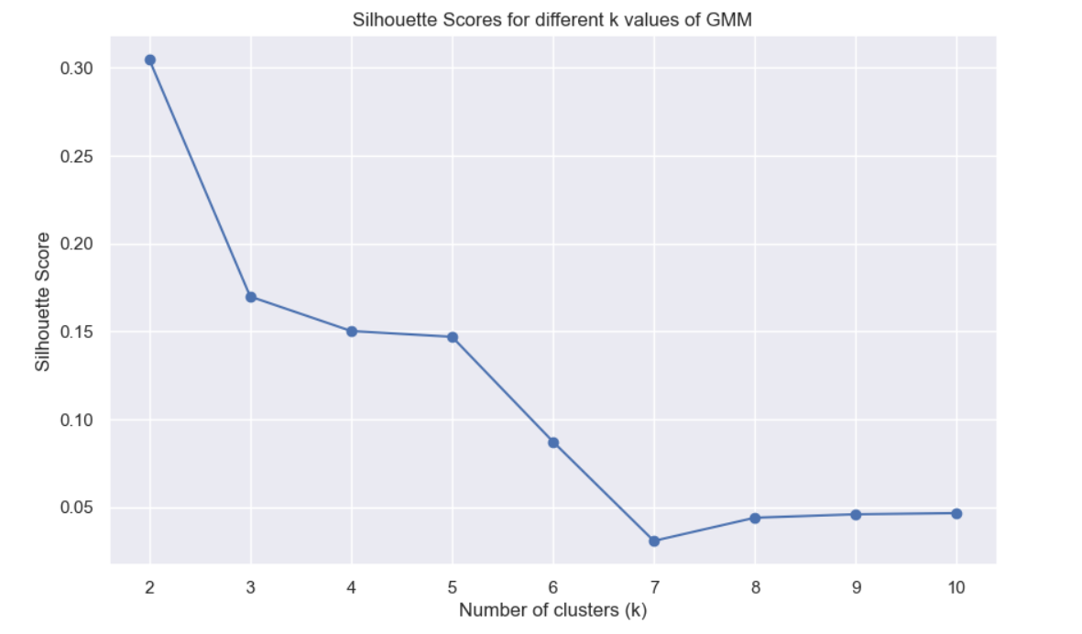
Solution Process

Slide 15
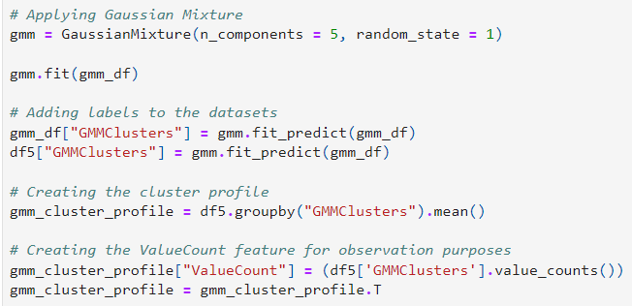
Final Model
Code
Model | Silhouette Score | # Clusters
K - Means | 0.27 | 3
K - Medoids | 0.11 | 5
Agglomerative (Hierarchical) Clustering | 0.22 | 3
Gaussian Mixture | 0.15 | 5
Model
Comparisons

