Slide 1
LYME’S DISEASE AND DRUG-INDUCED PHOTOSENSITIVITY
Brian J. Catton, PharmD
New Jersey Pharmacists Association
Notes:
Use question feature to send only to ME
Use chat feature to send to EVERYONE

Slide 2
Objectives
Pharmacists
Pharmacy Technicians
Review IDSA guidelines for treatment and prevention of Lyme’s Disease.
Identify drugs with a greater incidence of drug-induced sunburn.
Review how to treat sunburn with over-the-counter products and first-aid techniques.
Identify drugs used in treating and preventing Lyme’s Disease
Identify drugs with a greater incidence of drug-induced sunburn.
Identify how drug-induced sunburn in treated.

Slide 3
Disclaimers
Presenter does not have any conflict of interest with or affiliation with an organization whose philosophy could potentially bias this presentation.
Presenter has not received financial support or grant monies for this CE program.
All pictures depicted in this presentation has been obtained on public domains.

Slide 4
LYME’S DISEASE
Introduction
Early Localized Infection
Early Disseminated Disease
Late Disseminated Disease

Slide 5
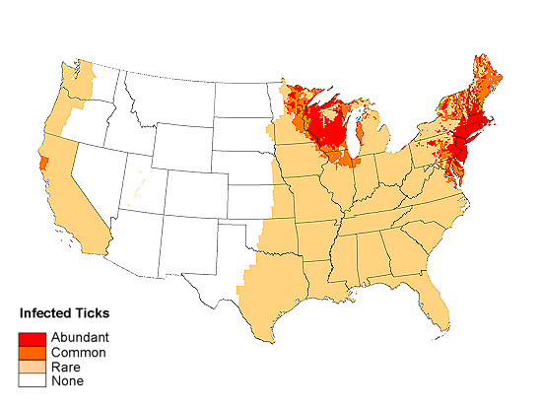

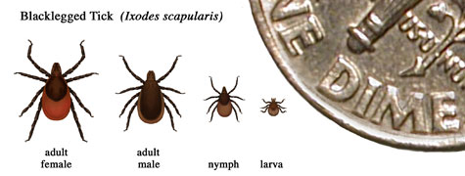
Lyme's Disease
Caused by Borrelia burgdorferi (BB) transmission
Carried by deer tick nymphs (Ixodes scapularis)
Most common arthropod-borne illness
Prevalence: Northeastern and Midwest United States
Notes:
Risk Classification:
Abundant: High density of host-seeking nymphal I.scapularis ticks.
Common: Medium density of host-seeking nymphal I.scapularis ticks or where at least 2% of I. pacificus ticks have been shown to be infected with BB
Rare: Areas where ticks have been reported, but host-seeking nymphs are extremely rare or infection prevalence is low
None: No reports of ticks

Slide 6
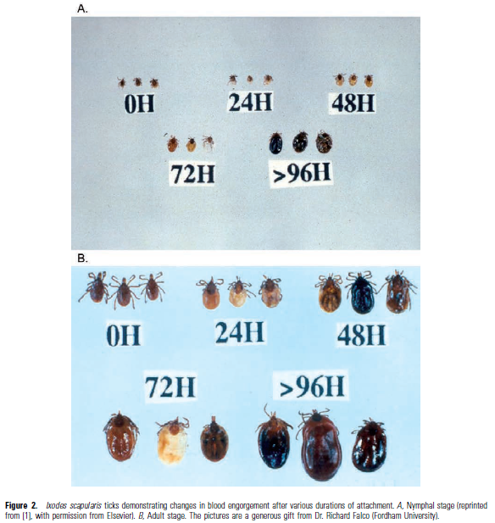
Transmission
Ticks attach to human anywhere
    Mostly dark, warm, moist areas
  Transmission: tick must bite and be attached for at least 36 hours or more
    Nymphs: Spring and Summer
    Adults: cooler months
Notes:
Dark, warm, moist areas (e.g. axilla, behind knees, and belt line)

Slide 7
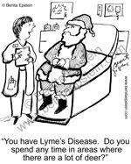
Non-Transmission Scenarios
Pregnancy/lactation
Blood transfusion
Human to human
Pets to humans
Venison or squirrel meat
Air, food, or water
Bites from flies, fleas, mosquitoes, or lice
Bites from other ticks
Notes:
Pregnancy/lactation: May lead to infection of the placenta and possible stillbirth; No harm to fetus if mother receives appropriate antibiotic treatment; No reports of transmission through breast milk
Blood transfusion
No LD cases linked
BB can live in blood that is stored for donation
Individuals currently receiving antibiotic treatment should not donate blood
Although no cases of Lyme disease have been linked to blood transfusion, scientists have found that the Lyme disease bacteria can live in blood that is stored for donation. Individuals being treated for Lyme disease with an antibiotic should not donate blood. Individuals who have completed antibiotic treatment for Lyme disease may be considered as potential blood donors. Information on the current criteria for blood donation is available on the Red Cross website at http://www.redcross.org/donate/give/
Pets (i.e. dogs and cats): no evidence that they spread LD directly to owners. However, pets can bring infected ticks into your home or yard. Consider protecting your pet, and possibly yourself, through the use of tick control products for animals.
Venison or squirrel meat: eating venison or squirrel meat will not result in LD, but in keeping with general food safety principles meat should always be cooked thoroughly. Note that hunting and dressing deer or squirrels may bring you into close contact with infected ticks.
Ticks not known to transmit LD:
Lone star tick (Amblyomma americanum)
American dog tick (Dermacentor variabilis)
Rocky Mountain wood tick (Dermacentor andersoni)
Brown dog tick (Rhipicephalus sanguineus)

Slide 8
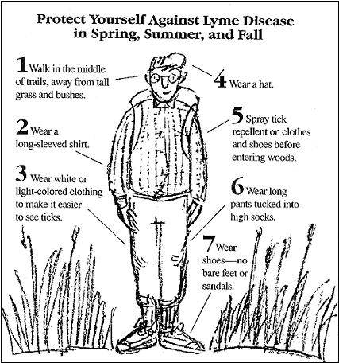
LD Prophylaxis
Best prevention: avoid exposure; if unavoidable,
  Use protective clothing and tick repellents
  Check entire body for ticks daily
  Removal attached ticks before infection can occur

Slide 9
LD Prophylaxis
If bitten by tick, give single dose of oral doxycycline
  Adults: 200 mg once
  Children over 8 years old: 4 mg/kg (maximum dose 200 mg)
Give doses when:
  Attached tick can be reliably identiﬁed as I. scapularis tick estimated to be attached for over 36 hours based on tick engorgement or tick exposure time;
  Prophylaxis can be started within 72 hours of time that tick was removed;
  Ecologic information indicates that local rate of infection of these ticks with BB is > 20%; and
  Doxycycline treatment is not contraindicated
Notes:
The time limit of 72 h is suggested because of the absence of data on the efﬁcacy of prophylaxis for tick bites following tick removal after longer time intervals.

Slide 10
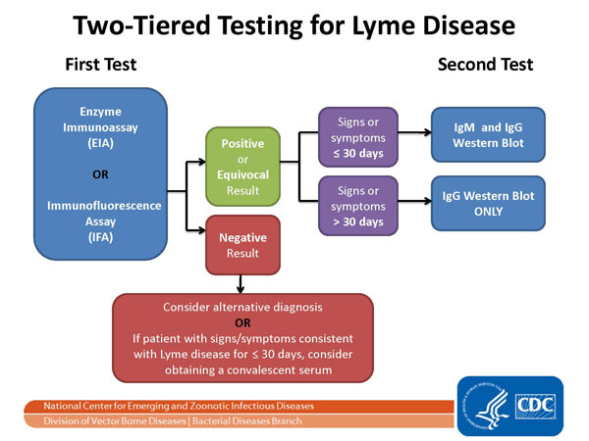

Notes:
The Two-tier Testing Decision Tree describes the steps required to properly test for Lyme disease. The first required test is the Enzyme Immunoassay (EIA) or Immunofluorescence Assay (IFA). If this test yields negative results, the provider should consider an alternative diagnosis; or in cases where the patient with has had symptoms for less than or equal to 30 days, the provider may treat the patient and follow up with a convalescent serum. If the first test yields positive or equivocal results, two options are available: 1) If the patient has had symptoms for less than or equal to 30 days, an IgM Western Blot is performed; 2) if the patient has had symptoms for more than 30 days, the IgG Western Blot is performed. The IgM should not be used if the patient has been ill for more than 30 days.
Positive IgM result alone is not recommended for determining active disease in persons with illness greater than 1 month's duration because the likelihood of a false-positive test result for a current infection is high for these persons.
Some say testing the tick may be helpful; it’s not because:
-If the test shows that the tick contained disease-causing organisms, that does not necessarily mean that you have been infected.
-If you have been infected, you will probably develop symptoms before results of the tick test are available. You should not wait for tick testing results before beginning appropriate treatment.
-Negative results can lead to false assurance. For example, you may have been unknowingly bitten by a different tick that was infected.

Slide 11
EARLY LOCALIZED INFECTION
Erythema Migrans (EM)

Slide 12
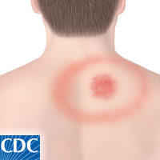
Early Localized Infection
Occurs within 2-4 weeks after tick bite
Large red macule or papule at bite site
Other signs/symptoms
  Fevers
  Arthralgias
  Headache
  Malaise
Notes:
Rash expands over days, forming a bright red flat border at the advancing edge; as lesion expands, central area of rash may clear
Rash is about 15 cm
Rash is NOT essential for diagnosis; only about 30% of pts will recall rash

Slide 13
Treatment
PREFERRED
Patient | Doxycycline | Amoxicillin | Cefuroxime axetil
Adult | 100 mg twice daily | 500 mg three times daily | 500 mg twice daily
Child | 4 mg/kg daily in two divided doses | 50 mg/kg daily in three divided doses | 30 mg/kg daily in two divided doses
Maximum dose | 100 mg | 500 mg | 500 mg
ALTERNATIVE
Patient | Azithromycin | Clarithromycin | Erythromycin
Adult | 500 mg daily | 500 mg twice daily | 500 mg four times daily
Child | 10 mg/kg daily | 7.5 mg/kg twice daily | 12.5 mg/kg four times daily
Duration | 7 – 10 days | 14 – 21 days | 14 – 21 days
Notes:
Duration USUALLY for EM is 14 days
Adult patients must NOT have neurologic manifestations or advanced AV heart block
Macrolides: UNLESS if they have documented allergic rxns to doxy, amoxil, or Ceftin
Ceftriaxone: do NOT use in EM; may cause serious side effects in the absence of neurologic manifestations or advanced AV block
Doxy in peds ONLY if child > 8 y/o

Slide 14
Early Localized Infection
Contraindications to doxycycline
  Pregnancy or lactation
  Children < 8 years of age
AVOID
  Macrolides
  Ceftriaxone
Notes:
Macrolide antibiotics are not recommended as ﬁrst-line therapy for early Lyme disease, because those macrolides that have been compared with other antimicrobials in clinical trials have been found to be less effective (E-I). When used, they should be reserved for patients who are intolerant of, or should not take, amoxicillin, doxycycline, and cefuroxime axetil.
Clarithromycin should NOT be used in pregnant women
Maximum daily dose for kids for all 3 macrolides = 500 mg
Patients treated with macrolides should be closely observed to ensure resolution of the clinical manifestations.

Slide 15
EARLY DISSEMINATED DISEASE
Lyme Meningitis
Lyme Carditis

Slide 16
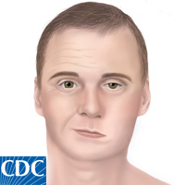
Signs & Symptoms
Severe or prolonged headache
Frank meningitis
Cranial nerve deficits
Peripheral neuritis
Joint pain/swelling
Lethargy
Notes:
Most common cranial nerve deficit: Bilateral Bell’s palsy
Frank meningitis: Neck stiffness, CSF lymphocytic pleocytosis, and elevated CSF protein with normal CSF glucose
Facial palsy: antibiotics should be given to prevent further sequelae (A-II).
Cranial nerve palsies in patients with Lyme disease are often associated with a lymphocytic CSF pleocytosis, with or without symptoms of meningitis.

Slide 17
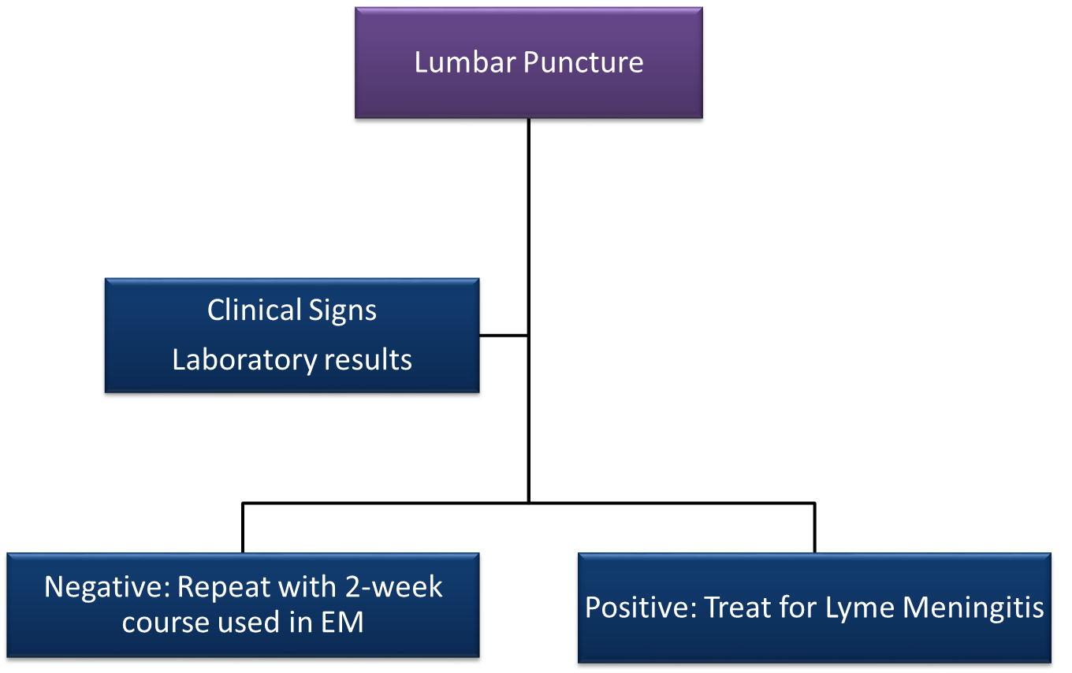
Lumbar Puncture
Notes:
Lumbar puncture recommended for those with strong clinical suspicion of CNS involvement.
CNS involvement = headache, lethargy, meningismus

Slide 18
Treatment
PREFERRED
Patient | IV Ceftriaxone
Adult | 2 gm daily
Child | 50-75 mg/kg daily
Maximum | 2 gm
ALTERNATIVE
Patient | IV Cefotaxime | IV Penicillin G K | PO Doxycycline
Adult | 2 gm every 8 hours | 3-4 million units every 3-4 hours | 100-200 mg twice daily
Child | 150-200 mg/kg in 3 or 4 divided doses daily | 200,000-400,000 units/kg every 4 hours | 4-8 mg/kg in 2 divided doses daily
Maximum | 6 gm | 18-24 million units | 100-200 mg/dose
Duration: 14 days
Notes:
Ceftriaxone: range, 10–28 days) in early Lyme disease is recommended for adult patients with acute neurologic disease manifested by meningitis or radiculopathy (B-I).
Range for all ABx is for 10 to 28 days
Note: abx will NOT resolve 7th cranial nerve palsy, but will prevent further effects of original infection

Slide 19
Lyme Carditis
Signs & Symptoms
  AV heart block
  Arrhythmias
Hospitalize and continually monitor symptomatic patients, especially with:
  Syncope
  Dyspnea
  Chest pain
  1st degree heart block when PR interval > 30 ms
  2nd or 3rd degree AV block
Notes:
Most common: 1st degree heart block; SOMETIMES you’ll see the 2nd and 3rd degree heart block

Slide 20
Treatment – Lyme Carditis
PREFERRED
Patient | IV Ceftriaxone
Adult | 2 gm daily
Child | 50-75 mg/kg daily
Maximum | 2 gm
ALTERNATIVE
Patient | IV Cefotaxime | IV Penicillin G K | PO Doxycycline
Adult | 2 gm every 8 hours | 3-4 million units every 3-4 hours | 100-200 mg twice daily
Child | 150-200 mg/kg in 3 or 4 divided doses daily | 200,000-400,000 units/kg every 4 hours | 4-8 mg/kg in 2 divided doses daily
Maximum | 6 gm | 18-24 million units | 100-200 mg/dose
Duration: 14 days
Notes:
Ceftriaxone: range, 10–28 days) in early Lyme disease is recommended for adult patients with acute neurologic disease manifested by meningitis or radiculopathy (B-I).
Range for all ABx is for 10 to 28 days
Note: abx will NOT resolve 7th cranial nerve palsy, but will prevent further effects of original infection

Slide 21
Treatment – Lyme Carditis
Advanced cases: temporary pacemaker
  Discontinue once heart block is resolved
  Change antibiotic therapy from IV to PO (same as Early Localized Infection)
Notes:
Advanced cases: ONLY if life threatening
Treatment is for 14 days
Change antibiotic therapy if conduction deficits resolve to complete patients’ course of treatment outpatient. (see Early Localized Infection)

Slide 22
LATE DISSEMINATED DISEASE
Lyme Arthritis
Late Neurologic Lyme’s Disease
Acrodermatitis Chronica Atrophicans
Notes:
Some patients never develop symptoms in primary stages

Slide 23
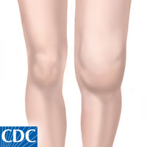
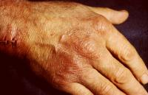
Late Lyme Disease
Arthritis
Neurologic complications
  Polyneuropathy
  Encephalitis or encephalopathy
Acrodermatitis chronica atrophicans
  Begins as bright red skin lesion, then mimics scleroderma
Notes:
Mostly large joints, like the knees
VERY impt to ensure proper diagnosis (Lyme’s arthritis manifests in pain AND swelling; also has sxs similar to fibromyalgia and chronic fatigue)
Polyneuropathy manifesting in peripheral neuropathy and neuropathic pain
Encephalopathy: cognitive (e.g. short-term memory loss; panic; anxiety; depression), and sleep disturbances
ACA: skin becomes leather-like

Slide 24
Treatment – Lyme Arthritis
Patient | Doxycycline | Amoxicillin | Cefuroxime axetil
Adult | 100 mg twice daily | 500 mg three times daily | 500 mg twice daily
Child | 4 mg/kg daily in two divided doses | 50 mg/kg daily in three divided doses | 30 mg/kg daily in two divided doses
Maximum dose | 100 mg | 500 mg | 500 mg
Duration: 28 days
Notes:
Duration: 28 days for adult patients without clinical evidence of neurologic disease.

Slide 25
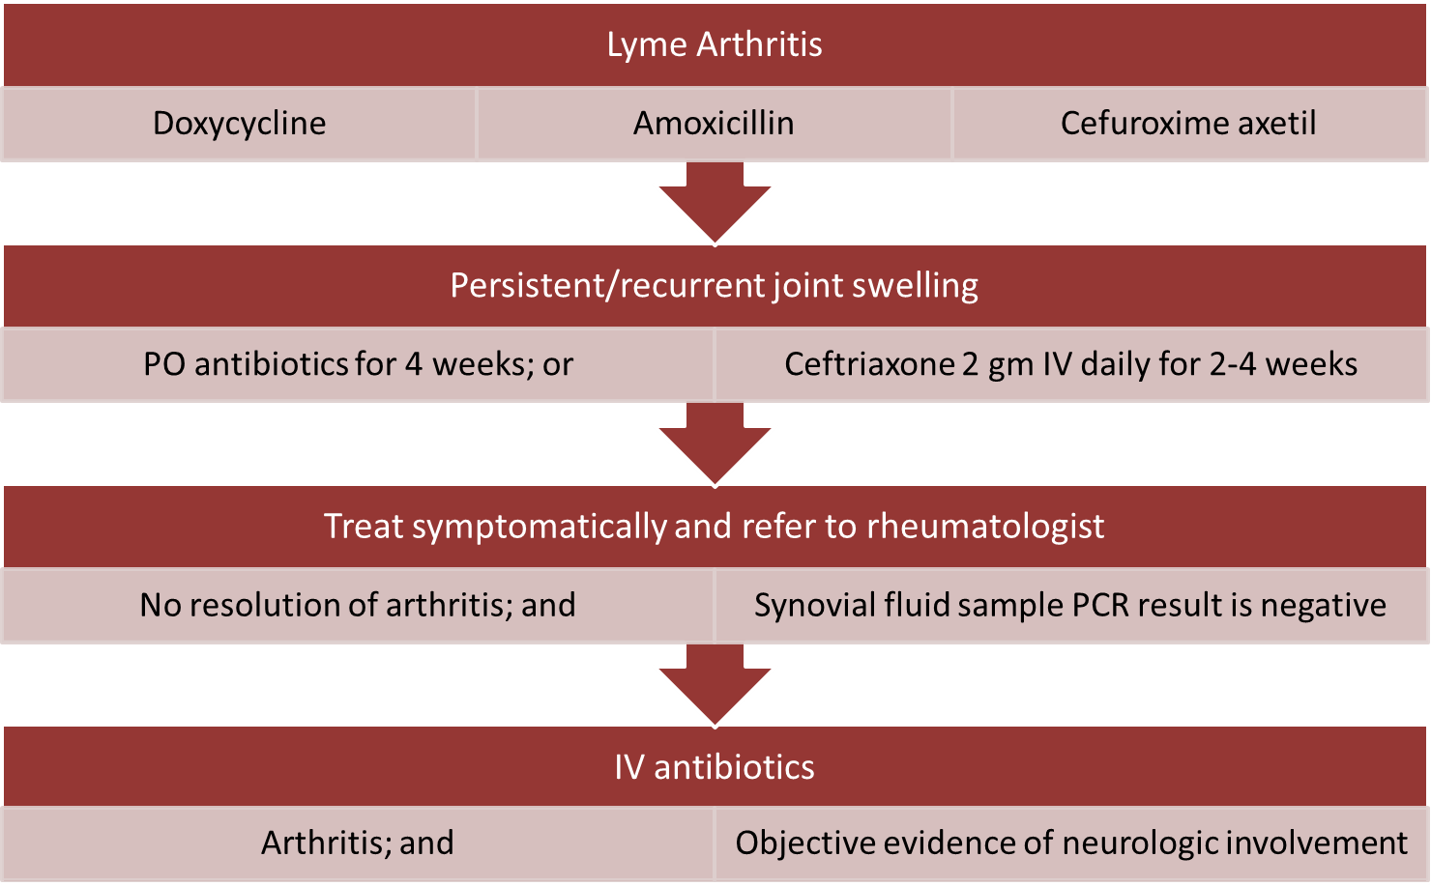
Treatment – Lyme Arthritis
Notes:
If no resolution of arthritis and PCR results of sample synovial fluid is negative, treat symtpomatically and refer to rheumatologist
NSAIDs
Intra-articular corticosteroids
DMARDs
Clinicians should consider waiting several months before initiating retreatment antibiotics because of anticipated slow resolution of inflammation after treatment

Slide 26
Treatment – Late Neurologic Lyme’s Disease
PREFERRED
Patient | IV Ceftriaxone
Adult | 2 gm daily
Child | 50-75 mg/kg daily
Maximum | 2 gm
ALTERNATIVE
Patient | IV Cefotaxime | IV Penicillin G K
Adult | 2 gm every 8 hours | 3-4 million units every 3-4 hours
Child | 150-200 mg/kg in 3 or 4 divided doses daily | 200,000-400,000 units/kg every 4 hours
Maximum | 6 gm | 18-24 million units
Notes:
Treatment duration: 2 to 4 weeks

Slide 27
Treatment: Acrodermatitis Chronica Atrophicans
Patient | Doxycycline | Amoxicillin | Cefuroxime axetil
Adult | 100 mg twice daily | 500 mg three times daily | 500 mg twice daily
Child | 4 mg/kg daily in two divided doses | 50 mg/kg daily in three divided doses | 30 mg/kg daily in two divided doses
Maximum dose | 100 mg | 500 mg | 500 mg
Duration: 21 days
Notes:
Duration is 21 days

Slide 28
SUN HEALTH
Drug-Induced Photosensitivity
Sun Health
Sunburn Treatment

Slide 29
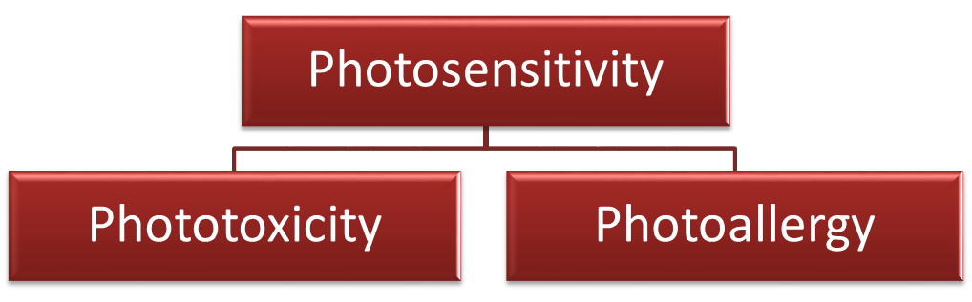
Phototoxicity or Photoallergy?
Feature | Phototoxic reaction | Photoallergic reaction
Incidence | High | Low
Amount of agent required | Large | Small
Onset of reaction | Minutes to hours | 24-72 hours
More than one exposure to agent required | No | Yes
Distribution | Sun-exposed skin only | Sun-exposed skin; may spread to unexposed areas
Clinical characteristics | Resembles exaggerated sunburn or blisters | Dermatitis
Immune-mediated | No | Yes; type IV

Slide 30
Phototoxicity Mechanism
Activated by UVA rays → excitation of drug metabolite’s electrons
Energy from electrons transfers to oxygen when metabolite regains chemical stability
Energy forms reactive oxygen intermediates → damaging cell membranes and DNA
Signal transduction pathways that lead to production of cytokines and arachidonic acid metabolites
Notes:
Phototoxicity: direct damage to tissue caused by photoactivated compound.

Slide 31
Photoallergy Mechanism
Photoactivation of drug metabolite
Metabolite binds to protein carriers in skin to form complete antigen
Notes:
Photoallergy: cell-mediated immune responses in which antigen is light-activated drug.

Slide 32

Common Sites
Ears
Nose
Forearms
Hands
Cheeks

Slide 33
Photosensitive Medications - Antibiotics
Phototoxic
Photoallergic
Tetracyclines
Fluoroquinolones
TB medications
SMX-TMP
Dapsone
Azole antifungals
Ceftazidime
Cefotaxime
Efavirenz
Griseofulvin
Fluoroquinolones
Sulfonamides
Griseofulvin
Notes:
TCNs: tetra; doxy (dose-dependent); mino doesn’t cause too much
Fluoroquinolones: mostly cipro; not much from levo or moxi
TB medications: isoniazid and pyrazinamide
Azoles: itra and vori; NO for fluc; nothing reported on keto

Slide 34
NSAIDs
Phototoxic
Photoallergic
Naproxen
Nabumetone
Sulinidac
Diclofenac
Ketoprofen
Piroxicam
Notes:
NSAIDs: ibuprofen very RARELY causes photosensitivity; COX-2’s do NOT

Slide 35
Photosensitive Medications – Cardiovascular
Phototoxic
Photoallergic
Diuretics
ACE Inhibitors
Valsartan
Calcium channel blockers
Amiodarone
Alpha-methyldopa
Statins
Thiazide diuretics
Notes:
Diuretics: thiazides, furosemide (esp. in high doses), bumetanide
ACEI: rami, quina, capto, and enala
Valsartan is the ONLY documented ARB with DIPS
CCBs: amlodipine, nifedipine, diltiazem, and verapamil
Statins: simvastatin has the most documented evidence; rosuva and pitava do NOT cause DIPE

Slide 36
Photosensitive Medications – Antineoplastic Agents
  Imatinib
  Fluorouracil
  Capecitabine
  Paclitaxel
  Hydroxyurea
  Methotrexate
Notes:
All of these are photoTOXIC

Slide 37
Photosensitive Medications – Psychotropics
Phototoxic
Photoallergic
Antipsychotics
  Typicals:
    Phenothiazines
    Thioxanthenes (thiothixene)
  Atypicals:
    Olanzapine
    Clozapine
Anticonvulsants
Antidepressants
  TCAs
  SSRIs
  Venlafaxine
Benzodiazepines
  Alprazolam
  Chlordiazepoxide
Phenothiazines
Notes:
Anticonvulsants: VPA and CBZ
Nothing documented on duloxetine

Slide 38
Miscellaneous
Phototoxic
Photoallergic
Coal tar
Topical antimicrobials
Metformin
Sulfonylureas
Retinoids
Oral contraceptives with ethinyl estradiol
Antihistamines
Clopidogrel
Topical antimicrobials
Sunscreen ingredients
  Avobenzone
  Cinnamates
  Ensulizone
  Oxybenzone
  PABA derivatives
  Sulisobenzone
Notes:
Antihistamines: diphenhydramine and ranitidine

Slide 39
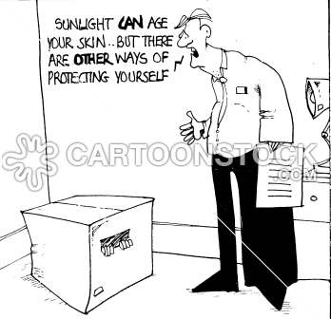
Managing Drug-Induced Photosensitive Reactions
Discontinue medication
Administer medication in evening
Oral corticosteroids
Counseling on sun health
Notes:
Photosensitivity will resolve in short time frame; in very rare cases, they persist for months to years
Topical steroids MAY help, but oral will resolve

Slide 40


Sun Health Counseling
Stay indoors between 10AM and 4PM
Long-sleeved shirts, long pants, and wide-brimmed hats
Smoking cessation

Slide 41
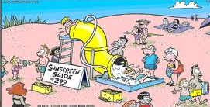
Sunscreen Counseling
Apply 15 minutes before going out in sun
Reapply:
  At least every 2 hours, even on cloudy days.
  After heavy sweating, swimming and toweling off
Best sunscreen products
  Broad spectrum
  SPF between 30 and 50
Do not use on children younger than 6 months
Notes:
For sprays, rub in sunscreen after spraying.
there is no additional benefit or difference if the SPF is greater than 50.
For children, lotions are the preferred dosage form.

Slide 42
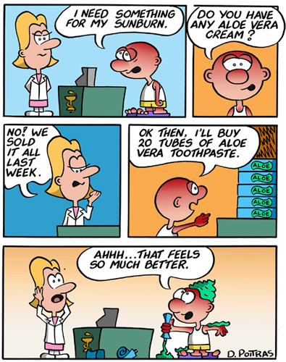
Sunburn First Aid
1st and 2nd degree burns
  Wash/soak burn areas in cool, soapy water
  Use over-the-counter antibiotic creams
  Dry and place loose, sterile gauze over burn area, then cover with bandage

Slide 43
Sunburn First Aid
3rd degree burns
  If within close proximity, go to Emergency Department
  If out camping
    Remove clothing from burned area. Cut around clothing/cloth that sticks to burned area
    Apply antiseptic cream to burned area, and then cover with sterile dressings, followed by bandage
    Treat for shock
    If conscious, allow them to drink water
    Get to ER ASAP

Slide 44
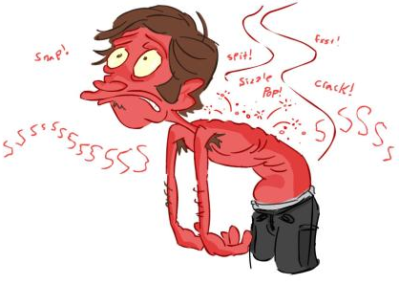
Sunburn Do Not’s
Touch burned area
Breathe on burn
Break or drain blisters
Change applied dressings
Notes:
Only advanced medical support should change or remove any dressings applied as first aid

Slide 45
Pop Quiz #1
What are important patient counseling points regarding doxycycline?
May cause photosensitivity – recommend sunscreen and apply as directed
Although medication may cause GI upset, do NOT take any antacid tablets
Take 2 hours before or after meals and medications
All of the above
Notes:
D is correct

Slide 46
Pop Quiz #2
Which patient is contraindicated for doxycycline treatment?
9 y/o WM asthma patient on Proventil HFA (2 puffs every 4-6 hours as needed)
28 y/o BF who is 28 weeks pregnant and taking PNV daily
42 y/o BM taking pantoprazole 40 mg daily for GERD
37 y/o WF diagnosed with trichomoniasis

Slide 47
Pop Quiz #3
Based on patient LD’s medication profile to the right, which of the following would be an appropriate choice for erythema migrans?
Amoxicillin 500 mg twice daily for 14 days
Azithromycin 500 mg daily for 14 days
Cephalexin 500 mg three times daily for 14 days
Doxycycline 100 mg twice daily for 14 days
Medications
Lisinopril/HCTZ 10/12.5 mg daily
Metformin 1000 mg daily
Pravastatin 20 mg daily
Lansoprazole 30 mg daily
Allergies
Codeine (nausea/vomiting)
Augmentin (anaphylaxis)
Notes:
D is correct

Slide 48
Pop Quiz #4
EM sees his PCP and was directed to go to the ER after being diagnosed with Lyme’s Disease. He was later admitted and diagnosed with Lyme Carditis secondary to 2nd degree AV block. Which of the following would be appropriate treatment for this patient?
Cefazolin 2 gm IV every 8 hours for 14 days
Penicillin G K 3 million units IV every 4 hours for 14 days
Ceftriaxone 2 gm IM daily for 14 days
Doxycycline 100 mg twice daily for 14 days
Medications
Amiodarone 200 mg daily
Metoprolol 50 mg twice daily
Pravastatin 20 mg daily
Coumadin 3 mg daily
Allergies
Tetracyclines (rash, hives)
PMH
Lyme’s Disease
Notes:
B is correct
Should he receive a temporary pacemaker? If unresolved, then yes

Slide 49
Pop Quiz #5
AH received ceftriaxone 2 gm IV daily for 28 days for Lyme Arthritis after failing doxycycline treatment. His condition has improved but is still not fully resolved. How should he be treated now?
Switch to cefotaxime 2 gm every 12 hours for 14 days
Switch to cefepime 2 gm IV every day for 28 days
Continue ceftriaxone 2 gm IV daily for 4 weeks
Switch to doxycycline 100 mg twice daily for 14 days
Notes:
C is correct

Slide 50
Pop Quiz #6
DB is a 60 y/o WM who comes into your pharmacy to pick up his monthly refills and sees your skin & sun awareness sign. He asks which medication(s) increase his risk for photosensitivity; what do you tell him?
“None of them do; chill out!”
“Simvastatin may increase your risk of your skin being more sensitive to the sun; let me tell you how to take care of your skin.”
“Pantoprazole may increase your risk of your skin being more sensitive to the sun; would you like me to contact your doctor to switch to lansoprazole instead?”
“Cymbalta may increase your risk of your skin being more sensitive to the sun; would you consider taking your medication at night instead?”
Medications
Pantoprazole 40 mg qAM
Levothyroxine 75 mcg qAM
Simvastatin 20 mg qHS
Metoprolol 50 mg BID
Cymbalta 30 mg qAM
Losartan 50 mg qDay
Notes:
B is correct

Slide 51
Pop Quiz Question #7
Which medication(s) does NOT increase the chance of photosensitivity?
Accutane, Zyprexa, and Cipro
Dyazide, enalapril, and naproxen
Fluconazole and ketoconazole
I ONLY
III ONLY
I AND II
II AND III
I, II, AND III
Notes:
B is correct

Slide 52
References
Albert, R. H., MD, PhD, & Skolnik, N. S., MD. (2008). Lyme Disease Prevention, Diagnosis, and Treatment. Essential Infectious Disease Topics for Primary Care, 235-239.
Boy Scout Troop 680. (2009). First Aid Guide - Burns [Fact sheet]. Retrieved May 8, 2013, from Boy Scout Troop 680 website: http://www.bsatroop680.org/First_Aid/first_Aid_Burns.htm.
Centers for Disease Control and Prevention. (2013, May 6). CDC - Lyme Disease Home Page. Retrieved May 8, 2013, from CDC- Lyme Disease Home Page website: http://www.cdc.gov/lyme/
Cheigh, N. H. (2005). Dermatologic Drug Reactions, Self-Treatable Skin Disorders, and Skin Cancer. In J. T. DiPiro, PharmD, FCCP, et. al (Eds.), Pharmacotherapy: A Pathophysiologic Approach (6th ed., pp. 1741-1753). McGraw-Hill.

Slide 53
References
Diaz, J.H., M, MPH&TM, DrPH, & Nesbitt Jr., L.T., MD (2013). Sun Exposure Behavior and Protection: Recommendations for Travelers. Journal of Travel Medicine, 20(2), 108-118.
Donta, S.T., MD (2002). Late and Chronic Lyme Disease. Medical Clinics of North America, 86(2), 341-349.
Drucker, A. M., & Rosen, C. F. (2011). Drug-Induced Photosensitivity. Drug Safety, 34(10), 821-837.
Fish, A. E., MD, MPH, Pride, Y. B., MD, & Pinto, D. S., MD. (2008). Lyme Carditis. Infectious Disease Clinics of North America, 22(2), 275-288.
Habif, T. B. (2010). Clinical Dermatology (5th ed.). Mosby.

Slide 54
References
Infectious Diseases Society of America. (2006). The Clinical Assessment, Treatment, and Prevention of Lyme Disease, Human Granulocytic Anaplasmosis, and Babesiosis: Clinical Practice Guidelines by the Infectious Diseases Society of America. Clinical Infectious Diseases, 43(9), 1089-1134.
Johnson, M. S., PharmD, BCPS (Presenter). (2008, October 16). Lyme's Disease. Speech presented at Shenandoah University, Winchester, VA.
Murray, T. S., MD, PhD, & Shapiro, E. D., MD. (2010). Lyme Disease. Clinics in Laboratory Medicine, 30(1), 311-328.
Pennsylvania Pharmacists Association. (2013, April 30). Sun Safety This Summer [Press release].

Slide 55


Slide 56
NJPHA OVERVIEW

Slide 57
NJPhA Mission
To advance the profession of pharmacy enabling our members to provide optimal care to
those they serve.

Slide 58
NJPhA Legislative Representation
Organizational leadership and support has led to the development of many legislative reforms on a state and federal level. Some include:
  1965: NJPhA proposed limited quantity of children's aspirin
    Saved lives, national recognition, President Johnson signed law, FDA action
  1969: First public anti-smoking campaign
  1970: First mandatory patient profile
  1975: Concern for senior citizens health prompted development of PAAD law in NJ
    First in US, has helped millions, now has 200,000 beneficiaries
  1994:Pharmacists may be reimbursed as Diabetes Educators by NJ Reg. Insurance Plans
  1999: Insurance audits must be performed at a mutually agreeable time
  2000: Mandatory Mail Order is not permitted for NJ State Regulated Plans.
  2005: Modernization of the Practice of Pharmacy
  2009: Pharmacists immunize patients in New Jersey; 2013: bill was amended to lower the age for flu vaccine administration
  2013: Collaborative Practice between Physicians and Pharmacists
  2014: Separation between consultant and provider extended
Notes:
Organizational leadership and support has led to the development of many legislative reforms on a state and federal level.
1965 NJPhA proposed limited quantity of children's aspirin/saved lives, national recognition, President Johnson signed law, FDA action
1969: First public anti-smoking campaign
1970: First mandatory patient profile
1975: Concern for senior citizens health prompted development of PAAD law in NJ (first in US, has helped millions, now has 200,000 beneficiaries) - The Laws Establishing the Pharmaceutical Assistance to Aged and Disabled Program (PAAD) and Senior Gold (SG) Program (1973-2005)
1994:Pharmacists may be reimbursed as Diabetes Educators by New Jersey - The law providing the pharmacists may be reimbursed as Diabetes Educators by New Jersey Regulated Insurance Plans. (1994)
1999: Insurance audits must be performed at a mutually agreeable time - The law requiring that pharmacies be allowed a mutually agreeable time for pharmacy audits by insurers (1999)
2000: Freedom Choice in Selecting a Pharmacy. Mandatory Mail Order is not permitted for New Jersey State Regulated Plans. - Two laws providing for Freedom Choice in Selecting a Pharmacy. Mandatory Mail Order is not permitted for New Jersey State Regulated Plans. (1993, 2000)
2005: Modernization of the Practice of Pharmacy - The Modernization of the Practice of Pharmacy in order to reflect the current training and education of pharmacists under the Pharmacy Practice Act (2005)
2009: Pharmacists immunize patients in New Jersey; 2013: bill was amended to lower the age for flu vaccine administration - The Law and Regulations Permitting Properly Qualified Pharmacists to Immunize Patients 18 years and older for all types of immunizations pursuant to Physician Standing Orders, Prescriptions or Government Sponsored Programs (2005, 2009)
2013: Collaborative Practice between Physicians and Pharmacists - The Law Providing for Collaborative Practice between Physicians and Pharmacists (2005) (Regulations adopted 2013)
2014: Separation between consultant and provider extended for 7 years
You may not be an immunizing pharmacist and therefore may not think this is important, however we are all one profession and when the hot topic in Trenton or Washington directly relates to YOUR area of practice, you would hope that the immunizing pharmacists stand with you just as you stood with them when they were in need of numbers.

Slide 59
NJPhA Federal Advocacy
Strength in Numbers!
  Our Advocacy Team actively works with APhA – American Pharmacists Association, NASPA – National Alliance of State Pharmacy Associations, NCPA - National Community Pharmacists Association and others to protect our best interests and promote grassroots federal advocacy on key issues.
  NJPhA is supporting APhA's initiative to advocate for national healthcare provider status for pharmacists. This will allow pharmaCISTS, not just pharmaCIES, to bill and receive reimbursement for patient care related services
Notes:
- This year, APhA has dedicated 1.5 million dollars to advocate for pharmacists gaining healthcare provider status on a national level. This will allow pharmaCISTS, not just pharmaCIES, to bill and receive reimbursement for patient care related services (NJPhA has agreed to support this initiative on a state and national level).
- NJPhA is working to form an official position statement on pharmacists working directly for pharmaceutical companies and their right to provide continuing education programs
- A full list of legislative accomplishments, policy statements and bills that are being worked on can be found on our website (which is currently undergoing a make-over)

Slide 60
NJPhA Regulation Representation
Influence Laws and Regulation to Impact Change
NJ Board of Pharmacy
NJ Board of Medical Examiners
NJ Drug Utilization Review Board
NJ Health Information Technology Committee
National Organizations
  NABP
  APhA
  CMS

Slide 61
NJPhA Membership
Becoming an Active Member
Founded in 1870 as a not-for-profit corporation to represent pharmacists in the State of New Jersey who practice in all areas of pharmacy.
Get involved in ways that meet your specific goals:
  Write for our peer reviewed journal
  Submit a poster to our annual convention
  Join one of our Academies (Consultant, Compounding, Disaster Management)
Learn skills outside of the office that hasten your development:
  Network and Make Connections
  Be Recognized
  Advance Your Expertise
  Champion the Profession
Notes:
The New Jersey Pharmaceutical Association was founded in 1870 as a not-for-profit corporation to represent pharmacists in the State of New Jersey who practice in all areas of pharmacy. Renamed the New Jersey Pharmacists Association in 1996, the organization has been continually operating since founding.
Its leadership and support has led to the development of many legislative reforms on a state and federal level, such as:
Last year, NJPhA made pharmacist-based Collaborative Practice a reality in New Jersey.
Our members were instrumental in supporting the bills related to reducing the immunization age in the state
This year, APhA has dedicated 1.5 million dollars to advocate for pharmacists gaining healthcare provider status on a national level.
NJPhA has agreed to support this initiative on a state and national level.
This will allow pharmaCISTS, not just pharmaCIES, to bill and receive reimbursement for patient care related services.
Get involved!
Committees include:
Continuing Education - Organizes educational programs provided by the organization.
Journal - Provides oversight of The New Jersey Journal of Pharmacy.
Government and Public Affairs - Reviews and prioritizes proposed legislation and regulatory changes.
Finance - Provides financial oversight of the organization.
Professional Affairs - Reviews professional issues affecting all areas of pharmacy practice.
Permanent Organization - Considers all propositions related to the amendment of the Constitution and By-laws.
Membership - Provides membership services, recruitment and retention initiatives.
Convention - Plans, organizes and executes the annual and semi-annual conventions.
Policy Development - Develops association policy as needed.
Student Practitioner - Identifies methods to strengthen pharmacy student relationships
Academies include:
Academy of Disaster Management Pharmacists - mission is to promote the health and safety of the residents of the State of New Jersey by preparing pharmacists and pharmacy technicians to respond to naturally occurring disasters and outbreaks, chemical, biological, radiological, nuclear, and explosive events, and other health and homeland security threats and emergencies.
Academy of Compounding Pharmacists - mission is to provide a forum for New Jersey Compounding Pharmacists to address certain specific key issues related to compounding and the protection of compounding in New Jersey.
Academy of Consultant Pharmacists - mission is to advance the discipline and practice of the profession of pharmacy consulting for the benefit of its members and the patients they service. Our commitment is to provide membership with resources to ensure clinical competency and regulatory awareness through the development and dissemination of professional knowledge.
Learn skills outside of the office that hasten your development.
Network and Make Connections, as a member, you’ll meet others who:
Share similar aspirations and goals.
Have overcome common challenges.
Are willing to share their expertise.
Build worthwhile relationships.
Be Recognized, as an active member, you’ll find the opportunity to:
Be nominated for annual awards.
Meet other professionals outside of work and demonstrate your abilities.
Reach out to members who you would have otherwise never known.
Advance Your Expertise, as a member, you’ll find:
Information that supports your practice setting.
Professional development opportunities that connect theory and practice.
Ongoing access to information at your convenience.
Champion the Profession, protecting the profession requires ongoing vigilance, our commitment to our members is to:
Keep you aware of the critical issues affecting your practice setting.
Advocate your interested to key government officials and other decision-makers in the State.
Promote your commitment to efficient and effective patient care to key audiences.
Sign up today with me for more information on how to get involved!

Slide 62
In Summary...
We are committed to...
Presenting a unified voice for NJ pharmacists and pharmacy technicians.
Providing a forum for exchange of innovative ideas to establish progressive health systems.
Promoting the optimization of drug therapy for the patients our members serve.
Anticipating future information and professional development needs.
Strengthening relationships between practitioners, student pharmacist, pharmacy technicians, and other health professionals.
Notes:
Membership is for you if you...
Are committed to delivering quality patient are and education
Believe that maintaining professional competence is essential
Are open to sharing and exchanging information
Want to establish worthwhile professional relationships
Are looking for an experience that will exceed your expectations
Want a strong advocacy voice for your profession

Slide 63
Join the Provider Status Team and Become a Member Today!
Sign up at today’s event – see the registration desk for details

Slide 64
The online evaluation code will be sent from the office tomorrow morning:
This code will be active for one week from the date of the lecture.
  Deadline: November 12, 2014
NOTE: your credits will be posted to CPE monitor within 45 days of program date

