Slide 1
AutogenRAG
Integrating Data IO tools with Autogen
Linkai Yu
Microsoft

Slide 2
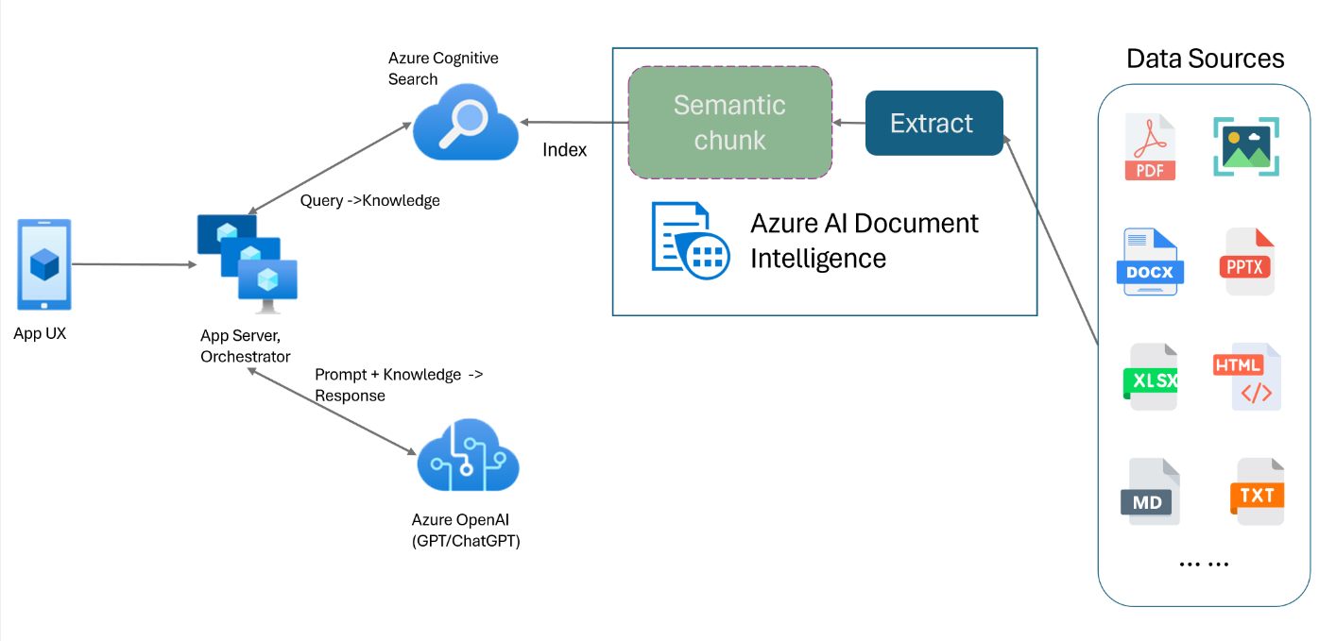
Standard RAG Architecture
Limitation: can’t access existing data sources

Slide 3
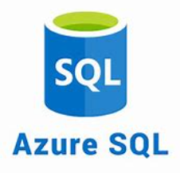
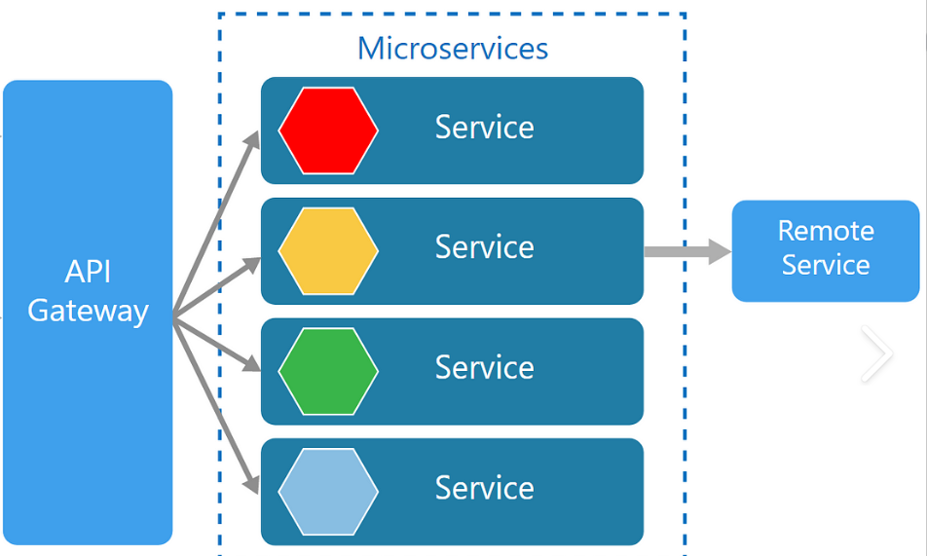

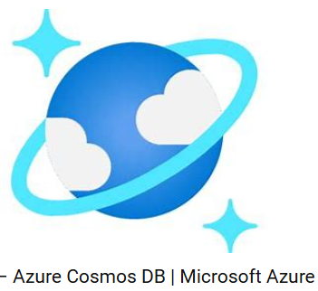
Enterprises have huge investment in data infrastructure

Slide 4

Autogen function call can help

Slide 5
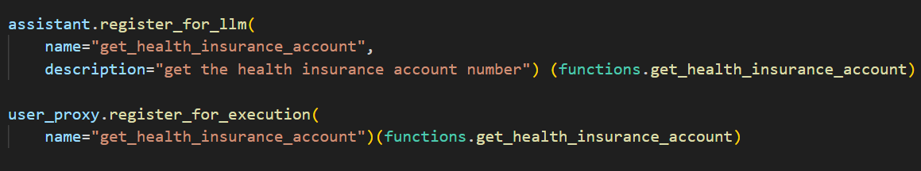
Hard coding for function registration is a limitation

Slide 6
Overcome the function registration limitation by dynamic function registration when it is needed by LLM
UserAgent
Assistant Agent(LLM)
make request (user prompt)
responds with requests for function registration (function description)
a. Looks up function name in vector DB
( function description)
b. Retrieves function (function name)
c. Register the function (meta data)
Uses the function meta data to issue function call to the UserAgent
(function name, parameters)
Invoke the function

Slide 7
The result:
User can input varied form of requests that is covered by the data IO functions. Think of letting users develop AI applications through prompts. This should improve users’ productivity.
Developers only need to implement functions to be registered for AutoGen. Most of the time is probably just a wrapper or a direct call to the existing backend service.

