Slide 1
A Thorough Look at Krati vs. BDB JE A Comparison of Throughput, Latency and GC
Jingwei Wu, Jiong Wang, Igor Perisic
SNA @ LinkedIn
July 12, 2010

Slide 2
Test Configuration
Test
Key size: 30 - 36 bytes
Key count: 2,500,000
Value size: 0.5-2 KB, Avg. 1 KB
Random read
Random write
Krati
SimpleDataStore with MemorySegment
DynamicDataStore with MemorySegment
BDB JE
Java JVM: -server –Xmx16G
Cache Size 8G (je.maxMemoryPercent=50)
Transactional
NoTxnSync
Notes:
Why different configs?

Slide 3
Performance - Krati vs. BDB JE
Krati SimpleDataStore with MemorySegment
 | Populate | Write Only | Read Only | Read & Write
put | 15-20/ms | 15-20/ms |  | 15-20/ms
get |  |  | 200 /reader/ms | 200 /reader/ms
Krati DynamicDataStore with MemorySegment (initLevel=2)
 | Populate | Write Only | Read Only | Read & Write
put | 5-10/ms | 10-20/ms |  | 10-20/ms
get |  |  | 175-200 /reader/ms | 175-200 /reader/ms
BDB JE StoredMap (Cache Size 8G, Transactional, NoTxnSync)
 | Populate | Write Only | Read Only | Read & Write
put | 15-20/ms | 10-15/ms |  | 10-15/ms
get |  |  | 45 /reader/ms | 45 /reader/ms
Notes:
initLevel ? What does it mean?

Slide 4
Write Throughput – Krati vs. BDB
# Writes per second
Krati
Time

Slide 5
Read Throughput – Krati vs. BDB
# Reads per second
Krati
Time

Slide 6
Write Latency – Krati vs. BDB
85.93%
81.67%
69.08%
Percentage %
Krati
Latency in Microseconds

Slide 7
Read Latency – Krati vs. BDB
95.85%
60.27%
Percentage %
55.48%
Krati
Latency in Microseconds

Slide 8
1-Hour GC Summary - Krati vs. BDB
2.5 Million Unique Keys
 | BDB JE | SimpleDataStore | DynamicDataStore
Test Time | 1h 5m 40s | 1h 4m 40s | 1h 8m 30s
Segment Size | 9-10 MB (.jdb) | 256 MB | 256 MB
Segment ID(s) | 0x0 – 0x2ace | 0 - 20 | 0 - 19
# Segments | 10958 | 529 | 790
Memory Footprint | 9.6 GB | 11.3 GB | 10.5 GB
Total Disk Writes | 102 GB | 132.25 GB | 197.5 GB
Disk Throughput | 26.5 MB/s | 34.9 MB/s | 39.2 MB/s
GC Perf. | 21166 MB/s | 187156 MB/s | 218298 MB/s
Full GC Perf. | 252 MB/s | 2.42 MB/s | 5.53 MB/s
GC Max Pause | 5144 ms | 1208 ms | 337.44 ms
GC Min Pause | 1.22 ms | 0.78 ms | 1.18 ms
GC Avg. Pause | 221.33 ms | 23.63 ms | 19.98 ms

Slide 9
Appendix

Slide 10
1-Hour GC Summary - Krati vs. BDB
2.5 Million Unique Keys
 | BDB JE | SimpleDataStore | DynamicDataStore
Test Time | 1h 5m 40s | 1h 4m 40s | 1h 8m 30s
Segment Size | 9-10 MB (.jdb) | 256 MB | 256 MB
Segment ID(s) | 0x0 – 0x2ace | 0 - 20 | 0 - 19
# Segments | 10958 | 529 | 790
Memory Footprint | 9.6 GB | 11.3 GB | 10.5 GB
Total Disk Writes | 102 GB | 132.25 GB | 197.5 GB
Disk Throughput | 26.5 MB/s | 34.9 MB/s | 39.2 MB/s
GC Perf. | 21166 MB/s | 187156 MB/s | 218298 MB/s
Full GC Perf. | 252 MB/s | 2.42 MB/s | 5.53 MB/s
GC Max Pause | 5144 ms | 1208 ms | 337.44 ms
GC Min Pause | 1.22 ms | 0.78 ms | 1.18 ms
GC Avg. Pause | 221.33 ms | 23.63 ms | 19.98 ms

Slide 11
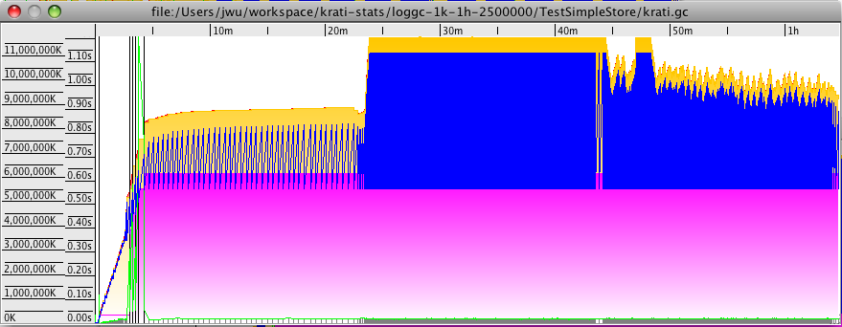
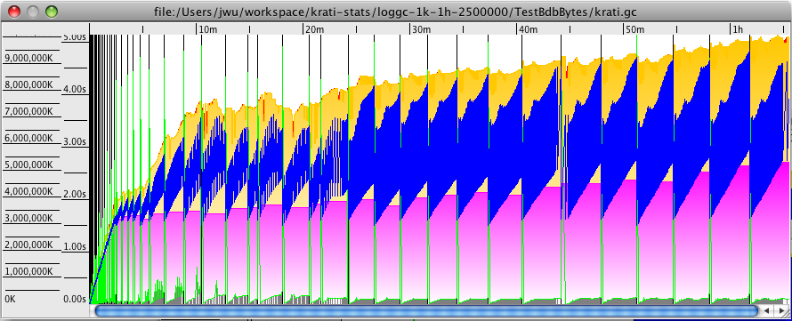
1-Hour GC Statistics – Krati vs. BDB
SimpleDataStore
BDB JE

Slide 12
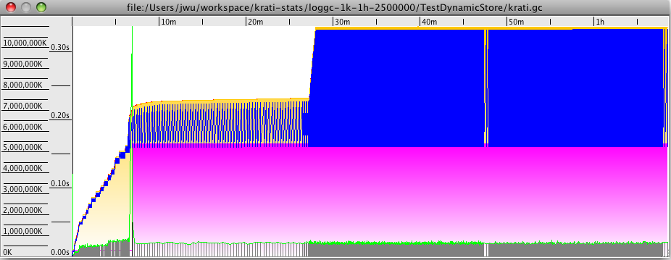
1-Hour GC Statistics – Krati vs. BDB
DynamicDataStore
BDB JE

Slide 13
5-Hour GC Summary - Krati vs. BDB
1 Million Unique Keys
 | BDB JE | SimpleDataStore | DynamicDataStore
Test Time | 5h 1m 57s | 5h 1m 41s | 5h 2m 14s
Segment Size | 9-10 MB (.jdb) | 256 MB | 256 MB
Segment ID(s) | 0x0 - 0x11485 | 0 - 7 | 0 - 7
# Segments | 70789 | 2093 | 3076
Memory Footprint | 9.08 GB | 3.59 GB | 3.53 GB
Total Disk Writes | 657 GB | 523.25 GB | 769 GB
Disk Throughput | 37.12 MB/s | 29.60 MB/s | 43.42 MB/s
GC Perf. | 178337 MB/s | 22248 MB/s | 22567 MB/s
Full GC Perf. | 1752 MB/s | 46.19 MB/s | 56.03 MB/s
GC Max Pause | 1173 ms | 396.29 ms | 407.25 ms
GC Min Pause | 0.99 ms | 0.3 ms | 0.34 ms
GC Avg. Pause | 30.25 ms | 6.53 ms | 6.13 ms

Slide 14
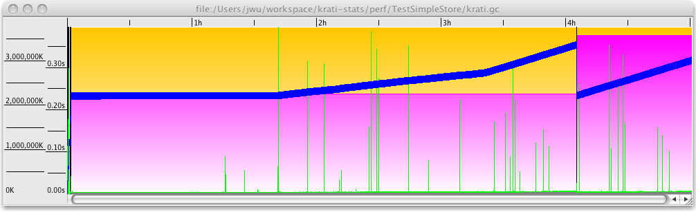
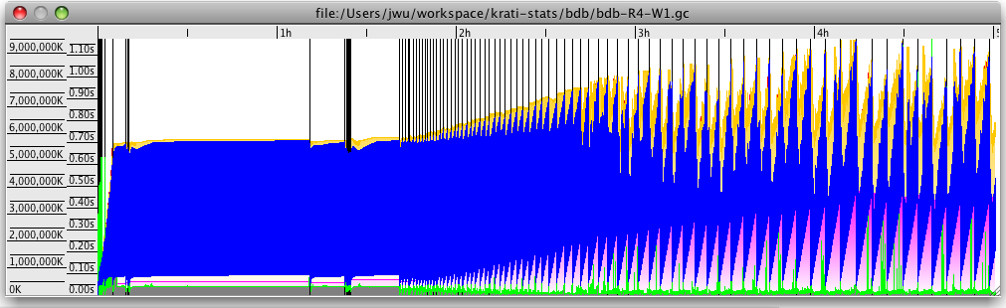
5-Hour GC Statistics – Krati vs. BDB
SimpleDataStore
BDB JE

Slide 15
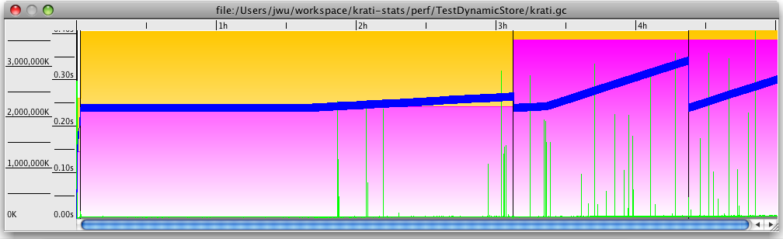
5-Hour GC Statistics – Krati vs. BDB
DynamicDataStore
BDB JE

