Slide 1
Avatara
Chris Riccomini
SAM SIG
10/27/10

Slide 2

Who?
Chris Riccominihttp://www.riccomini.name
http://www.sna-projects.com
criccomini@linkedin.com
@criccomini

Slide 3
Avatara

Slide 4
Scalable OLAP
select, count, where, group, having, order, limit

Slide 5
Built on Hadoop & Voldemort

Slide 6
Power Data Products

Slide 7
Data Products?

Slide 8


Slide 9
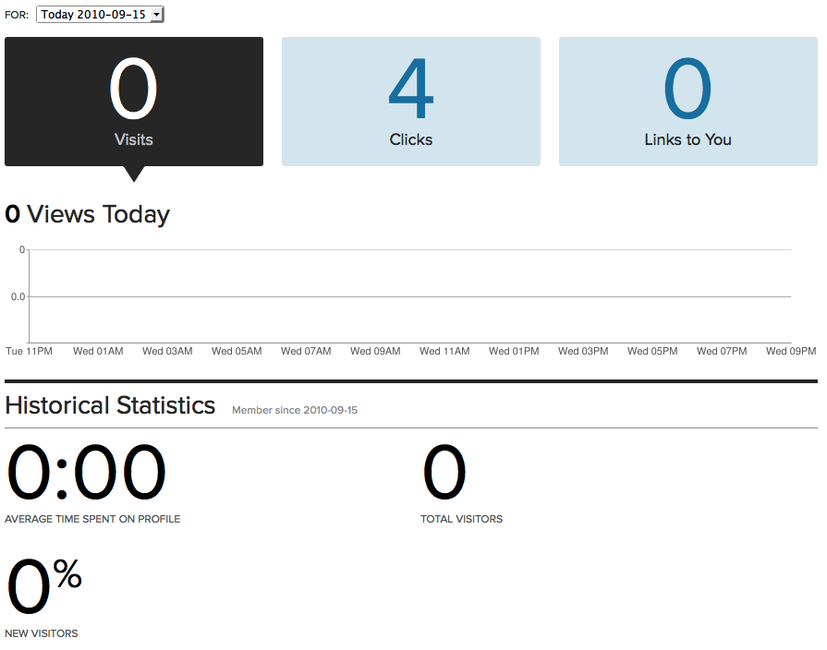

Slide 10
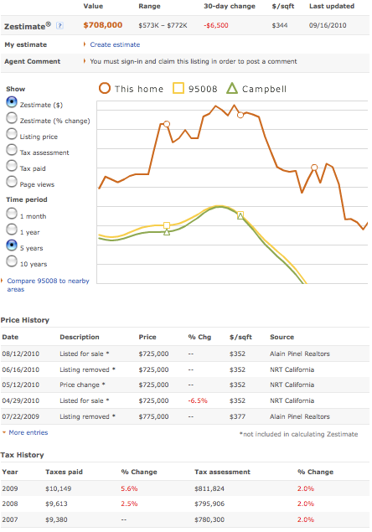

Slide 11
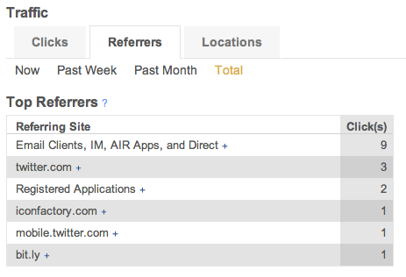

Slide 12


Slide 13
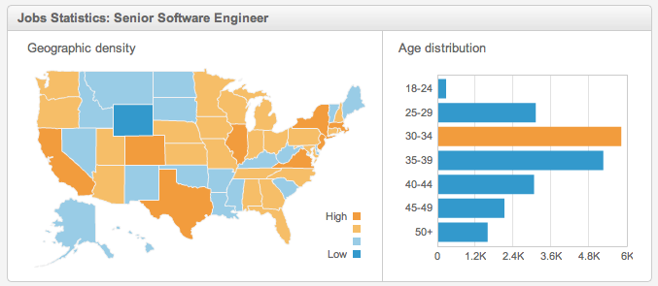

Slide 14
How to Compute?

Slide 15
How to Serve?

Slide 16
LinkedIn’s Requirements
Offline Aggregation
Event-Time Aggregation
Query-Time Aggregation

Slide 17
Problem: Competing Priorities
High Throughput
Low Latency

Slide 18
Solution: Split System
Hadoop
Voldemort

Slide 19
Shared Interface

Slide 20
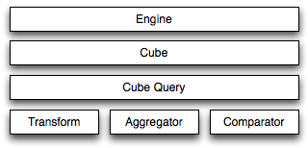

Slide 22
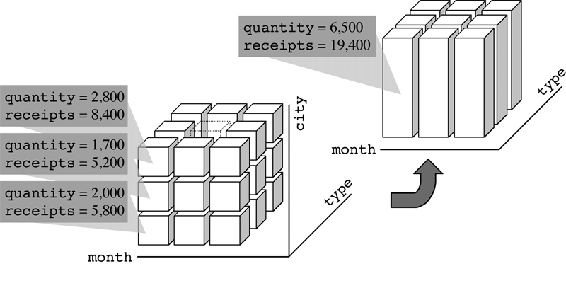

Slide 23
Cube Data Structure

Slide 24
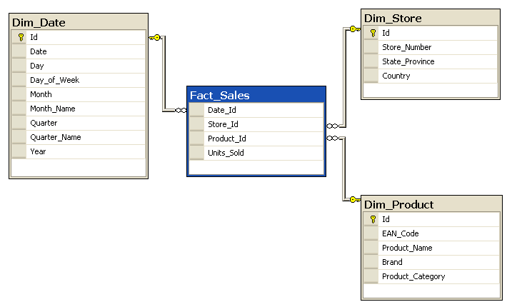
dimension sets
dimension
measure
fact
cube

Slide 25
dimension sets
dimension
measure
fact
cube

Slide 26
dimension sets
dimension
measure
fact
cube

Slide 27
dimension sets
dimension
measure
fact
cube

Slide 28
dimension sets
dimension
measure
fact
cube

Slide 29
dimension sets
dimension
measure
fact
cube

Slide 30
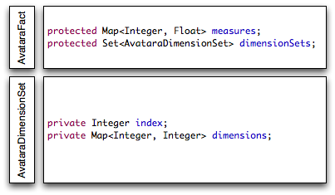
dimension sets
dimension
measure
fact
cube

Slide 31
Cube Aggregation

Slide 32
Map/Reduce

Slide 33
Map/Reduce on Hadoop

Slide 34
Map/Reduce in Memory

Slide 35
Map/Reduce on Voldemort

Slide 36
  public AvataraFactIterator<T> query(AvataraCubeQuery query);

Slide 37
  public AvataraCubeAppendable<T> add(
  Iterable<? extends AvataraFact> facts,
  AvataraBuilder builder,
  AvataraCubeSchema schema);
  public AvataraCubeAppendable<T> add(
  AvataraFact fact,
  AvataraBuilder builder,
  AvataraCubeSchema schema);

Slide 39
Avatara’s Map/Reduce

Slide 40
Partition

Slide 41
Sort

Slide 42
Transform

Slide 43
  public class AvataraTransFirstN implements AvataraTransform {
  private int n;
  public AvataraTransFirstN(int n) {
  this.n = n;
  }
  public void transform(
  AvataraFactIterator<? extends AvataraFact> facts,
  AvataraFactCollector<? extends AvataraFact> collector) {
  int countdown = n;
  while(facts.hasNext() && countdown-- > 0) {
  collector.collect(facts.next());
  }
  }
  })

Slide 44
Partition + Sort + Transform = AvataraCubeQuery

Slide 45
  public class AvataraCubeQuery implements Serializable {
  private AvataraFactAggregator aggregator;
  private Comparator<AvataraFact> sorter;
  private AvataraTransform transform;
  }

Slide 46
SELECT COUNT(*) FROM foo GROUP BY bar;

Slide 47
AvataraSqlishBuilder

Slide 48
  List<AvataraCubeQuery> queries = new AvataraSqlishBuilder()
  _{.group(”member_info.country”)}
  _{.sum()}
  _{.order(”impression", true)}
  _{.build(cubeSchema);}

Slide 50
Service Layer

Slide 51
  interface AvataraEngine {
  AvataraFactIterator<T> getFacts(..);
  void addFacts(..);
  AvataraCubeSchema getCubeSchema();
  void putCubeSchema(..);
  AvataraPartitionIndex getPartition(..);
  void putPartition(..);
  Map<Integer, String> getStrings(..);
  void putStrings(..);
  }

Slide 52
  interface AvataraEngine {
  AvataraFactIterator<T> getFacts(..);
  void addFacts(..);
  AvataraCubeSchema getCubeSchema();
  void putCubeSchema(..);
  AvataraPartitionIndex getPartition(..);
  void putPartition(..);
  Map<Integer, String> getStrings(..);
  void putStrings(..);
  }

Slide 53
AvataraCubeSchema

Slide 54
foo.bar ⬄ Integer

Slide 55
  public class AvataraCubeSchema implements Serializable {
  private HashBiMap<String, AvataraDimensionSetSchema> dimensionSetNames;
  private HashBiMap<String, Integer> measureNames;
  private Map<String, AvataraPartitionType> partitionIndexNames;
  }

Slide 56
  interface AvataraEngine {
  AvataraFactIterator<T> getFacts(..);
  void addFacts(..);
  AvataraCubeSchema getCubeSchema();
  void putCubeSchema(..);
  AvataraPartitionIndex getPartition(..);
  void putPartition(..);
  Map<Integer, String> getStrings(..);
  void putStrings(..);
  }

Slide 57
AvataraPartitionIndex

Slide 58
  public interface AvataraPartitionIndex {
  public AvataraPartition partitionFact(AvataraFact fact);
  public Set<AvataraPartition> partitionCubeQuery(AvataraCubeQuery query);
  public String getName();
  public AvataraPartitionType getType();
  }

Slide 59
Client-Side Indexing

Slide 60
Hash Partitions

Slide 61
Range Partitions

Slide 62
Compound Partitions

Slide 63
Still Evolving

Slide 64
  interface AvataraEngine {
  AvataraFactIterator<T> getFacts(..);
  void addFacts(..);
  AvataraCubeSchema getCubeSchema();
  void putCubeSchema(..);
  AvataraPartitionIndex getPartition(..);
  void putPartition(..);
  Map<Integer, String> getStrings(..);
  void putStrings(..);
  }

Slide 65
Integer ⬄ String

Slide 66
MD5 Integer

Slide 67
Auto-Increment Integer

Slide 68
Or?

Slide 70
  AvataraSqlishBuilder query = new AvataraSqlishBuilder()
  .group(”shares_table.share_id”)
  .sum(“impression”)
  .order("impression", false)
  .limit(3);
  AvataraFactIterator<AvataraSchemafiedFact> cube = engine.getCube(
  "shares-cube",
  new AvataraSchemafiedFactFactory(),
  query);
  for(AvataraSchemafiedFact fact : cube) {
  int shareId = fact.getSchemafiedDimension(”shares_table.share_id");
  float impressionCount = fact.getSchemafiedMeasure("impression");
  }

Slide 71
Avatara Applications

Slide 72
Data Products

Slide 73
Security

Slide 74
Reporting

Slide 75
Monitoring

Slide 76
Next Steps

Slide 77
Better String Support

Slide 78
More Partitioning

Slide 79
YCSB

Slide 80
More Platforms

Slide 81
Questions?

Slide 83
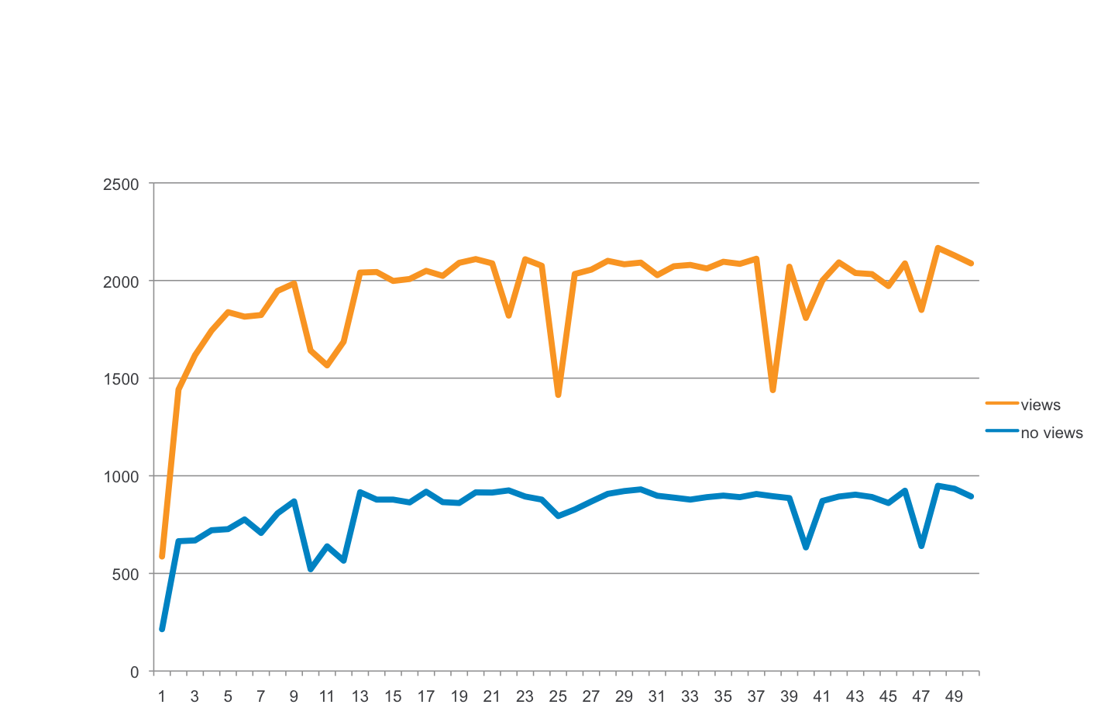
Performance
Throughput
Measures throughput from cold cache to hot cache
X axis – number of iterations of 1000 Avatara reads
Y axis – number of reads / sec

Slide 84
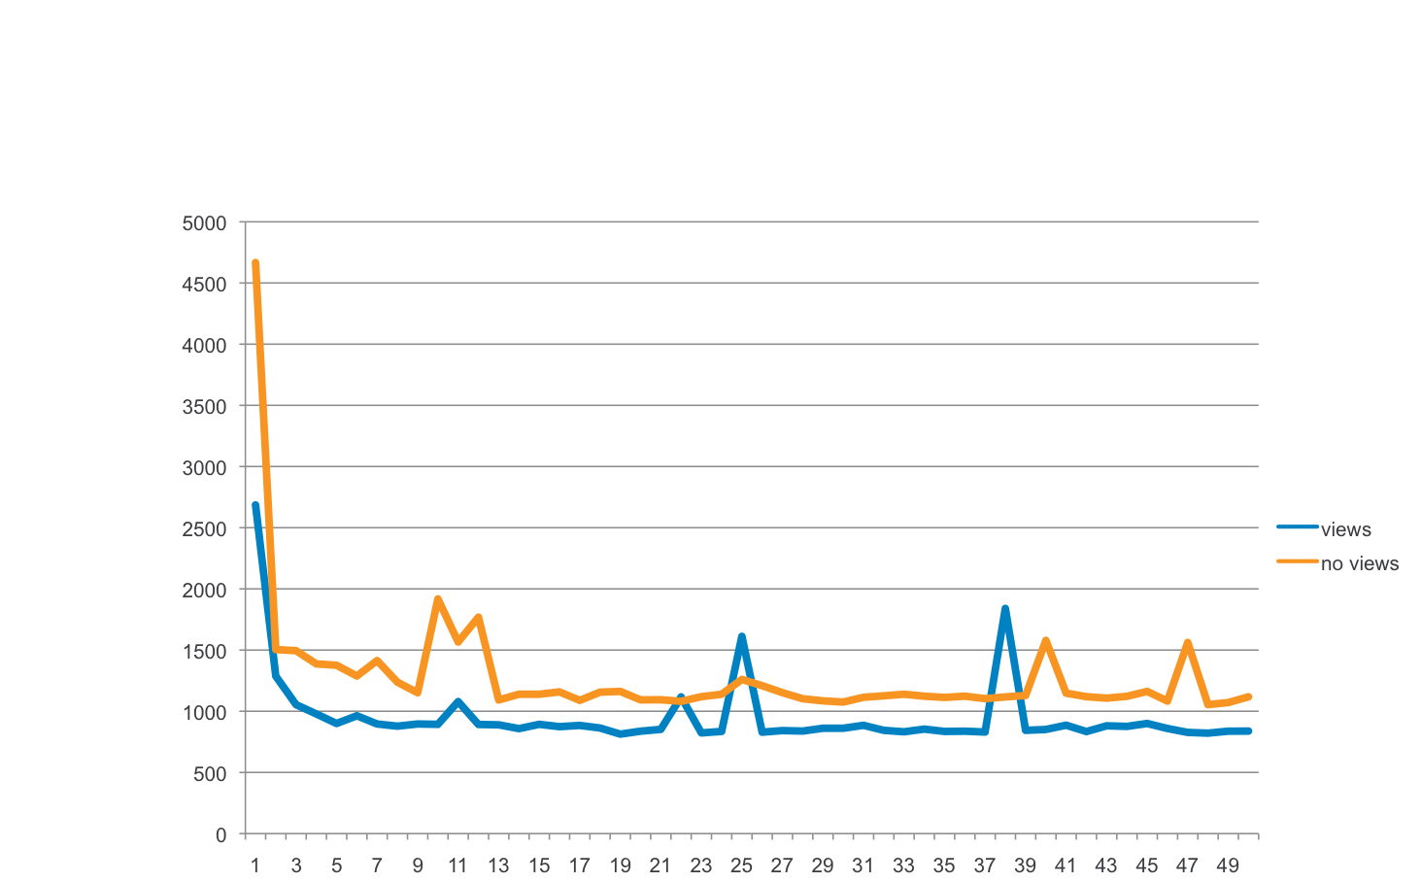
Performance
Latency
Measures throughput from cold cache to hot cache
X axis – number of iterations of 1000 Avatara reads
Y axis – runtime for 1000 reads in msec

